Slide 1

Task 5: student attrition model
Balaji R(D-13 batch)

Slide 2
Table of contents
Project Description
Problem Statement
Project Flow
Exploratory Data Analysis & Data Insights
Data Preprocessing & Feature Engineering
Model Building
Model Evaluation
Recommendations

Slide 3
Project description
Given the dataset of Clearwater State University's student information, a column contains data about student's early attrition is taken as target and an end-to-end machine learning model is built using 'Random Forest Classification' algorithm which has accuracy of 84%.

Slide 4
Problem statement
Clearwater State University has collected student data to check the enrolment to the curriculum programs and the percentage of students continuing to the next year. It was observed that many students are opting out from continuing the next year. The rate of attrition was very high.
Now, the goal is to,
Identify key drivers of early student attrition,
Build a predictive model to identify students with higher attrition risk,
Recommend appropriate interventions based on analysis.

Slide 5

Project Flow
Data Acquisition
Exploratory Data Analysis
Data Visualization
Data Preprocessing
Model Building
Model Evaluation

Slide 6
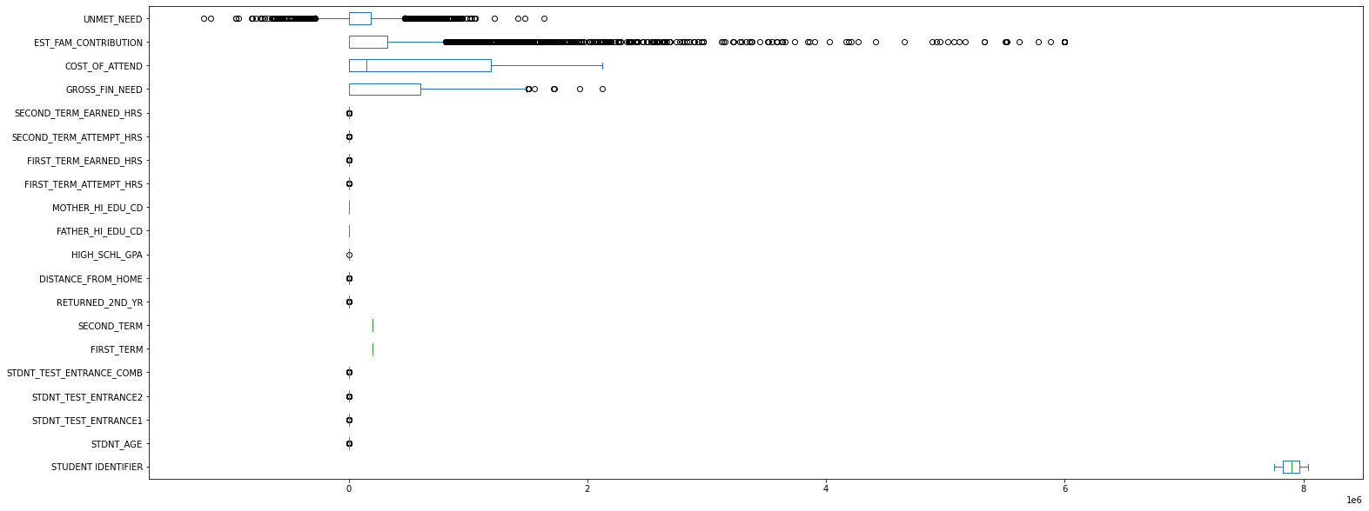
Exploratory Data Analysis & Data Insights
Box plot displaying the outliers in numerical columns.

Slide 7
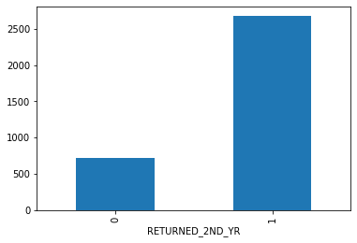
Exploratory Data Analysis & Data Insights
78.74% of students returned back to second year.
21.26% of students attrited from the university after first year.

Slide 8
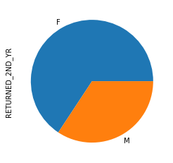
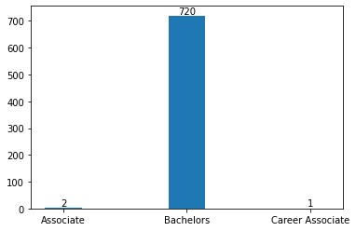
Exploratory Data Analysis & Data Insights
Female students have more attrition rate than male students.
The students who enrolled for bachelors degree drops out more than others.

Slide 9
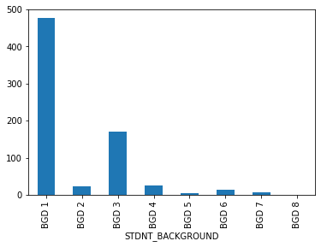
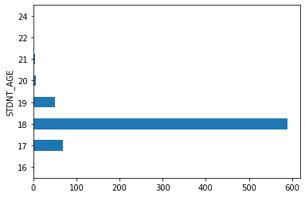
Exploratory Data Analysis & Data Insights
Students from first and third background have comparatively more attrition rate than the students from other backgrounds.
Students whose age is lesser than or equal to 18 has more attrition.

Slide 10
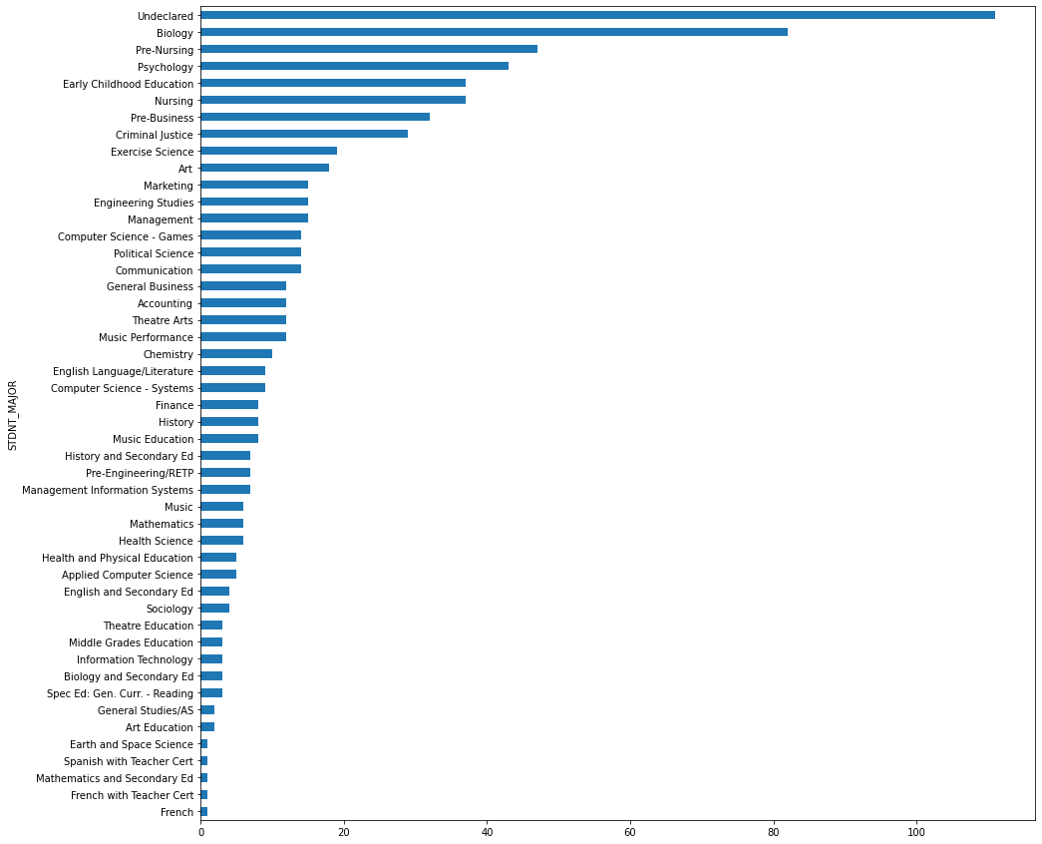
Exploratory Data Analysis & Data Insights
Students from the departments namely biology, pre-nursing, psychology, early childhood education, nursing have more attrition.

Slide 11
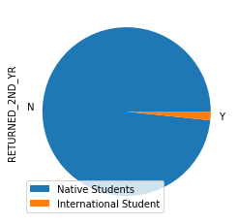
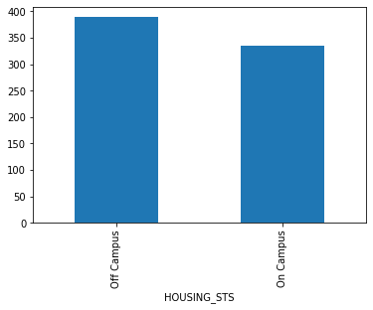
Exploratory Data Analysis & Data Insights
International students attrits lesser than the native students
The students who stays off campus drops out more than the ones who lives on campus.

Slide 12
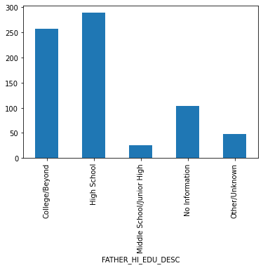
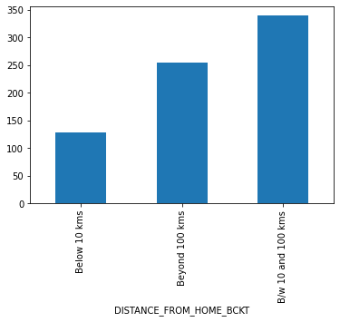
Exploratory Data Analysis & Data Insights
Students whose father went for high school and college has more attrition than others.
Students who staying between 10 and 100 kilometers from the university is dropping out more than others.

Slide 13
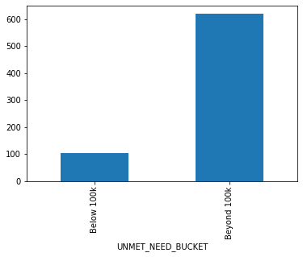
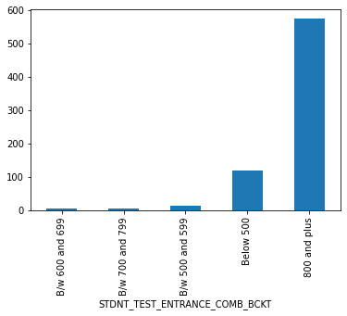
Exploratory Data Analysis & Data Insights
Students who scored 800 and above in entrance test have more attrition than others.
Students whose unmet financial need is beyond 100k drops out more.

Slide 14
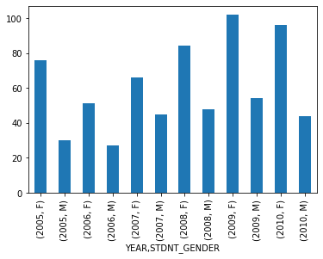
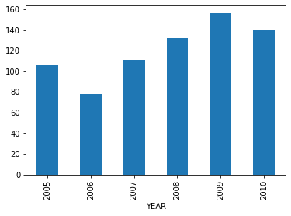
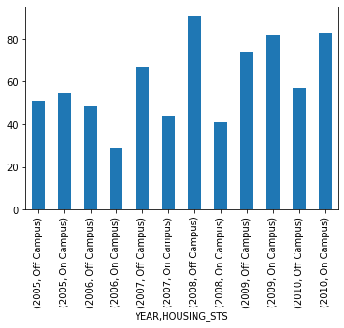
Exploratory Data Analysis & Data Insights
The attrition rate is getting increased in recent years.
On campus student attrits more in past two years.
Female students attrition count is increasing significantly every year.

Slide 15
Data Pre-processing & Feature Engineering
The given dataset contains,
3400 entries of data;
56 columns of which has,
10 are int datatype,
10 are float datatype,
36 are object datatype
Out of which, 32 columns have null values.

Slide 16
Data Pre-processing & Feature Engineering
Dropping the columns which has null value count more than 25%, viz.,
CORE_COURSE_NAME_6_S
CORE_COURSE_GRADE_6_S
CORE_COURSE_NAME_6_F
CORE_COURSE_GRADE_6_F
CORE_COURSE_NAME_5_S
CORE_COURSE_GRADE_5_S
CORE_COURSE_NAME_5_F
CORE_COURSE_GRADE_5_F
STDNT_TEST_ENTRANCE1
CORE_COURSE_NAME_4_S
CORE_COURSE_GRADE_4_S
CORE_COURSE_NAME_4_F
CORE_COURSE_GRADE_4_F
CORE_COURSE_NAME_3_S
CORE_COURSE_GRADE_3_S
STDNT_TEST_ENTRANCE2

Slide 17
Data Pre-processing & Feature Engineering
Dropping the ineffectual columns namely,
STUDENT IDENTIFIER
FATHER_HI_EDU_DESC
MOTHER_HI_EDU_DESC
DEGREE_GROUP_DESC
FIRST_TERM
SECOND_TERM

Slide 18
Data Pre-processing & Feature Engineering
Null Value Treatment:
Filling the null values with most common values in the following columns,
FATHER_HI_EDU_CD
MOTHER_HI_EDU_CD
HIGH_SCHL_NAME

Slide 19
Data Pre-processing & Feature Engineering
Null Value Treatment:
Filling the null values with their mean value in the following columns,
SECOND_TERM_ATTEMPT_HRS
SECOND_TERM_EARNED_HRS
STDNT_TEST_ENTRANCE_COMB
DISTANCE_FROM_HOME
HIGH_SCHL_GPA

Slide 20
Data Pre-processing & Feature Engineering
Null Value Treatment:
Filling null values in course name as 'ENG 1101 & ENG 1102' and grade as 'B & C‘ in the following columns,
CORE_COURSE_NAME_2_F
CORE_COURSE_GRADE_2_F
CORE_COURSE_NAME_3_F
CORE_COURSE_GRADE_3_F
CORE_COURSE_NAME_1_S
CORE_COURSE_GRADE_1_S
CORE_COURSE_NAME_2_S
CORE_COURSE_GRADE_2_S

Slide 21
Data Pre-processing & Feature Engineering
Replacing 'INCOMPL' as 'NOT REP' in below course grade columns,
CORE_COURSE_GRADE_1_F
CORE_COURSE_GRADE_2_F
CORE_COURSE_GRADE_1_S
Converting the following categorical columns into numerical columns,
HIGH_SCHL_NAME
STDNT_BACKGROUND

Slide 22
Data Pre-processing & Feature Engineering
Labelling the 'UNMET_NEED' column as,
0 if UNMET_NEED = 0
1 if UNMET_NEED > 0
2 if UNMET_NEED < 0
Replacing 1 as attriting and 0 as not attriting in 'RETURNED_2ND_YR' column.

Slide 23
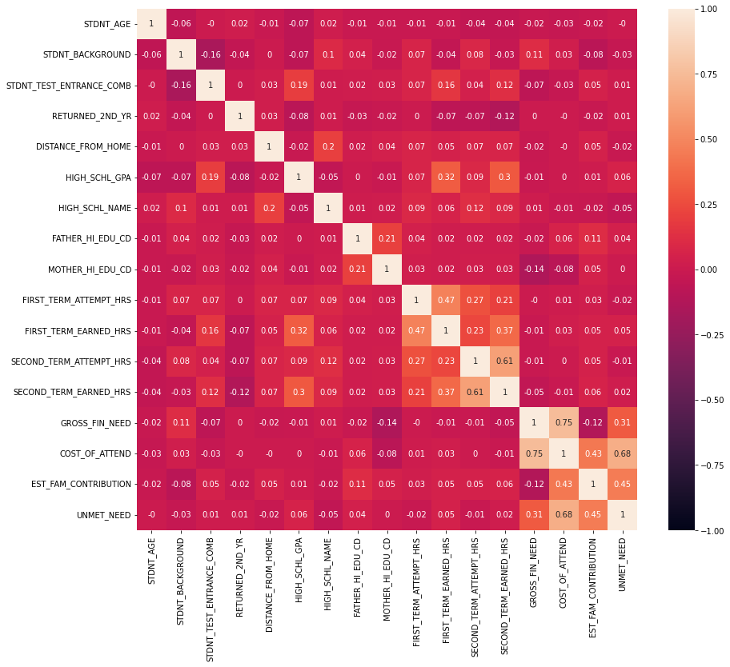
Data Pre-processing & Feature Engineering
From the above map,
COST_OF_ATTEND is highly correlated with GROSS_FIN_NEED & UNMET_NEED
FIRST_TERM_ATTEMPT_HRS is highly correlated with FIRST_TERM_ATTEMPT_HRS
SECOND_TERM_ATTEMPT_HRS is highly correlated with SECOND_TERM_ATTEMPT_HRS
So, the below columns are dropped.
UNMET_NEED
GROSS_FIN _NEED
FIRST_TERM_ATTEMPT_HRS
SECOND_TERM_ATTEMPT_HRS

Slide 24
Model Building
Classification algorithms such as Logistic Regression, Random Forest Classifier, XGB Classifier and Decision Tree Classifier are considered and their F1 score is as follows,
Out of this four algorithms, Random Forest Classifier is chosen and model is built.
Algorithm | F1 Score
Logistic Regression | 0.00275
Random Forest Classifier | 1.00
XGB Classifier | 0.94538
Decision Tree Classifier | 1.00

Slide 25
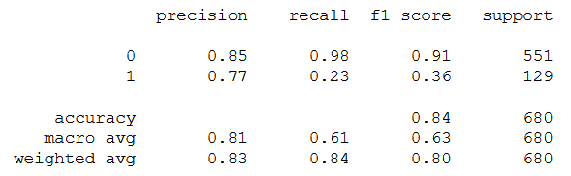
Model Evaluation
The given data is split into training and testing data with test size of 20% and the results were predicted.
Confusion Matrix:
Classification Report:
True Positive
542
False Positive
9
True Negative
30
False Negative
99

Slide 26
Conclusion – Recommendation - 1
Gender
Consistenly female students attrition increase every year.
66% female students left the college
Recommendation:
Special Care on Female Students:
Provide Safe environment, feel good factor to attend college
Empower women by boosting their moral
Special Scholarship for female students
Job opportunities
Implementation of POSH(Prevention of Sexual Harassment Act)
Identify female representative and have regular meeting to understand the real issue.

Slide 27
Conclusion – Recommendation - 2
Student Major Course & Entrance Score
More than 33% attrition contributed by Biology. Pre-Nursing, Psychology, Early Child Education & Nursing
‘Undeclared’ Stream accounts for – 15% of admission rate. Better stream declaration at the time of enrolment will help to improve
High Attrition from students those who scored more than 900 marks in their entrance exam
Recommendation
Course Consulting facility & Monitoring Systems:
Arrange Course Consulting before the admission to help the student to select the right course
Special focus on Biology, Pre-Nursing, Psychology, Early Child Education & Nursing
Assess student performance more frequently by interactive sessions and conducting tests
Arrange Student consulting/Mentorship (one to one discussion) throughout the course to provide the guidance to the students whenever required.

Slide 28
Conclusion – Recommendation - 3
Family contribution & Unmet financial need of the student
456 students left due to one of the reason of family contribution.
More than 63% students who does not get any support from family or society for fees
High No. of Students left due to unmet of financial needs.
Recommendations:
Provide Scholarship & Loan facility:
identify potential students who are good in studies and offer the scholarship
Provide Education loan facility
Earn and learn scheme so that they can also support to their families.
Enable Part-time jobs options.

