Slide 1


GMR Institute of Technology, Rajam
Oral Diseases Classification Using Dental Images:
A Hybrid Methodology
20-Mar-25
1
20-Mar-25
1

Slide 2
Oral Diseases Classification Using Dental Images: A Hybrid Methodology
1. T.U S S N L Durga Devi (21341A05I2)
2. P. Balaji (21341A05D9)
3. Y. Eswari (21341A05J7)
4.G. Jagadeesh (22345A0519)
5. R. Prasad (22345A0517)
Under the guidance of
Ms. S. Nirmala
Assistant Professor
GMR Institute of Technology

Slide 3
ABSTRACT
Oral diseases are often not diagnosed, which can have a negative impact on health. In this study, we use a deep learning method for internal image-based oral disease detection. Our approach proposes a hybrid methodology that combines EfficientNet for feature extraction and Channel Block Attention Module (CBAM) for classification. We use a two-step procedure: first we use EfficientNet to extract features from the last layer, then we use CBAM for classification. A hybrid approach uses attention mechanisms and feature extraction to improve accuracy. Once the disease is classified, we will recommend treatment or preventive measures to reduce the effects of the disease. Our approach uses deep learning algorithms and internal imaging techniques to provide early diagnosis and preventative measures. The accuracy of our hybrid model is 94.6%. The site effectively categorizes uploaded images into each of the five disease classifications and recommends preventative measures for each disease. In addition to using intraoral images to diagnose diseases, the website also uses symptoms to classify diseases into seven classifications. There are a total of 19 distinct symptoms in this study, from which the user can choose any three to recognise the disease and recommend the right kind of treatment. It uses deep learning algorithms and a hybrid approach to combat oral diseases, providing a useful tool for individuals and health professionals.
Keywords: Healthcare, Dentistry, Classification, Image analysis, oral diseases, Deep learning, Hybrid methodology, Intraoral Images ,Symptoms.

Slide 4
BASE PAPER
Chau, R. C. W., Li, G., Tew, I. M., Thu, K. M., McGrath, C., Lo, W., Ling, W., Hsung, T., & Lam, W. Y. H. (2023). “Accuracy of Artificial Intelligence-Based Photographic detection of gingivitis.” International Dental Journal, 73(5), 724–730.
Objective
To explore the application of AI systems in periodontology and the prevention and control of periodontal disease in communities.
To analyze the accuracy of a novel artificial intelligence system in detecting gingivitis using intraoral photographs.
They detected the various effected regions in the images and classified them into healthy , diseased, questionable.
The dataset they used contains the less amount of images. They used the intraoral images of only Chinese people.
To compare the accuracy of the AI system with visual examination by human dentists.

Slide 5
INTRODUCTION
Oral diseases pose a significant global health burden, affecting millions of individuals worldwide and contributing to substantial healthcare costs. Timely and accurate detection of these conditions is crucial for effective treatment and prevention of complications. In recent years, advancements in artificial intelligence (AI) and image processing have paved the way for innovative approaches to oral diseases detection. This research focuses on the development of an intelligent machine for oral diseases detection using teeth images, leveraging state-of-the-art deep learning techniques. Notably, the model outputs probabilities of a given image belonging to each disease class, providing clinicians with valuable insights into the likelihood of specific oral conditions. The development of an intelligent machine for oral diseases detection holds immense importance in the realm of public health and clinical practice. By facilitating early detection and intervention, this technology has the potential to mitigate the progression of oral diseases, improve patient outcomes, and reduce the overall burden on healthcare systems. Furthermore, the model's ability to output probabilities for each disease class enhances its diagnostic utility, enabling clinicians to prioritize interventions based on the highest likelihood of a specific condition.

Slide 6
Literature survey
Reference 1
Chau, R. C. W., Li, G., Tew, I. M., Thu, K. M., McGrath, C., Lo, W., Ling, W., Hsung, T., & Lam, W. Y. H. (2023). “Accuracy of Artificial Intelligence-Based Photographic detection of gingivitis.” International Dental Journal, 73(5), 724–730.
They used the DeepLabv3+ architecture to detect the gingivitis by using intraoral images.
They detected the various effected regions in the images and classified them into healthy , diseased, questionable.
The dataset they used contains the less amount of images. They used the intraoral images of only Chinese people.
Sensitivity: 0.92
Specificity: 0.94
The images must be collected from all nation people and the dataset must be large.

Slide 7
Literature survey
Reference 2
Rashid, J., Qaisar, B. S., Faheem, M., Akram, A., Amin, R. U., & Hamid, M. (2023). “Mouth and oraldisease classification using InceptionResNetV2 method.” Multimedia Tools and Applications.
They developed a model that can classify the the mouth and oral diseases into 7 categories by using InceptionResNetV2
The developed model achieved accuracy of 99.51 compared to previous models.
The dataset contains the limited amount of images due to which the overfitting happened.
Accuracy:99.51
Recall:99.33
F1 Score:99.33
There is a chance to cover additional diseases on a wider and more generalizable dataset.

Slide 8
Literature survey
Reference 3
Park, S., Erkinov, H., Hasan, M. a. M., Nam, S., Kim, Y., Shin, J., & Chang, W. (2023). “Periodontal Disease Classification with Color Teeth Images Using Convolutional Neural Networks.” Electronics, 12(7), 1518.
They presented a model for periodontal diseases classifications from color teeth images with convolutional neural network.
They proposed a model that was designed to classify teeth images calculi and inflammation, especially when the amount of the training data was insufficient.
All the teeth images are taken with the mouth opener.
Classification
Accuracy:74.54
F1-Score:99.99
A mobile application can be developed that can classify the periodontal images

Slide 9
Literature survey
Reference 4
Sivari, E., Senirkentli, G. B., Bostancı, E., Güzel, M. S., Açıcı, K., &Aşuroğlu, T. (2023). “Deep Learning in Diagnosis of Dental Anomalies and Diseases: A Systematic review.” Diagnostics, 13(15), 2512.
They performed a review on the papers that were published on dental diseases classification, detection and segmentation
The review they performed gave an complete insight on no.of disease classification, segmentation and detection works took place till today.
Deep learning and AI is lagging behind in the dentistry when compared with other fields .
The new emerging deep learning models can be used in the field of dentistry.

Slide 10
Literature survey
Reference 5
Patil, S., Albogami, S., Hosmani, J., Mujoo, S., Kamil, M. A., Mansour, M. A., Abdul, H. N., Bhandi, S., & Ahmed, S. S. S. J. (2022). “Artificial Intelligence in the Diagnosis of Oral Diseases: Applications and Pitfalls.” Diagnostics (Basel, Switzerland), 12(5), 1029.
It explains us the various applications of AI in the dentistry field and explains about the challenges occurred while dealing with AI in dentistry and how to overcome these challenges
They explained about the different works and their accuracy took place on different dental diseases separately.
They explained about the less works on dental diseases.
The review papers should also explain about the works on disease classification, detection etc.

Slide 11
Literature survey
Reference 6
Alalharith, D. M., Alharthi, H. M., Alghamdi, W. M., Alsenbel, Y. M., Aslam, N., Khan, I. U., Shahin, S. Y., Dianišková, S., Alhareky, M. S., & Barouch, K. K. (2020). “A Deep Learning-Based Approach for the Detection of Early Signs of Gingivitis in Orthodontic Patients Using Faster Region-Based Convolutional Neural Networks.” International journal of environmental research and public health, 17(22), 8447.
They developed a model that can detect the early signs of gingivitis in Orthodontic patients by using Faster R-CNN. They used two ResNet-50 models in which one used to detect teeth and other to identify gingivitis.
The model helpful for the orthodontic patients to detect the periodontal disease in early stage.
The model only focuses on the particular region of gingiva not the entire region.
The accuracy of Inflammation detection model need to be increased.

Slide 12
Literature survey
Reference 7
Park, E. Y., Cho, H., Kang, S., Jeong, S., & Kim, E. (2022). “Caries detection with tooth surface segmentation on intraoral photographic images using deep learning.” BMC Oral Health, 22(1).
s
They developed a deep learning model for caries detection through the segmentation of the tooth surface using intraoral images
Training CNN algorithms to predict the tooth surface in each photographic image can improve its performance in terms of both tooth classification and localization of carious lesions.
Compared with an X-ray image, intraoral photographic images cannot express the inside of the tooth and the interproximal tooth surface.
Accuracy:0.813,Sensitivity:0.867,Precision:0.779
The relatively low sensitivity and negative predictive value need to be improved along with the general improvement of all the evaluation indexes.

Slide 13
Literature survey
Reference 8
Kawazu, T., Takeshita, Y., Fujikura, M., Okada, S., Hisatomi, M., &Asaumi, J. (2024). “Preliminary study of dental caries detection by deep Neural Network applying Domain-Specific Transfer Learning.” Journal of Medical and Biological Engineering.
They explored the value of YOLOV3 algorithm for detection and diagnosis of dental caries in intraoral images captured by mobiles.
They used the images that are captured using smartphones that can help us in building a real-world application
The model can’t make definitive predictions of occult carries.
The dataset is relatively small and the dataset should contains images of all teeth orientations.

Slide 14
Literature survey
Reference 9 I
mak, A., Celebi, A., Siddique, K., Turkoglu, M., Sengur, A., & Salam, I. (2022). Dental caries detection using score-based multi-input deep convolutional neural network. IEEE Access, 10, 18320-18329.
They developed a multi-input deep convolution neural network ensemble method(MI-DCNNE) for the automatic diagnosis of dental caries using periapical images consisting of 340 images(caries and non -caries).
Provides efficient decision support system for dental caries detection.
Lack of publicly available dataset for dental caries studies.
Accuracy:99.13%,Sensitivity:98%,Specificity:100%,Precision:100%,F1-Score:98.99%
The statistical analysis of the results from the various deep CNN models is investigated to determine how reliable the reported differences in mean accuracy scores

Slide 15
Literature survey
Reference 10
Zhou, M., Jie, W., Tang, F., Zhang, S., Mao, Q., Liu, C., & Hao, Y. (2024). Deep learning algorithms for classification and detection of recurrent aphthous ulcerations using oral clinical photographic images. Journal of Dental Sciences, 19(1), 254-260.
They evaluate convolution neural networks(CNNs) for automated classification and detection of recurrent aphthous ulcerations(RAU), normal oral mucosa and other using oral photographs
Deep learning models classify and detect recurrent aphthous ulcerations accurately.
Cannot predict a wide range of oral mucosal disease.
ResNet50 for classification :Precision:92.86%Recall:91.84%
YOLOV5 for detection:Precision:98.70%.
Future multi-center large samples studies for wide range of oral mucosal disease.

Slide 16
Literature survey
Reference 11
Elsayed, A., Mostafa, H., Tarek, R., Mohamed, K., Hossam, A., & Selim, S. (2022, July). Oral Dental Diagnosis Using Deep Learning Techniques: A Review. In Annual Conference on Medical Image Understanding and Analysis (pp. 814-832). Cham: Springer International Publishing.
s
They performed a review on the papers using deep learning in the dental health care system .
Various neural networks models are used for efficient dental diagnosis
Lack of detailed mathematical representations in some diagnosis techniques.
Verify accuracy of AI models in dental healthcare with more cases.

Slide 17
Literature survey
Reference 12
Kumar A, Bhadauria HS, Singh A. Descriptive analysis of dental X-ray images using various practical methods: A review. PeerJ Comput Sci. 2021 Sep 13;7:e620. doi: 10.7717/peerj-cs.620. PMID: 34616881; PMCID: PMC8459782.
The paper provides a comprehensive survey of dental image segmentation and analysis, covering more than 130 research works conducted through various dental imaging modalities.
The survey classifies the state-of-the-art research works into three major categories: image processing, machine learning, and deep learning approaches.
One limitation is the lack of availability of datasets, which can hinder the development and evaluation of segmentation algorithms
Designing more sophisticated segmentation techniques to improve clinical treatment efficiency.

Slide 18
Literature survey
Reference 13
Jaiswal, P., & Bhirud, S. (2023). An intelligent deep network for dental medical image processing system. Biomedical Signal Processing and Control, 84, 104708.
They Developed Intelligent a novel Image Analysis and Classification Neural Model (IALCNM) for segmenting affected parts in teeth and classifying wear and periodontitis diseases from dental X-ray images.
Enhanced accuracy in segmenting affected parts and disease prediction.
Accuracy:77%
Implement early detection of periodontitis in the form of gingivitis.

Slide 19
Literature survey
Reference 14
Zhao, S., Liu, C., & Luo, Q. (2019, August). Dental data analysis based on dental x-ray panorama. In Proceedings of the Third International Symposium on Image Computing and Digital Medicine (pp. 133-137).
This paper presents a study on tooth segmentation for dental X-ray panorama and analyzes the performance of a single tooth using pixel statistical analysis.
Significant grayscale intensity differences between healthy and unhealthy teeth
Accuracy:99.78%
Research on tooth position recognition and dental analysis.

Slide 20
Literature survey
Reference 15
M. Muthu Lakshmi & Dr. P. Chitra (2020). “Classification of Dental Cavities from X-ray images using Deep CNN algorithm”, IEEE Xplore, 774-779.
The paper proposes a method for early diagnosis of dental cavities using deep CNN and Sobel edge detection from X-ray images.
The method allows for early detection of dental cavities, enabling timely intervention and treatment.
They performed on only one dental disease called dental cavities and used only 1900 dental x-ray images.
Accuracy:96.08%
To using statistical feature extraction of dental disease like Osteoporosis, Periodontal, and Gum prediction by using Deep CNN.

Slide 21
Literature survey
Reference 16
Abdulaziz A. Al Kheraif, Ashraf A. Wahba, H. Fouad, (2019) “Detection of dental diseases from radiographic 2d dental image using hybrid graph-cut technique and convolutional neural network”, Science Direct, 146, 333-342.
The paper proposes a deep learning based convolutional neural network to detect dental diseases from radiographic 2D dental images.
The model deep learning-based CNN attains high accuracy compare with other models
They used only 1500 dental 2d X-ray images for their model
Accuracy: 97.07%
Increasing the number of 2D X-ray images, the model accuracy will be increase.

Slide 22
Literature survey
Reference 17
Shreyansh A. Prajapati, R. Nagaraj and Suman Mitra, (2017). “Classification of Dental Diseases Using CNN and Transfer Learning”, IEEE Xplore, 70-74.
The paper focus the challenge of accurate classification of dental diseases using labeled dataset of 251 Radio Visio Graphy X-ray images across three classes.
They used transfer learning with VGG16 model for better accuracy and they got 88.46% accuracy
They used a small dataset consisting of 251 RVG (Radio Visio Graphy) X-ray images.
Accuracy:88.46%
To achieve high accuracy, classify three dental diseases by using more RVG X-ray images.

Slide 23
Literature survey
Reference 18
Hu Chen, Hong Li, Yijiao Zhao, Jianjiang Zhao, Yong Wang, (2021). “Dental disease detection on periapical radiographs based on deep convolutional neural networks”, Springer, 16, 649–661.
The paper aims to explore the potential of deep CNNs in developing an auxiliary diagnosis system for dental periapical radiographs, focusing on lesion detection.
The deep CNNs are able to detect lesions with severe levels and diseases on clinical dental periapical radiographs.
In this, they totally collected 2900 digital dental periapical radiographs to train the model.
Increase the number of classes to make the model much better

Slide 24
Literature survey
Reference 19
Ngnamsie Njimbouom S, Lee K, Kim J-D.(2022) “MMDCP: Multi-Modal Dental Caries Prediction for Decision Support System Using Deep Learning.” International Journal of Environmental Research and Public Health. 19(17):10928.
The introduced a method to predict the dental caries using multi-modal data i.e the numerical and image data applied to an hybrid neural network.
They used the multi modal data i.e the numerical and image data.
The accuracy of the model is less.
Accuracy: 90%, F1-score:89%, recall:90% precision: 89%.
The more methods should be developed that can accept the several types of data to classify or detect caries.

Slide 25
Literature survey
Reference 20
Almalki YE, Din AI, Ramzan M, Irfan M, Aamir KM, Almalki A, Alotaibi S, Alaglan G, Alshamrani HA, Rahman S.(2022) “Deep Learning Models for Classification of Dental Diseases Using Orthopantomography X-ray OPG Images.” Sensors. 22(19):7370.
The paper proposed a approach for detecting and classifying the four diseases: cavities, root canals, dental crowns and broken-down root canals by using YOLOV3 model using X-ray images
The proposed method outperforms existing state-of-the-art methods in terms of accuracy and has a wide range of applications in computer-assisted tooth treatment and diagnosis.
The newer versions of YOLO should be used.
Accuracy: 99.93%,F1-score: 0.99,Precision:0.99
The real time application need to be build by using these models

Slide 26
Literature survey
Reference 21
Kabir, T., Lee, C. T., Nelson, J., Sheng, S., Meng, H. W., Chen, L., ... & Shams, S. (2021, December). An end-to-end entangled segmentation and classification convolutional neural network for periodontitis stage grading from periapical radiographic images. In 2021 IEEE international conference on bioinformatics and biomedicine (BIBM) (pp. 1370-1375). IEEE.
HYNETS combines segmentation and classification tasks to provide accurate and consistent results.
Combines segmentation and classification tasks, leveraging a multi-task learning strategy, to achieve highly accurate and consistent result.
Limited sample size and data diversity may affect the generalizability of the results.
The paper could explore the generalizability of the proposed model by testing it on a larger and more diverse dataset to ensure its effectiveness across different populations and imaging conditions .

Slide 27
Literature survey
Reference 22
Li, X., Zhao, D., Xie, J., Wen, H., Liu, C., Li, Y., ... & Wang, S. (2023). Deep learning for classifying the stages of periodontitis on dental images: a systematic review and meta-analysis. BMC Oral Health, 23(1), 1017.
classification of periodontitis based on dental images.
Provides a flow chart of the study selection process and inclusion and exclusion criteria.
Variation in the reference tests used for periodontitis classification among the included.
sensitivity: 0.88
specificity: 0.82

Slide 28
Literature survey
Reference 23
Zhang, X., Liang, Y., Li, W., Liu, C., Gu, D., Sun, W., & Miao, L. (2022). Development and evaluation of deep learning for screening dental caries from oral photographs. Oral diseases, 28(1), 173-181.
This paper presents the development and evaluation of a deep learning model for screening dental caries from oral photographs.
Dental caries using oral photographs from consumer cameras, which can significantly improve dental health assessment among large populations.
The limitations of this study include a dataset collected from a single organization.
Accuracy:85.65%
Deep learning classifier to reduce false-positive predictions of dental caries.

Slide 29
Literature survey
Reference 24
Yu, H., Lin, Z., Liu, Y., Su, J., Chen, B., & Lu, G. (2020). A new technique for diagnosis of dental caries on the children’s first permanent molar. Ieee Access, 8, 185776-185785.
This paper presents a systematic review and meta-analysis of deep learning methods for classifying periodontitis stages using dental images
Low cost and high performance for the diagnosis of dental caries on the children’s first permanent molar.
The paper does not discuss the potential challenges or limitations of implementing the UCDA framework in real-world clinical settings.
Accuracy:95%
The paper proposes a unified caries detection and assessment (UCDA) framework and introduces the Child-OID database.

Slide 30
Literature survey
Reference 25
Mohammad‐Rahimi, H., Motamedian, S. R., Rohban, M. H., Krois, J., Uribe, S., Nia, E. M., Rokhshad, R., Nadimi, M., & Schwendicke, F. (2022). Deep learning for caries detection: A systematic review. Journal of Dentistry, 122, 104115.
The paper provides a systematic review on deep learning models on caries detection using different kinds of images.
The review they provided gave an complete insight on current works of caries detection using deep learning models.
The paper suggested that the study and report quality should be better.

Slide 31
Literature survey
Reference 26
Lian L, Zhu T, Zhu F, Zhu H.(2021) Deep Learning for Caries Detection and Classification. Diagnostics. 11(9):1672.
They used deep learning methods to detect caries lesions, classify different radiographic extensions on panoramic films, and compare the classification results with those of expert dentists.The performance of deep learning methods was similar to that of expert dentists
Reference dataset used in their research is not fully generalizable.
Segmentation model:
Accuracy:0.986,Sensitivity:0.821,Specificity:1.000,Precision:1.000
Classification model:
Accuracy: 0.957,Precision: 0.812,Sensitivity: 0.765
Well-trained neural networks in random and prospective designs.

Slide 32
Literature survey
Reference 27
Mima, Y., Nakayama, R., Hizukuri, A. et al. Tooth detection for each tooth type by application of faster R-CNNs to divided analysis areas of dental panoramic X-ray images. Radiol Phys Technol 15, 170–176 (2022).
They used Faster R-CNN model for the detection of panoramic X-ray images.
To development of a computer-aided diagnosis (CAD) scheme for dental panoramic X-ray images.
The full range of variations in panoramic dental X-ray images, such as the presence of metals, missing teeth, and implants.
Classification Accuracy:91.7%
Detection Rate :98.9%
investigate the generalizability of the proposed method by testing it on larger and more diverse datasets

Slide 33
Literature survey
Reference 28
T. Dhake and N. Ansari, "A Survey on Dental Disease Detection Based on Deep Learning Algorithm Performance using Various Radiographs," 2022 5th International Conference on Advances in Science and Technology (ICAST), Mumbai, India, 2022, pp. 291-296,.
They utilizes deep learning algorithms for dental disease detection based on various radiographs.
The deeep learning model of dental image analysis for the detection and diagnosis of dental problems,such as tooth identification, caries.
They does not mention the specific datasets used for training, validation, and testing of the deep learning models
Further research is needed to explore the performance of hybrid models, such as CNN-SVM on large datasets.

Slide 34
Literature survey
Reference 29
A., Suresh, Kumar., Manivel, Kandasamy., P., Anitha. (2023). Analysis of Panoramic Images using Deep Learning For Dental Disease Identification
They utilizes deep learning algorithms for dental disease identification in panoramic images.
The use of panoramic imaging systems provides a comprehensive view of the maxillofacial region, including all the teeth, allowing for accurate detection of dental diseases.
They does not discuss the potential challenges or limitations of using panoramic imaging systems, such as OPG, for dental disease detection.
The different datasets and populations should be investigated to assess its effectiveness in diverse clinical settings.

Slide 35
Literature survey
Reference 30
M., B., H., Moran., Marcelo, Faria., Marcelo, Faria., Gilson, A., Giraldi., Luciana, Freitas, Bastos., Larissa, F.C., de, Oliveira., Aura, Conci. (2021). Classification of Approximal Caries in Bitewing Radiographs Using Convolutional Neural Networks.. Sensors,
Using Convolutional Neural Networks
They introduced the image processing and CNN to identify and classify dental caries in bitewing radiographic images..
The use of convolutional neural networks allows for automated and objective analysis of bitewing images.
Accuracy:73.3%
further research is needed to assess the proposed method's performance in larger datasets and with a more diverse range of dental conditions.

Slide 36
Literature Survey
Sl no | Title | year | Description | Advantages | Limitations | Performance Metrics | Future Gaps
1 | Accuracy of Artificial Intelligence-Based Photographic Detection of Gingivitis. | 2023 | They used the DeepLabv3+ architecture to detect the gingivitis by using intraoral images. | They detected the various effected regions in the images and classified them into healthy , diseased, questionable. | The dataset they used contains the less amount of images. They used the intraoral images of only Chinese people. | Sensitivity: 0.92 Specificity: 0.94 | The images must be collected from all nation people and the dataset must be large.
2 | Mouth and oral disease classification using InceptionResNetV2 method. | 2023 | They developed a model that can classify the the mouth and oral diseases into 7 categories by using InceptionResNetV2. | The developed model achieved accuracy of 99.51 compared to previous models. | The dataset contains the limited amount of images due to which the overfitting happened. | Accuracy: 99.51 Recall: 99.33 F1 Score:99.33 | There is a chance to cover additional diseases on a wider and more generalizable dataset.

Slide 37
Literature Survey
3 | Periodontal Disease Classification with Color Teeth Images Using Convolutional Neural Networks. | 2023 | They presented a model for periodontal diseases classifications from color teeth images with convolutional neural network. | They proposed a model that was designed to classify teeth images calculi and inflammation, especially when the amount of the training data was insufficient. | All the teeth images are taken with the mouth opener. | Classification Accuracy: 74.54 F1 score: 99.99 | A mobile application can be developed that can classify the periodontal images
4 | Deep Learning in Diagnosis of Dental Anomalies and Diseases: A Systematic review. | 2023 | They performed a review on the papers that were published on dental diseases classification, detection and segmentation. | The review they performed gave an complete insight on no.of disease classification, segmentation and detection works took place till today. | Deep learning and AI is lagging behind in the dentistry when compared with other fields . | ---- | The new emerging deep learning models can be used in the field of dentistry.

Slide 38
Literature Survey
5 | Artificial Intelligence in the Diagnosis of Oral Diseases: Applications and Pitfalls. | 2022 | It explains us the various applications of AI in the dentistry field and explains about the challenges occurred while dealing with AI in dentistry and how to overcome these challenges. | They explained about the different works and their accuracy took place on different dental diseases separately. | They explained about the less works on dental diseases. | ---- | The review papers should also explain about the works on disease classification, detection etc.
6 | A Deep Learning-Based Approach for the Detection of Early Signs of Gingivitis in Orthodontic Patients Using Faster Region-Based Convolutional Neural Networks. | 2020 | They developed a model that can detect the early signs of gingivitis in Orthodontic patients by using Faster R-CNN. They used two ResNet-50 models in which one used to detect teeth and other to identify gingivitis. | The model helpful for the orthodontic patients to detect the periodontal disease in early stage. | The model only focuses on the particular region of gingiva not the entire region. | Teeth detection Model: Accuracy:100% Recall:100% Precision:100% | The accuracy of Inflammation detection model need to be increased.
 |  |  |  |  |  | Inflammation detection model: Accuracy:77.12%, Precision:88.02%, recall:41.75%

Slide 39
Literature Survey
7 | Caries detection with tooth surface segmentation on intraoral photographic images using deep learning | 2022 | They developed a deep learning model for caries detection through the segmentation of the tooth surface using intraoral images. | Training CNN algorithms to predict the tooth surface in each photographic image can improve its performance in terms of both tooth classification and localisation of carious lesions. | Compared with an X-ray image, intraoral photographic images cannot express the inside of the tooth and the interproximal tooth surface. | Accuracy:0.813 Sensitivity: 0.867 Precision: 0.779 | The relatively low sensitivity and negative predictive value need to be improved along with the general improvement of all the evaluation indexes.
8 | Preliminary study of dental caries detection by deep Neural Network applying Domain-Specific Transfer Learning | 2024 | They explored the value of YOLOV3 algorithm for detection and diagnosis of dental caries in intraoral images captured by mobiles. | They used the images that are captured using smartphones that can help us in building a real world application. | The model can’t make definitive predictions of occult carries. | Primary caries: Precision: 93.33% Recall: 69.42% F1-Score: 0.80 | The dataset is relatively small And the dataset should contains images of all teeth orientations.
 |  |  |  |  |  | Secondary caries: Precision: 100% Recall:52.38% F1-score:0.69

Slide 40
Literature Survey
9 | Dental Caries Detection Using Score-Based Multi-Input Deep Convolutional Neural Network | 2022 | They used a multi-input deep convolution neural network ensemble method(MI-DCNNE) | Provides efficient decision support system for dental caries detection. | Lack of publicly available dataset for dental caries studies. | Accuracy:99.13% Sensitivity:98% Specificity:100% Precision:100% F1-score:98.99% | the statistical analysis of the results from the various deep CNN models is investigated to determine how reliable the reported differences in mean accuracy scores.
10 | Deep learning algorithms for classification and detection of recurrent aphthous ulcerations using oral clinical photographic images | 2023 | Deep learning models are used for classification and detection ResNet50, YOLOV5. | Deep learning models classify and detect recurrent aphthous ulcerations accurately. | Cannot predict a wide range of oral mucosal disease. | ResNet50 for classification : Precision:92.86% Recall:91.84% | Future multi-center large samples studies for wide range of oral mucosal disease.
 |  |  |  |  |  | YOLOV5 for detection: Precision:98.70%.

Slide 41
Literature Survey
11 | Oral Dental Diagnosis Using Deep Learning Techniques: A Review | 2022 | Deep leaning models are used | Various neural networks models are used for efficient dental diagnosis. | Lack of detailed mathematical representations in some diagnosis techniques. | ----- - | Verify accuracy of AI models in dental healthcare with more cases
12 | Descriptive analysis of dental X-ray images using various practical methods: A review. | 2021 | provides a comprehensive survey of dental image segmentation and analysis, focusing on various dental imaging modalities such as X-ray, CT, and CBCT | Automation in dental image segmentation and examination ensures error-free diagnosis and better treatment planning | lack of availability of datasets and proper selection of methodology are also identified as limitations in the field of dental X-ray image segmentation and analysis ions. | -------- | advanced image processing techniques and algorithms to improve the accuracy and efficiency of dental image segmentation and analysis .

Slide 42
Literature Survey
13 | An intelligent deep network for dental medical image processing system | 2023 | Developed IALCNM method using python | Enhanced accuracy in segmenting affected parts and disease prediction. | ---- | Accuracy:77% | Implement early detection of periodontitis in the form of gingivitis.
14 | Dental Data Analysis Based on Dental X-ray Panorama | 2019 | Using optimized U-net model for dental x-ray panorama | Significant grayscale intensity differences between healthy and unhealthy teeth | ---- | Accuracy:99.78% | Research on tooth position recognition and dental analysis.
15 | Classification of Dental Cavities from X-ray images using Deep CNN algorithm | 2020 | The paper proposes a method for early diagnosis of dental cavities using deep CNN and Sobel edge detection from X-ray images. | The method allows for early detection of dental cavities, enabling timely intervention and treatment. | They performed on only one dental disease called dental cavities and used only 1900 dental x-ray images. | Accuracy: 96.08% | To using statistical feature extraction of dental disease like Osteoporosis, Periodontal, and Gum prediction by using Deep CNN.

Slide 43
Literature Survey
16 | Detection of dental diseases from radiographic 2d dental image using hybrid graph-cut technique and convolutional neural network | 2019 | The paper proposes a deep learning based convolutional neural network to detect dental diseases from radiographic 2D dental images. | The model deep learning based CNN attains high accuracy compare with other models. | They used only 1500 dental 2d X-ray images for their model. | Accuracy: 97.07% | Increasing the number of 2D X-ray images, the model accuracy will be increase.
17 | Classification of Dental Diseases Using CNN and Transfer Learning | 2017 | The paper focus the challenge of accurate classification of dental diseases using labeled dataset of 251 Radio Visio Graphy X-ray images across three classes. | They used transfer learning with VGG16 model for better accuracy and they got 88.46% accuracy | They used a small dataset consisting of 251 RVG (Radio Visio Graphy) X-ray images. | Accuracy: 88.46% | To achieve high accuracy, classify three dental diseases by using more RVG X-ray images.

Slide 44
Literature Survey
18 | Dental disease detection on periapical radiographs based on deep convolutional neural networks | 2021 | The paper aims to explore the potential of deep CNNs in developing an auxiliary diagnosis system for dental periapical radiographs, focusing on lesion detection. | The deep CNNs are able to detect lesions with severe levels and diseases on clinical dental periapical radiographs. | In this, they totally collected 2900 digital dental periapical radiographs to train the model. | ---- | Increase the number of classes to make the model much better.
19 | MMDCP: Multi-Modal Dental Caries Prediction for Decision Support System Using Deep Learning | 2022 | The introduced a method to predict the dental caries using multi-modal data i.e the numerical and image data applied to an hybrid neural network. | They used the multi modal data i.e the numerical and image data. | The accuracy of the model is less. | Accuracy: 90%, F1-score:89%, recall:90% precision: 89%. | The more methods should be developed that can accept the several types of data to classify or detect caries.

Slide 45
Literature Survey
20 | Deep Learning Models for Classification of Dental Diseases Using Orthopantomography X-ray OPG Images | 2022 | The paper proposed a approach for detecting and classifying the four diseases: cavities, root canals, dental crowns and broken-down root canals by using YOLOV3 model using X-ray images. | The proposed method outperforms existing state-of-the-art methods in terms of accuracy, and has a wide range of applications in computer-assisted tooth. | The newer versions of YOLO should be used. | Accuracy: 99.93% F1-score: 0.99 Precision:0.99 | The real time application need to be build by using these models.
21 | An End-to-end Entangled Segmentation and Classification Convolutional Neural Network for Periodontitis Stage Grading from Periapical Radiographic Images | 2021 | HYNETS combines segmentation and classification tasks to provide accurate and consistent results. | Combines segmentation and classification tasks, leveraging a multi-task learning strategy, to achieve highly accurate and consistent results. | Limited sample size and data diversity may affect the generalizability of the results. | ---- | The paper could explore the generalizability of the proposed model by testing it on a larger and more diverse dataset to ensure its effectiveness across different populations and imaging conditions .

Slide 46
Literature Survey
22 | Deep learning for classifying the stages of periodontitis on dental images: a systematic review and meta-analysis | 2023 | classification of periodontitis based on dental images. | Provides a flow chart of the study selection process and inclusion and exclusion criteria. | Variation in the reference tests used for periodontitis classification among the included. | sensitivity: 0.88 specificity: 0.82 | ----
23 | Development and evaluation of deep learning for screening dental caries from oral photographs. | 2020 | This paper presents the development and evaluation of a deep learning model for screening dental caries from oral photographs. | Dental caries using oral photographs from consumer cameras, which can significantly improve dental health assessment among large populations. | The limitations of this study include a dataset collected from a single organization. | Accuracy: 85.65% | Deep learning classifier to reduce false-positive predictions of dental caries.

Slide 47
Literature Survey
24 | A New Technique for Diagnosis of Dental Caries on the Children’s First Permanent Molar | 2020 | This paper presents a systematic review and meta-analysis of deep learning methods for classifying periodontitis stages using dental images. | Low cost and high performance for the diagnosis of dental caries on the children’s first permanent molar. | The paper does not discuss the potential challenges or limitations of implementing the UCDA framework in real-world clinical settings, | Accuracy: 95% | The paper proposes a unified caries detection and assessment (UCDA) framework and introduces the Child-OID database.
25 | Deep learning for caries detection: A systematic review. | 2022 | The paper provides a systematic review on deep learning models on caries detection using different kinds of images. | The review they provided gave an complete insight on current works of caries detection using deep learning models. | ----- | ----- | The paper suggested that the study and report quality should be better.

Slide 48
Literature Survey
26 | Deep Learning for Caries Detection and Classification. | 2021 | They used deep learning methods to detect caries lesions, classify different radiographic extensions on panoramic films, and compare the classification results with those of expert dentists. | The performance of deep learning methods was similar to that of expert dentists. | Reference dataset used in their research is not fully generalizable. | Segmentation model: Accuracy:0.986Sensitivity: 0.821 Specificity: 1.000 Precision:1.000 | Well-trained neural networks in random and prospective designs.
 |  |  |  |  |  | Classification model: Accuracy: 0.957 Precision: 0.812 Sensitivity: 0.765
27 | Tooth detection for each tooth type by application of faster R‑CNNs to divided analysis areas of dental panoramic X‑ray images | 2022 | They used Faster R-CNN model for the detection of panoramic X-ray images. | To development of a computer-aided diagnosis (CAD) scheme for dental panoramic X-ray images | The full range of variations in panoramic dental X-ray images, such as the presence of metals, missing teeth, and implants | Classification Accuracy:91.7% Detection Rate :98.9% | investigate the generalizability of the proposed method by testing it on larger and more diverse datasets

Slide 49
Literature Survey
28 | A Survey on Dental Disease Detection Based on Deep Learning Algorithm Performance using Various Radiographs | 2022 | They utilizes deep learning algorithms for dental disease detection based on various radiographs. | The deeep learning model of dental image analysis for the detection and diagnosis of dental problems,such as tooth identification, caries. | They does not mention the specific datasets used for training, validation, and testing of the deep learning models | ------- | Further research is needed to explore the performance of hybrid models, such as CNN-SVM on large datasets.
29 | Analysis of Panoramic Images using Deep Learning For Dental Disease Identification | 2023 | They utilizes deep learning algorithms for dental disease identification in panoramic images. | The use of panoramic imaging systems provides a comprehensive view of the maxillofacial region, including all the teeth, allowing for accurate detection of dental diseases | They does not discuss the potential challenges or limitations of using panoramic imaging systems, such as OPG, for dental disease detection. | ----------- | The different datasets and populations should be investigated to assess its effectiveness in diverse clinical settings

Slide 50
Literature Survey
30 | Classification of Approximal Caries in Bitewing Radiographs Using Convolutional Neural Networks | 2021 | They introduced the image processing and CNN to identify and classify dental caries in bitewing radiographic images. | The use of convolutional neural networks allows for automated and objective analysis of bitewing images. | The study did not provide information on the specific criteria used by the experts to label the tooth images, | Accuracy:73.3% | further research is needed to assess the proposed method's performance in larger datasets and with a more diverse range of dental conditions

Slide 51
Literature Survey

Slide 52
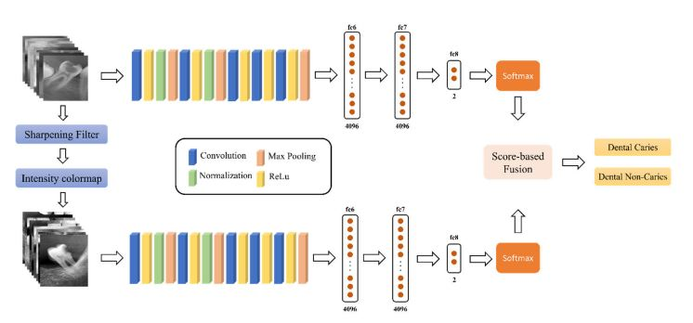
Existing Model/Architecture of your project

Slide 53
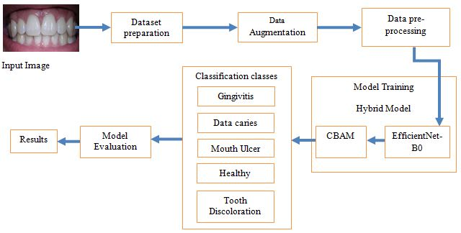
METHODOLOGY
The methodology used in this approach is a hybrid methodology where the output of one model is given as input to another model to perform a better classification. Our study used intraoral images and examined five different disease classes. In a dataset of five classes, three represent diseases, one represents conditions, and the rest represent health. The below figure shows the methodology we followed in this study.
Proposed Model/Architecture of your project

Slide 54
Dataset Preparation: The database we receive is an open source database. Oral Disease Name Database. We modified the database by removing unnecessary classes and folders and duplicate images that are not used much to train the model. Then we see 4 classes from the database such as Gingivitis, Data caries, tooth discoloration, oral ulcers. We have also collected images of a new class called Healthy and added them to the database. We then split the dataset into train, test and validation folder in the ratio of 0.8: 0.1: 0.1.
Data Augmentation: The dataset contains five classes they were Healthy, Gingivitis, Tooth Discoloration, Mouth Ulcer, Data Caries. Here Healthy folder contains 120 images in total, Gingivitis folder contains 1879 images in total, Tooth Discoloration folder contains 146 images in total, Mouth Ulcer folder contains 212 images in total and Data Caries folder contains 175 images in total. We observed that the dataset is imbalanced as the there was a wide range of difference in number of images in each folder.
So to balance the dataset we used the augmentation techniques. We used the techniques like rotation, zoom, vertical flip, horizontal flip etc to generate new images from original images. We applied the data augmentation techniques on all classes except the Gingivitis as already it was having more number of images.

Slide 55
Data Pre-processing: The train folder was now containing 5 folders in which each folder contain the real folder and augmented folders. The real folder contains the real images and augmented folder contains the augmented images. The images in the train folder, test folder, validation folder are loaded by using the ImageDataGenerator . We considered the target size as 224,224 and the color mode as RGB.
Model Training: We considered the Hybrid model for our work. Our Hybrid model consists of two models one was for feature extraction and other is for classification.
EfficientNet: The EfficientNetB0 was considered for the feature extraction. First we gave the train images to the pretrained EfficientNet and extracted the last layer features from the model. We not included the fully connected layers (top layers) of the model. The shape of the input images that the model will accept was (224, 224, 3). The last layer of our EfficientNetB0 was block7a_project_bn. So the features that were extracted from this layer were stored in a variable.
CBAM-Channel Attention: After extracting the last layer features we gave those features to the CBAM Channel Attention. So by using those features the channel attention was used for the classification task. So, here we extracted the last layer features by using the EfficientNetB0 and gave those features as an input for CBAM-Channel Attention inorder to perform the classification task.

Slide 56
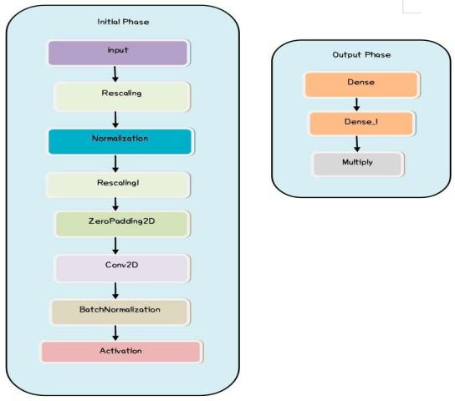
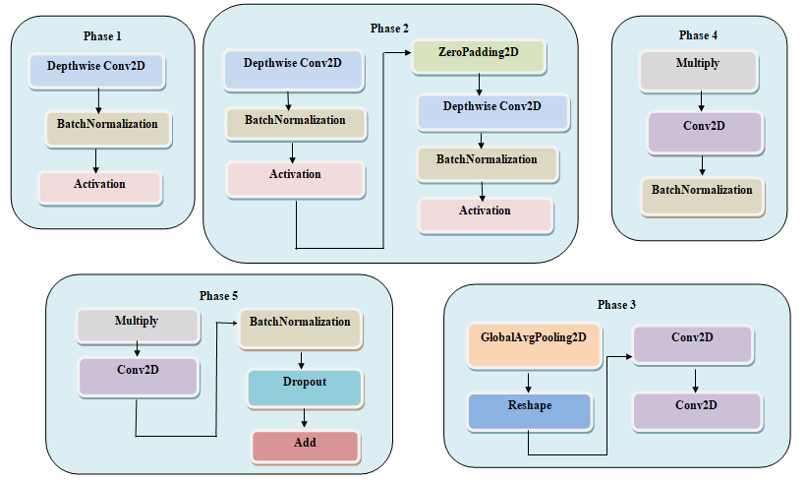
DIFFERENT PHASES:

Slide 57
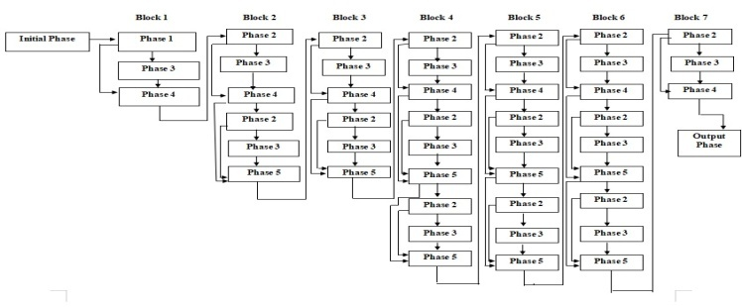
MODEL ARCHITECTURE
Model Evaluation: We trained the model by using the metrics like accuracy, precision, recall and AUC. We used the Adam as an optimizer and categorical cross entropy as loss function. The model performed well on the test data. The model also predicted the new unseen data very well.

Slide 58
RESULTS AND DISCUSSION
The model achieved the accuracy of 94.6%, precision of 0.9511, recall of 0.9460, AUC of 0.9960, loss of 0.1606. The model also performed well on the unseen data. We randomly given some images other than the dataset that we collected inorder to test the performance of the model. The model predicted the disease well on those data. We also trained the EfficientNetB0 model and CBAM model individually on the dataset. We got better results by training the Hybrid model.
From the table below we can conclude that the Hybrid model has given better results compared to other models. Future research may focus on optimizing the performance of intelligent machines through continuous model improvement and validation on real patient databases. A mobile application can be developed to detect oral diseases, which will be useful for everyone. In addition, multimodal data integration studies can improve the predictive ability and support comprehensive patient care, and should include mobile camera images in the database

Slide 59
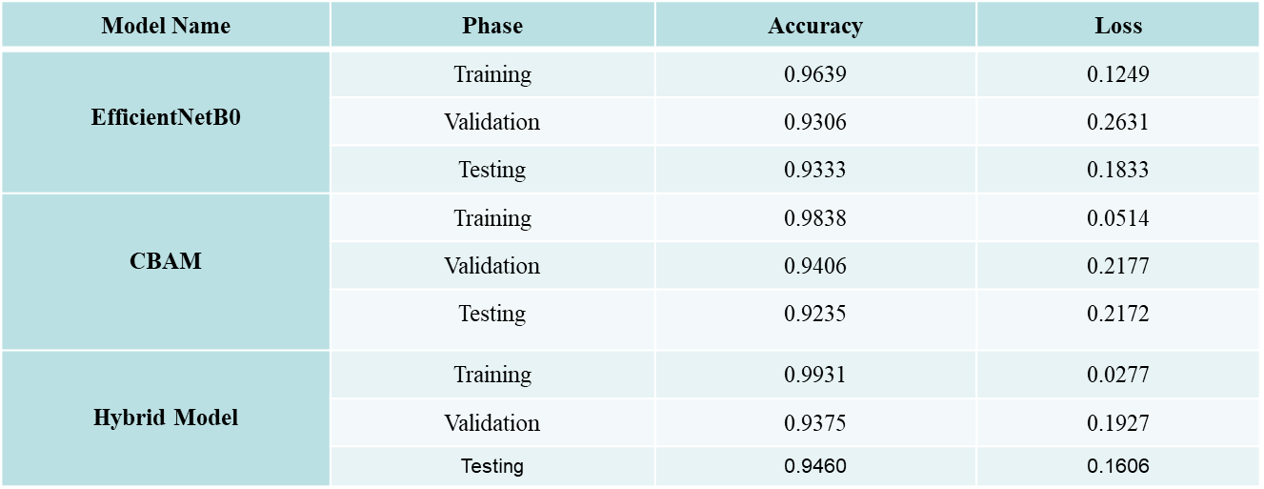
Comparing the metrics of different models

Slide 60
CONCLUSION
In conclusion, our study addresses the lag in technological development in dentistry compared to other fields, especially in the context of deep learning methods. We provide the first solution to address this gap by developing a robust model for oral disease classification using internal images. Our research results show the effectiveness of our hybrid model, which achieved an effective accuracy rate of 94.6%. In addition, we translate our research into practical applications by creating a user-friendly website where individuals can upload internal images to predict disease. Our focus on internal imaging demonstrates cost-effectiveness compared to conventional radiographic imaging and makes our approach more suitable for widespread implementation. By ensuring early disease detection, our research enables people to take proactive action and receive timely treatment, ultimately improving oral health outcomes and reducing healthcare costs.

Slide 61
References
[1] Chau, R. C. W., Li, G., Tew, I. M., Thu, K. M., McGrath, C., Lo, W., Ling, W.,Hsung,T., & Lam, W. Y. H. (2023). “Accuracy of Artificial Intelligence-Based Photographic detection of gingivitis.” International Dental Journal, 73(5), 724–730.
[2] Rashid, J., Qaisar, B. S., Faheem, M., Akram, A., Amin, R. U., & Hamid, M.
(2023). “Mouth and oraldisease classification using InceptionResNetV2 method.” Multimedia Tools and Applications.
[3] Park, S., Erkinov, H., Hasan, M. a. M., Nam, S., Kim, Y., Shin, J., & Chang, W. (2023). “Periodontal Disease Classification with Color Teeth Images Using Convolutional Neural Networks.” Electronics, 12(7), 1518.
[4] Sivari, E., Senirkentli, G. B., Bostancı, E., Güzel, M. S., Açıcı, K., &Aşuroğlu, T. (2023). “Deep Learning in Diagnosis of Dental Anomalies and Diseases: A Systematic review.” Diagnostics, 13(15), 2512.
[5] Patil, S., Albogami, S., Hosmani, J., Mujoo, S., Kamil, M. A., Mansour, M. A.,Abdul, H. N., Bhandi, S., & Ahmed, S. S. S. J. (2022). “Artificial Intelligence in the Diagnosis of Oral Diseases: Applications and Pitfalls.” Diagnostics (Basel, Switzerland), 12(5), 1029.

Slide 62
References
[6]Alalharith, D. M., Alharthi, H. M., Alghamdi, W. M., Alsenbel, Y. M., Aslam, N., Khan, I. U. Shahin, S. Y., Dianišková, S., Alhareky, M. S., & Barouch, K. K. (2020). “A Deep Learning Based Approach for the Detection of Early Signs of Gingivitis in Orthodontic Patients Using Faster Region-Based Convolutional Neural Networks.” International journal of environmental research and public health, 17(22), 8447.
[7] Park, E. Y., Cho, H., Kang, S., Jeong, S., & Kim, E. (2022). “Caries detection with tooth surface segmentation on intraoral photographic images using deep learning.” BMC Oral Health,22(1).
[8]Kawazu, T., Takeshita, Y., Fujikura, M., Okada, S., Hisatomi, M., &Asaumi, J. (2024).“Preliminary study of dental caries detection by deep Neural Network applying Domain-Specific Transfer Learning.” Journal of Medical and Biological Engineering.
[9] Imak, A., Celebi, A., Siddique, K., Turkoglu, M., Sengur, A., & Salam, I. (2022). Dental caries detection using score-based multi-input deep convolutional neural network. IEEE Access, 10, 18320-18329.
[10]Zhou, M., Jie, W., Tang, F., Zhang, S., Mao, Q., Liu, C., & Hao, Y. (2024). Deep learningalgorithms for classification and detection of recurrent aphthous ulcerations using oral clinical photographic images. Journal of Dental Sciences, 19(1), 254-260.

Slide 63
References
[11] Elsayed, A., Mostafa, H., Tarek, R., Mohamed, K., Hossam, A., & Selim, S. (2022, July). Oral
Dental Diagnosis Using Deep Learning Techniques: A Review. In Annual Conference on Medical Image Understanding and Analysis (pp. 814-832). Cham: Springer International Publishing.
[12]Kumar A, Bhadauria HS, Singh A. Descriptive analysis of dental X-ray images using various practical methods: A review. PeerJ Comput Sci. 2021 Sep 13;7:e620. doi: 10.7717/peerj-cs.620. PMID: 34616881; PMCID: PMC8459782
[13] Jaiswal, P., & Bhirud, S. (2023). An intelligent deep network for dental medical image
processing system. Biomedical Signal Processing and Control, 84, 104708.
[14]Zhao, S., Liu, C., & Luo, Q. (2019, August). Dental data analysis based on dental x-raypanorama. In Proceedings of the Third International Symposium on Image Computing and Digital Medicine (pp. 133-137).
[15]M. Muthu Lakshmi & Dr. P. Chitra (2020). “Classification of Dental Cavities from X-ray images using Deep CNN algorithm”, IEEE Xplore, 774-779.
[16]Abdulaziz A. Al Kheraif, Ashraf A. Wahba, H. Fouad, (2019) “Detection of dental diseases from radiographic 2d dental image using hybrid graph-cut technique and convolutional neural network”,Science Direct, 146, 333-342.
[17]Shreyansh A. Prajapati, R. Nagaraj and Suman Mitra, (2017). “Classification of Dental Diseases Using CNN and Transfer Learning”, IEEE Xplore, 70-74.

Slide 64
References
[18] Hu Chen, Hong Li, Yijiao Zhao, Jianjiang Zhao, Yong Wang, (2021). “Dental disease detection on periapical radiographs based on deep convolutional neural networks”, Springer, 16, 649–661.
[19] Ngnamsie Njimbouom S, Lee K, Kim J-D.(2022) “MMDCP: Multi-Modal Dental Carie Prediction for Decision Support System Using Deep Learning.” International Journal of Environmental Research and Public Health. 19(17):10928.
[20]Almalki YE, Din AI, Ramzan M, Irfan M, Aamir KM, Almalki A, Alotaibi S, Alaglan G, Alshamrani HA, Rahman S.(2022) “Deep Learning Models for Classification of Dental Diseases Using Orthopantomography X-ray OPG Images.” Sensors. 22(19):7370.
[21] Kabir, T., Lee, C. T., Nelson, J., Sheng, S., Meng, H. W., Chen, L., ... & Shams, S. (2021, December). An end-to-end entangled segmentation and classification convolutional neural network for periodontitis stage grading from periapical radiographic images. In 2021 IEEE international conference on bioinformatics and biomedicine (BIBM) (pp. 1370-1375). IEEE.
[22] Li, X., Zhao, D., Xie, J., Wen, H., Liu, C., Li, Y., ... & Wang, S. (2023). Deep learning for classifying the stages of periodontitis on dental images: a systematic review and meta-analysis. BMC Oral Health, 23(1), 1017.
[23] Zhang, X., Liang, Y., Li, W., Liu, C., Gu, D., Sun, W., & Miao, L. (2022). Development and evaluation of deep learning for screening dental caries from oral photographs. Oral diseases, 28(1), 173-181.

Slide 65
References
[24] Yu, H., Lin, Z., Liu, Y., Su, J., Chen, B., & Lu, G. (2020). A new technique for diagnosis of dental caries on the children’s first permanent molar. Ieee Access, 8, 185776-185785.
[25] Mohammad‐Rahimi, H., Motamedian, S. R., Rohban, M. H., Krois, J., Uribe, S., Nia, E. M., Rokhshad, R., Nadimi, M., & Schwendicke, F. (2022). Deep learning for caries detection: A systematic review. Journal of Dentistry, 122, 104115.
[26] Lian L, Zhu T, Zhu F, Zhu H.(2021) Deep Learning for Caries Detection and Classification. Diagnostics. 11(9):1672.
[27] Mima, Y., Nakayama, R., Hizukuri, A. et al. Tooth detection for each tooth type by application of faster R-CNNs to divided analysis areas of dental panoramic X-ray images. Radiol Phys Technol 15, 170–176 (2022).
[28] T. Dhake and N. Ansari, "A Survey on Dental Disease Detection Based on Deep Learning Algorithm Performance using Various Radiographs," 2022 5th International Conference on Advances in Science and Technology (ICAST), Mumbai, India, 2022, pp. 291-296.
[29] A., Suresh, Kumar., Manivel, Kandasamy., P., Anitha. (2023). Analysis of Panoramic Images using Deep Learning For Dental Disease Identification.
[30] M., B., H., Moran., Marcelo, Faria., Marcelo, Faria., Gilson, A., Giraldi., Luciana, Freitas, Bastos., Larissa, F.C., de, Oliveira., Aura, Conci. (2021). Classification of Approximal Caries in Bitewing Radiographs Using Convolutional Neural Networks.. Sensors.

Slide 66

66

