Slide 1


GMR Institute of Technology, Rajam
Oral Diseases Classification Using Dental Images: A Hybrid Methodology
31-May-24
1
31-May-24
1

Slide 2
Oral Diseases Classification Using Dental Images: A Hybrid Methodology
1. T.U S S N L Durga Devi (21341A05I2)
2. P. Balaji (21341A05D9)
3. Y. Eswari (21341A05J7)
4.G. Jagadeesh (22345A0519)
5. R. Prasad (22345A0517)
Under the guidance of
Mr. S. Nirmala
Assistant Professor
GMR Institute of Technology

Slide 3
ABSTRACT
Oral diseases are often not diagnosed, which can have a negative impact on health. In this study, we use a deep learning method for internal image-based oral disease detection. Our approach proposes a hybrid methodology that combines EfficientNet for feature extraction and Channel Block Attention Module (CBAM) for classification. We use a two-step procedure: first we use EfficientNet to extract features from the last layer, then we use CBAM for classification. A hybrid approach uses attention mechanisms and feature extraction to improve accuracy. Once the disease is classified, we will recommend treatment or preventive measures to reduce the effects of the disease. Our approach uses deep learning algorithms and internal imaging techniques to provide early diagnosis and preventative measures. The accuracy of our hybrid model is 94.6%. The site effectively categorizes uploaded images into each of the five disease classifications and recommends preventative measures for each disease. In addition to using intraoral images to diagnose diseases, the website also uses symptoms to classify diseases into seven classifications. There are a total of 19 distinct symptoms in this study, from which the user can choose any three to recognise the disease and recommend the right kind of treatment. It uses deep learning algorithms and a hybrid approach to combat oral diseases, providing a useful tool for individuals and health professionals.
Keywords: Healthcare, Dentistry, Classification, Image analysis, oral diseases, Deep learning, Hybrid methodology, Intraoral Images ,Symptoms.

Slide 4
INTRODUCTION
A substantial global health burden, oral illnesses impact millions of individuals globally. In order to effectively manage this problem and avoid consequences, an immediate and precise diagnosis is essential. In modern era, advances in artificial intelligence (AI) and image processing have led to innovative approaches to detecting oral diseases. The integration of deep learning techniques has revolutionized several areas of medicine, especially in diagnostic imaging and disease detection .While disciplines such as radiology and pathology have seen advances in deep learning, the adoption of this technology in dentistry has been slower. However, the potential impact of deep learning techniques in dentistry field, particularly when it comes to using dental images to diagnose oral illnesses. Deep learning developments have greatly advanced medical specialty analysis, leading to more accurate and efficient disease diagnosis in many specialties. Conversely, despite the need for better methods to diagnose oral diseases, dentistry has lagged behind in taking advantage of these technological advances.
Undiagnosed oral diseases such as periodontal disease, tooth decay, and mouth ulcers can have serious consequences if left untreated. If left untreated, gum disease can progress to periodontitis, causing irreparable damage to the tooth's supporting structures. Tooth decay, commonly known as tooth decay, can lead to tooth loss and systemic health problems if not treated immediately. Mouth ulcers, although usually benign, can be a symptom of a systemic condition or oral cavity, highlighting the importance of timely diagnosis.
31 May 2024

Slide 5
To diagnose oral disease in the past, dentists have depended on palpation, visual inspection, and radiographic imaging. Although these methods remain indispensable in clinical practice, they are not without limitations. Visual examination can miss early signs of disease, especially in inaccessible areas, while radiographic imaging techniques such as X-rays are expensive and can expose patients to ionizing radiation. Furthermore, relying on the subjective judgments of clinicians introduces variability and can lead to missed diagnoses . Public ignorance about the importance of regular dental checkups and the potential consequences of untreated oral disease fuel this problem. Too many people wait until their symptoms are worse before seeking dental care, which can lead to delayed diagnosis and worsening of oral health problems. New approaches using deep learning and computational imaging in dentistry are needed to overcome these barriers to early diagnosis.
In this context, the development of an intelligent machine for oral diseases detection using dental images represents a significant step towards improving oral healthcare outcomes. By leveraging a hybrid methodology that integrates deep learning algorithms for feature extraction and classification, this research aims to enhance the accuracy and efficiency of oral diseases diagnosis. Through early detection and intervention facilitated by intelligent machines, the burden of oral diseases can be mitigated, resulting in better patient outcomes and lower medical expenses.

Slide 6
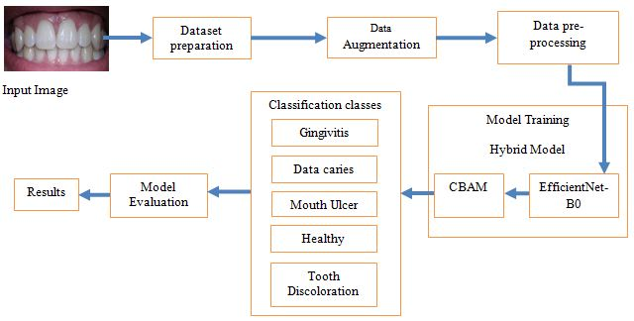
METHODOLOGY
The methodology used in this approach is a hybrid methodology where the output of one model is given as input to another model to perform a better classification. Our study used intraoral images and examined five different disease classes. In a dataset of five classes, three represent diseases, one represents conditions, and the rest represent health. The below figure shows the methodology we followed in this study.
Explaining the Flow of Methodology
31 May 2024

Slide 7
Dataset Preparation: The database we receive is an open source database. Oral Disease Name Database. We modified the database by removing unnecessary classes and folders and duplicate images that are not used much to train the model. Then we see 4 classes from the database such as Gingivitis, Data caries, tooth discoloration, oral ulcers. We have also collected images of a new class called Healthy and added them to the database. We then split the dataset into train, test and validation folder in the ratio of 0.8: 0.1: 0.1.
Data Augmentation: The dataset contains five classes they were Healthy, Gingivitis, Tooth Discoloration, Mouth Ulcer, Data Caries. Here Healthy folder contains 120 images in total, Gingivitis folder contains 1879 images in total, Tooth Discoloration folder contains 146 images in total, Mouth Ulcer folder contains 212 images in total and Data Caries folder contains 175 images in total. We observed that the dataset is imbalanced as the there was a wide range of difference in number of images in each folder.
So to balance the dataset we used the augmentation techniques. We used the techniques like rotation, zoom, vertical flip, horizontal flip etc to generate new images from original images. We applied the data augmentation techniques on all classes except the Gingivitis as already it was having more number of images.

Slide 8
Data Pre-processing: The train folder was now containing 5 folders in which each folder contain the real folder and augmented folders. The real folder contains the real images and augmented folder contains the augmented images. The images in the train folder, test folder, validation folder are loaded by using the ImageDataGenerator . We considered the target size as 224,224 and the color mode as RGB.
Model Training: We considered the Hybrid model for our work. Our Hybrid model consists of two models one was for feature extraction and other is for classification.
EfficientNet: The EfficientNetB0 was considered for the feature extraction. First we gave the train images to the pretrained EfficientNet and extracted the last layer features from the model. We not included the fully connected layers (top layers) of the model. The shape of the input images that the model will accept was (224, 224, 3). The last layer of our EfficientNetB0 was block7a_project_bn. So the features that were extracted from this layer were stored in a variable.
CBAM-Channel Attention: After extracting the last layer features we gave those features to the CBAM Channel Attention. So by using those features the channel attention was used for the classification task. So, here we extracted the last layer features by using the EfficientNetB0 and gave those features as an input for CBAM-Channel Attention inorder to perform the classification task.

Slide 9
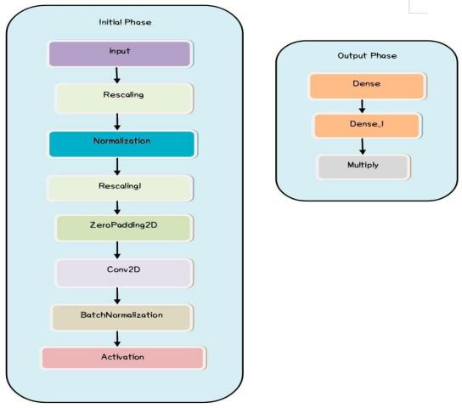
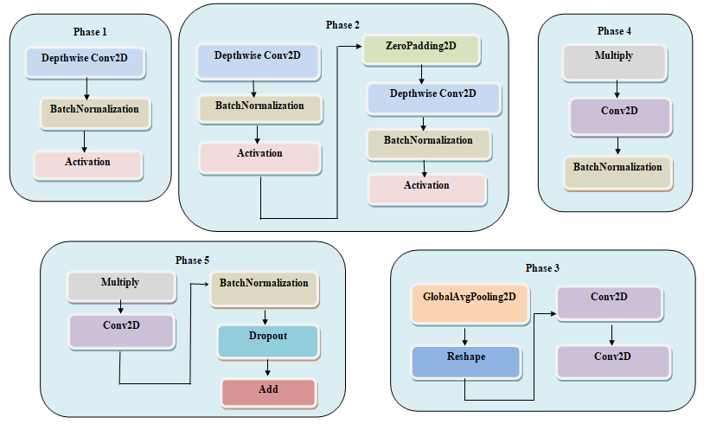
Different Phases:

Slide 10
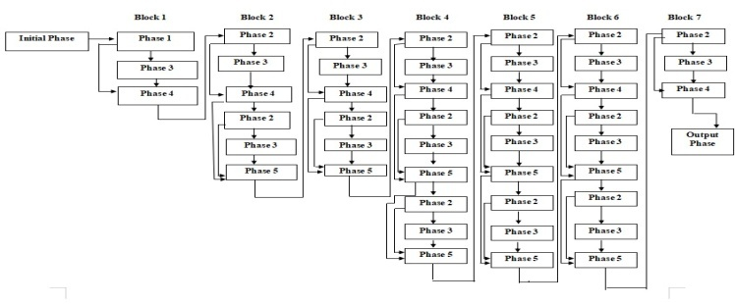
Model Architecture
Model Evaluation: We trained the model by using the metrics like accuracy, precision, recall and AUC. We used the Adam as an optimizer and categorical cross entropy as loss function. The model performed well on the test data. The model also predicted the new unseen data very well.

Slide 11
RESULTS AND DISCUSSION
The model achieved the accuracy of 94.6%, precision of 0.9511, recall of 0.9460, AUC of 0.9960, loss of 0.1606. The model also performed well on the unseen data. We randomly given some images other than the dataset that we collected inorder to test the performance of the model. The model predicted the disease well on those data. We also trained the EfficientNetB0 model and CBAM model individually on the dataset. We got better results by training the Hybrid model.
From the table below we can conclude that the Hybrid model has given better results compared to other models. Future research may focus on optimizing the performance of intelligent machines through continuous model improvement and validation on real patient databases. A mobile application can be developed to detect oral diseases, which will be useful for everyone. In addition, multimodal data integration studies can improve the predictive ability and support comprehensive patient care, and should include mobile camera images in the database.

Slide 12
Model Name | Phase | Accuracy | Loss
EfficientNetB0 | Training | 0.9639 | 0.1249
 | Validation | 0.9306 | 0.2631
 | Testing | 0.9333 | 0.1833
CBAM | Training | 0.9838 | 0.0514
 | Validation | 0.9406 | 0.2177
 | Testing | 0.9235 | 0.2172
Hybrid Model | Training | 0.9931 | 0.0277
 | Validation | 0.9375 | 0.1927
 | Testing | 0.9460 | 0.1606
Comparing the metrics of different models

Slide 13
CONCLUSION
In conclusion, our study addresses the lag in technological development in dentistry compared to other fields, especially in the context of deep learning methods. We provide the first solution to address this gap by developing a robust model for oral disease classification using internal images. Our research results show the effectiveness of our hybrid model, which achieved an effective accuracy rate of 94.6%. In addition, we translate our research into practical applications by creating a user-friendly website where individuals can upload internal images to predict disease. Our focus on internal imaging demonstrates cost-effectiveness compared to conventional radiographic imaging and makes our approach more suitable for widespread implementation. By ensuring early disease detection, our research enables people to take proactive action and receive timely treatment, ultimately improving oral health outcomes and reducing healthcare costs.

Slide 14


