Slide 1




Automate Applications Using Ansible | Cloud Stroms | Technical Hub
AUTOMATE APPLICATIONS USING ANSIBLE
By Cloud Stroms

Slide 2

Automate Applications Using Ansible | Cloud Stroms | Technical Hub
Overview
01. Introductions
05. The Result
02. The Problem
06. Analysis
03. Technologies
07. Conclusions
04. Implementations
08. References

Slide 3
Automate Applications Using Ansible | Cloud Stroms | Technical Hub
Introductions
Ansible is an open-source automation tool that enables IT professionals to manage the configuration, deployment, and orchestration of software applications and infrastructure. It was created by Michael DeHaan in 2012 and later acquired by Red Hat.
Ansible works by using SSH protocol to connect to remote systems and perform tasks using YAML-based playbooks. Playbooks contain a set of instructions that define the desired state of the system, and Ansible handles the execution of these tasks to ensure the system reaches that state.
One of the key benefits of Ansible is its agentless architecture, which means that there is no need to install any software on the target systems. This makes it lightweight and easy to set up, especially in environments with a large number of servers or virtual machines.

Slide 4
Automate Applications Using Ansible | Cloud Stroms | Technical Hub
Problems
01.
Manual Configuration
Without Ansible, configuration management and deployment will have to be done manually, which is time-consuming and prone to human error.
02.
Inconsistent Configuration
Manual configuration can lead to inconsistencies across environments and deployments, which can cause issues in production.
03.
Difficult to Scale
Scaling infrastructure and applications can be challenging without automation tools like Ansible, which can lead to slower deployment times and delays in releasing new features.
04.
Limited Monitoring
Ansible can be used to monitor the health of infrastructure and applications, which is essential for maintaining a stable and reliable environment. Without Ansible, monitoring may be limited, making it difficult to troubleshoot issues.

Slide 5
Technologies
01.
02.
03.
Ansible
Git & Git-Hub
AWS
AWS (Amazon Web Services) is a cloud computing platform that provides a wide range of services and solutions for businesses and individuals.
It offers on-demand computing resources, such as virtual machines, storage, and databases, that can be accessed over the internet.
Ansible is an open-source automation tool.
It uses YAML-based playbooks to define desired system state.
Ansible is agentless, lightweight, and easy to set up.
Git is a distributed version control system.
It allows developers to track changes to their code over time.
Git enables collaboration among developers by allowing them to work on the same codebase simultaneously.

Slide 6
Automate Applications Using Ansible | Cloud Stroms | Technical Hub
Implementations
01.
02.
03.
Create ec2 instances where one of the created instance is master and the rest of them are treated as slaves.
Create a common user in all the created instances (ex: ansible). Give Administrator access to the created user in all the instances.
Install ansible2, python, python ,open ssh in master instance.. Add the public ip of the slave in master in the following location (/etc/ansible/hosts)

Slide 7
Automate Applications Using Ansible | Cloud Stroms | Technical Hub
Implementations
04.
05.
06.
Change password Authuntication in all the server from no to yes. Generate ssh key in master instances by using ssh-keygen. Copy the created ssh key into the slaves by using ssh-copy-ip
clone a website repo from github into master. create a yaml file where the yaml file contains plays.. create a play for installing any webserver and other for coping our website into webserver
Run The yaml file (ansible-playbook filename.yml). Now we Can Access the webiste by using our slaves instance public ip

Slide 8
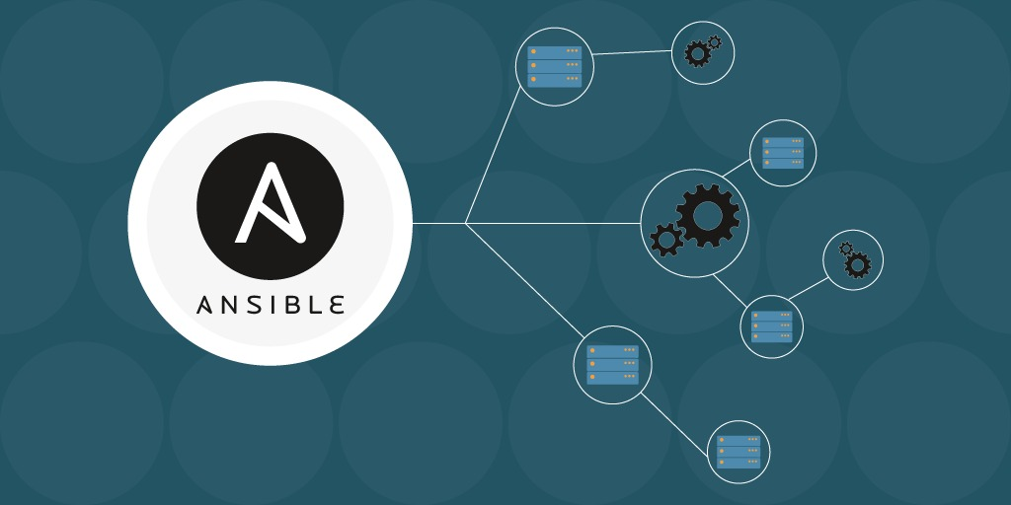
Automate Applications Using Ansible | Cloud Stroms | Technical Hub
The Result
The final result of automating the deployment and management of an application using Ansible is a more efficient, scalable, consistent, and secure process that saves time and reduces costs.
Automating remote servers with a control server using Ansible allows for efficient management of infrastructure and applications. It enables IT professionals to easily deploy and configure software, manage updates and patches, and ensure consistency across multiple servers. This approach can lead to increased productivity, faster deployment times, and improved scalability, making it a popular choice for DevOps and infrastructure automation.

Slide 9
Automate Applications Using Ansible | Cloud Stroms | Technical Hub
Analysis
01.
02.
03.
Time and cost savings
Scalability
Consistency
Ansible allows you to easily add or remove machines from your deployment process, making it easier to scale your application.
By automating the process, you ensure that the deployment and management of your application is done in a consistent manner across all of your remote machines.
Automating the deployment and management of your application using Ansible can save time and reduce costs associated with manual labor.

Slide 10
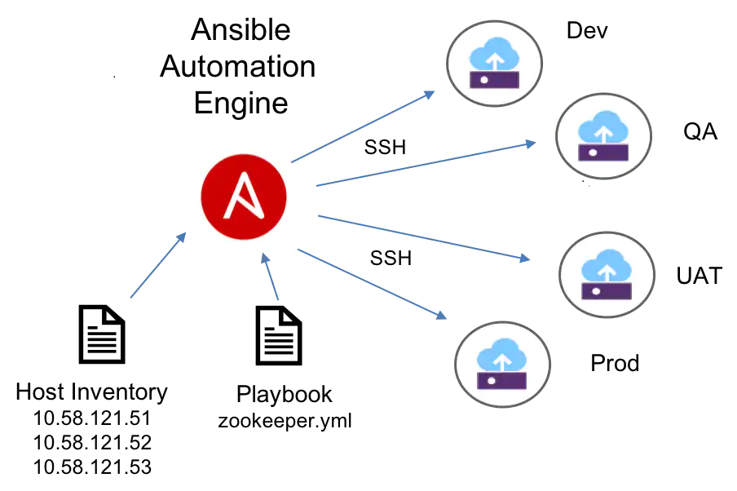
Automate Applications Using Ansible | Cloud Stroms | Technical Hub
Conclusions
In conclusion, automating web application deployment using Ansible can significantly streamline the deployment process, ensure consistency across different environments, and save time. By defining your infrastructure and application configurations as code using Ansible, you can easily repeat and reproduce the same environment consistently across different machines. Ansible's agentless approach, ease of use, cross-platform support, scalability, declarative approach, and community support make it a popular choice for automating web application deployment.

Slide 11
Automate Applications Using Ansible | Cloud Stroms | Technical Hub
References
01. Ansible Community Documentation(https://docs.ansible.com/)
02. Git Tutorial(https://git-scm.com/docs)
03. Ansible Tutorials (https://youtu.be/zw8eUSGNLq4)
04. AWS Documentation (https://docs.aws.amazon.com/)

Slide 12
Thanks
Team Members:
Prasad Reddy (TL)
Naga Balaji Reddy
Sunil
Rama Reddy

