Slide 1

EC22401
ANALOG INTEGRATED CIRCUITS AND ITS APPLICATIONS

Slide 2
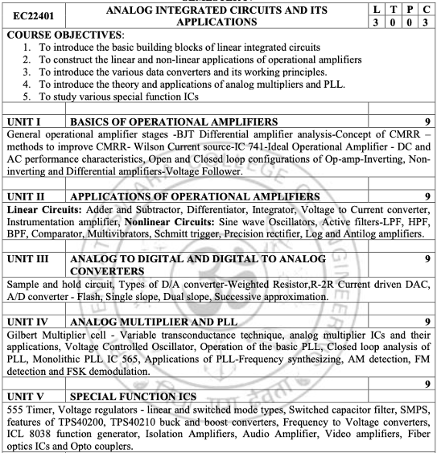
EC22401- ANALOG INTEGRATED CIRCUITS AND ITS APPLICATIONS
SYLLABUS

Slide 3
UNIT III - ANALOG TO DIGITAL AND
DIGITAL TO ANALOG CONVERTERS
Sample and hold circuit
Types of D/A converter
Weighted Resistor,
R-2R Current driven DAC,
A/D converter
Flash,
Single slope,
Dual slope,
Successive approximation

Slide 4
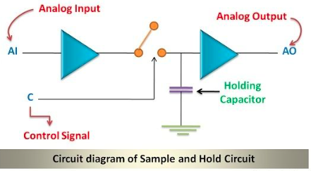
Sample and Hold circuit
The Sample and Hold circuit is an electronic circuit which creates the samples of voltage given to it as input, and after that, it holds these samples for the definite time. The time during which sample and hold circuit generates the sample of the input signal is called sampling time (between 1µs to 14 µs) Similarly, the time duration of the circuit during which it holds the sampled value is called holding time. The holding time can assume any value as required in the application..
Sampling a signal is the process of acquiring its values only at discrete points in time”.

Slide 5
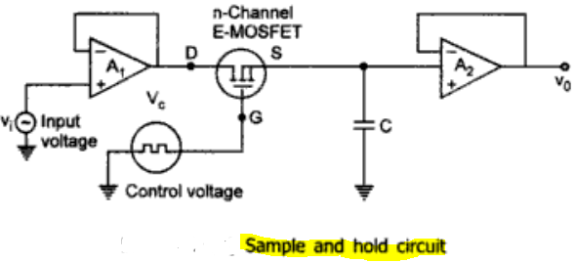
Sample and Hold circuit
A sample and hold circuit samples an input signal and holds on to its last sampled value until the input is sampled again. This type of circuit is very useful in digital interfacing and analog to digital and pulse code modulation systems. One of the simplest practical sample and hold circuit configuration is shown in Fig. The n-channel E-MOSFET works as a switch and is Controlled by the control voltage V_{c} and the capacitor C stores the charge.
The analog signal V_{i} to be sampled is applied to the drain of E-MOSFET and the control voltage V_{c} is applied to its gate.
When V_{c} is positive, the E-MOSFET turns on and the capacitor C charges to the instantaneous value of input V_{i} with a time constant [R_{o} + r_{ds} (on)] C.
Here R₀ is the output resistance of the voltage follower A₁ and r_{ds} (on) is the resistance of the MOSFET when on. Thus the input voltage V_{i} appears across the capacitor C and then at the output through the voltage follower A2.

Slide 6
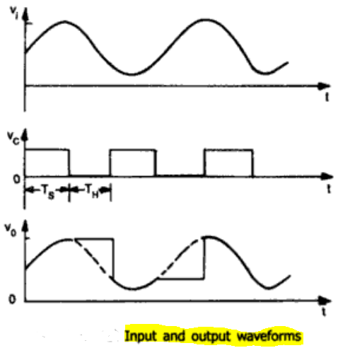
Sample and Hold circuit
The weveforms are as shown in Fig.
During the time when control voltage Vc is zero. the E-MOSFET is off. The capacitor C is now facing the high input impedence of the voltage follower A2 and hence cannot discharge. The capacitor holds the voltage across it. The time period T_{s} , the time during which voltage across the capacitor is equal to input voltage is called Sample period.
The time period T_{H} of Vc during which the voltage across the capacitor is held constant is called hold period.
The frequency of the Control voltage should be kept higher than [at least twice] the input so as to retrieve the input from output waveform.
A low leakage capacitor such as Polystrene, Mylar, or Teﬂon should be kept to retain the stored charge.

Slide 7
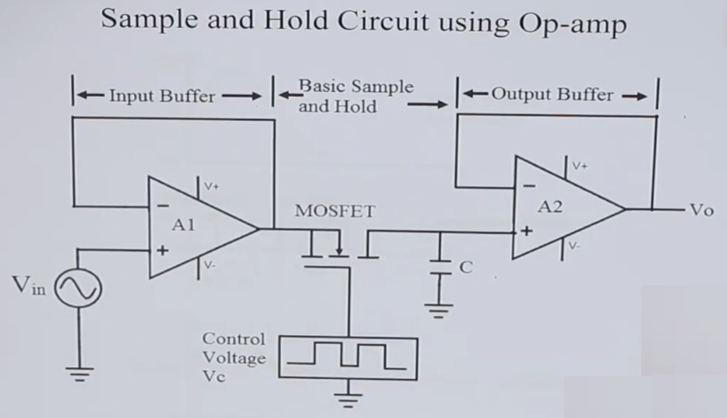

Slide 8
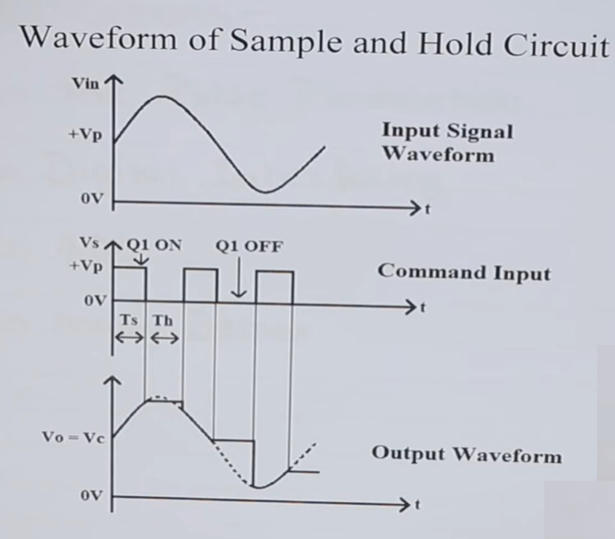

Slide 9
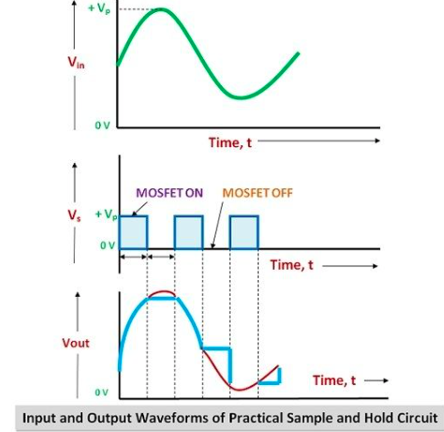
Sample and Hold circuit

Slide 10
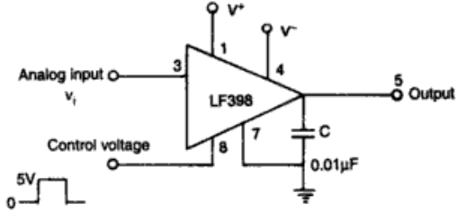
Sample and Hold circuit IC
IC’s
Specially designed sample and hold ICs of make Harris semiconductor HA2420, National semiconductor such as LF198, LF398 are
also available.
A typical connection diagram of the LF398 is shown in Fig. It may be noted that the storage capacitor C is connected externally.

Slide 11
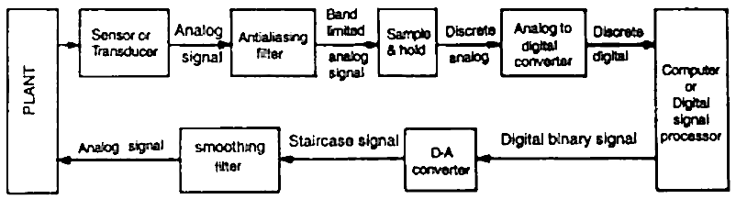
ANALOG AND DIGITAL DATA CONVERTIONS
Real world processes produce analog signals which carry information pertaining to process variables such as voltage, current, charge, temperature and pressure. The rate of flow of such information may be very slow or very fast. It is difficult to store, manipulate, compare, calculate and retrieve such data with good accuracy using purely analog technology. But, computers can perform these operations quickly and efficiently using digital techniques. Therefore, it is necessary to convert the analog signals from various transducers into its equivalent digital data, which in turn act as the input for digital systems.
In the application of signal processing, the measurement and analysis of signals are very important to discover their characteristics. If the signal is unknown, the process of analysis begins with the acquisition of the signal. The most common technique of acquiring signals is by sampling. “Sampling a signal is the process of acquiring its values only at discrete points in time”.

Slide 12
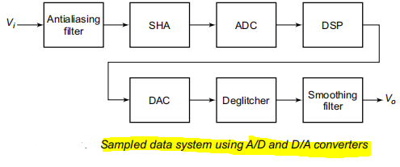
ANALOG AND DIGITAL DATA CONVERTIONS
Process of sampling and the subsequent analog and digital conversion processes are:
(i) An analog signal is a signal that is defined over a continuous period of time in which the
amplitude may assume a continuous range of values.
(ii) the term quantisation refers to the process of representing a variable by a finite set of discrete values.
(iii) a quantised variable is the signal variable that can assume only finite distinct values.
(iv) a discrete time signal is the one that is defined at particular points of time only. Therefore, the independent time variable is quantised. When the amplitude of a discrete-time signal is allowed to assume a continuous range of values, the function is called a sampled-data signal. A sampled data signal could result from sampling an analog signal at discrete points of time.
(v) a digital signal is a function, in which the time and amplitude are quantised. A digital signal is always represented by a sequence of words, where each word can contain a finite number of bits (binary digits).

Slide 13
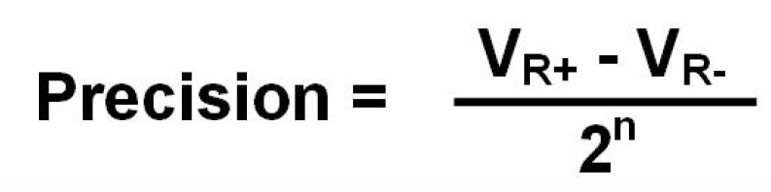
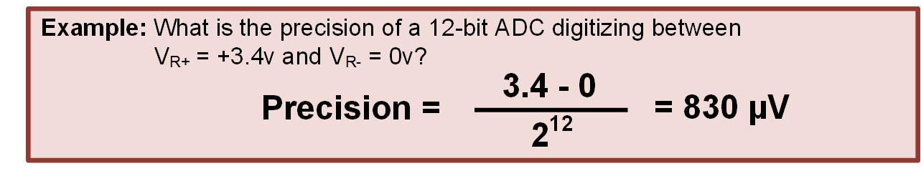
DIGITAL TO ANALOG CONVERTERS
The digital signal is converted into analog signal by D/A converter (DAC) for use in analog form.
The D/A converter is usually operated at the same frequency fs as that of A/D converter.
The output of D/A converter is commonly a staircase signal, which is passed through a smoothing filter to eliminate the quantisation noise effects.
The precision of an ADC is the smallest voltage that the LSB of the digital output can represent.
This is found by dividing the input voltage range by the number of discrete zones.
Specifications of DAC / ADC
Accuracy,
Offset voltage,
Linearity,
Monotonicity,
Resolution and
Settling time

Slide 14

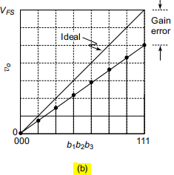
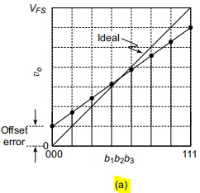
DIGITAL TO ANALOG CONVERTERS
Accuracy:
The components in D/A converter circuits are prone to mismatches, drift, ageing, noise and other sources of errors. These factors lead to degradation in conversion performance.
Absolute accuracy defines the maximum deviation of the output from the ideal value and it is expressed in fractions of 1 LSB. The D/A converter manufacturers follow different ways of specifying accuracy.
The D/A converter errors are classified as static and dynamic errors.
Offset voltage:
The simplest kind of static errors are offset error and gain error. Ideally, the output
of a D/A converter is 0V when all the bits of binary input word are 0s. In practice, however, there is a very small output voltage called offset voltage or offset error as depicted in Fig.(a). The offset error is nullified by translating the actual A/D converter characteristics up or down so that it goes through the origin as shown in Fig.(b). The gain error shown in Fig.(b) is compensated by adjusting the scale factor K.
Notes:
The accuracy is how close the digital output is to the input signal.
By design, an ADC will only ever be able to get within +/- ½ LSB of the original analog value.

Slide 15
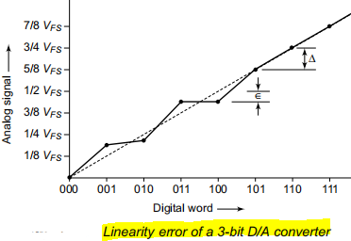
DIGITAL TO ANALOG CONVERTERS
Linearity:
The most common dynamic errors are full-scale error and linearity error. Full-scale error
is the maximum deviation of the output value from its expected or ideal value, expressed in percentage of full-scale. Linearity error is the maximum deviation in step size from the ideal step size. More expensive D/A converters have full-scale and linearity errors as low as 0.001% of full-scale. General purpose D/A converters have accuracies in the range of 0.01 to 0.1%.
“The linearity of a D/A converter is defined as the precision with which the digital input is converted into analog output.” An ideal D/A converter produces equal increments in analog output for equal increments in digital input as shown in dotted line curve of the transfer characteristics of Fig →. However, in an actual D/A converter, the gain and offset errors due to resistors introduce non-linearity as shown by the solid line of the transfer characteristics of Fig.→
Commonly, the linearity of D/A converter is specified as less than ± 1/2 (LSB)

Slide 16

DIGITAL TO ANALOG CONVERTERS
Monotonicity:
A D/A converter is monotonic if its output value increases as the binary inputs are incremented from one value to the next. That is, the staircase output can have no downward step as the binary input is incremented. Figure in prev slide shows the transfer curve for a non-monotonic D/A converter.
The output decreases when the input word changes from 011 to 100.
The monotonic characteristic is important in control applications, without which, oscillations will result. If a D/A converter is identified to be monotonic, the error must be less than ± 1/2 LSB at each output level.
Hence, all the D/A converter ICs are designed to have linearity error of less than ± 1/2 LSB
Resolution ( Step size):
“Resolution of D/A converter is defined as the smallest change that can occur in the analog output as a result of a change in the digital input”. The resolution is always equal to the weight of the LSB and is also known as the step size, since it is the amount of Vo that will change when the digital input data goes from one step to the next.
Although resolution can be expressed as the amount of voltage or current per step, it is more useful to express it as a percentage of the full-scale output.
The percentage resolution is given by

Slide 17
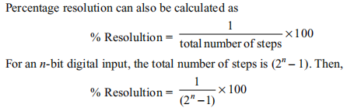
DIGITAL TO ANALOG CONVERTERS
Resolution ( Step size):
Settling time:
The time required for the output of a D/A converter to settle down to within ±(1/2) LSB of the final value for a given digital input is known as settling time. It depends on the switching time of the logic circuits, which in turn depends on the inevitable stray capacitances and inductances present in the converter circuit. The settling time normally ranges from 100 ns to 10 ms based on the word length and the conversion technique employed.
Temperature Sensitivity:
For a fixed digital input, the analog input varies with temperature, normally from ±50 ppm/ºC to ±1.5 ppm/ºC. This is introduced due to the temperature sensitivity of the reference voltages, the resistors used in the converters, the op-amp and its offset voltage. Therefore, this factor determines the stability of D/A converter.

Slide 18
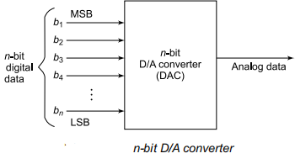
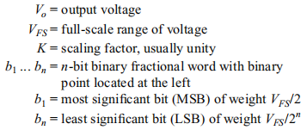
DIGITAL TO ANALOG CONVERTERS
Various types of D/A converters,
(i) Weighted resistor type,
(ii) R-2R ladder type,
(iii) Voltage mode R-2R ladder type and
(iv) Inverted or current mode R-2R ladder type.
Basic D/A Conversion techniques
The input digital data for a D/A converter is an n-bit binary word D. The bit b1 is called the most significant bit (MSB) and bit bn the least significant bit (LSB).
Then, the quantity D can be represented by D = b₁2^{–1} + b₂2^{–2}+ b₃2^{–3} + .... + b_{n}2^{–n}
The D/A converter accepts the binary input D and produces an analog output,
which is proportional to D using a reference voltage V_{R}. The converted analog value is either in voltage or current form. For a voltage output D/A converter, the conversion characteristic may be expressed as

Slide 19
DIGITAL TO ANALOG CONVERTERS
Binary-Weighted resistor type
In the weighted resistor type D/A converter, each digital level is converted into an equivalent analog voltage or current. In a 4-bit D/A converter which accepts data from 0000 to 1111, there are 15 discrete levels of input above the zero level, and hence it is convenient to divide the output analog signal into 15 levels above zero. The LSB of the digital data causes a change in the analog output that is equal to 1/15th of the full-scale analog output voltage (V_{R}). Therefore, the weighted resistor network is designed in such a way that a 1 in LSB (2⁰) position results in V_{R} x 1/15 at the output.
A 1 in the 2¹ bit position must cause a change in the analog output voltage that is equal to 2/15th of V_{R} (i.e. twice the size of the LSB).
Similarly, a 1 in 2² and 2³ bit positions must cause a change of V_{R} x 4/15V and V_{R} x 8/15V respectively as the analog output.
It is important to note that the sum of the weights assigned to various bit positions
of a 4-bit D/A converter must be equal to 1,
i.e. (1/15 + 2/15 + 4/15 + 8/15 = 15/15) V_{R} = V_{FS}.
In general, the weight assigned to the LSB is 1/(2^{n} – 1), where n is the number of bits in the digital input.

Slide 20
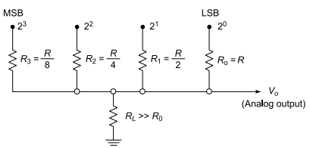
DIGITAL TO ANALOG CONVERTERS
Binary-Weighted resistor type
Thus, the 4-bit weighted resistor network shown in Fig --> performs the following D/A conversion:
The 2⁰ bit is changed to 1/15th of V_{R}, 2¹ bit to 2/15th of V_{R}, 2² bit to 4/15th of V_{R} and 2³ bit to 8/15th of V_{R}.
These four voltages are added together to form the analog output voltage using an op-amp summer circuit.
The resistor R₀, R₁, R₂ and R₃ form the voltage divider network connected with the op-amp and R_{L} is the load resistor which should be large enough so as not to load the divider network.
The LSB should be connected with the highest input resistance R0 while the 2¹ bit is connected with a resistance of half the value of LSB resistor, i.e. R0/2. Therefore, its current contribution at the summing junction of op-amp will be twice that of LSB. The 2² bit is connected with a 1/4th of LSB resistance, i.e. R0 /4. Similarly, the MSB is connected with 1/8th of the LSB resistance, i.e. R0 /8. The output is the sum of these four attenuated voltages.

Slide 21

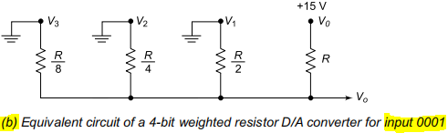

DIGITAL TO ANALOG CONVERTERS
Binary-Weighted resistor type
Operating principle of the circuit
The equivalent circuit of Fig.( in prev slide), when applied with the digital data of 0001, is shown in Fig.(b). The analog output voltage Vo can be calculated using Millman’s theorem, which states that the voltage at any node in a resistive network is equal to the sum of the currents entering the node divided by the sum of the conductance connected at the node. Then the output voltage is expressed as
For the weighted resistor network, assuming R1 = R, R2 = R/2, R3 = R/4 and R4 = R/8, and applying the Millman’s theorem to the circuit of Fig.(b), we get

Slide 22
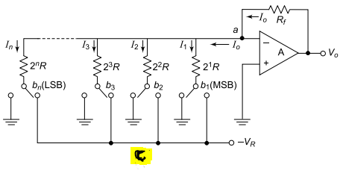
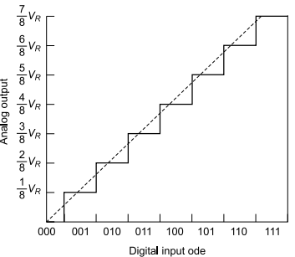
DIGITAL TO ANALOG CONVERTERS
Binary-Weighted resistor type
n-bit D/A converter using op-amp
Figure(c) shows the circuit of an n-bit D/A converter using op-amp as a summing amplifier. It employs a binary-weighted resistor network to generate the terms b_{i}2^{–i}
where i = 1, 2, … n. The circuit also uses n-electronic switches controlled by the binary input word b1, b2, ... bn and a reference voltage –V_{R}. The switches are of single pole double throw (SPDT) type. If the binary input to a switch is 1, then the switch connects the resistance to the reference voltage –VR. When the input bit to the switch is 0, it connects the resistor to ground.
(The op-amp is operated as a current-to-voltage converter)
Transfer Characteristics

Slide 23

DIGITAL TO ANALOG CONVERTERS
Binary-Weighted resistor type
Considering an ideal op-amp A, the output current Io is given by
The n-bit D/A converter circuit shown in Fig.(a) uses a negative reference voltage, thus producing a positive staircase voltage. The analog output voltage waveform for 3-bit weighted resistor D/A converter is shown in the transfer characteristics of Fig.(b) for an input binary word 000, 001, … 111.
Disadvantage of binary weighted D/A converter :
Requirement of wide range of resistor values. As the length of the binary word is increased, the range of resistor values needed also increases. For an 8-bit D/A converter, the resistor values to be connected with the bits are 2⁰R + 2¹R + ... + 2⁷R. Therefore, the largest resistor corresponding to bit b₈ is 128 times the value of the smallest resistor corresponding to bit b₁. The fabrication of such large value of resistors of the order of MW is not practically possible in
monolithic circuit fabrication.

Slide 24

DIGITAL TO ANALOG CONVERTERS
Problems on Binary-Weighted resistor type

Slide 25
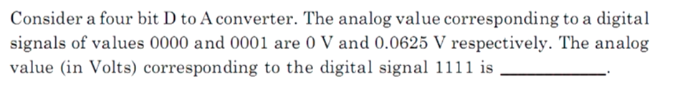

Slide 26
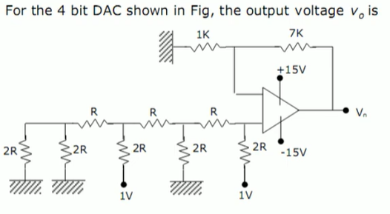

Slide 27


DIGITAL TO ANALOG CONVERTERS
Problems on Binary-Weighted resistor type
1
2

Slide 28


DIGITAL TO ANALOG CONVERTERS
Problems on Binary-Weighted resistor type
1.38V

Slide 29
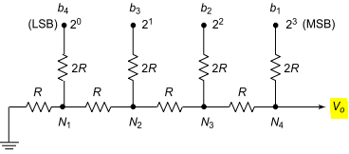
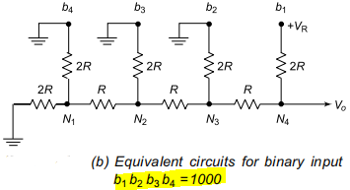
DIGITAL TO ANALOG CONVERTERS
R-2R ladder type
The R-2R ladder type D/A converter is a better choice for practical applications and it overcomes drawbacks of previous Binary Weighted type
In R-2R ladder D/A converter, resistors of only two values, i.e. R and 2R are used. Hence, it is suitable for integrated circuit fabrication. The typical values of R used vary from 2.5 kW to 10 kW.
4-Bit R-2R ladder type DAC:
Binary input, b1 b2 b3 b4,
Analog output Vo and
one terminating resistor 2R.
“ The output voltage is a weighted sum of digital inputs”.
For example,
if the 4-bit binary input, b1 b2 b3 b4 is 1000, i.e. if MSB is 1, while the other three inputs are 0, the circuit shown in Fig.(a) can be modified as shown in Fig.(b).
fig (a) 4-bit R-2R ladder type DAC

Slide 30
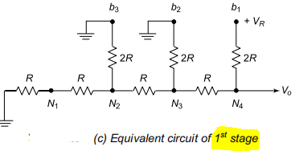
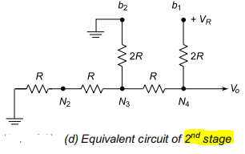
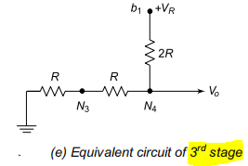

DIGITAL TO ANALOG CONVERTERS
R-2R ladder type
Here, the terminating resistor (2R) and the resistor connected to b4 input (2R) are combined at node N1 to form an equivalent resistor (R) as shown in the equivalent circuit of 1st stage in Fig.(c).
Then, at node N2, the resistor connected with b3 input (2R) can be combined with the resistor (R + R = 2R) to form the 2nd stage of equivalent circuit as shown in Fig.(d).
Similarly, at Node N3, the equivalent resistor is R as shown in the equivalent circuit of stage 3 in Fig.(e). Then, the analog output voltage Vo is given by

Slide 31

DIGITAL TO ANALOG CONVERTERS
R-2R ladder type
Thus, for digital input b1 b2 b3 b4 = 1000, i.e. when MSB = 1, the output is V_{R} /2.
Similarly, it can be found that for digital input b1 b2 b3 b4 = 0100, i.e. when second MSB = 1, the output is V_{R} /4;
for b1 b2 b3 b4 = 0010, the output is V_{R} /8 and
for b1 b2 b3 b4 = 0001, i.e., when LSB = 1, the output becomes V_{R} /16.
Since the resistive ladder is a linear network, the principle of superposition can be used to find the total analog output voltage for a particular digital input by adding the output voltages caused by the individual digital inputs. This can be represented for an n-bit D/A converter as follows:
---------------------[1]
where n is the total number of bits at the input.

Slide 32
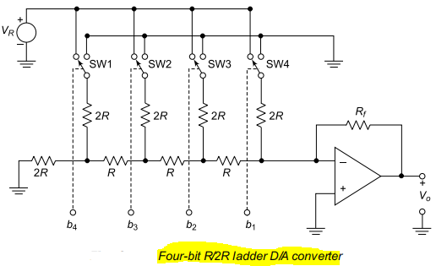



DIGITAL TO ANALOG CONVERTERS
R-2R ladder type
---------------------[2.1]
The resolution of the R/2R ladder type D/A converter with voltage output is given by
The resolution of the R/2R ladder type D/A converter with current output is given by
-------[4]
-------[3]
where Rf is the feedback resistance of the op-amp

Slide 33
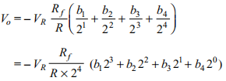
DIGITAL TO ANALOG CONVERTERS
R-2R ladder type
Figure --> shows a practical circuit arrangement of a 4-bit D/A converter using an op-amp. The inverting input terminal of the op-amp acts as summing junction for the ladder inputs. Using Eq.[1]
the output voltage Vo is expressed by
-----------[2]
Or, more generally for an n-bit input signal, assuming R_{f} = R
---------------------[2.1]
The resolution of the R/2R ladder type D/A converter with voltage output is given by
The resolution of the R/2R ladder type D/A converter with current output is given by
-------[4]
-------[3]
where Rf is the feedback resistance of the op-amp

Slide 34
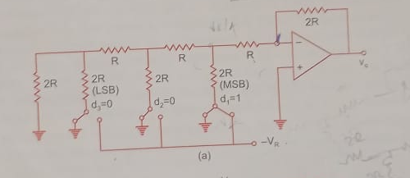

Slide 35
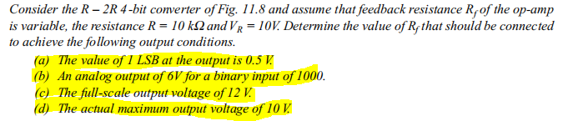
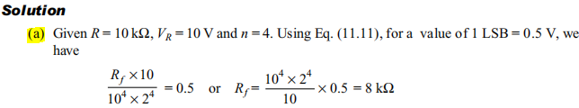


DIGITAL TO ANALOG CONVERTERS
Problems on R-2R ladder type
below
[4]
[2]

Slide 36



DIGITAL TO ANALOG CONVERTERS
R-2R ladder type

Slide 37
UNIT III - ANALOG TO DIGITAL AND
DIGITAL TO ANALOG CONVERTERS
Sample and hold circuit
Types of D/A converter
Weighted Resistor,
R-2R Current driven DAC,
A/D converter
Flash,
Single slope,
Dual slope,
Successive approximation

Slide 38
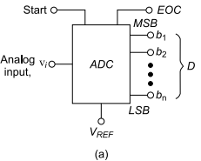
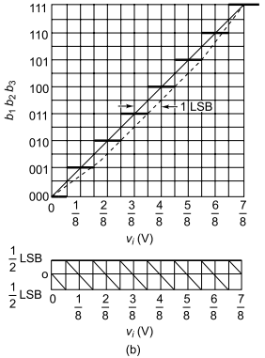

ANALOG TO DIGITAL CONVERTERS
An A/D converter does the inverse function of a D/A converter. It converts an analog signal into its equivalent n-bit binary coded digital output signal. The analog input is sampled at a frequency much higher than the maximum frequency component of the input signal. The digital output from an A/D converter can be in serial or parallel form.
The A/D converter accepts an analog input V_{i} and produces an output binary word b1, b2 ... bn of fractional value
D such that
where b₁ is the MSB and b_{n} is the LSB. The symbolic representation of an n-bit A/D converter is shown in Fig.(a). Two additional control pins START input and End of Conversion (EOC) output are provided with A/D converters. The START input initiates the conversion and the EOC announces when the conversion is complete. The output can be of parallel or serial form.

Slide 39
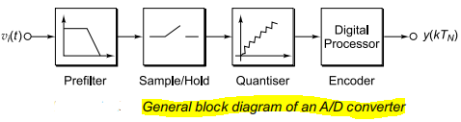
ANALOG TO DIGITAL CONVERTERS
The prefilter avoids the aliasing of high frequency signals.
The Sample-and-Hold circuit holds the input analog signal into the A/D converter at a constant value during the conversion time.
The quantiser segments the reference voltage signal into subranges. Typically, for an n-bit digital output code, there are 2n subranges.
The digital processor forms the encoder circuit which encodes the subrange into the corresponding digital bits. Therefore, the analog input signal is converted into an equivalent digital output code within the conversion time.
ADC TYPES
Flash,
Single slope,
Dual slope,
Successive approximation,

Slide 40
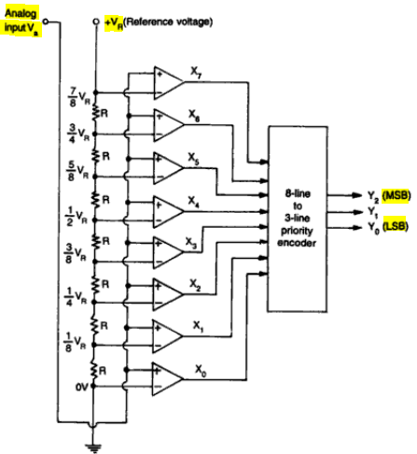
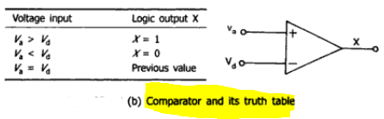
ANALOG TO DIGITAL CONVERTERS
Flash type
Also called as Parallel Comparator, Simultaneous type
Fastest Typical conversion time is 100 ns or less.)
Most expensive
This type A/D converter is based on comparing an unknown analog input voltage with a set of reference voltages. To convert an analog signal into a digital signal of n output bits (2^{n} – 1) number of comparators are required. For example, a 2-bit A/D converter requires 3 or (2² – 1) comparators, while a 3-bit converter needs 7 or (2³ – 1) comparators.
The construction is simple and easier to design.

Slide 41
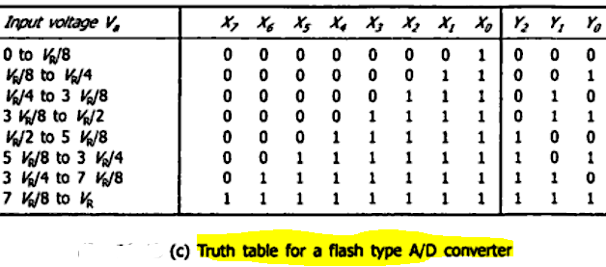
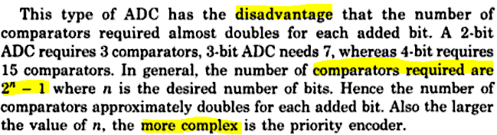
ANALOG TO DIGITAL CONVERTERS
Flash type
Construction:
The op-amps are used as comparators. The non-inverting inputs of all the comparators are connected to the analog input voltage. The inverting input terminal of the op-amps are connected to a set of reference voltages V/4, 2V/4 and 3V/4 , etc respectively, which are obtained using a resistive divider network and power supply +V.

Slide 42
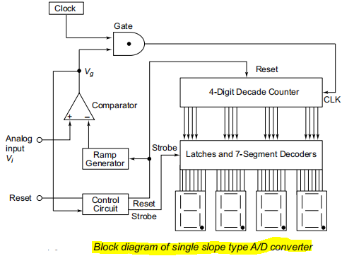
ANALOG TO DIGITAL CONVERTERS
Single Slope type (Counter type)
If short conversion time is not important, one can consider single or dual slope type A/D converter. These converter techniques are based on comparing the unknown analog input voltage with a reference voltage that begins at 0V and increases linearly with time. The time required for the reference voltage to reach the value of unknown analog input voltage is proportional to the amplitude of unknown analog input voltage. This time period can be measured using a digital counter.
Construction:
The main circuit of this converter is a ramp generator, which, on receiving a RESET from the control circuit increases linearly with time from 0V to a maximum voltage V_{m}. For example, if V_{m} = 10 V and it takes 1 ms to move from 0 V to 10 V, then the slope is 10 V/ms. Such a ramp generator can be either an op-amp based integrator circuit or a DAC driven by a sequence binary counter, whose output waveform is a staircase increasing linearly.

Slide 43
ANALOG TO DIGITAL CONVERTERS
Single Slope type
Working Principle:
Assume that a positive analog input voltage Vi is applied at the non-inverting input of the comparator. Now, when a RESET signal is applied to the control logic, the 4-digit decade counter resets to 0 and the ramp voltage begins to increase. Since V_{i} is positive, the comparator output is in HIGH state. This allows the CLK pulse to pass to the input of the 4-digit counter through the AND gate and the counter is incremented. This process continues until the analog input voltage is greater than the ramp generator voltage. When the ramp generator voltage is equal to the analog input voltage, the comparator output becomes negatively saturated or logic 0 and the clock is prevented from passing through the gate, ceasing the counter operation. Then, the control circuit generates a STROBE signal, which latches the counter value in the 4-digit latch, which is displayed on 7-segment displays. The displayed value is then equivalent to the amplitude of analog input voltage.
The single slope converter has a disadvantage due to the component value errors (R,C) and the clock errors. i.e The integrated output voltage is a function of the product of R and C, which is Temp dependent

Slide 44
ANALOG TO DIGITAL CONVERTERS
Single Slope type
Working Principle: Analysis
For example, if CLK value is 1 MHz and the slope of the ramp generator is 1V/ms, the 4-digit decade counter reaches its full-scale value, i.e. 9999 in 9999µs (i.e., 9.999ms). It means when the time is 9.999 ms, the ramp generator voltage reaches 9.999 V. So, this single slope type A/D converter can display any analog input value from 0 V to 9.999 V.
If Vi = 5.62 V, the counter requires 5620 clock pulses to advance from 0000 to 5620, the ramp voltage rising to 5.62 V. Therefore, at the end of conversion, the display will be 5620. Now, by activating the decimal point of most significant seven segment display, it will directly read as 5.620 V

Slide 45
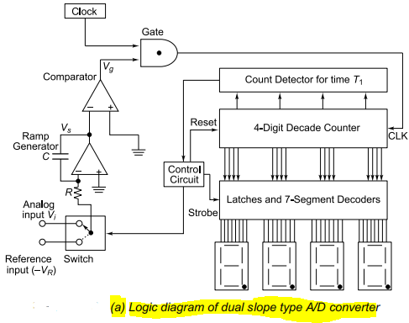
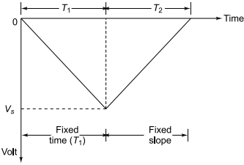
ANALOG TO DIGITAL CONVERTERS
ANALOG TO DIGITAL CONVERTERS
Dual Slope type
Dual Slope type
In dual slope type A/D converter, the integrator generates two different ramps, one with the unknown analog input voltage V_{i}
as the input, and another with a known reference voltage (–V_{R}) as the input.
Hence, it is called dual slope type A/D converter. Its logic diagram is shown in Fig.(a) and the dual ramp output waveform in Fig. (b).
(b) Dual ramp O/P Waveform

Slide 46

ANALOG TO DIGITAL CONVERTERS
Dual Slope type
Working Principle:
Assume that 1) the 4-digit decade counter is initially reset to 0000, 2) the ramp output Vs is reset to 0V, 3) analog input voltage is positive, and the input to the ramp generator or integrator is switched to the unknown analog input voltage. Since the positive analog input voltage is connected to the inverting input of the integrator, the integrator output Vs is a negative ramp while the comparator output Vg is positive, and the CLK is passed through the AND gate. This results in counting-up of the 4-digit decade counter.
The negative ramp will proceed for a fixed time period T1, which is determined by a count detector for the time period T1. At the end of fixed time period T1, the ramp voltage is given by
where RC is the time constant of the ramp generator circuit

Slide 47



ANALOG TO DIGITAL CONVERTERS
Dual Slope type
Inference
From the above equation, it is clear that the unknown analog input voltage is proportional to the time period T2, because V_{R} is a known reference voltage and T1 is the predetermined time period.
Also, the contents of the 4-digit decade counter at the end of conversion reflect the variable time period T2.
Working Principle: Analysis
For example, consider the frequency of CLK is 1 MHz, the reference voltage is –1.0 V, the fixed time period T1 is 1 ms and the RC time constant is set at RC = 1 ms. Assuming the unknown analog input voltage amplitude as Vi = 5 V, during the fixed time period T1 the integrator output Vs will go down to
Then, during the time period T2, Vs will integrate all the way back to 0 V
i.e,
Hence, the 4-digit counter value is 5000, and by activating the decimal point of MSD seven segment displays, the display can directly read as 5V.

Slide 48
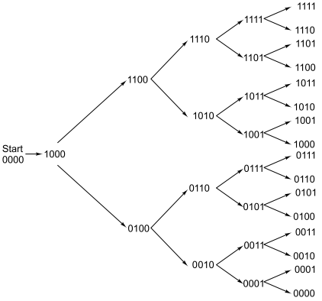
ANALOG TO DIGITAL CONVERTERS
Successive approximation type
The conversion time is maintained constant in successive approximation type A/D converter, and it is proportional to the number of bits in the digital output, unlike the counter and continuous type A/D converters.
The basic principle of this A/D converter is that the unknown analog input voltage is approximated against an n-bit digital value by trying one bit
at a time, beginning with the MSB.
This type of A/D converter operates by successively dividing the voltage range by half, as explained in the following steps.
(i) The MSB is initially set to 1 with the remaining three bits set as 0. The digital equivalent is compared with the unknown analog input voltage.
(ii) If the analog input voltage is higher than the digital equivalent, the MSB is retained as 1 and the second MSB is set to 1. Otherwise, the MSB is reset to 0 and the second MSB is set to 1.

Slide 49
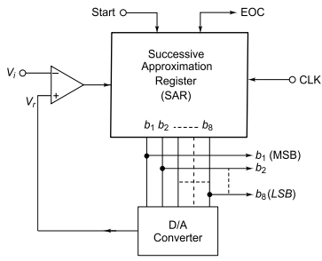
ANALOG TO DIGITAL CONVERTERS
Successive approximation type
(iii) Comparison is made as given in step 1 to decide whether to retain or reset the second MSB. The third MSB is set to 1 and the operation is repeated down to LSB and by this time, the converted digital value is available in the SAR.
From Fig. (prev slide), it can be seen that the conversion time is constant (i.e., four cycles for 4-bit A/D converter) for various digital outputs. This method uses a very efficient search strategy to complete an n-bit conversion in just n-clock periods. Therefore, for an 8-bit successive approximation type A/D converter, the conversion requires only 8 cycles, irrespective of the amplitude of analog input voltage.
Construction:
The circuit employs a successive approximation register (SAR) which finds the required value of each successive bit by trial and error method. The output of the SAR is fed to an n-bit D/A converter.
Functional diagram of
Successive Approximation type ADC

Slide 50
ANALOG TO DIGITAL CONVERTERS
Successive approximation type
The analog output equivalent of the D/A converter is applied to the non-inverting input of the comparator, while the other input of the comparator is connected with an unknown analog input voltage Vi under conversion. The comparator output is used to activate the successive approximation logic of SAR.
When the START command is applied, the SAR sets the MSB (b1) of the digital signal, while the other bits are made zero, so that the trial code becomes 1 followed by zeros. For example, for an 8-bit A/D converter the trial code is 10000000. The output of the SAR is converted into analog equivalent Vr and gets compared with the input signal Vi.
If Vi is greater than the D/A converter output, then the trial code 10000000 is less than the correct digital value. The MSB is retained as 1 and the next significant bit is made 1 and the testing is repeated.
If the analog input Vi is now less than the D/A converter output, then the value 11000000 is greater than the exact digital equivalent. Therefore, the comparator resets the second MSB to 0 and proceeds to the next most significant bit. This process is repeated for all the remaining lower bits in sequence until all the bit positions are tested. The EOC signal is sent out when all the bits are scanned and the value of D/A converter output just crosses Vi.

Slide 51
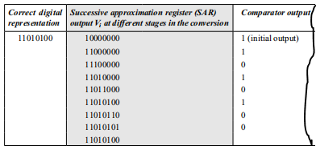
If the analog input voltage is higher than the digital equivalent , the MSB is retained as 1 and the second MSB is set to 1 .
Otherwise , the MSB is reset to 0 and the second MSB is set to 1.

Slide 52
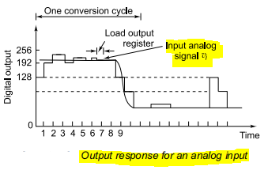
ANALOG TO DIGITAL CONVERTERS
Successive approximation type
Table shows the flow of conversion sequence and Fig. below shows the output response with the associated waveforms.
It can be observed that the D/A converter output voltage gets successively closer to the analog input voltage Vi.
For an 8-bit A/D converter, it requires 8 pulses to compute the output irrespective of the value of the analog input.

Slide 53
End of Unit-3

