Slide 1
Plant disease prediction using CNN
presented by: S.Balaji
III year,KVCET
NM ID-au421221243004
Email ID-balajisivakumar743@gmail.com

Slide 2
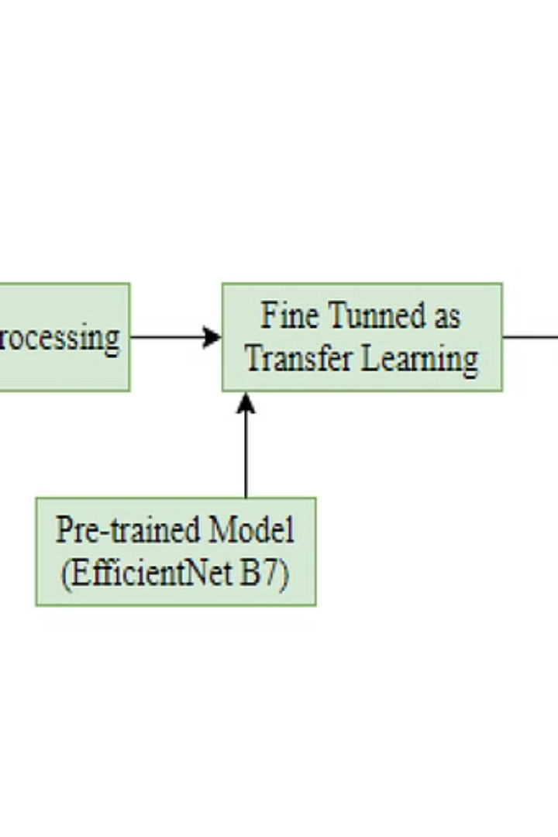
Proposed System
The proposed system aims to utilize Convolutional Neural Networks (CNN) for disease prediction in plants. By training the model with a diverse dataset of plant diseases, accurate predictions can be made to identify and address potential issues in crops.

Slide 3
Problem statement
Limited Diagnostic Accuracy
Time-Consuming Process
Traditional methods for plant disease diagnosis lack precision and reliability.
Manual inspection of plant diseases is labor-intensive and time-consuming.
Quality Crop Preservation
Farmer Empowerment
Ensuring high-quality crop yield and preventing economic losses due to diseases.
Providing accessible and accurate tools for farmers to effectively manage crop health.

Slide 4

Proposed solution
Implementation of CNN: Utilize Convolutional Neural Network for accurate disease prediction.
Data augmentation techniques: Using methods like rotation, flipping, and zooming to increase dataset diversity.
Integration with mobile app: Make the prediction model accessible through a user-friendly mobile application.

Slide 5

System approach
1
Research & Analysis
Conduct in-depth research on plant diseases and gather relevant data.
2
Model Development
Design and train a CNN model for plant disease prediction.
3
Integration & Testing
Integrate the model into the system and thoroughly test its accuracy.

Slide 6
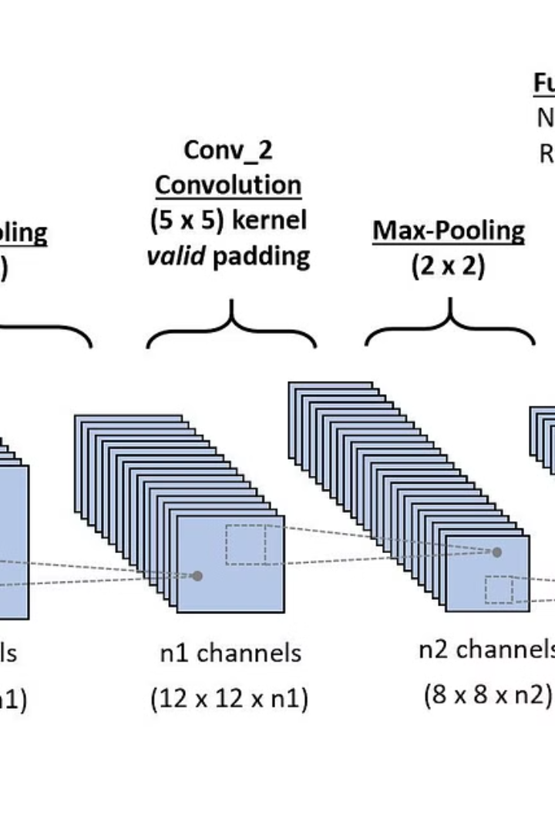
Algorithm and Deployment
In the proposed system, a Convolutional Neural Network (CNN) will be deployed to classify and identify plant diseases. The CNN will be trained on a labeled dataset of diseased and healthy plants.
Deployment will involve setting up the trained model on a server or cloud platform, ensuring efficient predictions and real-time disease identification for farmers and agronomists.

Slide 7
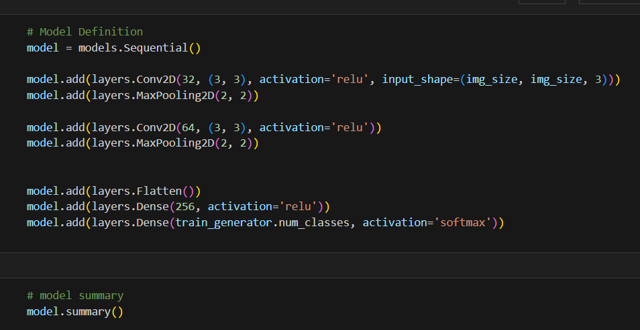
Training and Process
The training of the proposed model involves the utilization of Convolutional Neural Networks (CNN) to process the unique features of plant diseases. This process requires a diverse dataset covering a wide range of plant diseases to ensure accurate recognition and prediction.
The CNN model undergoes multiple training epochs to refine its understanding of the unique characteristics of various plant diseases, ensuring high prediction accuracy.

Slide 8



Prediction Process
Data Analysis
Precision Measurement
Machine Learning
Utilizing advanced algorithms to analyze input data for disease prediction.
Measuring the accuracy and precision of the disease prediction model.
Implementing cutting-edge machine learning techniques for accurate predictions.

Slide 9
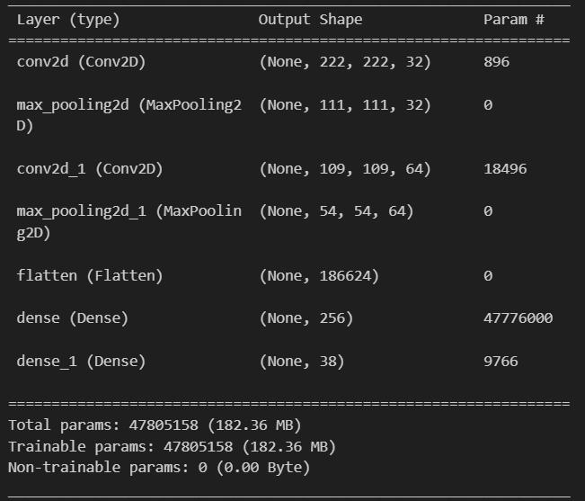
Output

Slide 10
Result & Conclusion
Accuracy of Predictions
Impact on Agriculture
The CNN model achieved a high accuracy rate in predicting plant diseases, leading to more efficient crop management.
Implementation of the system resulted in early detection and prevention of diseases, leading to increased crop yield.
User Feedback
Future Development
Positive feedback from farmers and agricultural experts on the effectiveness and ease of use of the prediction system.
Potential improvements and expansions to the system for broader application and integration with other agricultural technologies.

Slide 11
Future Scope
Advanced Disease Detection Models
1
Implement state-of-the-art CNN architectures for improved accuracy
Real-time Diagnosis Application
2
Develop an interactive mobile app for instant disease identification
Global Disease Mapping
3
Utilize data to create global visualizations of plant diseases distribution
Collaborative Research Initiatives
4
Form partnerships with agricultural experts to advance disease control

Slide 12

Reference
This section provides a list of references used in the development and implementation of the plant disease prediction system. The references include academic papers, articles, and credible online resources related to convolutional neural networks (CNN) in agriculture and plant disease detection.

