Slide 1
Plant disease prediction using CNN
presented by: S.Balaji
III year,KVCET
NM ID-au421221243004
Email ID-balajisivakumar743@gmail.com

Slide 2
INTRODUCTION
Agriculture plays vital role in Indian economy. Agriculture contributes nearly 17-18% country GDP. Due to various factors, sometime yield of the agriculture is not as good as expected. The agriculture yield is affected by nature as well as disease.
The challenges in agricultural field are seed selection, irrigation techniques, soil defects, weather condition and water treatment. The virus, fungi and bacteria causes the plant disease.
It is another challenge in the agriculture field. If the plant diseases are not correctly and timely identified,

Slide 3
ORIGINALITY
The propsed methodology is predict the plant disase from the plant leaf using convolutional neural network
It extracts the features and predict the disease from the plant leaf. It is able to predict 38 different diseases from plant leaf.

Slide 4
Importance of early disease detection in plants
Preserving Crop Yield
2
Reducing Environmental Impact
Early detection helps prevent widespread crop damage due to disease, ensuring maximum yield.
Timely identification minimizes the need for excessive pesticide use, benefiting the environment.
3
Economic Impact
4
Food Security
Early intervention preserves the economic stability of farmers and the agricultural industry.
Early disease detection contributes to maintaining a steady food supply for communities.

Slide 5
Data Collection and Preprocessing for Training CNN
Data Collection
Collecting labeled images of diseased and healthy plants from various sources.
2
Data Preprocessing
Resizing, normalizing, and augmenting the images to create a balanced training dataset.
3
Data Splitting
Splitting the dataset into training, validation, and testing sets for model evaluation.

Slide 6
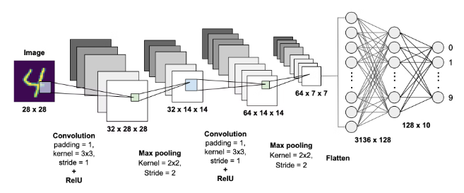
Training process of the CNN model
The training process of a Convolutional Neural Network (CNN) involves feeding the network with labeled images. Each image is passed through various layers of the network to learn features and patterns relevant to plant diseases.
During training, the network adjusts its parameters to minimize prediction errors, improving its ability to identify diseases accurately.
The training process also includes validation to ensure the model's generalization and testing to evaluate its performance on unseen data.

Slide 7




Testing and validation of the CNN model
Data Splitting
Model Evaluation
Testing the Model
The dataset is split into training, validation, and testing sets.
The trained model is evaluated on the validation data to assess its performance.
The final step involves testing the model on new, unseen plant disease images.

Slide 8
Challenges in Plant Disease Prediction Using CNN
Data Collection
Model Interpretability
Overfitting
Computational Resources
Obtaining diverse and high-quality datasets is crucial for training CNN models.
Avoiding overfitting while training the model to accurately detect diseases.
Understanding how CNN models make predictions is a complex challenge.
Requirement of significant computational power for training CNN models.

Slide 9



Future prospects and advancements in this field
AI Integration
Utilizing AI for precise disease identification
Automated Monitoring
Continuous surveillance for early detection
Big Data Analytics
Analyzing extensive datasets for patterns
The future of plant disease prediction using CNN holds exciting advancements, including AI integration for precise disease identification, automated monitoring systems for continuous surveillance, and big data analytics to analyze extensive datasets for patterns. These developments promise to revolutionize agricultural practices and ensure early disease detection.

Slide 10
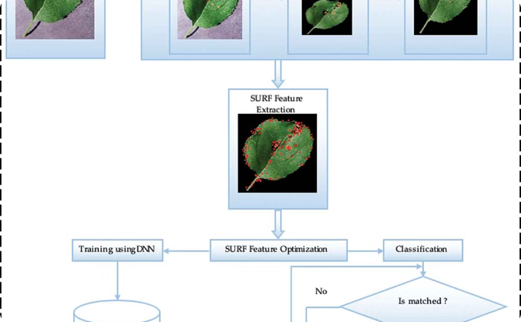
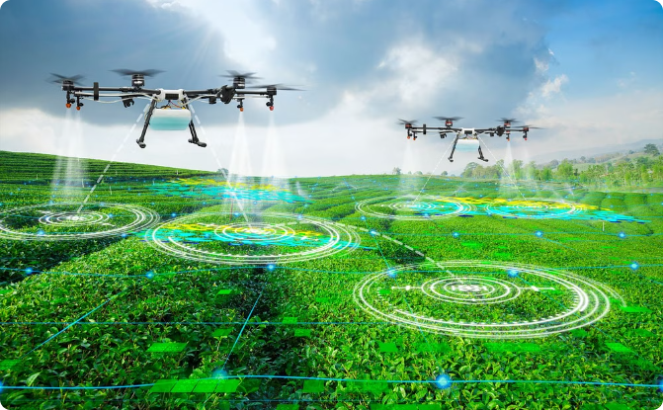
Case studies and real-world applications
Case Studies
Smart Agriculture
Explore real-world examples of successful plant disease prediction using CNN models.
Learn how CNN-based disease prediction contributes to the advancement of smart agricultural practices.

Slide 11

Conclusion and key takeaways
Utilizing CNN for plant disease prediction is a promising approach in ensuring early detection and prevention. The use of image recognition technology can significantly improve agricultural outcomes and contribute to global food security. Continuous research and advancements in machine learning will further enhance the accuracy and efficiency of disease prediction in plants.

Slide 12
REFERENCES
Gokulnath, B. V., & Usha Devi, G. A survey on plant disease prediction using machine learning and deep learning techniques. Inteligencia Artificial, 22(63), 0-19, 2017
Ashok, S., Kishore, G., Rajesh, V., Suchitra, S., Sophia, S. G., & Pavithra, B.
Tomato Leaf Disease Detection Using Deep Learning Techniques. In 2020 5th International Conference on Communication and Electronics Systems (ICCES) (pp. 979-983). IEEE, 2020.
Ferentinos, K. P. Deep learning models for plant disease detection and diagnosis. Computers and Electronics in Agriculture, 145, 311-318, 2018

