Slide 1



Team Details
TEAM NAME : CLICHÉ COOKIES
Balaji P
College: SRM IST KTR
Stream: CSE with AIML
Year of graduation: 2025
Dhruv Choudhary
College: SRM IST KTR
Stream: CSE with AIML
Year of graduation: 2025
Yashwardhan Khanna
College: SRM IST KTR
Stream: CSE with AIML
Year of graduation: 2025

Slide 2

Problem Statement: Reinventing Parking Management with a Smart Parking System
Issue: Parking congestion within organizations leads to employee frustration and time wastage due to inefficient parking space utilization.
Objective: Develop and implement a Smart Parking System using technology to transform parking experiences and mitigate congestion issues.
Key Focus Areas:
Prebooking Convenience: Create a user-friendly mobile application enabling students and faculty to reserve parking slots in advance, ensuring availability and convenience.
Live-Time Monitoring: Implement a network of cameras at parking facility entrances and exits to monitor occupancy status in real-time, providing accurate data to users.
QR Code Integration: Integrate QR code scanning technology at the entrance for streamlined user identification and seamless parking slot booking.
Real-Time Notifications: Enable automated messaging to notify users about their assigned parking slots, locations, and any changes in availability or status.
Comprehensive App: Develop a feature-rich mobile application that displays parking locations, availability, and relevant information to enhance the overall parking experience.
Impact: By leveraging technology-driven solutions, the proposed Smart Parking System aims to optimize parking resource utilization, elevate convenience for users, and improve overall campus mobility.
Innovation: This project seeks to revolutionize parking management through innovative technologies, offering a comprehensive solution to the persistent challenge of parking congestion within organizations.

Slide 3
Proposed Solution: Smart Parking System Revolutionizing Mobility
In response to the prevalent issue of parking congestion within organizations, we present our visionary solution – the Smart Parking System. This groundbreaking innovation harnesses cutting-edge technology to alleviate parking challenges and enhance campus mobility.
Key Features:
Prebooking Convenience: Our user-friendly mobile application empowers students and faculty to effortlessly reserve parking slots in advance, ensuring seamless availability and convenience.
Live-Time Monitoring: By deploying a network of real-time cameras at parking entrances and exits, we enable accurate monitoring of occupancy status. Users gain instant access to up-to-the-minute parking information.
QR Code Integration: Streamlining the parking process, our QR code scanning technology at entry points facilitates hassle-free user identification and instant parking slot booking.
Real-Time Notifications: Automated messaging keeps users informed about assigned parking slots, locations, and any changes in availability, enabling stress-free parking experiences.
Comprehensive App: Our feature-rich mobile application provides an intuitive interface displaying parking locations, real-time availability, and pertinent details, significantly enriching the overall parking journey.
Impact:
By leveraging the potential of technology-driven solutions, our Smart Parking System aims to optimize parking resource utilization, elevate convenience for all users, and catalyze improved campus mobility.
Innovation at the Core:
Our project represents a pioneering leap in parking management, addressing the persistent challenge of parking congestion through innovation. By integrating these technologies, we offer a holistic solution that redefines how organizations manage parking resources efficiently and seamlessly.

Slide 4
Driving Change with Innovative Technology: The Smart Parking System Advantage
Our innovation, the Smart Parking System, harnesses technology to ignite transformative change within parking management. This pioneering approach accelerates change in several impactful ways:
Efficiency Amplified: By leveraging real-time monitoring and data analytics, our system optimizes parking space utilization. This reduces congestion, curtails wasted time, and enhances overall operational efficiency.
User-Centric Revolution: Through a user-friendly mobile application and seamless QR code integration, we revolutionize the parking experience. This streamlined process enhances convenience, minimizes frustration, and saves valuable time for all stakeholders.
Informed Decision-Making: Our technology empowers administrators with real-time occupancy insights, aiding informed decisions about resource allocation, expansions, and improvements. This data-driven approach enhances planning accuracy.
Sustainability Focused: With reduced circling and idling, our solution promotes sustainability. By curbing emissions and conserving fuel, we contribute to a greener environment and align with eco-friendly practices.
Holistic Mobility Hub: Beyond parking, our comprehensive app becomes a hub for various mobility services. Shuttle schedules, traffic updates, and ride-sharing options foster enhanced campus mobility.

Slide 5
Innovative Distinction: Unveiling the Uniqueness of the Smart Parking System
In a landscape saturated with parking solutions, the Smart Parking System sets a new benchmark with its exceptional attributes, effectively distinguishing us from the competition:
Advanced Real-Time Monitoring: Our system stands out with its network of state-of-the-art cameras that provide immediate occupancy updates. Unlike conventional solutions, which may offer delayed data, our real-time monitoring ensures unparalleled accuracy and reliability.
Seamless Integration with QR Codes: The incorporation of QR code technology at entry points sets us apart by simplifying user identification and slot reservation. The seamless integration we offer surpasses the complexities associated with conventional methods.
Comprehensive Mobility Hub: Our app transcends traditional parking solutions by serving as a versatile mobility hub. It enriches user experiences with a range of services, a unique feature absent in other singular-purpose solutions.
Holistic Sustainability: Our solution not only manages parking but also emphasizes sustainability. By mitigating emissions and supporting eco-friendly practices, we go beyond standard solutions that solely focus on parking management.
AI-Powered Predictive Analysis: Our innovation stands apart by employing AI to predict parking demand. Our system's algorithm harnesses past data to create forecasts based on factors like time, weather, traffic, and user behavior.
Advantages for Parking Managers: This AI-powered feature equips parking managers with predictions of future demand, considering intricate variables. From time slots to weather conditions, our solution empowers better decision-making.

Slide 6
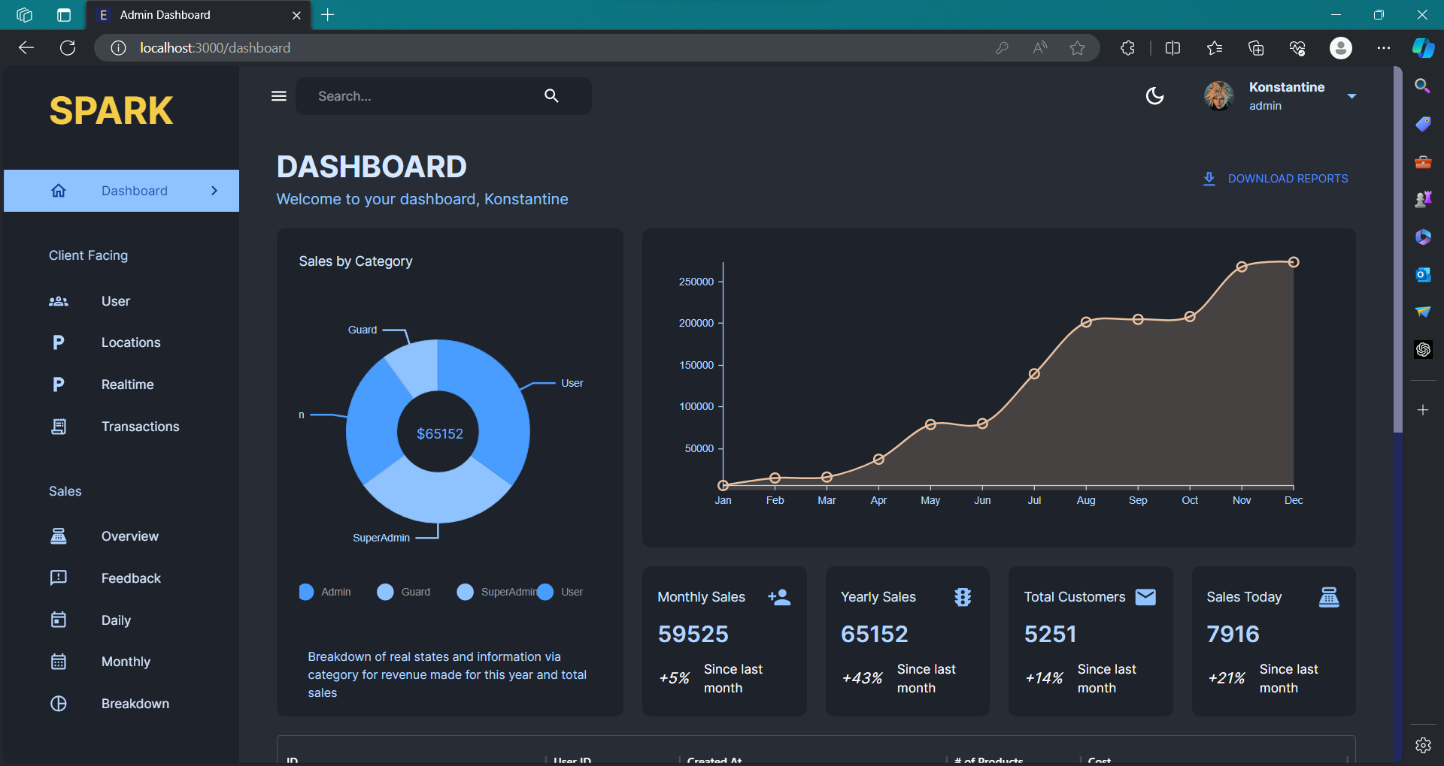
Working Prototype
PATENT FILED: NO
GitHub - Balajithegr8/Smart-parking-system (github.com)

Slide 7
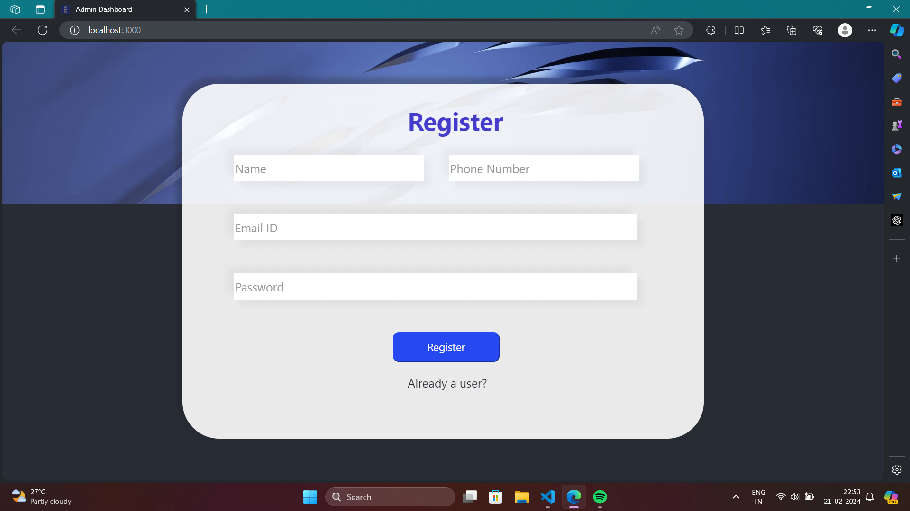

Slide 8
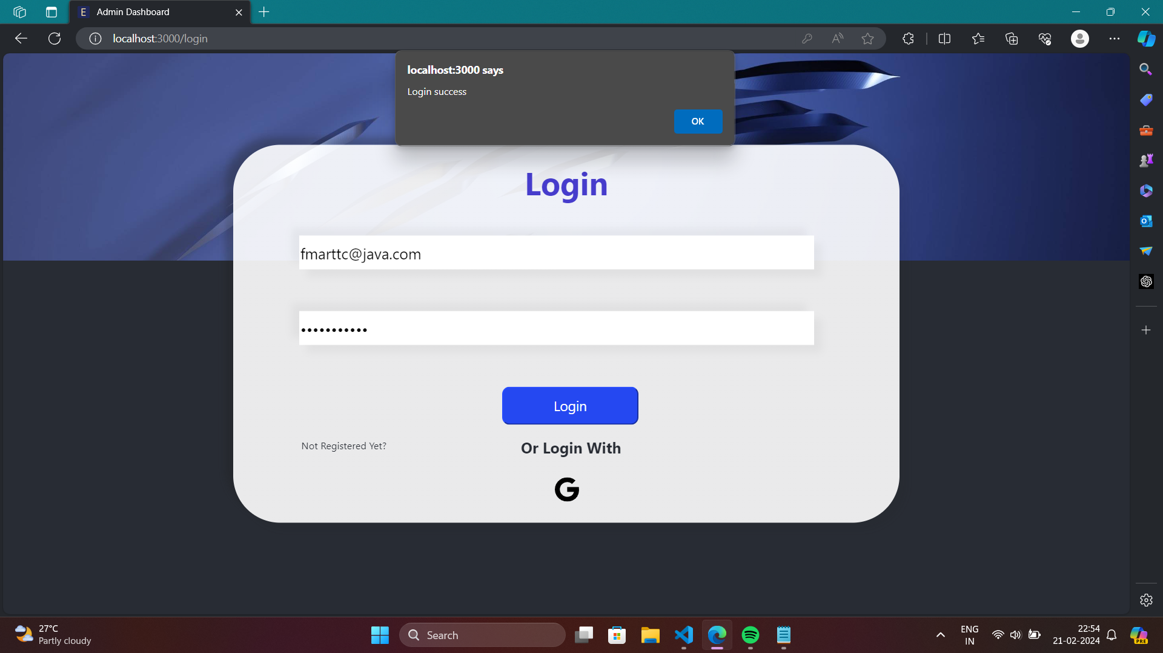

Slide 9
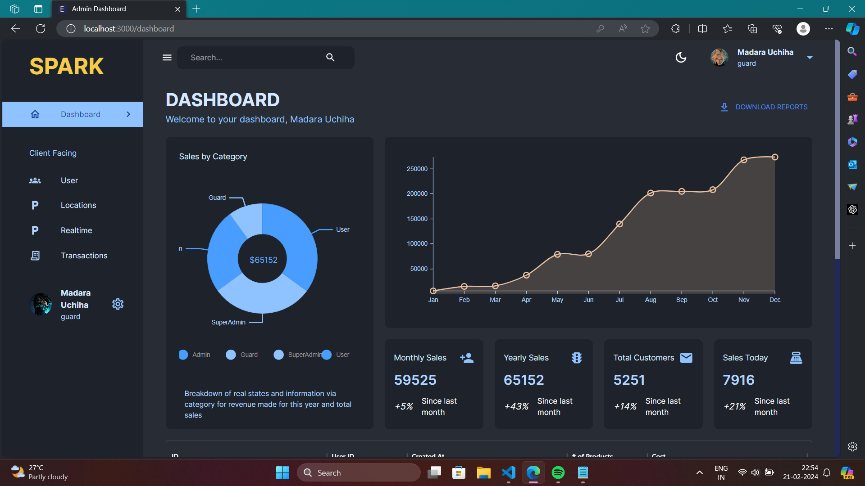

Slide 10
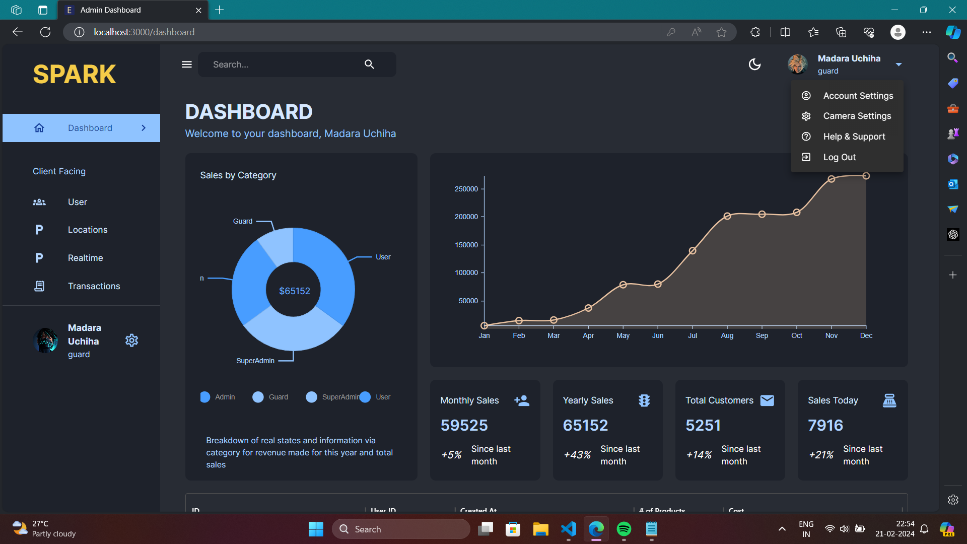

Slide 11


Slide 12
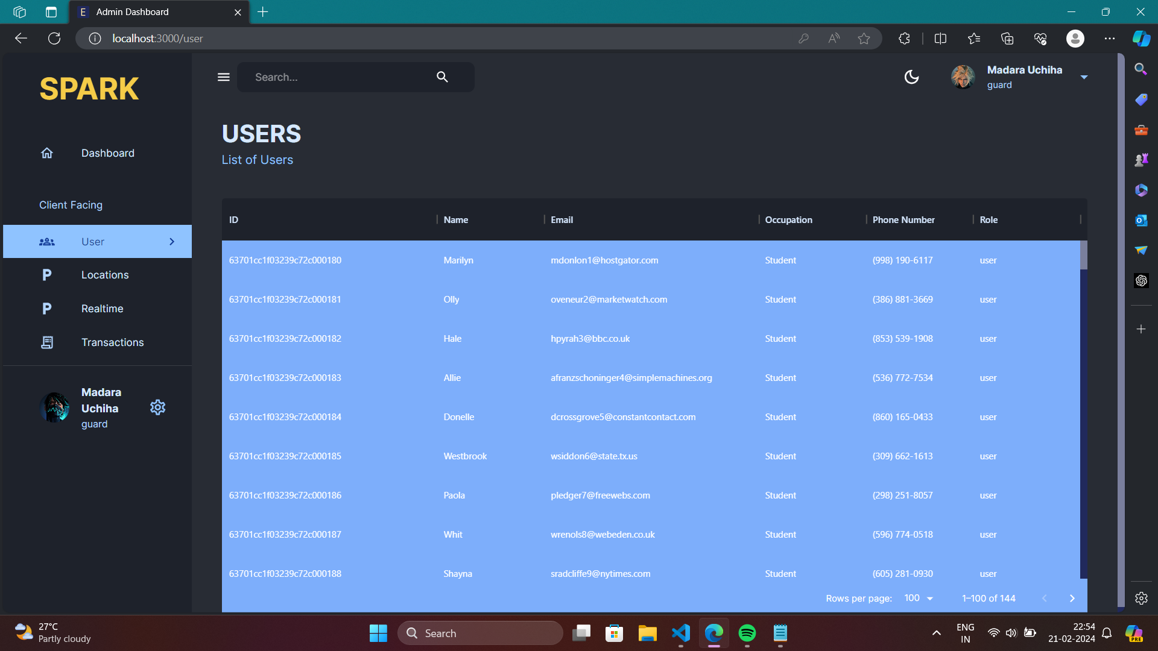

Slide 13
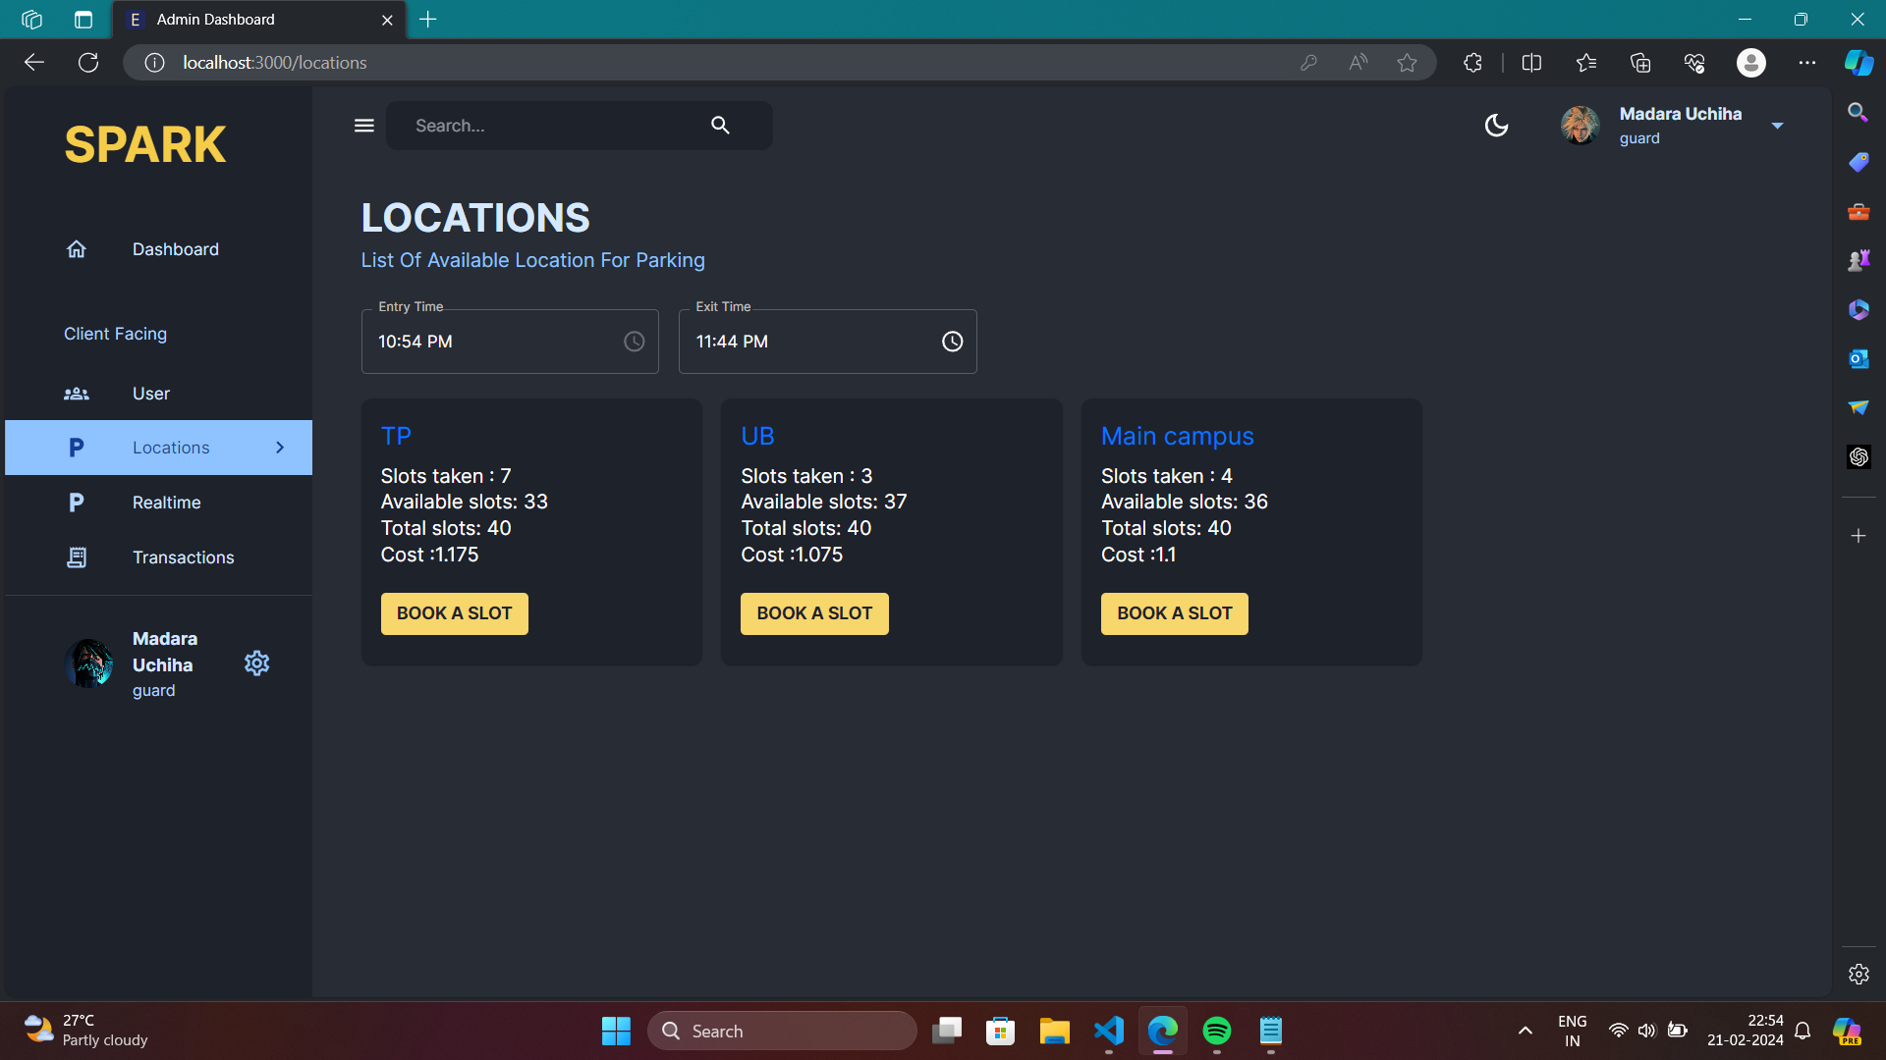

Slide 14
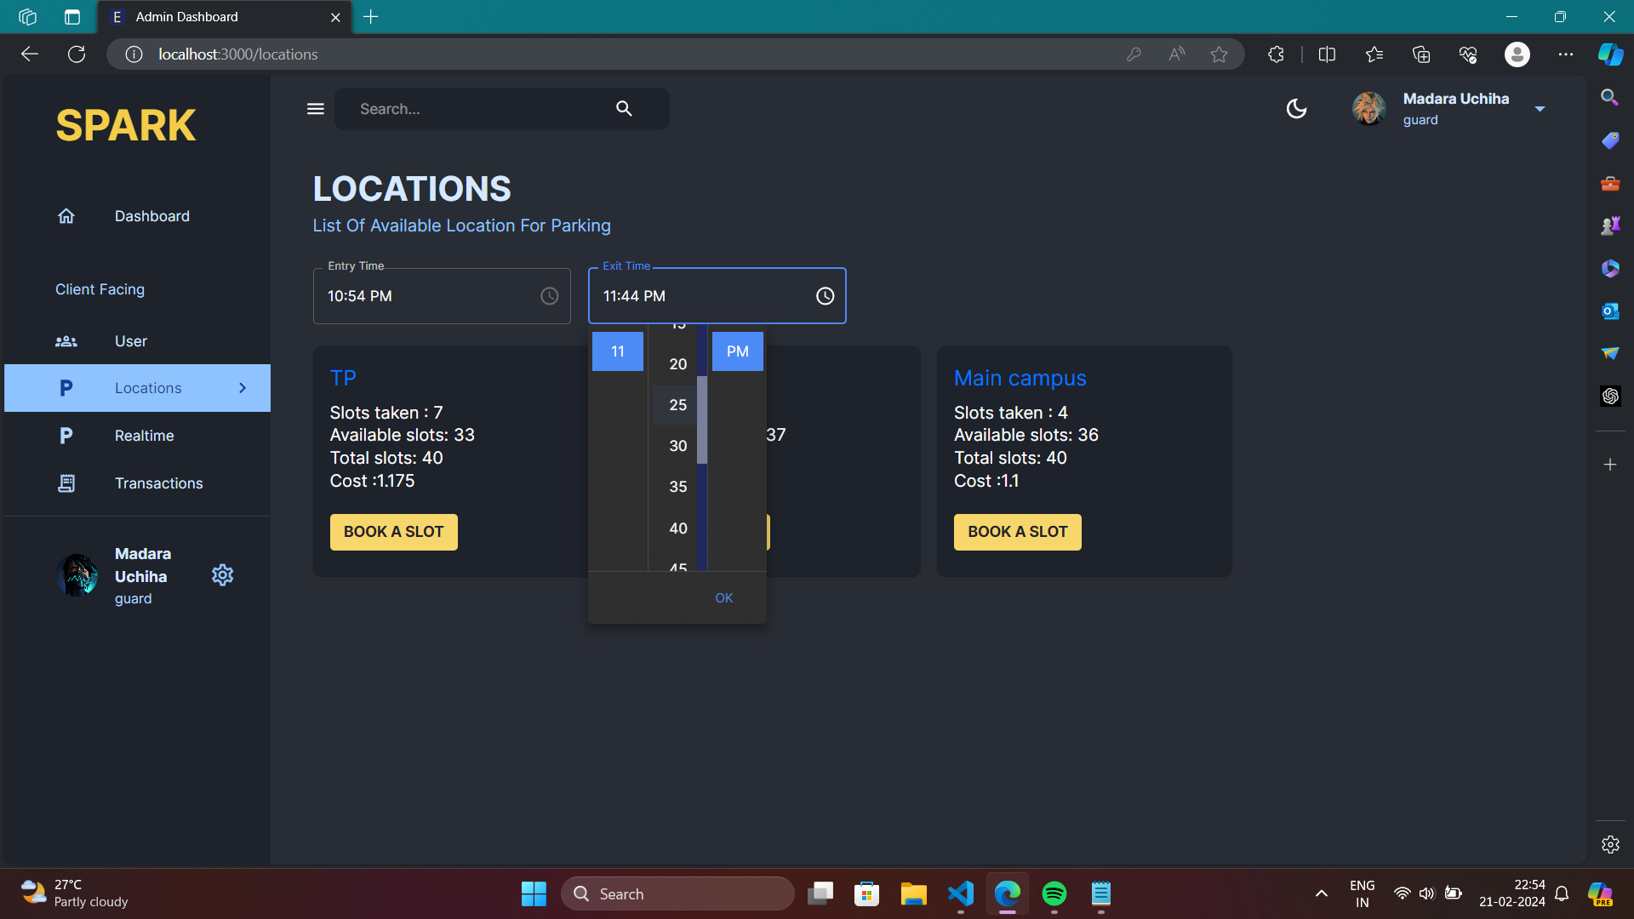

Slide 15
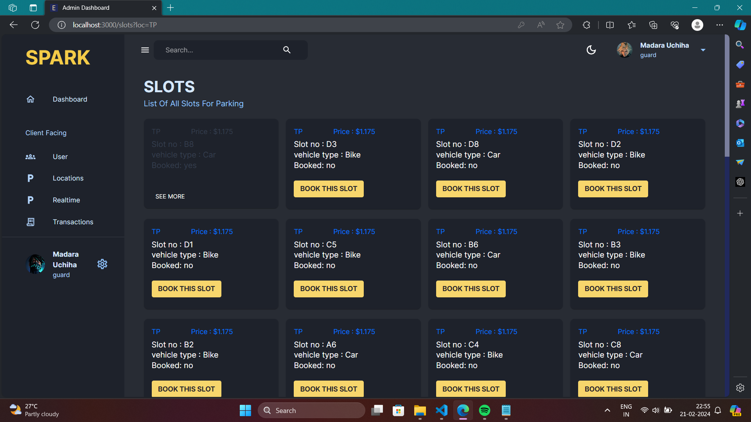

Slide 16
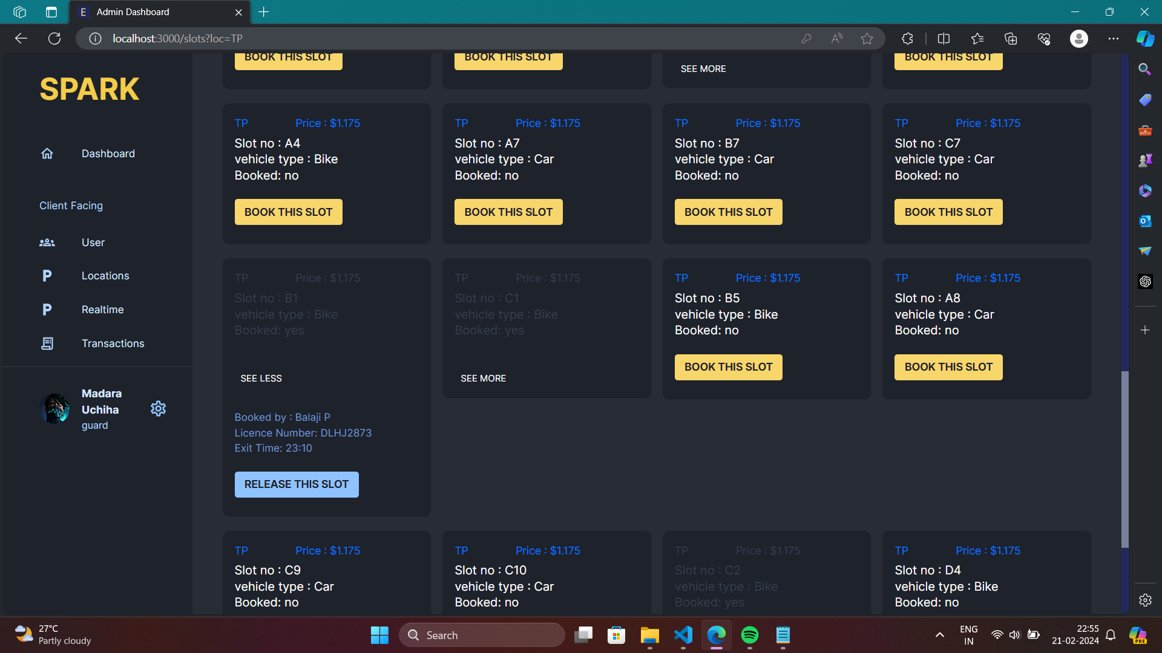

Slide 17
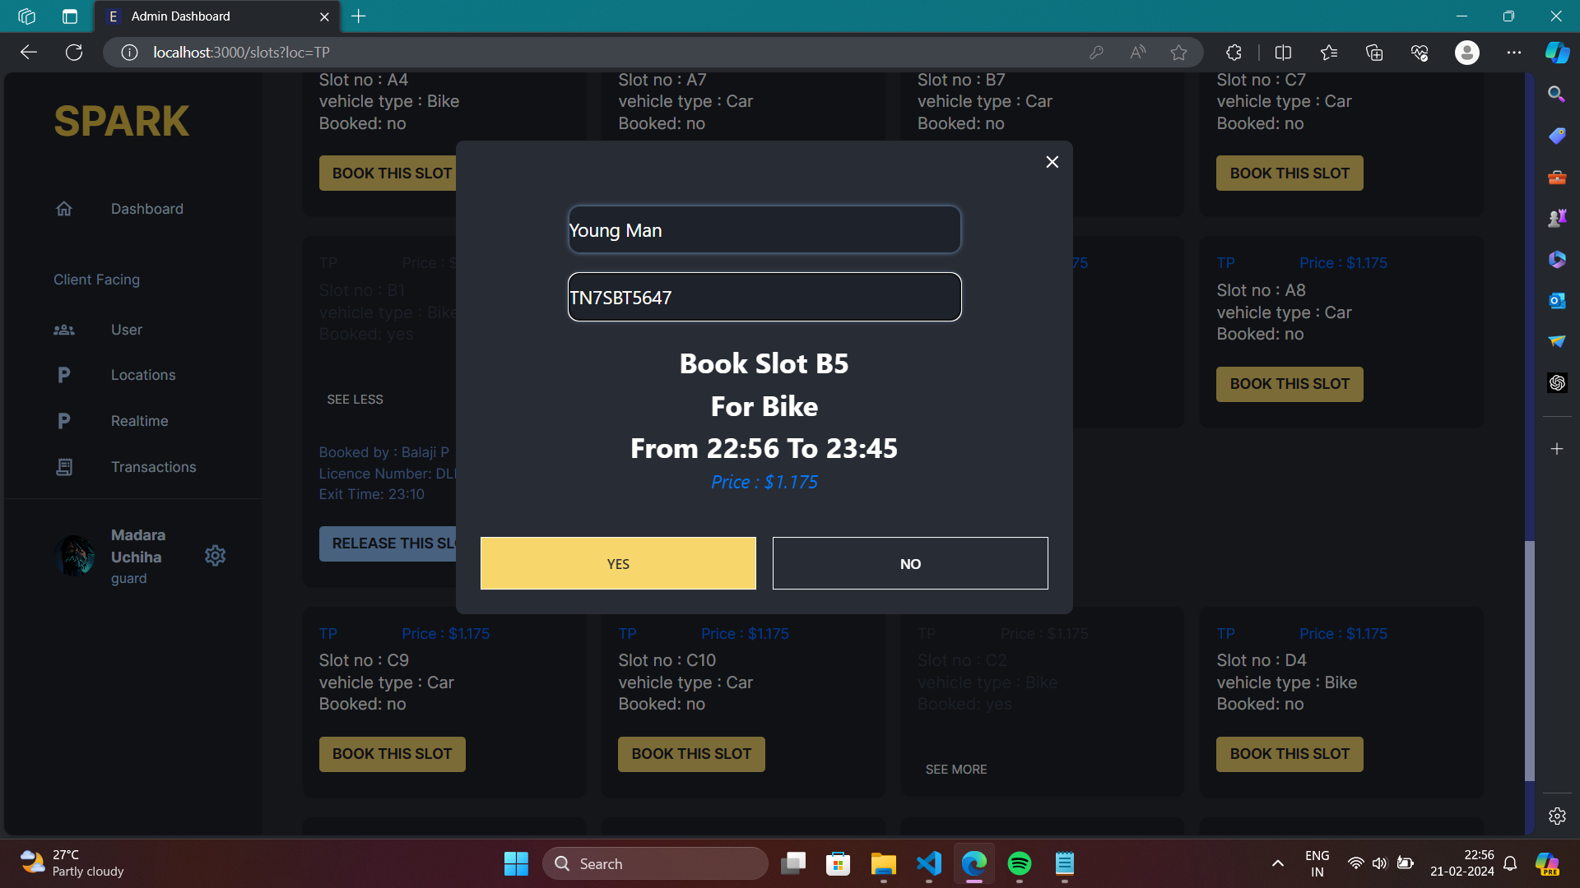

Slide 18
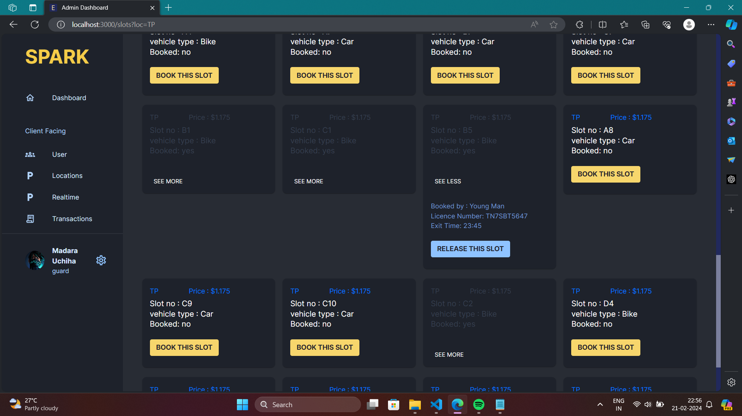

Slide 19
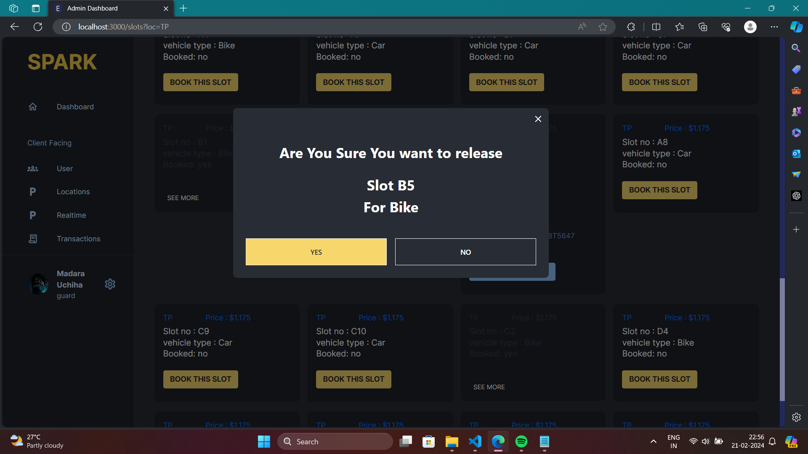

Slide 20
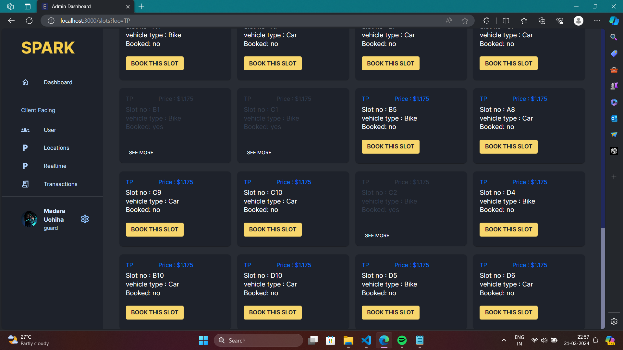

Slide 21
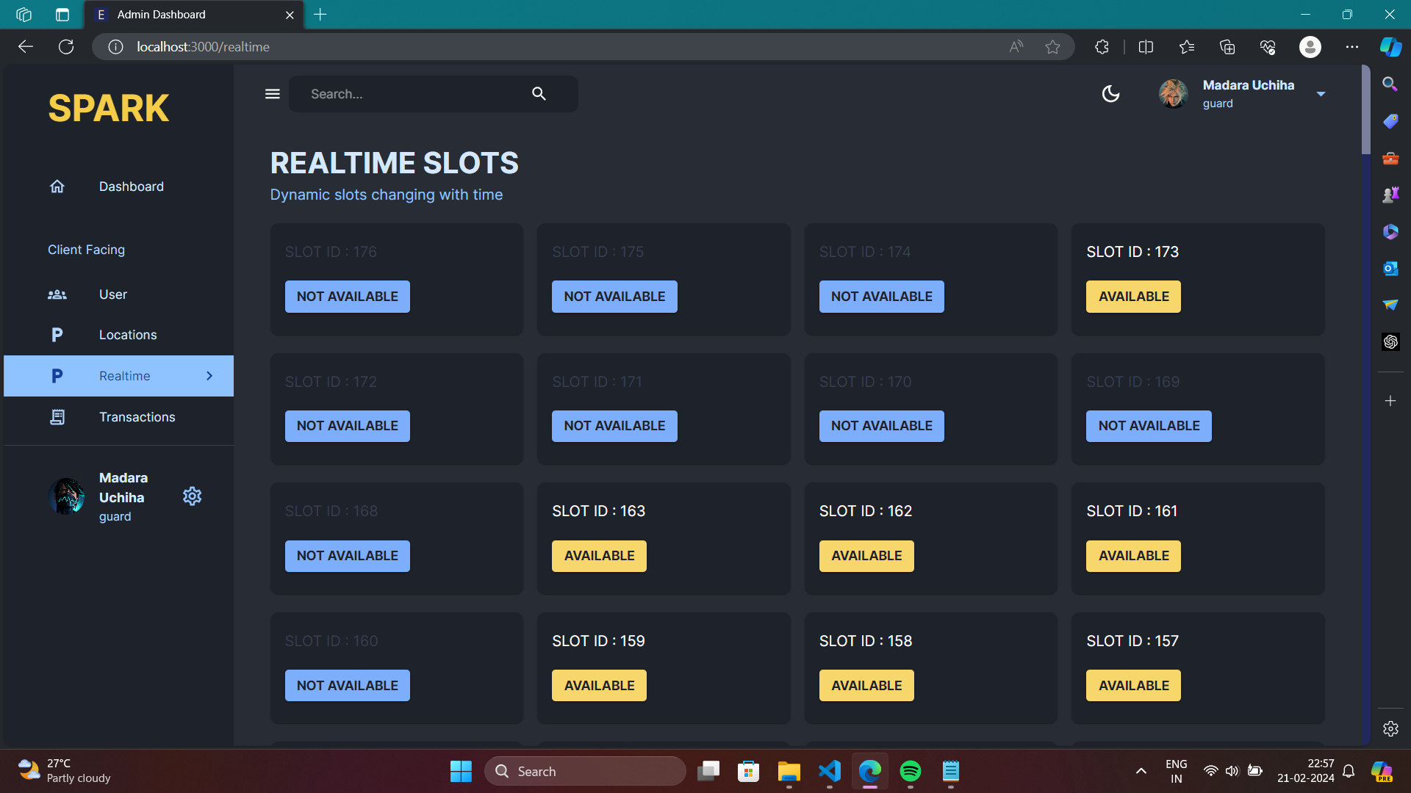

Slide 22
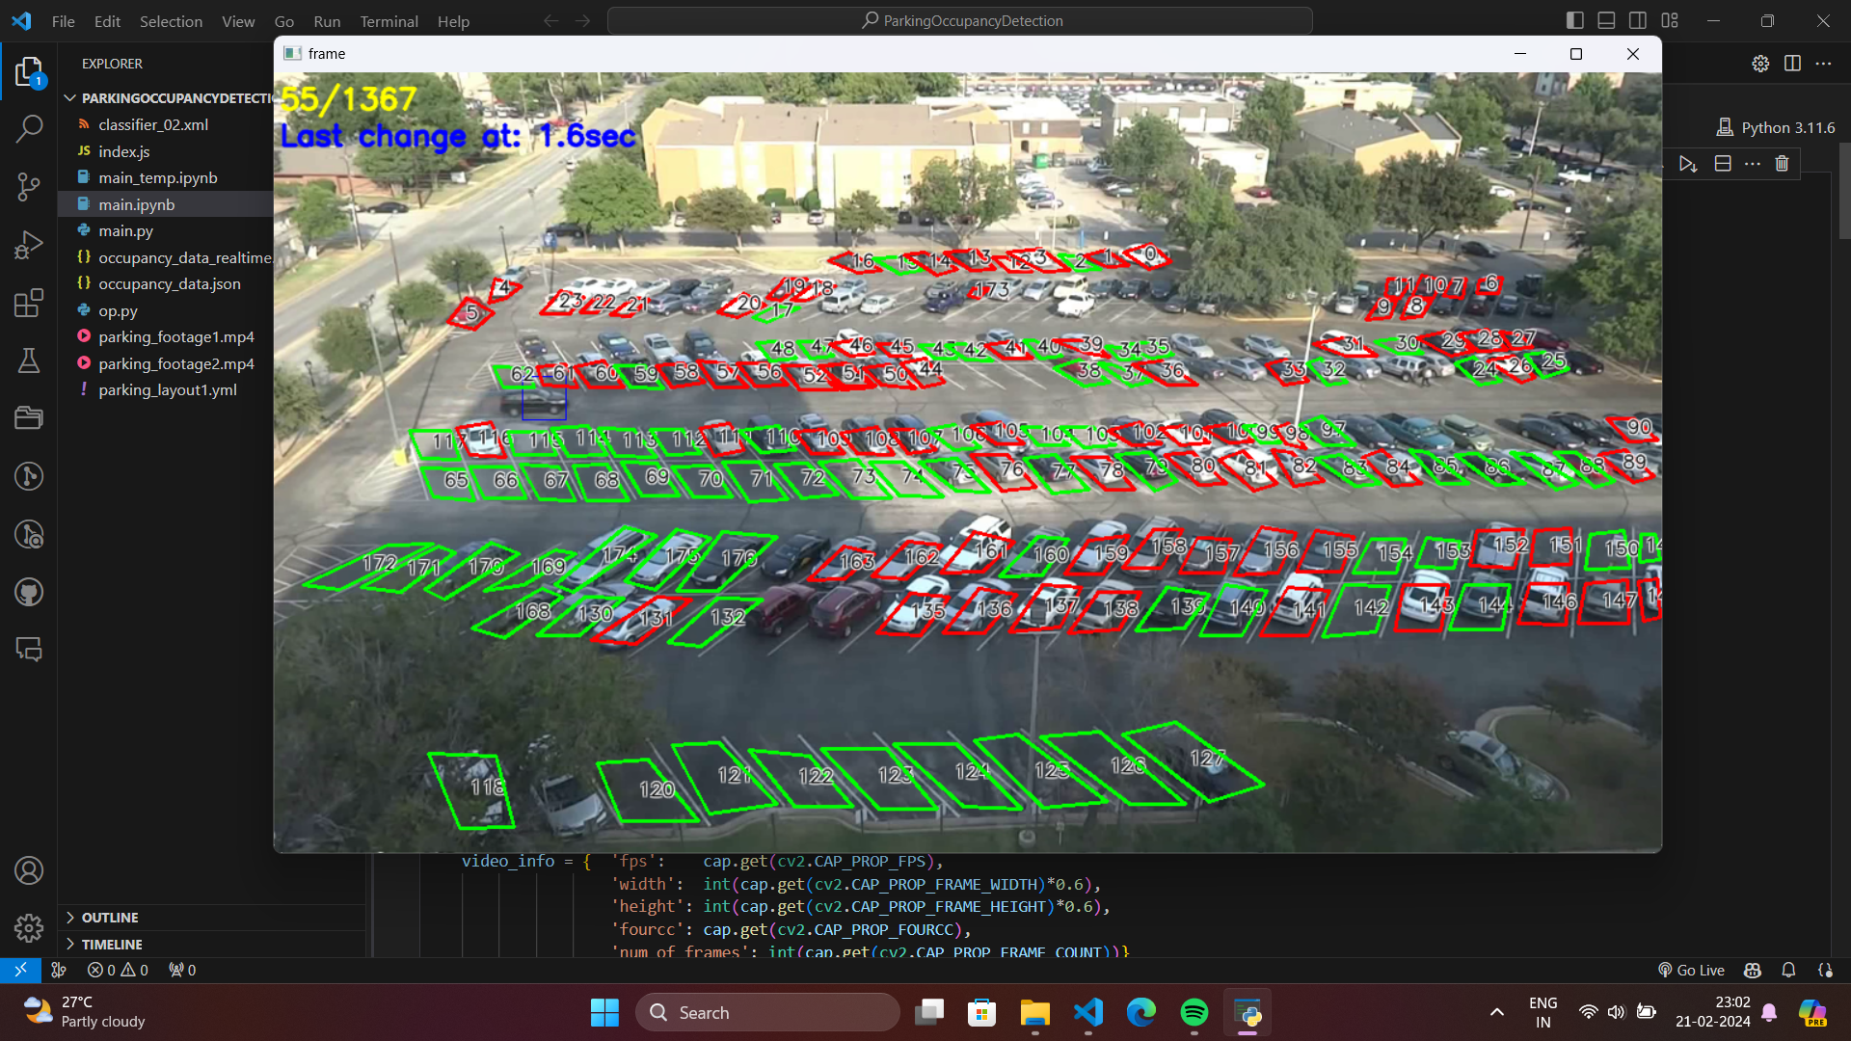

Slide 23
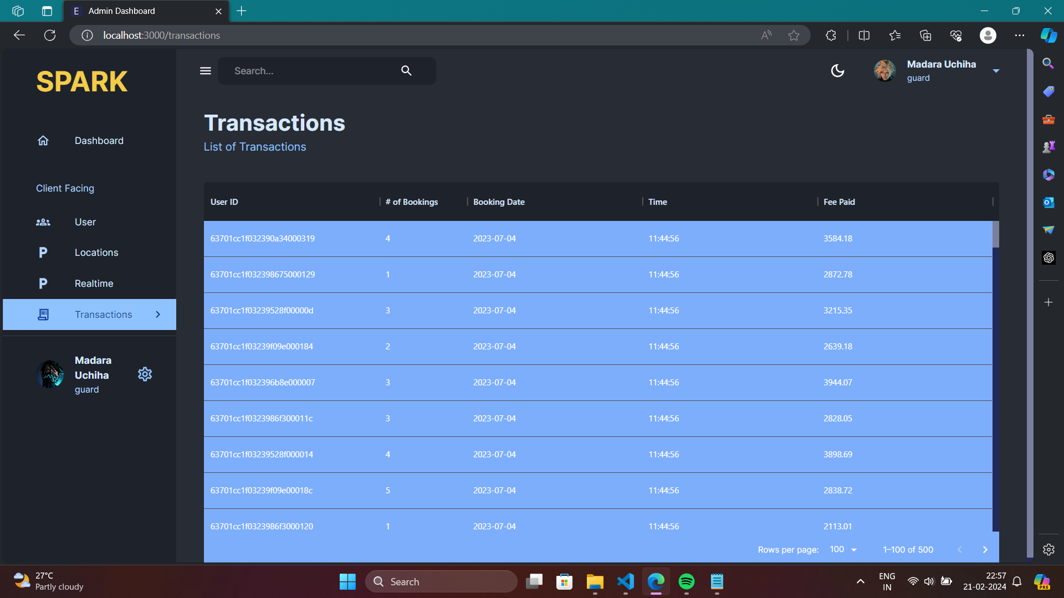

Slide 24
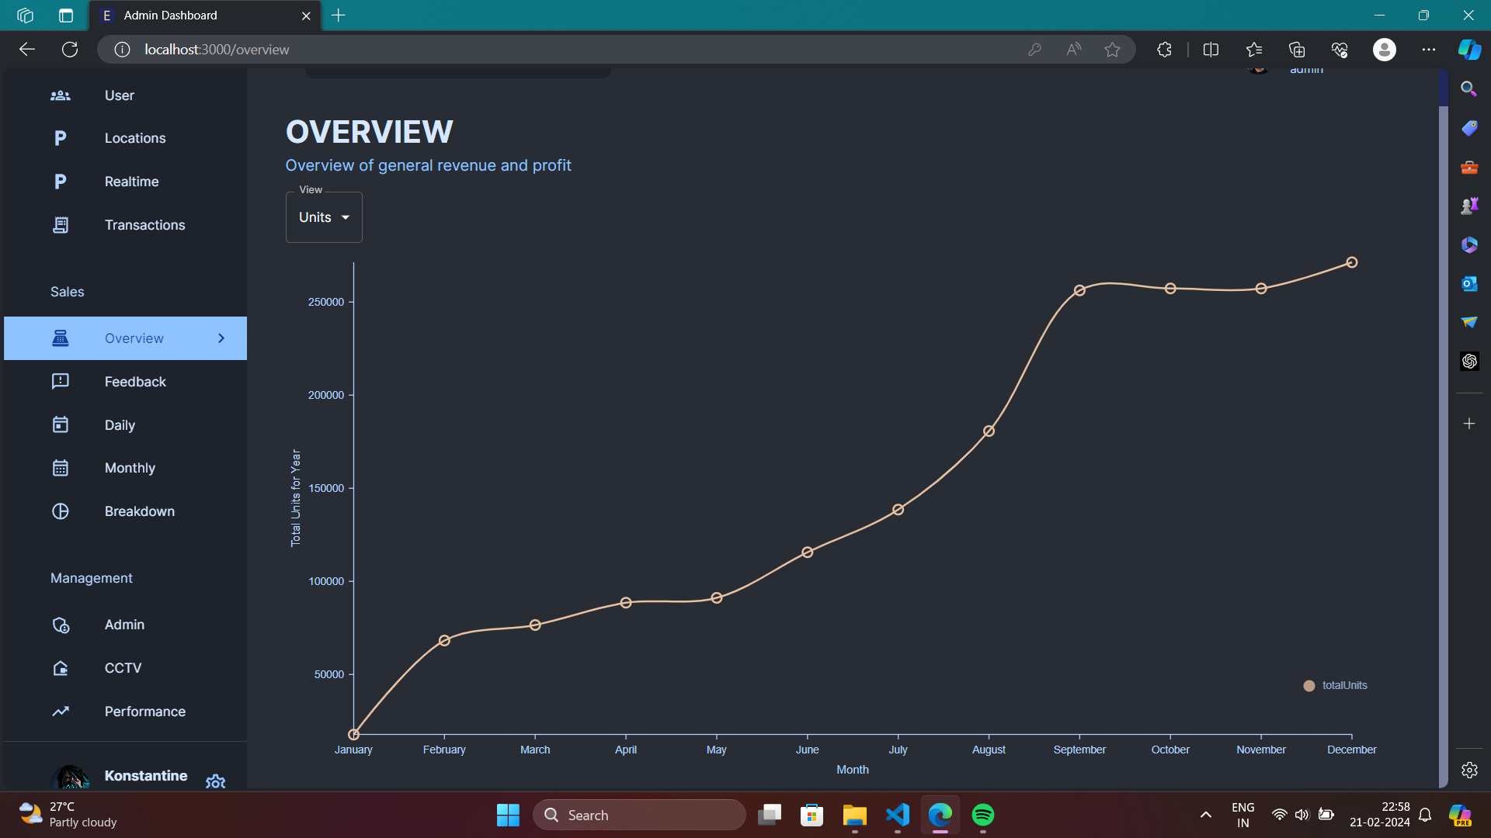

Slide 25
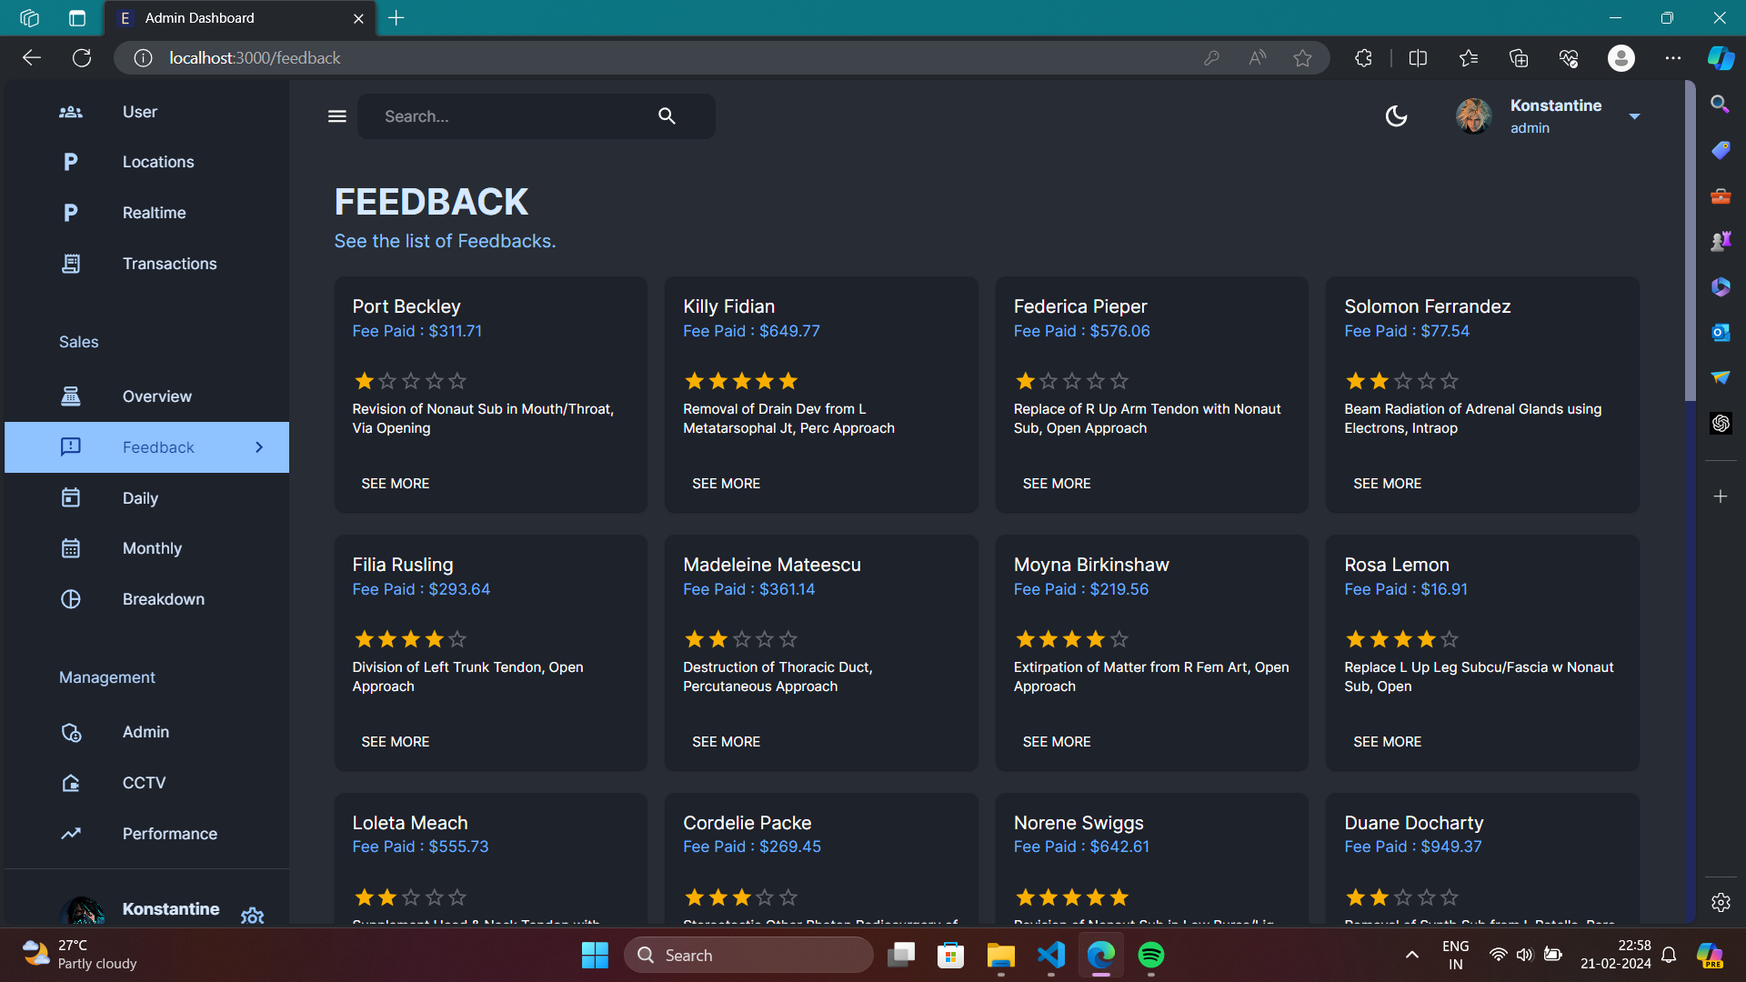

Slide 26
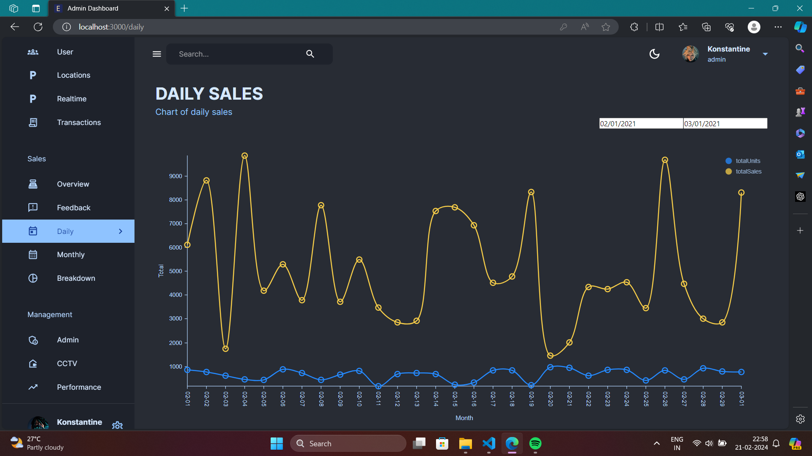

Slide 27
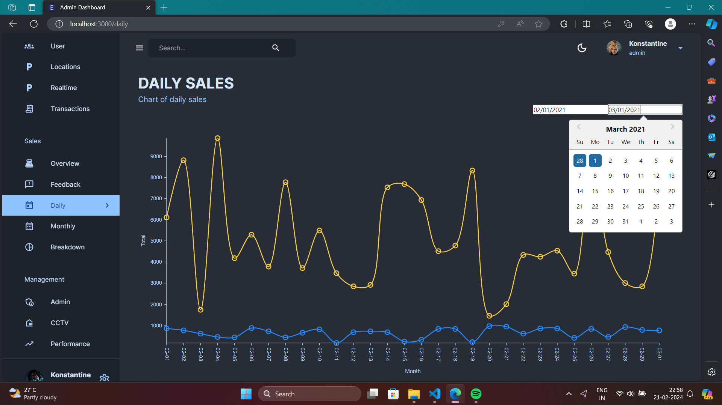

Slide 28
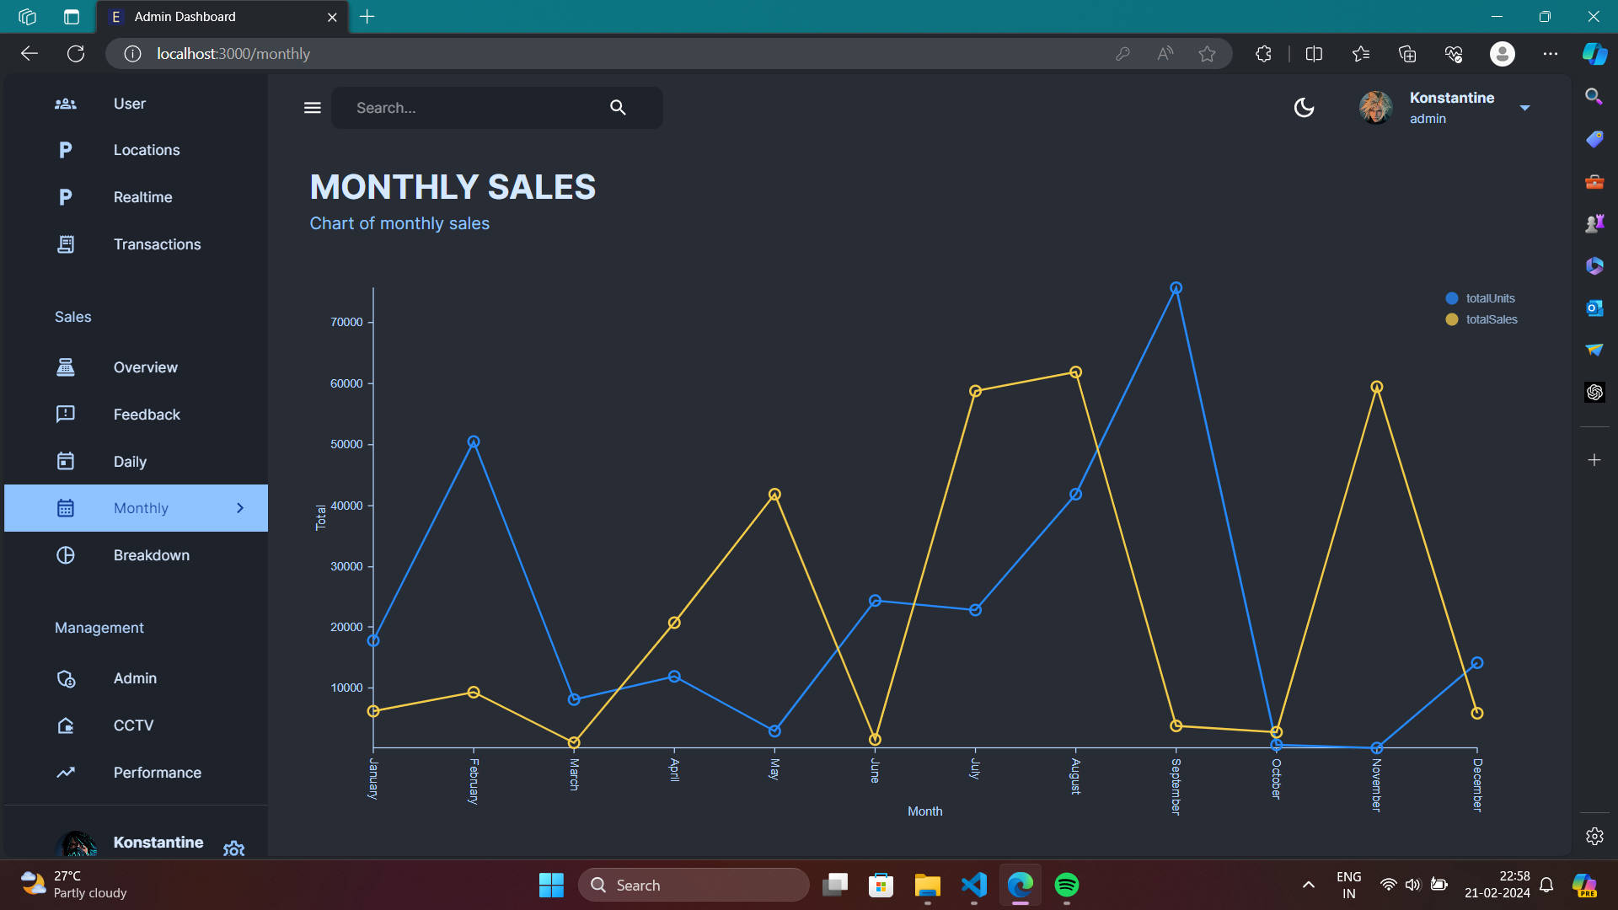

Slide 29
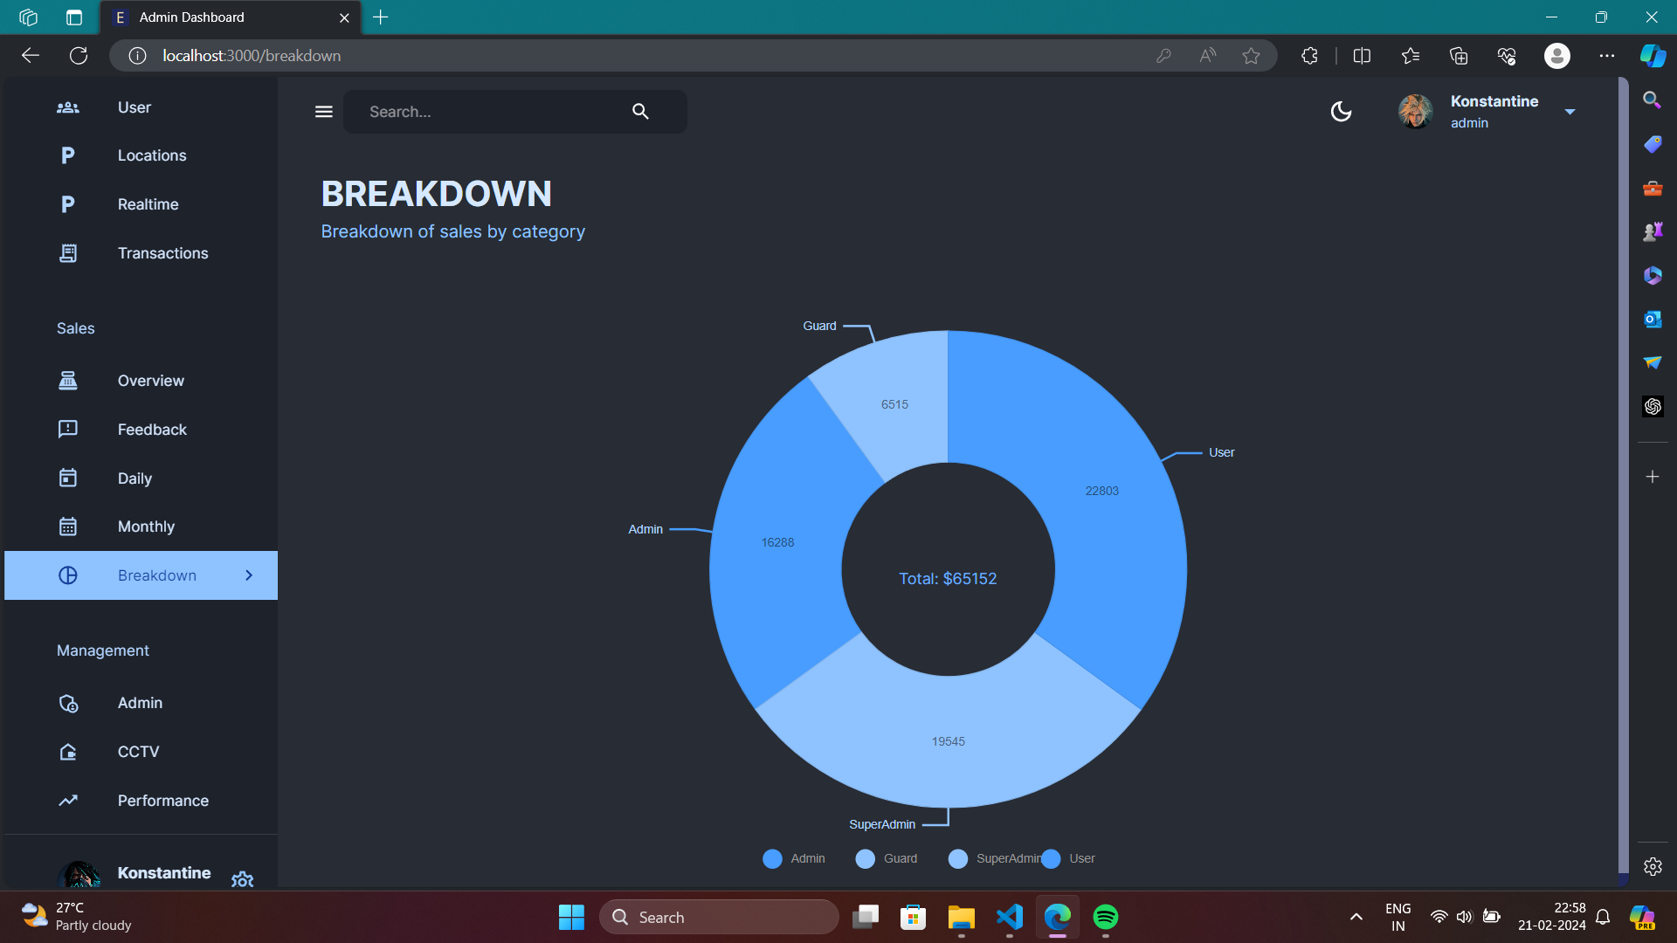

Slide 30
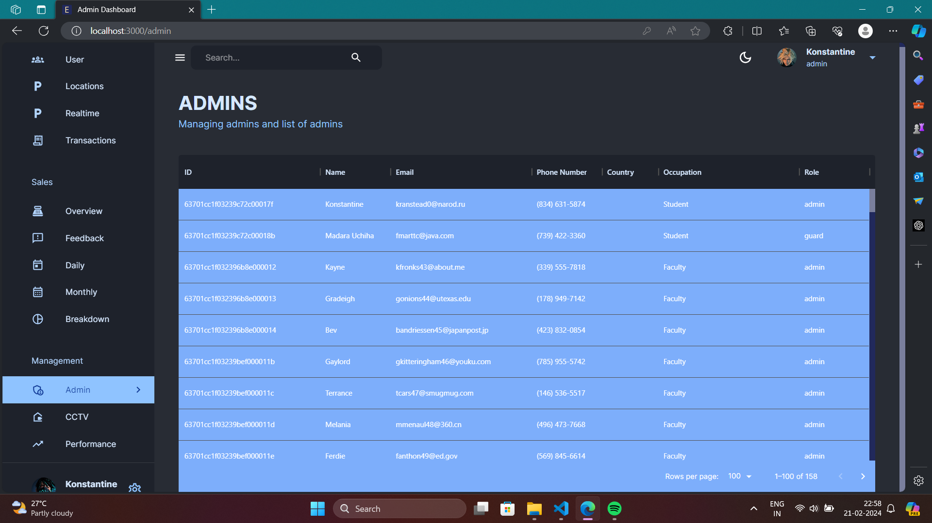

Slide 31
