Slide 1
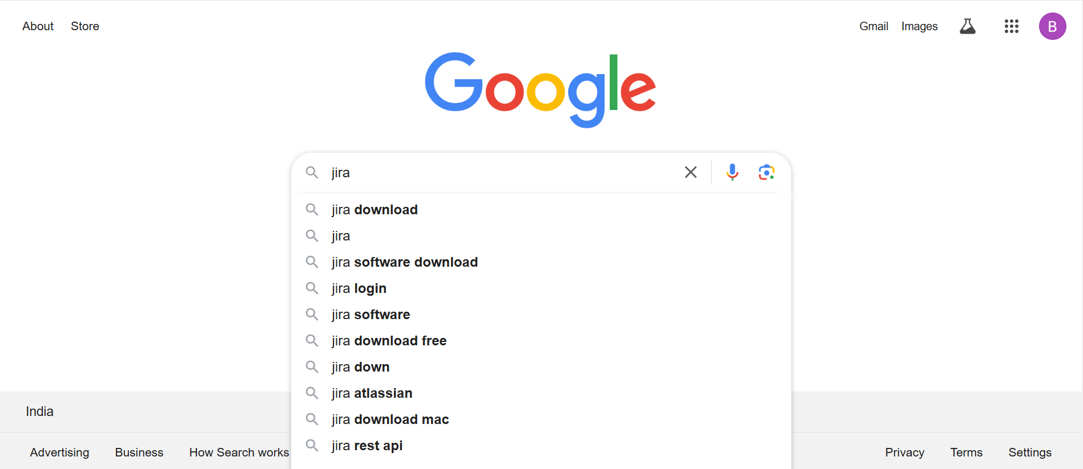
Type in jira in Google search bar and hit enter

Slide 2
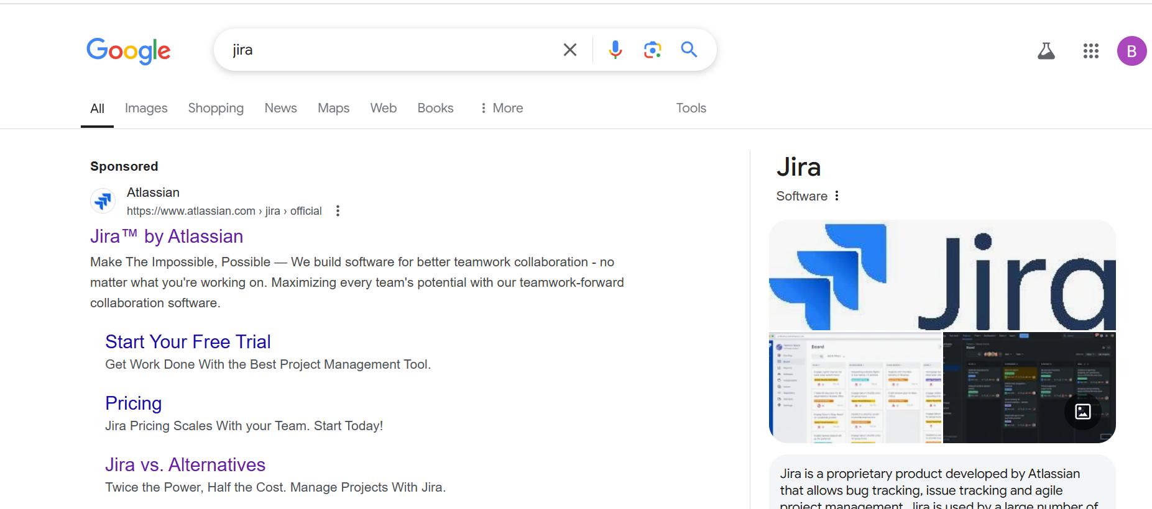
Click this link

Slide 3
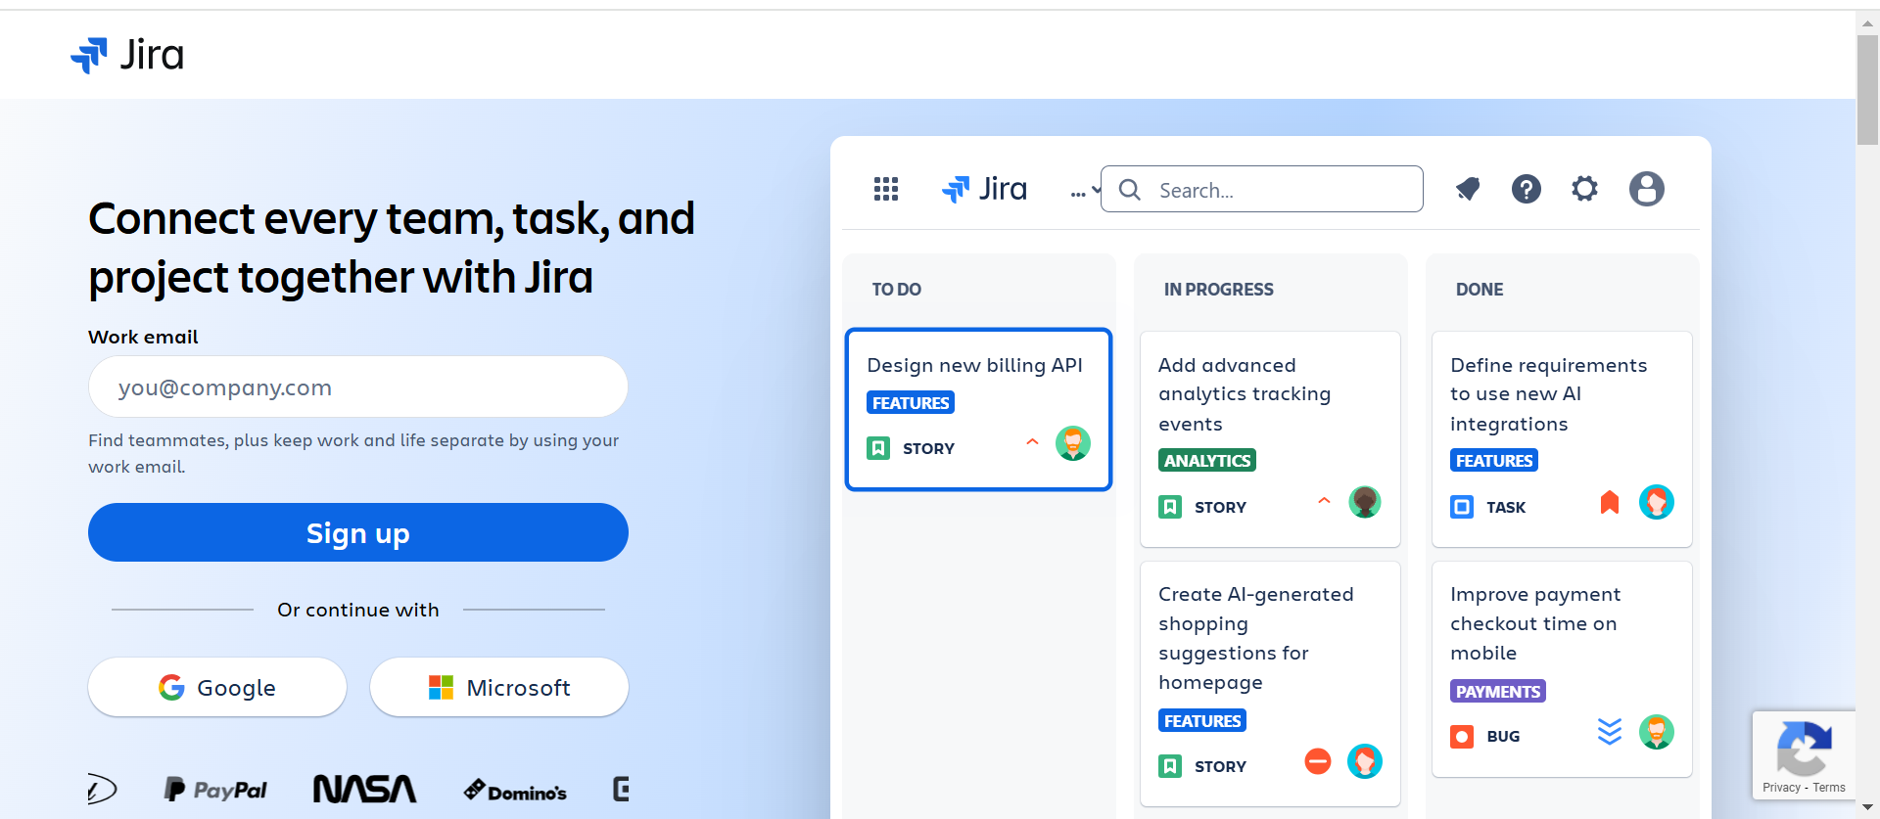
To continue with Google, click this Google button

Slide 4
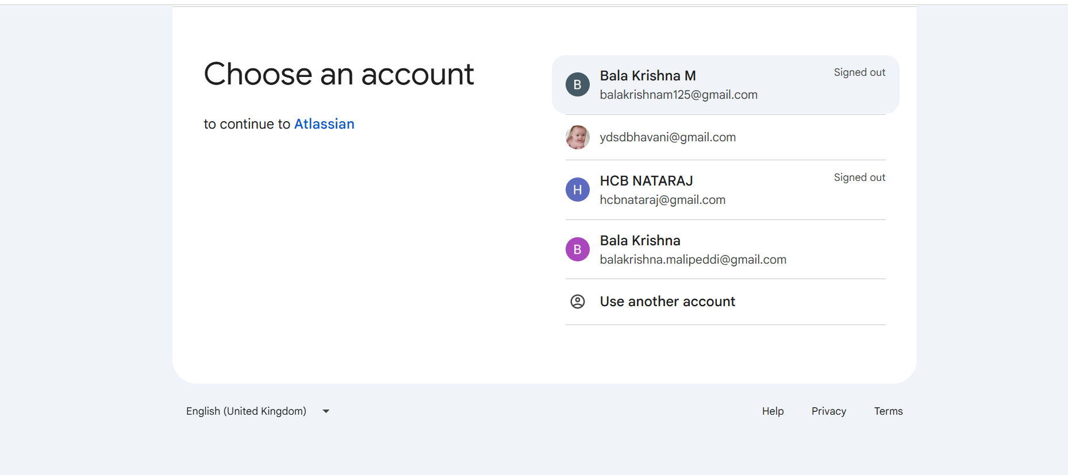
Enter/choose your Google account

Slide 5
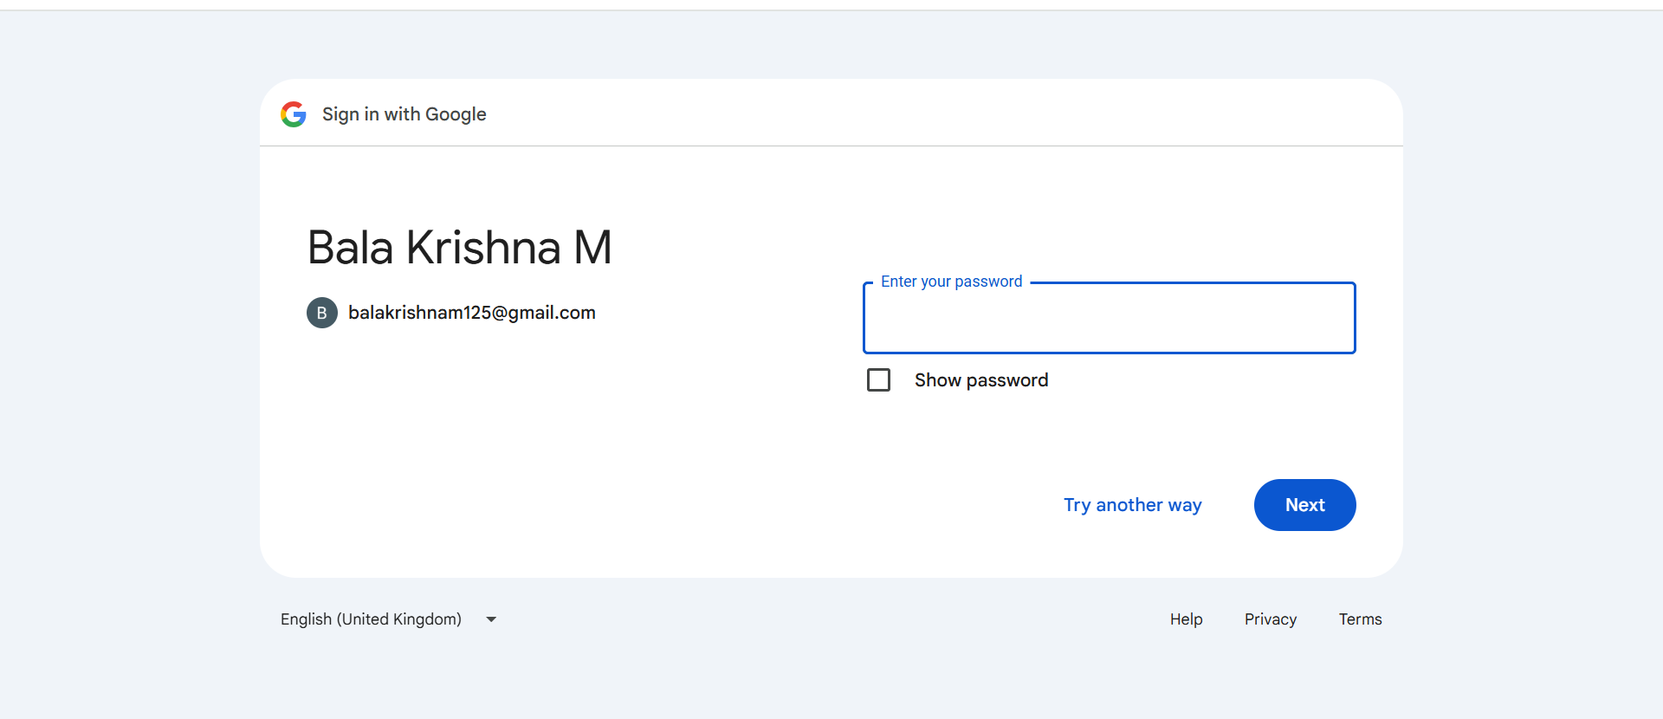
Enter your password

Slide 6
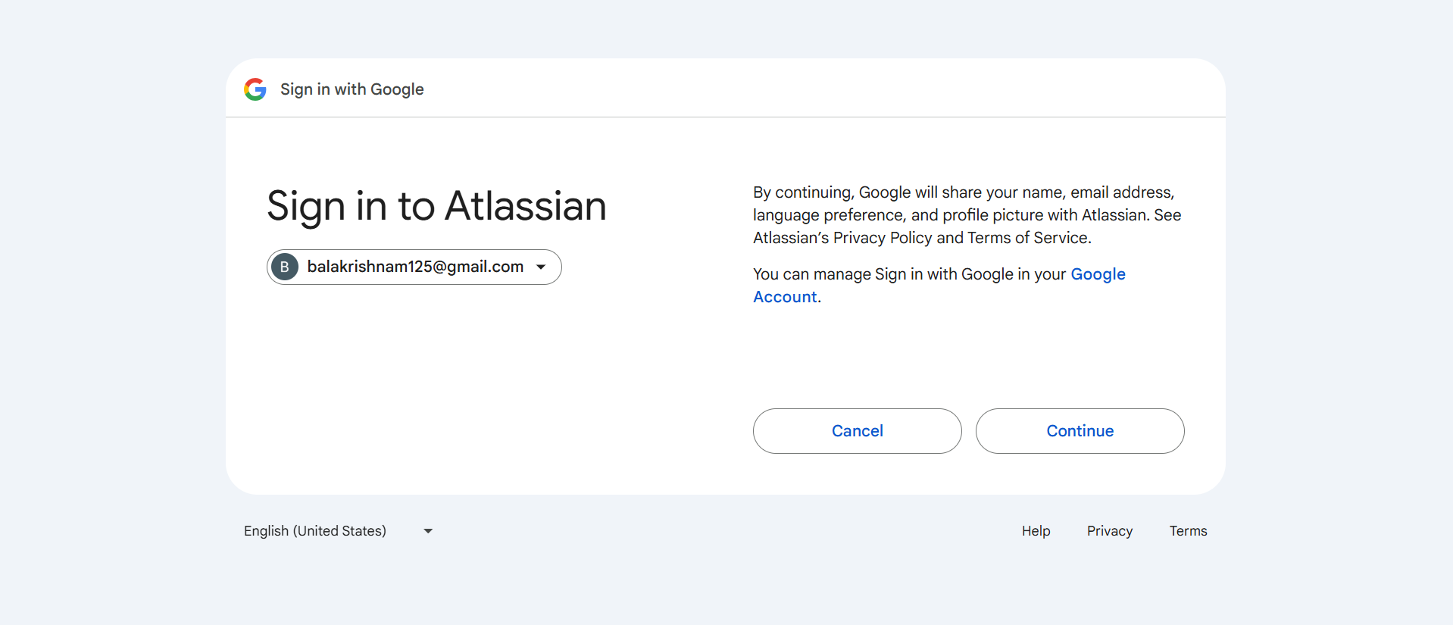
Click Continue button

Slide 7
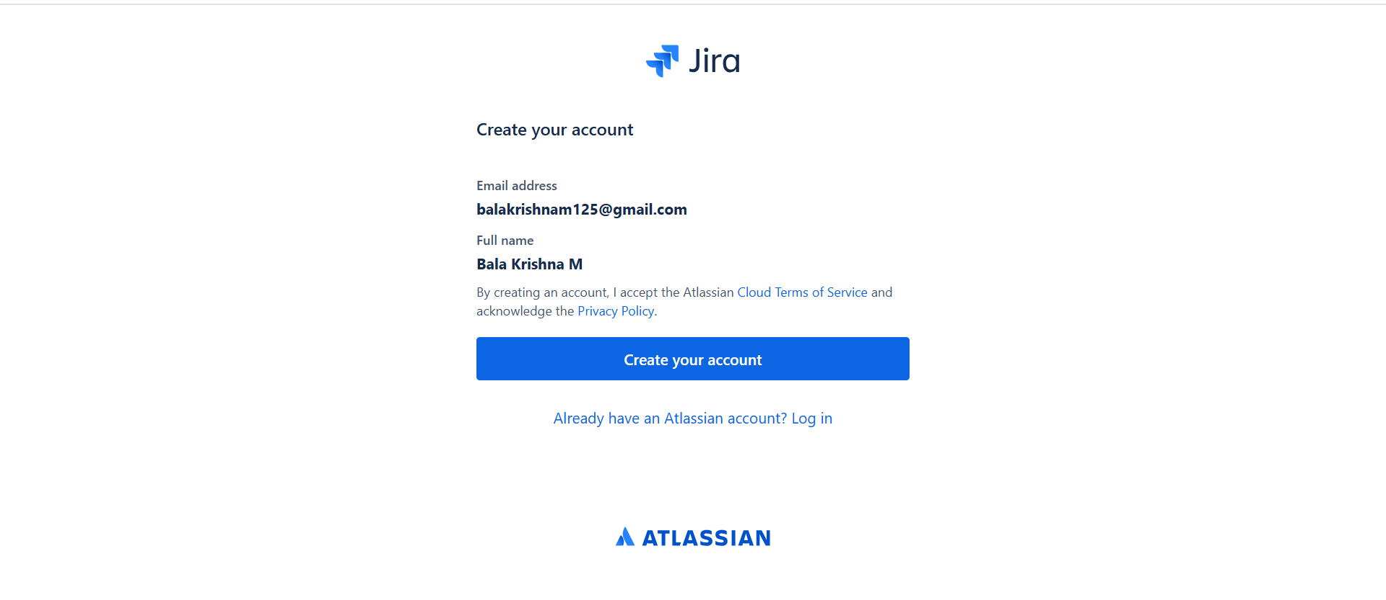
Click Create your accont

Slide 8
Congratulations, you are ready to use Jira

