Slide 1
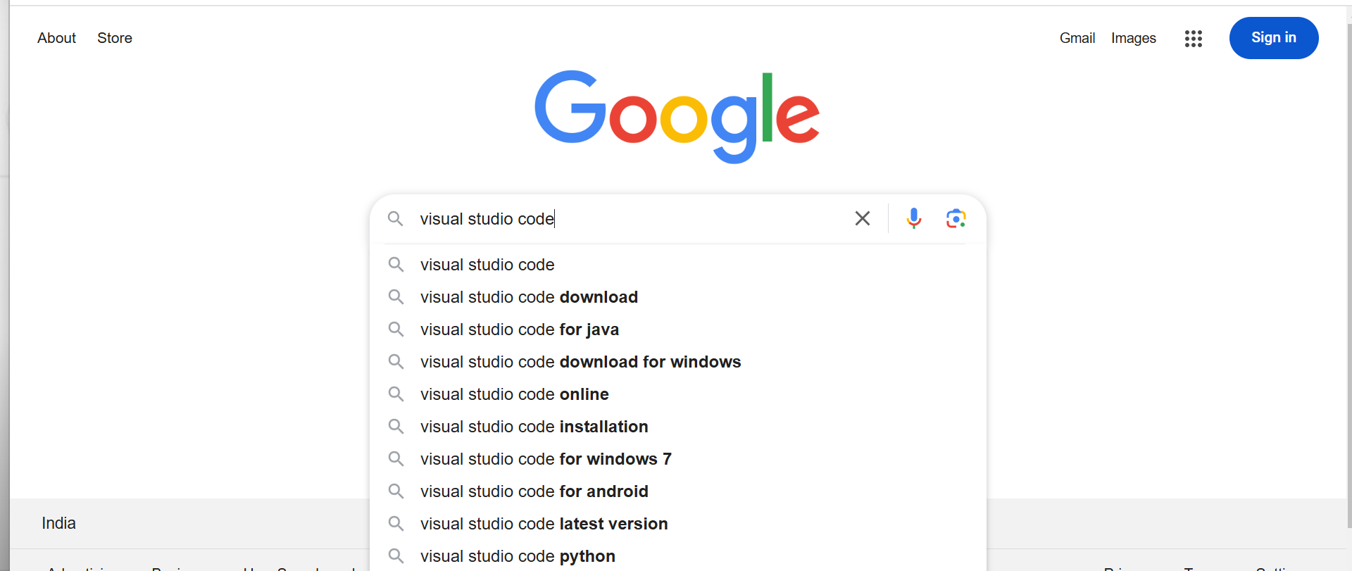
Type “visual studio code” in google search bar

Slide 2
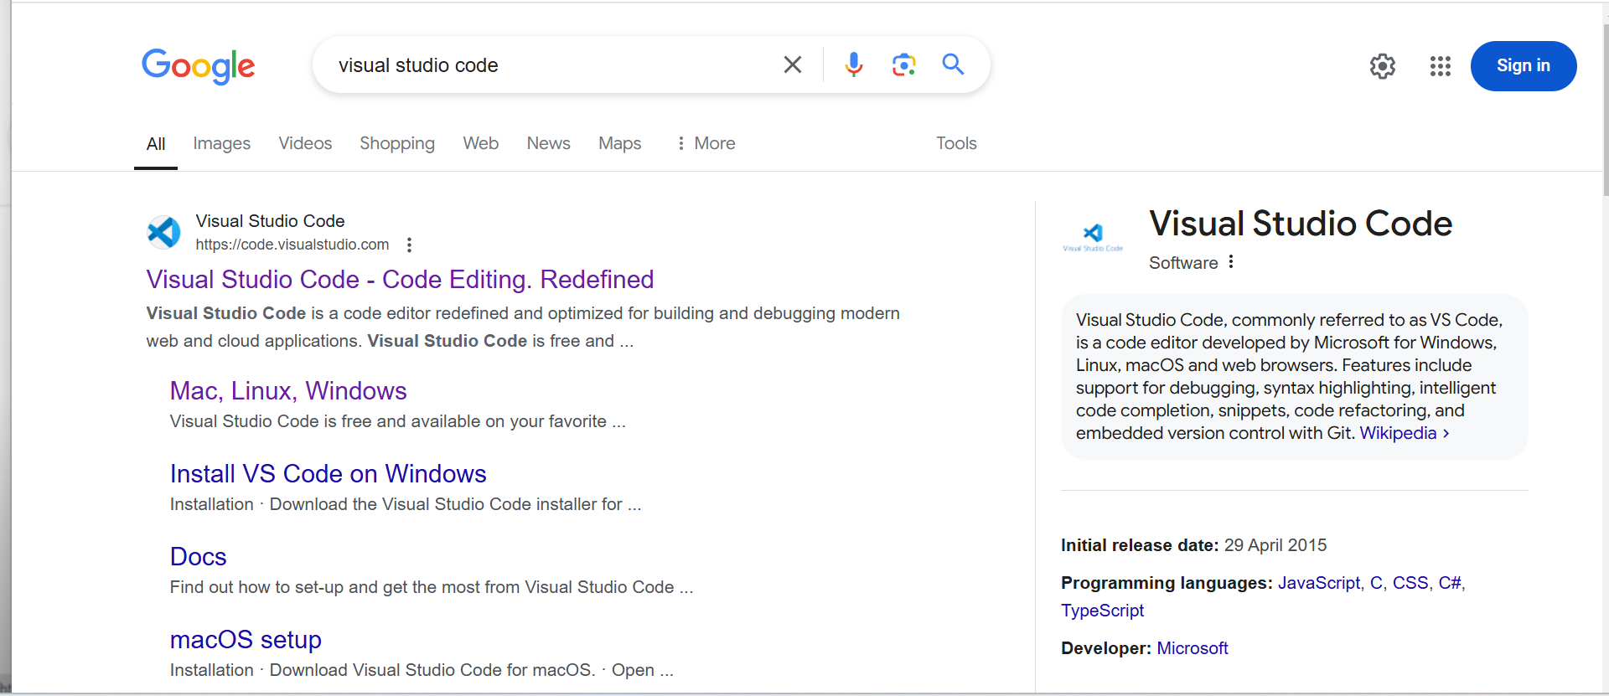
Click on this link

Slide 3
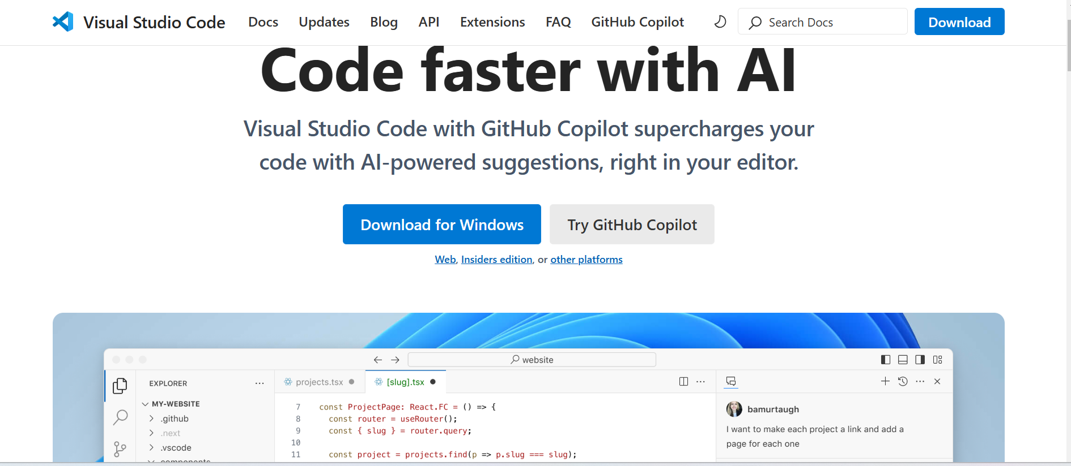
Click on “Download for Windows”

Slide 4
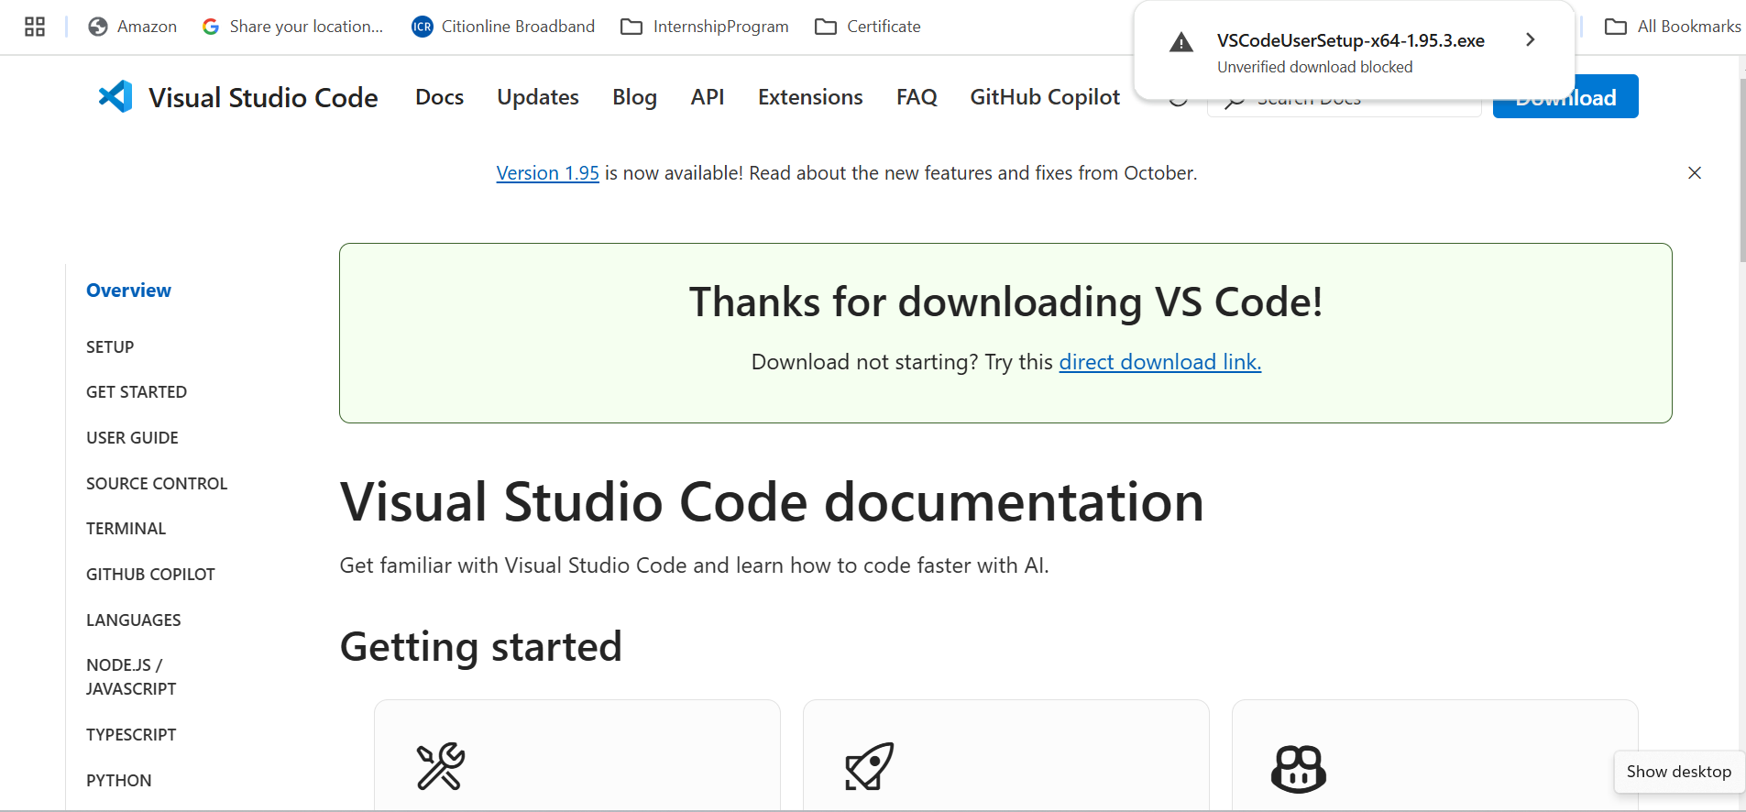
Click on this executable (.exe) file

Slide 5
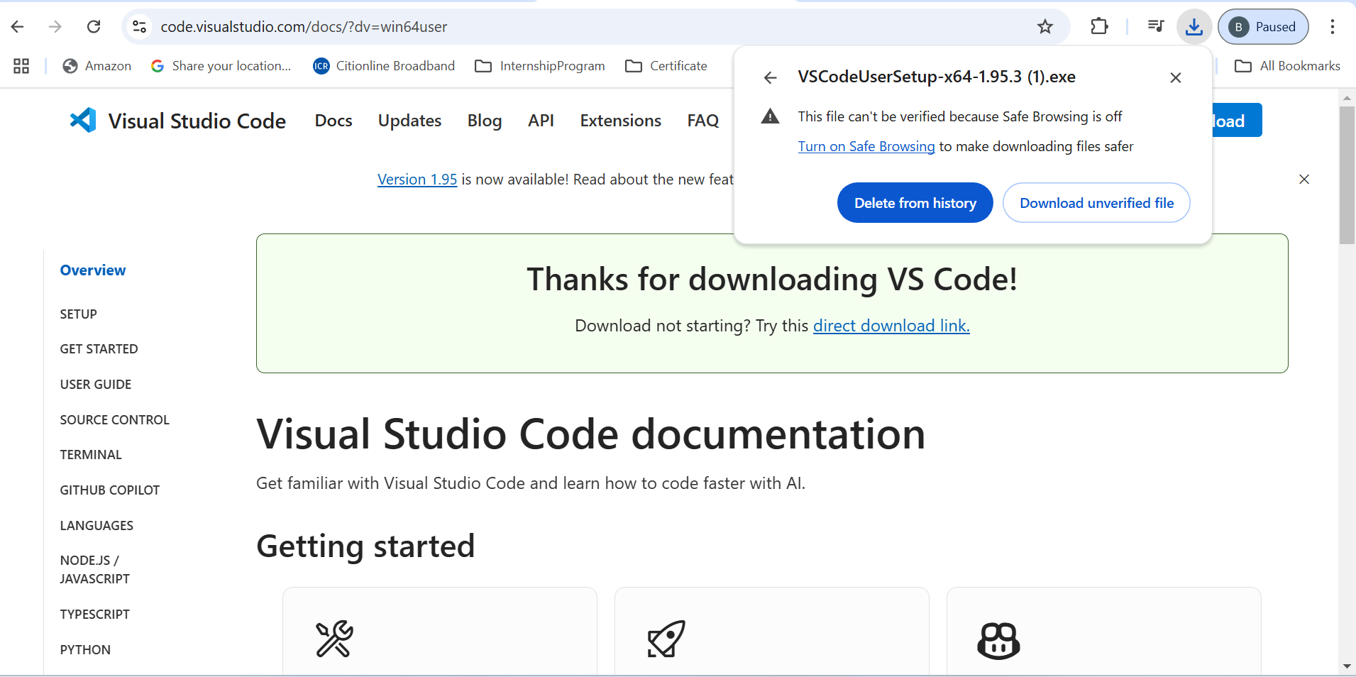
Click on “Download unverified file”

Slide 6
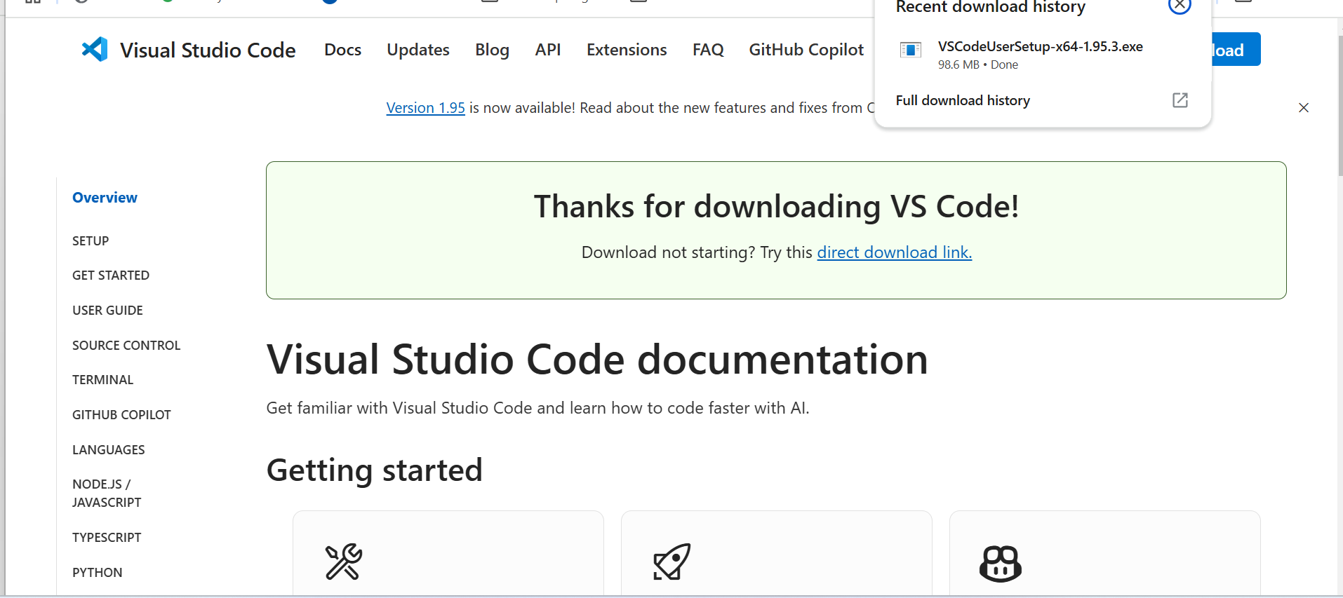
Double click on this .exe file

Slide 7
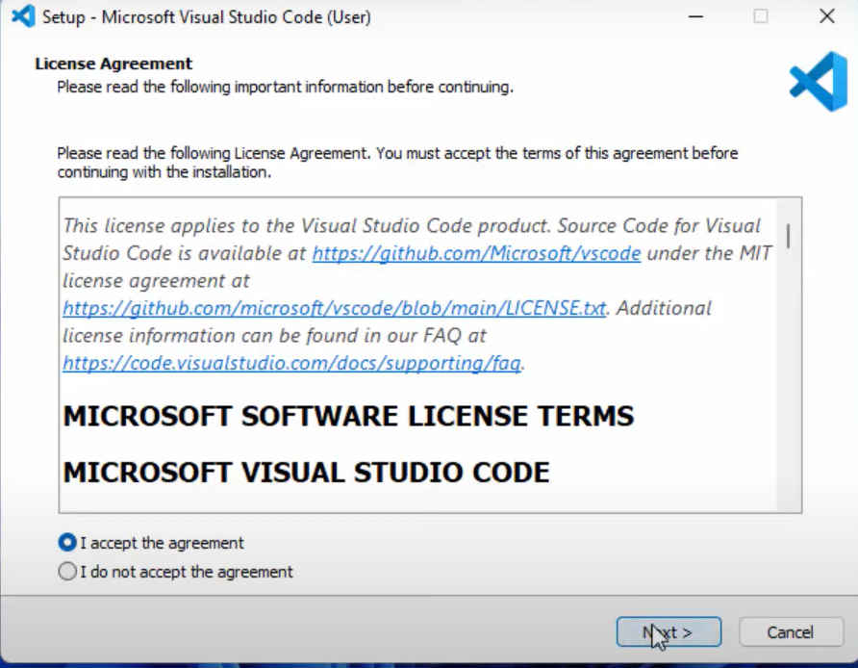
Click on “I accept the agreement.”
Click on “Next”

Slide 8
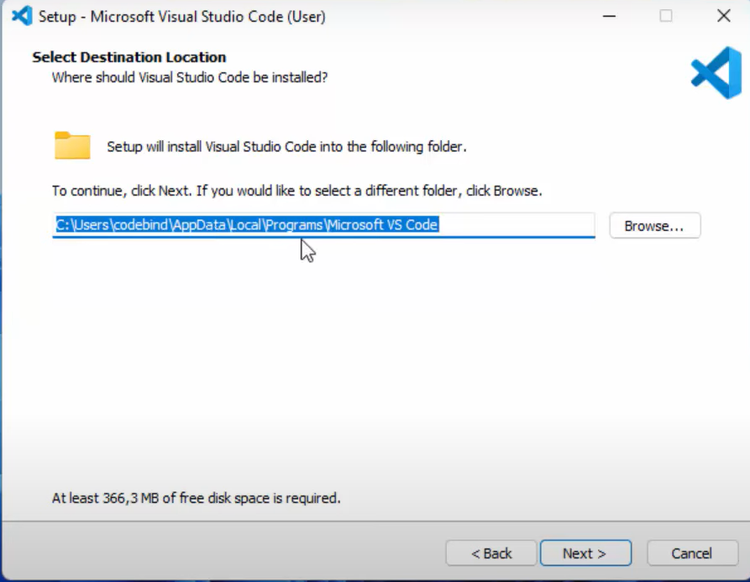
Keep the default folder as it
Click on “Next”

Slide 9
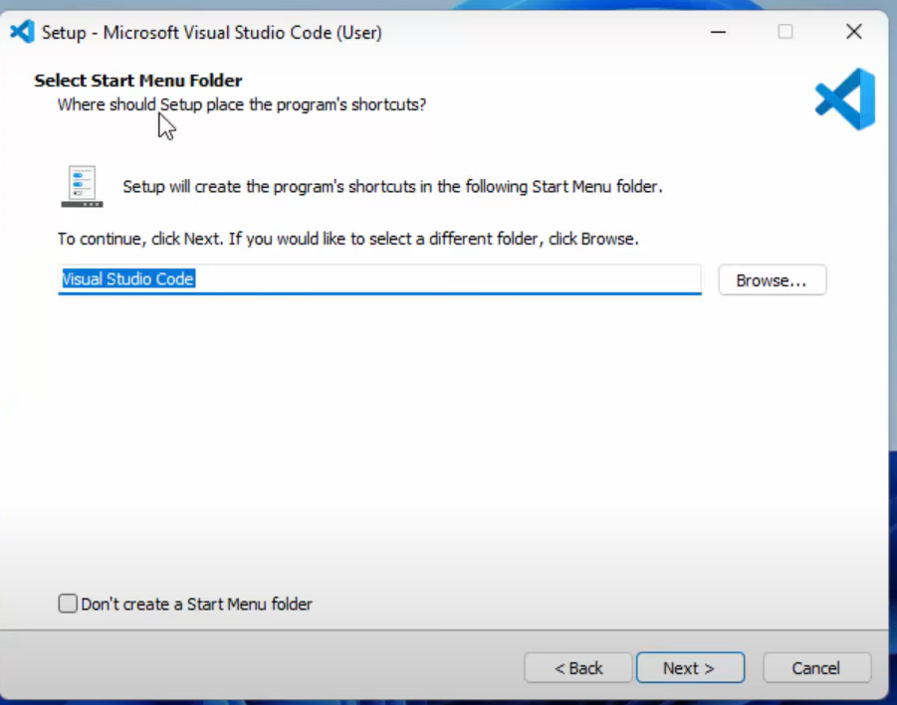
Click on “Next”

Slide 10
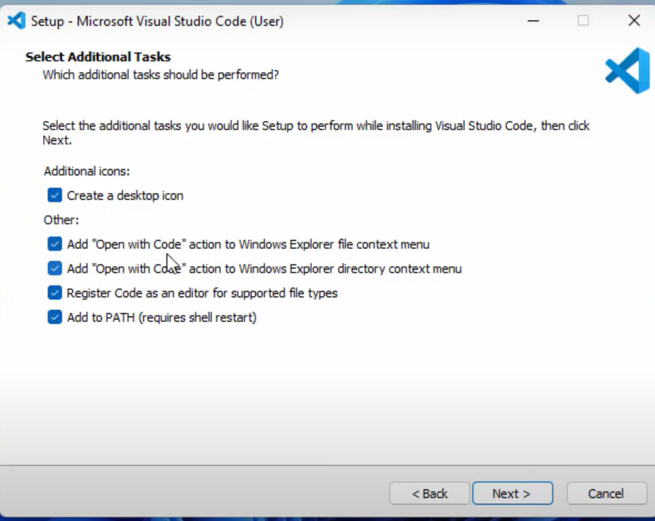
Check all these boxes
Click on “Next

Slide 11
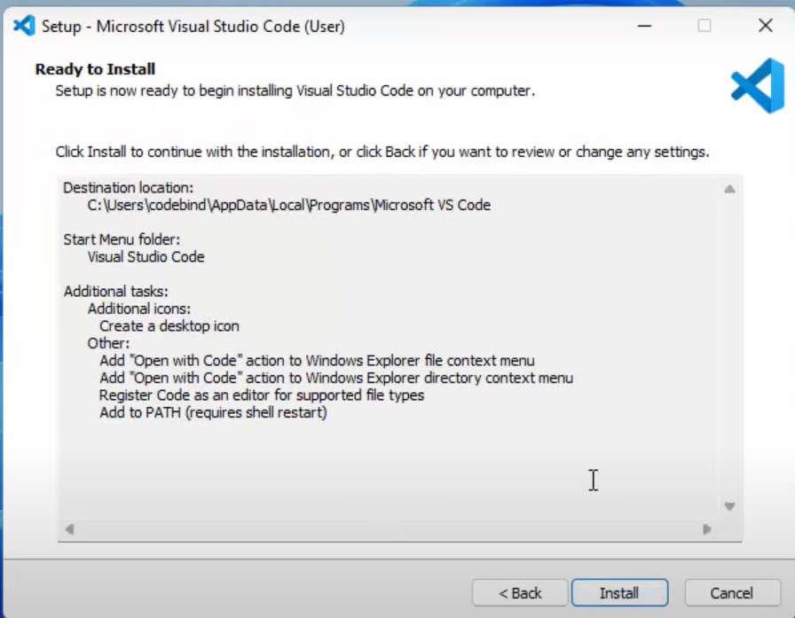
Click on “Install”

Slide 12
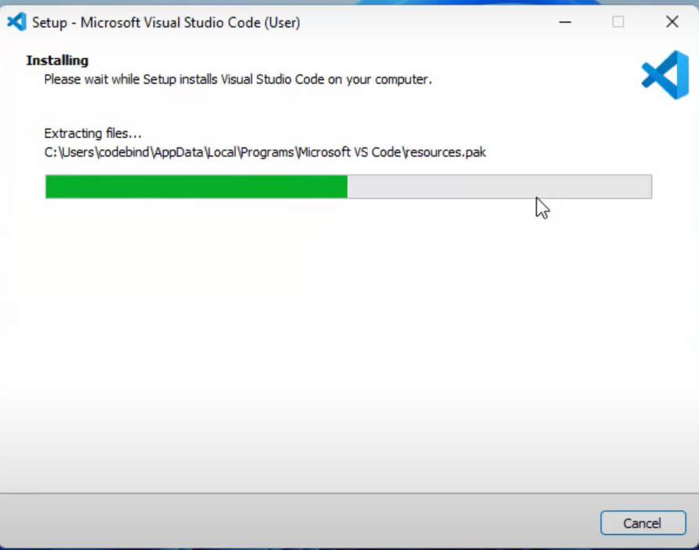
Let the installation process be completed. You do not have to do anything here.

Slide 13
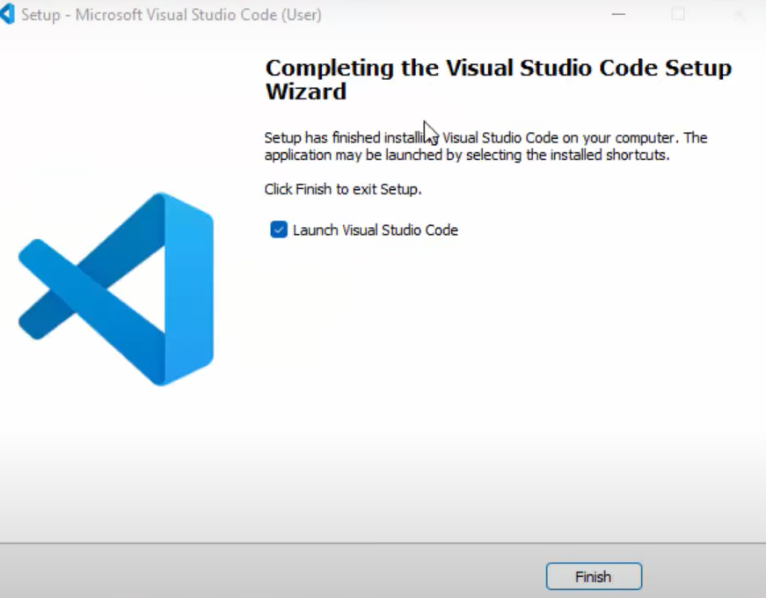
Click on “Finish”

