Slide 1
Preventing Cyberbullying in Social Networking Sites using Deeplearning model
Supervisor
Mrs. P.SHENBAGAM, MCA.,ME,(Ph.D.,)
Head & Assistant Professor,
RVS College of Engineering
Dindigul-624005
Presented By
BALAKRISHNAN S- 921521622007
RVS College of Engineering
Dindigul-624005

Slide 2
ABSTRACT
Social networking site is being rapidly increased in recent years, which provides platform to connect people all over the world and share their interests.
Cyberbullying is harassing or insulting a person by sending messages of hurting or threatening nature using electronic communication.
Detection of cyberbullying and the provision of subsequent preventive measures are the main courses of action to combat cyberbullying.
Present methods to automatically determine the bully level, and block post and users of the post by the utilizing deep learning on pre-trained language models with annotated data to create automated cyberbullying detectors.

Slide 3
INTRODUCTION
Deep learning is also referred to as deep structured learning. It is a subset of Artificial Intelligence that is concerned with imitating how human brain would react to a situation.
Machines employ deep learning algorithms that are capable of learning unsupervised from unstructured data (Investopedia).
Social media has become an essential facet of modern society, wherein people share their opinions on a wide variety of topics.
Deep learning with social network data science for modeling social influence and predicting human behavior on real-world activities.

Slide 4
Existing System
Naive Bayes: is a learning algorithm based on the Bayes theorem's use with strong (naive) independence assumptions.
Support Vector Machine (SVM): SVM is a binary classifier assuming a clear distinction between data samples.
K-Nearest Neighbor: is a simple method that is used to solve classification and regression problems.
Decision Tree: DT is used to construct a training model, which can be used by learning simple decision rules derived from preliminary data to predict a target variable class.

Slide 5
Disadvantage
Difficult to track.
Most of the cyberbullying cases go unreported.
Low accuracy.
Time consuming process.
Response time is slow.
Blocking the blacklisting user is not considered.

Slide 6
Proposed System
This project proposed a system for automatic detection and prevention cyberbullying considering the main characteristics of cyberbullying such as Intention to harm an individual, repeatedly and over time and using abusive curl language or hate speech using BiLSTM algorithm.
The proposed model is capable to detect cyberbullying content on social media automatically.
Block the Bullied users

Slide 7
Advantages
It successfully classifies the tweets in various classes.
Auto report generator generates a simple report for probable accusers.
Several analytics and report can be sent to the crime department.
Accuracy is high.
An automatically generate a report for each incident is also provided.

Slide 8
System Requirments
Server Side : Python 3.7.4(64-bit) or (32-bit)
Client Side : HTML, CSS, Bootstrap
IDE : Flask 1.1.1
Server : Wampserver 2i

Slide 9
Modules Description
Social Network Web App
User Access Control
Cyberbullying Classification API
Cyberbullying Detection
Bullied Level Indicator
Blocker
Performance Analysis

Slide 10
Dataset
In light of all of this, this dataset contains more than 47000 tweets labelled according to the class of cyberbullying:
Age;
Ethnicity;
Gender;
Religion;
Other type of cyberbullying;
Not cyberbullying

Slide 11
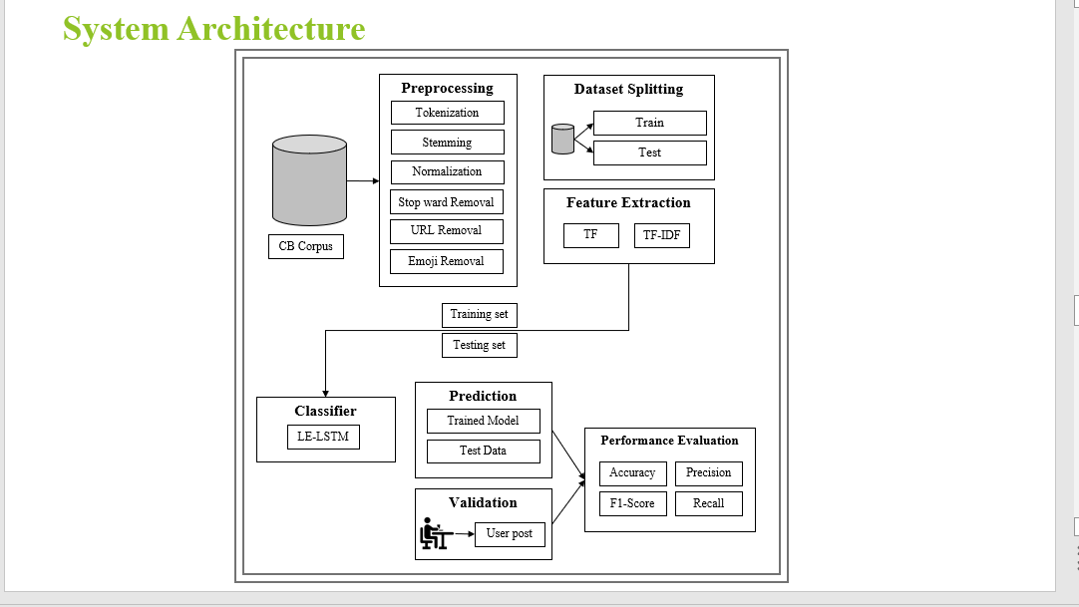

Slide 12
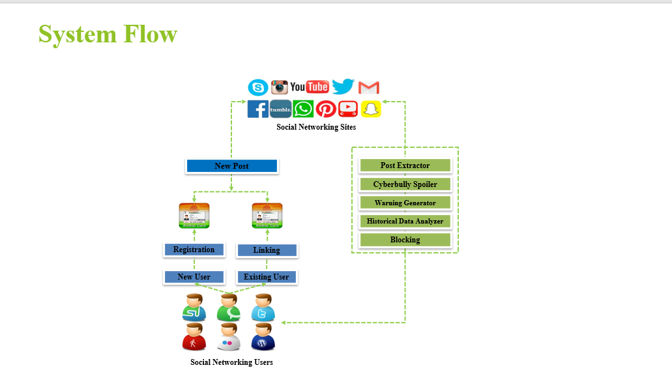

Slide 13
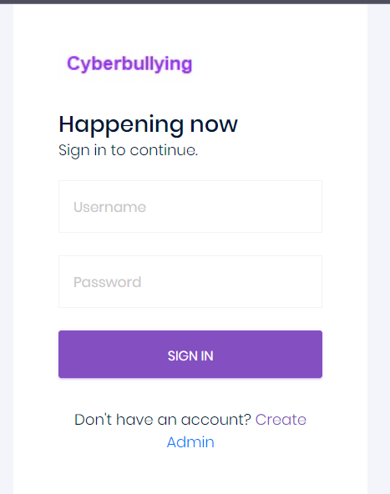
SCREEN SHOT

Slide 14
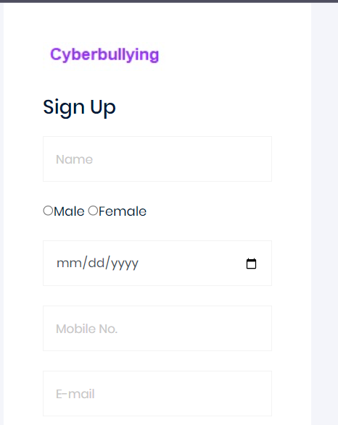
SignUp Page

Slide 15
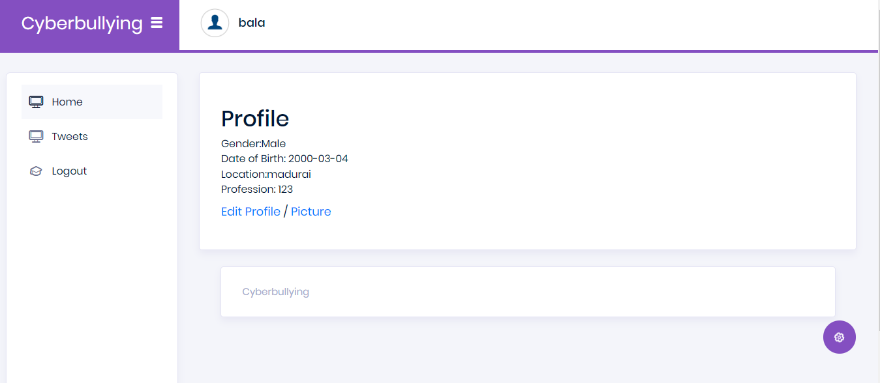
User Home page

Slide 16
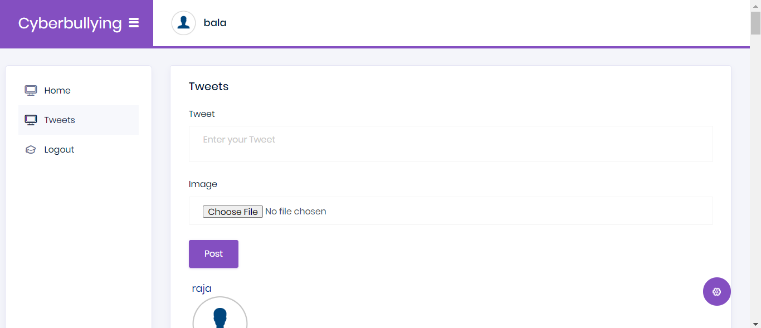
Tweets page

Slide 17
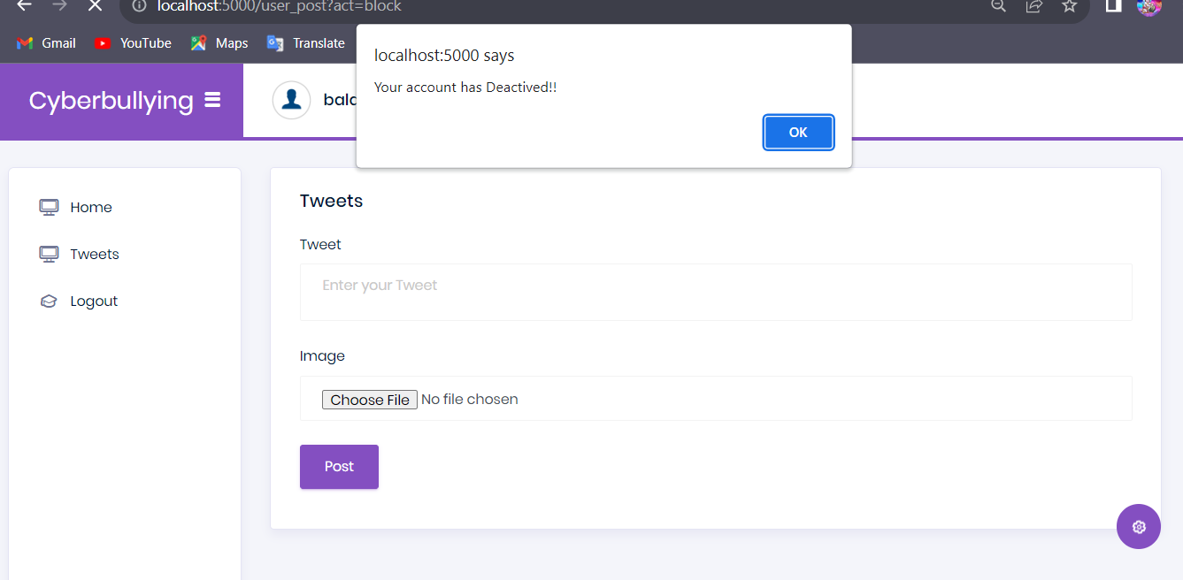

Slide 18
Conclusion
Cyberbullying is the harassment that takes place in digital devices such as mobile phones, computers and tablets. The means used to harass victims are very diverse: text messages, applications, social media, forums or interactive games.
One of the things that complicates these types of situations that occur through the Internet, is the anonymity this environment allows. Since this facilitates cyberbullying can cover almost all areas of the victim’s life, that is: educational environment, work, social or loving life

Slide 19
Future Enhancements
For the present, the bot works for Twitter, so it can be extended to various other social media platforms like Instagram, Reedit, etc. Currently, only images are classified for NSFW content, classifying text, videos could be an addition.
A report tracking feature could be added along with a cross-platform Mobile / Desktop application (Progressive Web App) for the Admin.
This model could be implemented for many languages like French, Spanish, Russian, etc. along with India languages like Hindi, Gujarati, etc.

Slide 20
Thank You

