Slide 1
QUERYING A STUDENT DATABASE USING NATURAL LANGUAGE PROCESSING
Mohan Raj.R
Balakrishnan.s

Slide 2
Project Description
The main purpose of this project is to query a database through Natural language.
It generates an appropriate query for the user given natural language input and fetches the relevant data from the Database.

Slide 3

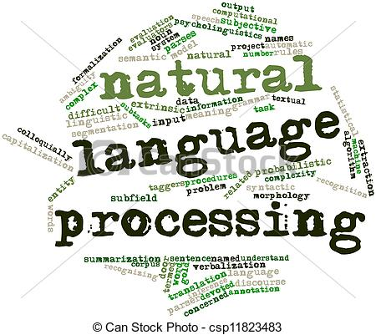


Process Flow

Slide 4
What It Does:
USER INPUT
TOKENIZE
FILTERING
MEANINGFULL WORDS
MATCHING
WITH KEYWORDS
GENERATE
APPROPRIATE QUERY

Slide 5
Packages Used
Sqlite3
Nltk
Config
Logging
Sys
Signal

Slide 6
Challenges:
The API available is able to generate a query only when approached with W,H questions and interfacing of it with a custom DB is difficult.
Accessing Each and every loacation of words after filtering was quite a Tedious process

Slide 7
Limitations:
Union of Querries

Slide 8
THANK YOU

