Slide 1


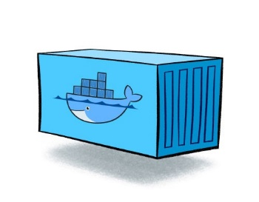





COVID19Dashboard Repo
COVID19 Data Source Repo
Dockerhub
Downloading Docker Image
sunishsurendrank/grapanaimage Container
InfluxDB Container
Docker Engine
https://localhost:3000
Cloned Data Source CSV
Local User Machine
Run the loaddb.py Script

Slide 2

Dockerhub
Downloading Docker Image
sunishsurendrank/pythonimage Container
sunishsurendrank/grapanaimage Container
InfluxDB Container
Docker Engine
https://localhost:3000
Local User Machine

Slide 3
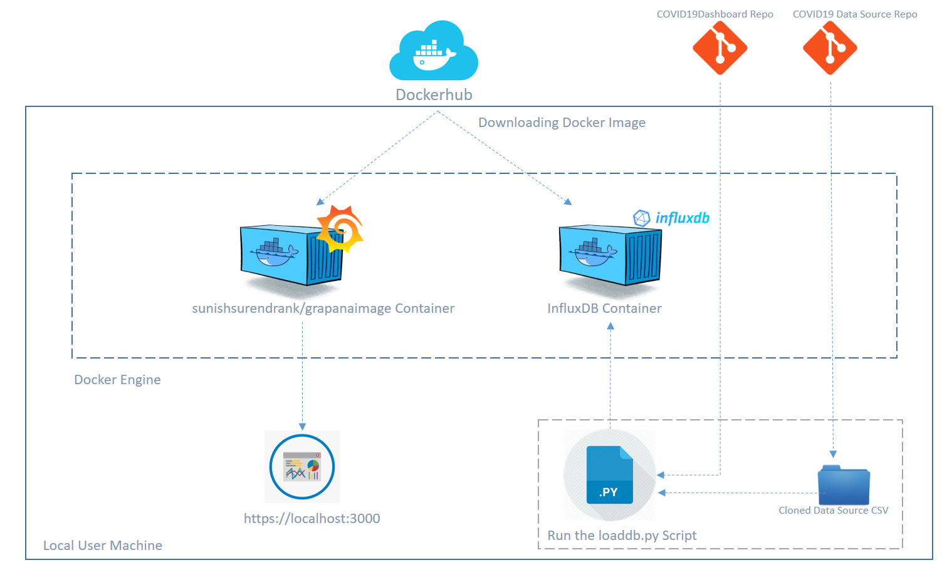
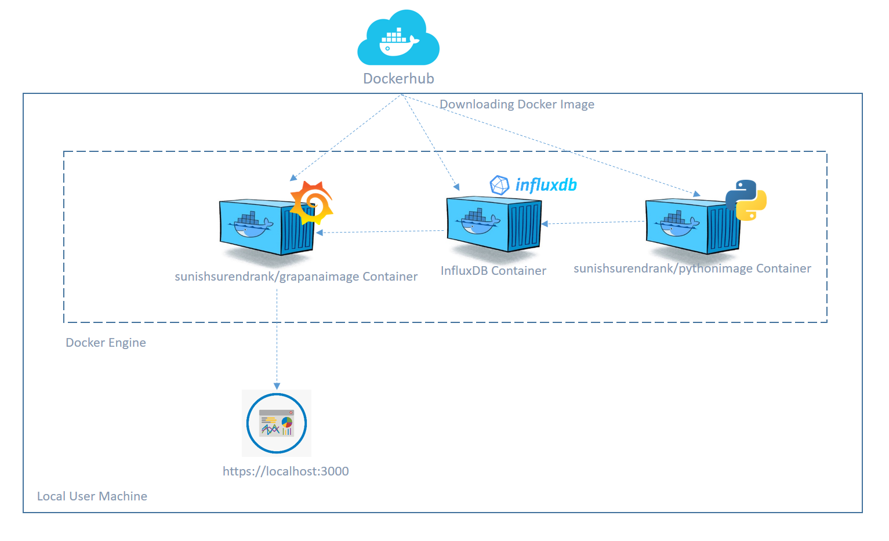
Old Architecture Diagram
Latest Architecture Diagram

