Slide 1
Data Mining Overview

Slide 2
Core Ideas in Data Mining
Classification - Classifying the outcome of categorical variable based on historical data
Prediction – prediction of a given output variable (target variable) based on other variables or features
Association Rules & Recommenders
Data & Dimension Reduction
Data Exploration
Visualization

Slide 3
Supervised Learning
Predictive modeling describes supervised learning - the training data we feed the algorithm includes the target variable. We are “supervising” the training process
Training data, where target value is known
Score to data where value is not known
Methods: Classification and Prediction

Slide 4
Supervised: Classification
The object of classification is to predict a categorical variable
Examples: Purchase/no purchase, fraud/no fraud, creditworthy/not creditworthy…
Target variable is often binary (yes/no)

Slide 5
Supervised: Prediction
Goal: Predict numerical target (outcome) variable
Examples: sales, revenue, performance
As in classification:
Each row is a case (customer, tax return, applicant)
Each column is a variable
Taken together, classification and prediction constitute “predictive analytics”

Slide 6
Unsupervised Learning
Performs an analysis without a target variable
Goal: Segment data into meaningful segments; detect patterns
There is no target (outcome) variable to predict or classify
Example: Clustering – segments the observations into to similar groups based on the variables

Slide 7
Unsupervised: Association Rules
Goal: Produce rules that define “what goes with what”
Example: “If X was purchased, Y was also purchased”
Rows are transactions
Used in recommender systems – “Our records show you bought X, you may also like Y”
Also called “affinity analysis”

Slide 8
Unsupervised: Data Reduction
Distillation of complex/large data into simpler/smaller data
Reducing the number of variables/columns (e.g., principal components)
Reducing the number of records/rows (e.g., clustering)

Slide 9
Unsupervised: Data Visualization
Graphs and plots of data
Histograms, boxplots, bar charts, scatterplots
Especially useful to examine relationships between pairs of variables

Slide 10
Data Exploration
Data sets are typically large, complex & messy
Need to review the data to help refine the task
Use techniques of Reduction and Visualization

Slide 11
The Process of Data Mining

Slide 12
Steps in Data Mining
Define/understand purpose
Obtain data (may involve random sampling)
Explore, clean, pre-process data
Reduce the data; if supervised DM, partition it
Specify task (classification, clustering, etc.)
Choose the techniques (regression, neural networks, etc.)
Iterative implementation and “tuning”
Assess results – compare models
Deploy best model

Slide 13
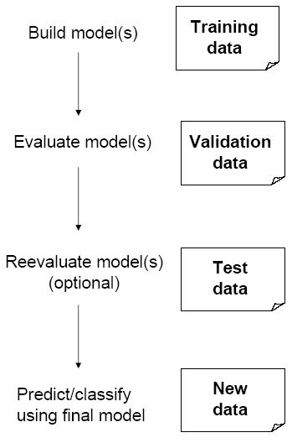
Test Partition
When a model is developed on training data, it can overfit the training data (hence need to assess on validation)
Assessing multiple models on same validation data can overfit validation data
Some methods use the validation data to choose a parameter. This too can lead to overfitting the validation data
Solution: final selected model is applied to a test partition to give unbiased estimate of its performance on new data

Slide 14
Data Splitting
Data are split into training and test sets.
Training data is used to train the model
Testing data is used to estimate an unbiased assessment of the model’s performance
#Random splitting of iris data into 70% train and 30%test datasets
ind <- sample(2, nrow(data), replace=TRUE, prob=c(0.7, 0.3))
trainData <- data[ind==1,]
testData <- data[ind==2,]

Slide 15
Simple Random Sampling
All observations have an equal chance of selection
# Using base R
set.seed(123) # for reproducibility
index_1 <- sample(1:nrow(ames), round(nrow(ames) * 0.7))
train_1 <- ames[index_1, ]
test_1 <- ames[-index_1, ]

Slide 16
Rare Event Oversampling
Often the event of interest is rare
Examples: response to mailing, fraud in taxes, …
Sampling may yield too few “interesting” cases to effectively train a model
A popular solution: oversample the rare cases to obtain a more balanced training set
Later, need to adjust results for the oversampling

Slide 17
Stratified Sampling
Common in classification problems where the response variable may be severely imbalanced
Example: 90% of the observations have a “yes” response and 10% have a “no” response.
Solution: segment into quartiles and then random sample from each quartile
set.seed(123)
split_strat <- initial_split(attrition, prop = 0.7,
strata = "Attrition")
train_strat <- training(split_strat)
test_strat <- testing(split_strat)

