Slide 1
Characteristics of K-NN
Data-driven, not model-driven
Makes no assumptions about the data

Slide 2
K-nn
KNN is a Supervised Learning algorithm that uses labeled input data set to predict the output of unknown data points.
It is one of the most simple Machine learning algorithms and it can be easily implemented for a varied set of problems.
It is mainly based on feature similarity. KNN checks how similar a data point is to its neighbor and classifies the data point into the class it is most similar to.

Slide 3
Basic Idea
For a given record to be classified, identify nearby records
“Near” means records with similar predictor values X₁, X₂, … X_{p}
Classify the record as whatever the predominant class is among the nearby records (the “neighbors”)

Slide 4
How to measure “nearby”?
The most popular distance measure is Euclidean distance
Typically, predictor variables are first normalized (= standardized) to put them on comparable scales

Slide 5
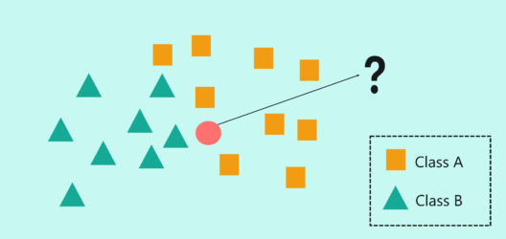
K-nearest neighbor

Slide 6
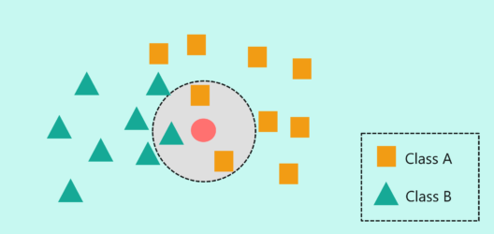
K = 3

Slide 7
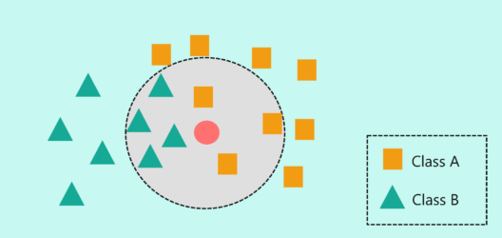
K = 7

Slide 8
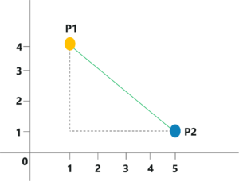
Euclidean Distance Euclidean distance is a measure to determine the distance between a new data point and its neighbors

Slide 9
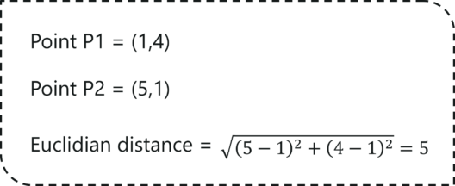
Calculate Euclidean Distance The coordinates for P1 and P2 are (1,4) and (5,1) The Euclidian Distance can be calculated:

Slide 10
Choosing k
K is the number of nearby neighbors to be used to classify the new record
K=1 means use the single nearest record
K=5 means use the 5 nearest records
Typically choose that value of k which has lowest error rate in validation data

Slide 11
Low k vs. High k
Low values of k (1, 3, …) capture local structure in data (but also noise)
High values of k provide more smoothing, less noise, but may miss local structure
Note: the extreme case of k = n (i.e., the entire data set) is the same as the “naïve rule” (classify all records according to majority class)

Slide 12
Advantages
Simple
No assumptions required about Normal distribution, etc.
Effective at capturing complex interactions among variables without having to define a statistical model

Slide 13
Shortcomings
Required size of training set increases exponentially with # of predictors, p
This is because expected distance to nearest neighbor increases with p (with large vector of predictors, all records end up “far away” from each other)
In a large training set, it takes a long time to find distances to all the neighbors and then identify the nearest one(s)
These constitute “curse of dimensionality”

