Slide 1
The Modeling Process

Slide 2
Types of Variables
Determine the types of pre-processing needed, and algorithms used
Main distinction: Categorical vs. numeric
Numeric
Continuous
Integer
Categorical
Ordered (low, medium, high)
Unordered (male, female)

Slide 3
Variable handling
Numeric
Most algorithms can handle numeric data
May occasionally need to “bin” into categories
Categorical
Naïve Bayes can use as-is
In many algorithms we must create binary dummies (number of dummies = number of categories – 1)

Slide 4
Normalizing (Standardizing) Data
Used in some techniques when variables with the largest scales would dominate and skew results
Puts all variables on same scale
Normalizing function: Subtract mean and divide by standard deviation
Alternative function: scale to 0-1 by subtracting minimum and dividing by the range
Useful when the data contain dummies and numeric

Slide 5
Detecting Outliers
An outlier is an observation that is “extreme”, being distant from the rest of the data (definition of “distant” is deliberately vague)
Outliers can have disproportionate influence on models (a problem if it is spurious)
An important step in data pre-processing is detecting outliers
Once detected, domain knowledge is required to determine if it is an error, or truly extreme.
In some contexts, finding outliers is the purpose of the DM exercise (airport security screening). This is called “anomaly detection”.

Slide 6
The Problem of Overfitting
Statistical models can produce highly complex explanations of relationships between variables
The objective is to fit a line (a curve) to the training data that can be used to make predictions or classifications on new data
The “fit” may be excellent on the training data
But when the model is used with new data, models of great complexity do not do so well.
Notes:
6

Slide 7
100% fit – not useful for new data
Notes:
7

Slide 8
Overfitting
Causes:
Too many predictors
A model with too many parameters
Consequence: Deployed model will not work as well as expected with completely new data.
Notes:
8

Slide 9
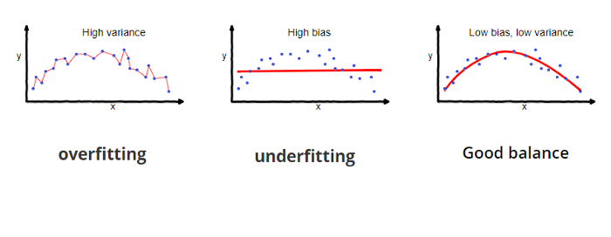

Slide 10
Bias
Bias is the difference between the average prediction of our model and the correct value which we are trying to predict.
Measures how far off we are from the correct value and the prediction
Models with high bias pays very little attention to the training data and oversimplifies the model.
Leads to high error in training and test data.

Slide 11
Variance
Variance is the variability of model prediction for a given data point or a value
Tells the us spread of our data.
Model with high variance puts a lot of attention into the training data
But does not generalize well to new data
These models perform very well on training data but has high error rates on test data.

Slide 12
There is often a tradeoff between a model’s ability to minimize variance and minimize bias at the same time

Slide 13
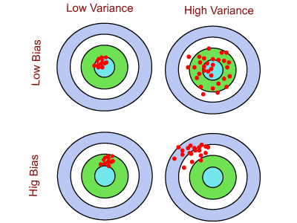
If there is low bias and low variance, the predicted output is mostly close to the desired output.
If there is low bias and high variance, the model is not consistent.
If there is low variance and high bias, the model is consistent but predicted results are far away from the actual output.
If there is high bias and high variance, then the model is inconsistent, and also predictions are much different with actual value. It is the worst case of bias and variance.

Slide 14
Resampling Methods: K-fold Cross Validation
K-fold cross validation –randomly divide the training data into k groups of relatively equal size.
Fit the model to k-1 groups and then the remaining group is used for validation - to evaluate model performance
This is repeated k times, each time with a different group as the validation set.
Example: 10 fold cross validation

Slide 15
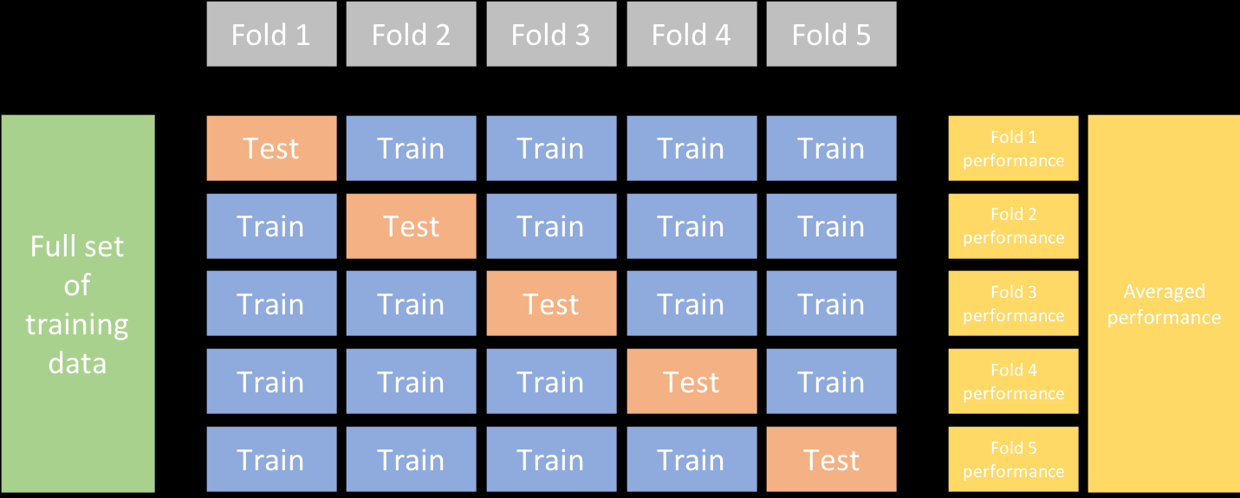

Slide 16
Bootstrapping
A Bootstrap sample is a random sample taken with replacement
After a data point is selected for inclusion in the sample it is still available for another selection.
A Bootstrap sample is the same size as the original dataset
There is less variability in the error measurement because observations in the sample will likely be replicated
But, this may increase the bias of the error measurement

Slide 17
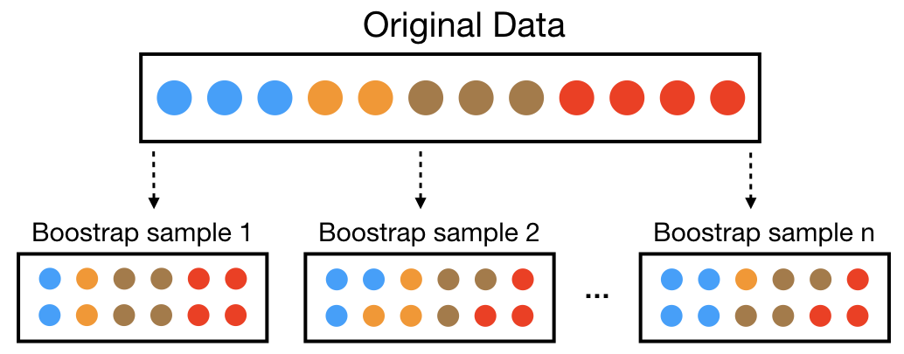

Slide 18
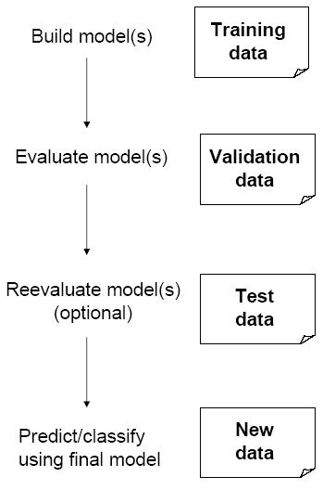
Partitioning the Data
Problem: How well will our model perform with new data?
Solution: Separate data into two parts
Training partition to develop the model
Validation partition to implement the model and evaluate its performance on “new” data
Addresses the issue of overfitting

Slide 19
Hyperparameter Tuning
We try to control the complexity of machine learning algorithms and, consequently the bias-variance tradeoff
Hyperparameters are parameters we can use to improve our model and control the bias-variance tradeoff
Most machine learning algorithms have at least one hyperparameter
Ex: k-nn - one parameter: k
If k is small, the basis for a decision is only on that small number – leads to high variability (but low bias)
As k gets larger we are basing our decision on the average of a larger subset – variability goes down, but bias goes up

Slide 20
Hyperparameters
We can “fiddle” or manipulate the hyperparameters manually until we find a combination of hyperparameter values that results in high accuracy
Could be tedious and laborious to do if there a large number of available hyperparameters for the algorithm
Can do a Grid Search: and automated approach to searching the combinations of hyperparameter values
Example: k-nn – a grid search would generate a list of possible values for k and perform a resampling method to (like k-fold CV) to determine which value of k might generalize best to new data

Slide 21
Model Evaluation
Regression Models:
Mean Squared Error
Root Mean Squared Error
Mean Absolute Error
Mean Absolute Deviation
Classification Models
Misclassification
Confusion Matrix – compares actual categorical levels to predicted levels

Slide 22
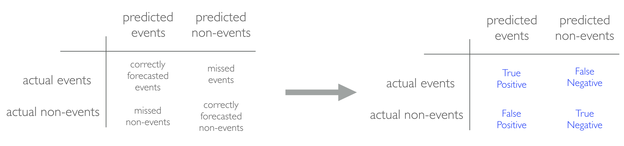
Confusion Matrix
Accuracy – measure of correct classification – opposite of misclassification
Precision - of the number of predictions we made, how many were correct?
Sensitivity – For the events that occurred, how many did we predict? True positive rate
Specificity – How accurately did we predict non-events? True negative rate

Slide 23
| wbcd_test_pred
Actual | Benign | Malignant | Row Total |
--------------------------------------|----------- |
Benign | 61 | 0 | 61 |
| 1.000 | 0.000 | 0.610 |
| 0.953 | 0.000 | |
| 0.610 | 0.000 | |
------------|-----------|-----------|----------- |
Malignant| 3 | 36 | 39 |
| 0.077 | 0.923 | 0.390 |
| 0.047 | 1.000 | |
| 0.030 | 0.360 | |
------------|-----------|-----------|----------- |
Column Total 64 | 36 | 100
| 0.640 | 0.360 | |
-----------------|-----------|-----------|-----------|

Slide 24
AUC: Area Under the Curve
ROC curve
Plots the false positive rate along the x-axis and the true positive rate along the y axis
Random guess marks the straight line from the origin to the upper right corner
The higher the line drifts to the upper left hand corner the better
AUC computes the area under the curve

Slide 25
