Slide 1
Hackathon-30-Nov-2024
Cross-Sell Prediction

Slide 2
Problem Overview
Problem Statement
Insurance company wants to cross-sell their Vehicle Insurance to the customer who’ve already brought their Health insurance.
Data set provided
train.csv - 381109 records with 12 columns
test.csv - 127037 records with 11 columns

Slide 3
Observations
There no null values or missing data observed in the provided Train/Test Dataset
No major outliers identified
Response is the Target to be identified
Out of 12 columns only 3 where Categorical columns remain where numerical including Target
Output response is binary (i.e.) the response recieved is 0/1 or Yes/No. Hence this problem statement is classification
Train dataset is imbalanced and it is highly skewed towards 0, where customer are not interested in buying the addon or vehicle insurance

Slide 4
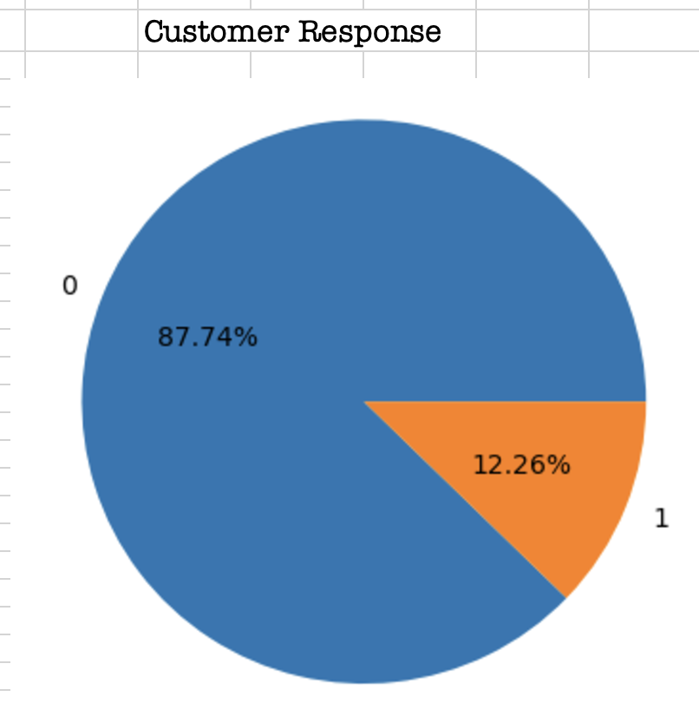
Data Analysis – Target Distribution

Slide 5
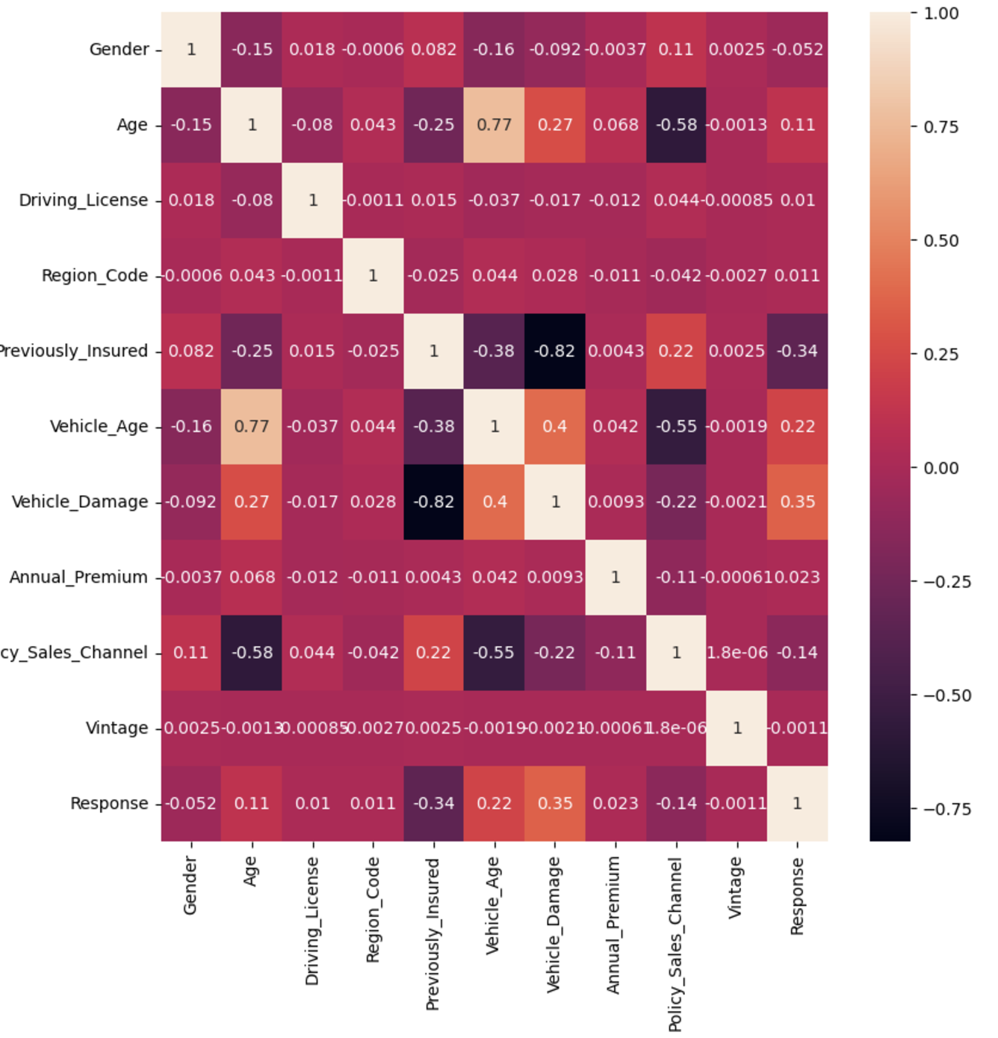
Data Analysis – Feature Correlation with Target

Slide 6
Data Preparation
Both the Numerical and Categorical input were preprocessed using pipeline strategy
To mitigate the imbalance we’ve applied both under sampling and over sampling techniques
As part over sampling both random & SMOTE where used
Since its classification problem I’ve fitted the data with different models like logistic regression, Decision Tree, Random forest, KNN
Also, I’ve implied boosting technique like AdaBoost,XGBoost,GradientBoost
GridSearchCV was also used for applying best hypermeter interms of Regularization

Slide 7
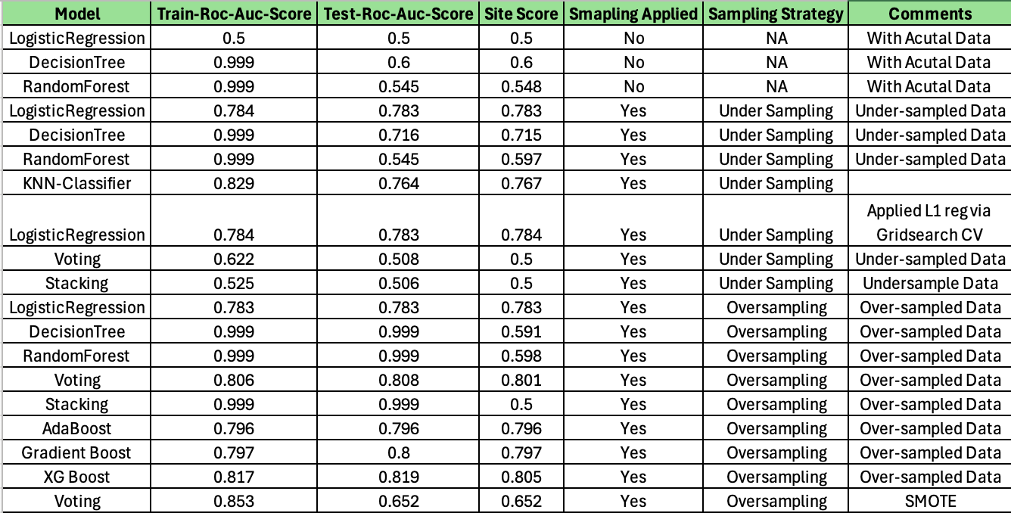
Classification Analysis
Applied the following models and scores obtained

Slide 8
Prediction Success rate
Results of predicted output compared with Target column in Test data
Model | Success Rate
Gradient Boost | 79.7%
XG Boost | 80.05%
Voting | 80.01%

Slide 9
Conclusion
Out of the 19 iterations of testing and modelling we are recommending the XGBoost model for this vehicle insurance cross-sell prediction

Slide 10
Repo and Cloud Deployment links
Git Repo
https://github.com/BalamuruganDE/DataScience/tree/main/MachineLearning/Hackathon_30Nov2024
Files:
Main file:
https://github.com/BalamuruganDE/DataScience/blob/main/MachineLearning/Hackathon_30Nov2024/Cross-sell-Prediction.ipynb
WebUI:
https://github.com/BalamuruganDE/DataScience/tree/main/MachineLearning/Hackathon_30Nov2024/WebUI

Slide 11
Repo and Cloud Deployment links.. Cont..
FastApi:
https://github.com/BalamuruganDE/DataScience/tree/main/MachineLearning/Hackathon_30Nov2024/FastApi
GCP FastAPI link
https://hackathon-fastapi-1087285761306.us-central1.run.app
GCP WebUI link
https://hackathon-webui-1087285761306.us-central1.run.app

Slide 12
Thank You

