Slide 1
Random Forest Model for Booking Prediction
By Balamurugan Thirukonda S. B.
November 2024

Slide 2
Objective
Purpose:
Predict customer booking completion
Objective:
Use machine learning to predict booking behaviour based on features like purchase lead time, length of stay, booking origin, seat preference, extra baggage preference etc
Business Relevance:
Enable targeted marketing and better resource allocation

Slide 3
Data Overview
Dataset:
Raw Data: 50,000 records (with some missing values and duplicates removed) include sales_channel, purchase_lead, length_of_stay, wants_extra_baggage, wants_preferred_seat, flight_duration_category, booking_origin, booking_complete features.
Processed Data Used in the Model: 48993 samples after cleaning, transformation.
Feature Engineering:
Created lead_stay_interaction, which represents the product of purchase_lead_time and length_of_ stay.
Converted booking_origin countries to continents
Categorized flight_duration into short_haul, medium_haul and long_haul.
Converted purchase_lead into 5 categeroies (example- 0-100, 101-200 until 401-500)
Data Preprocessing:
Applied SMOTE to handle class imbalance
One-hot encoding for categorical variable (booking_origin_continent, flight_duration, sales_channel, purchase category)

Slide 4
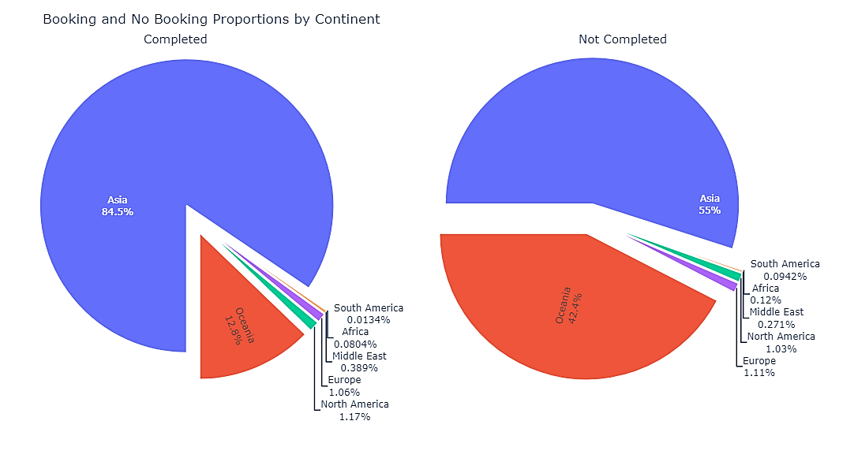
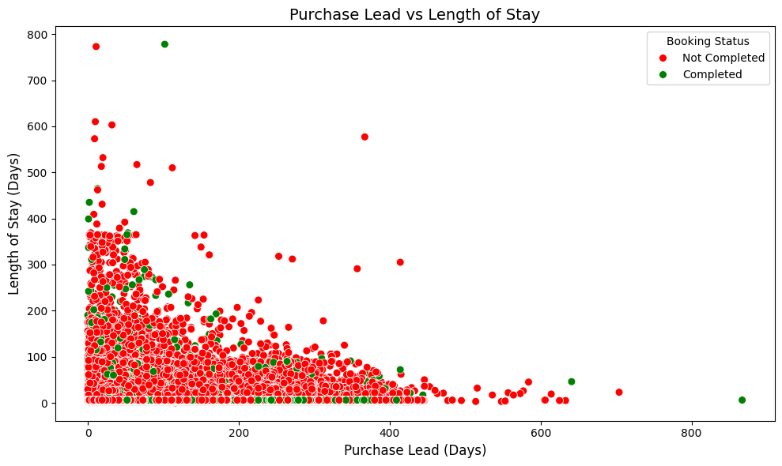
Exploratory Analysis
Majority of the booking, both completed and incompleted took place in the regions from Asia and Oceania contients.
In contrast to completed booking, the proprotion of incomplete booking is higher in Oceania.
Most of the customers were found to book flight tickets approximately 100 days in advance.
Also, most of the customers checked/booked tickets with approximately 100 days length of stay
Both length of stay and Purchase_lead has outliers.

Slide 5
Model and Evaluation
Model: Random Forest Classifier
Hyperparameter Tuning:
GridSearchCV was used to tune:
max_depth': [10, 20, None],
min_samples_split': [2, 5, 10],
min_samples_leaf': [1, 2, 5],
Class_weight': ['balanced', {0: 1, 1: 5}, {0: 1, 1: 10}],
max_features': ['sqrt', 'log2’]
Threshold Used for Prediction:
Threshold for class prediction: 0.55 (increased from the default 0.5 to increase recall for completed bookings)
This change improved recall but resulted in a slight drop in precision for class 0.
Evaluation Metrics:
Accuracy: 0.60
Precision for Class 1: 0.19
Recall for Class 1: 0.51
F1 Score: 0.28
Confusion Matrix:
 | Predicted Class 0 | Predicted Class 1
Actual 0 (Booking incomplete) | 5098 | 3228
Actual 1 (Booking complete) | 716 | 757

Slide 6
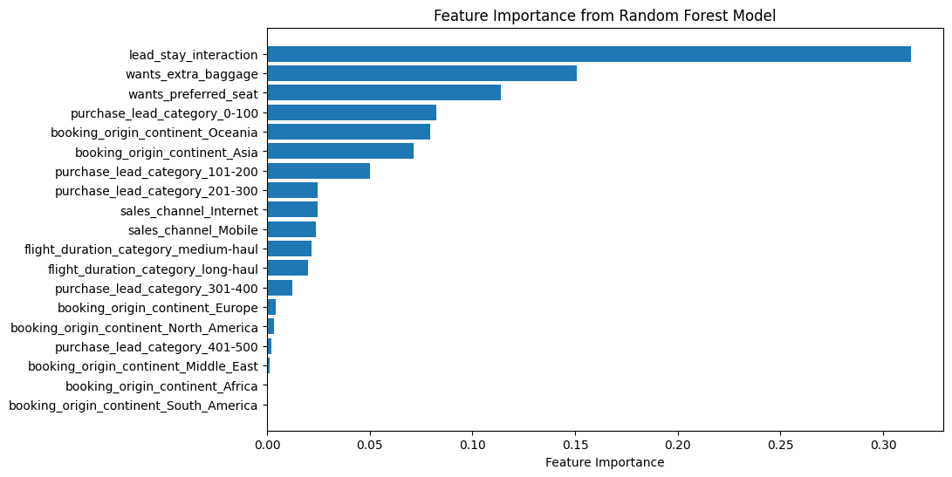
Feature Importance
Key Features:
Lead_stay_interaction is the most important factor, suggesting that customers who purchase their tickets farther in advance are more likely to complete the booking.
Want_extra_baggage, want_preferred_seat, prior booking (0-100 days) are also critical.
booking_origin (continent instead of country) shows regional trends in booking behavior.

Slide 7
Model Interpretation & Insights
Key Tools Used:
Feature Importance: Identified key features driving booking completion.
SHAP Values: Explained individual feature impacts on predictions.
Key Findings:
Purchase Lead Time: Shorter lead time increases booking completion.
Length of Stay: Shorter stays correlate with higher completion rates.
Booking Origin: Regional differences affect completion rates.
Flight Duration: Long-haul flights see more completions.
Business Implications:
Target Shorter Purchase Lead Times: Offer targeted promotions to last-minute bookers.
Promote Shorter and Moderate Stays: Use package deals to encourage shorter trips.
Regional Marketing: Focus efforts in regions with higher completion rates (e.g., Asia, Oceania and Europe).
Tailor Offers for Long-Haul Flights: Offer value-added services for long-haul travellers.

Slide 8
Conclusion and Recommendation
Conclusion:
This analysis shows that the RandomForest model provides valuable insights into the factors influencing booking completion. The model effectively captures trends in the majority class, though precision in predicting completed bookings (the minority class) remains a challenge.
Recommendations:
Explore additional features to improve predictive power, such as seasonal trends or customer demographics.
Consider testing Gradient Boosting or XGBoost models to improve minority class precision and overall predictive accuracy.

Slide 9
Thank you!

