Slide 1




Hexaware CODE&RISE PROGRAM
TECHIES_VELAMMAL_INST
Innovative Rides, Smarter Commutes

Slide 2
Team Details
Team Name : TECHIES
Application Name : Rideshare Application
Team Members
Email ID
Balamurugan.A
balamurugan16022004@gmail.com
Vinod.A
vinodanbu2209@gmail.com
Elangovan.M
muruganelango2004@gmail.com
Mukesh .S
mukesh160504@gmail.com

Slide 3

Strengthens CSR and employer branding.
Impact/Potential Value of the Application
Reduces commuting expenses for employees and company.
Promotes sustainable commuting practices.
Can be adapted for other regions or services.
Fosters connections and team cohesion.
Strengthens CSR and employer branding.
Improves route planning, reduces tardiness.
Demonstrates innovation with AI, provides useful data.

Slide 4
The Solution Proposed by our Team
Solution Highlights
Key Features / Approach
Simplifies the commuting process, making it more convenient and less stressful.
Supports Hexaware’s sustainability goals and reduces the company’s carbon footprint.
Potential for adding features like real-time traffic updates or partnerships with public transportation.
Reduces overall transportation expenses for both employees and the company.
AI to match employees with similar travel routes and schedules, optimizing ride-sharing opportunities.
Streamlines the commuting experience by providing a user-friendly platform for finding and coordinating rides.
Highlights Hexaware’s dedication to innovative and sustainable practices, strengthening its reputation as a socially responsible employer.
Cost Reducing Mechanism
Sustainability Metrics
AI-Powered Route Matching
Monitoring and Optimization
Safety and Security Features
User-Friendly Interface

Slide 5
Technologies Used
Security Technologies: SSL/TLS for encryption; regular security audits, compliance with GDPR and CCPA.
User Interface (UI) and User Experience (UX) Tools: Figma, Adobe XD for design; InVision, Marvel for prototyping.
Real-Time Communication: Push notifications with Firebase Cloud Messaging (FCM), OneSignal; WebSockets, PubNub for in-app messaging.
Development and Deployment Tools: Git, GitHub, GitLab for version control; Jenkins, CircleCI, GitHub Actions for CI/CD.
Data Analytics and Reporting: Tableau, Power BI for business intelligence; Google Analytics, Mixpanel for user behavior and performance tracking .
Database Management: PostgreSQL, MySQL for relational data; MongoDB, Firebase for NoSQL

Slide 6
Gen AI Tool Utilization
Personalized Recommendations
Natural Language Processing
Traffic Predictions
Dynamic Pricing Models
Fraud Detection
Feedback Analysis

Slide 7
System Architecture, Functionalities and Design Diagram
Data Flow and Processing Steps
User Registration and Authentication
Real-Time Ride Tracking
Data Storage and Analytics
Components and Their Interactions
Route Optimization Engine
Real – Time Communication Module
Authentication Service
Data Pipeline,API,and Exteral Services
Geolocation API
Traffic Data Providers
Data Processing

Slide 8
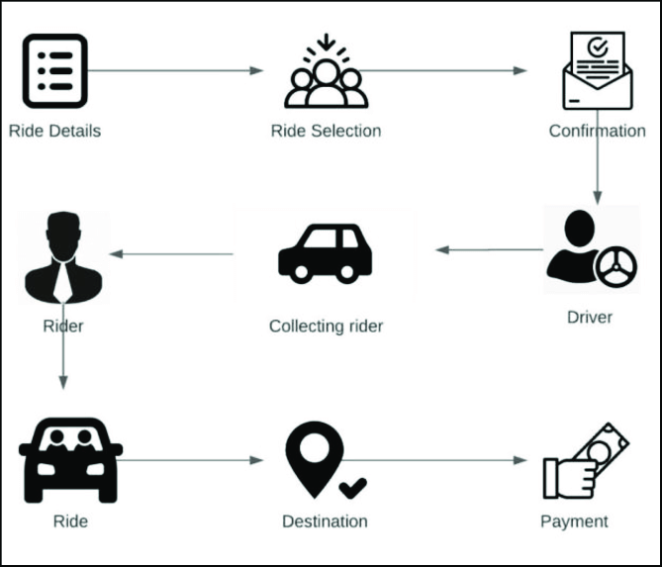
How it works
Functional Architecture

Slide 9
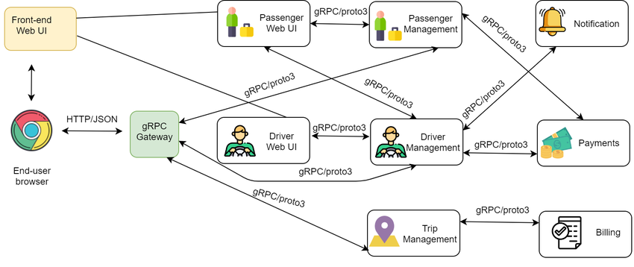
How It Works
Technical Architecture

Slide 10
Innovation and Creativity
AI-Driven Route Optimization
Real-Time Communication
Innovative UI/UX Design
Advanced Analytics
Dynamic Scheduling
Smart Cost Sharing

Slide 11
Scalability, Performance and Security
Scalability
Cloud-based Architecture
Load Balancing
Database Sharding
Performance
Real-Time Data Processing
Performance Monitoring
Efficient Algorithms
Security
Data Encryption
Secure Authentication
Regular Security Audits and Access Controls

Slide 12
Best practices and industry standards followed
Implementing robust data encryption, secure authentication, and compliance with privacy regulations
Designing for scalability with cloud-based infrastructure and modular architecture to handle growth and peak loads.
Ensuring intuitive design and usability through user-centered design principles and regular usability testing.
Using standardized APIs and protocols for integration with third-party services like payment gateways and mapping services.
Conducting performance testing to ensure fast load times and smooth app operation under varying conditions.
Adhering to local regulations and industry standards related to transportation, safety, and financial transactions.

Slide 13
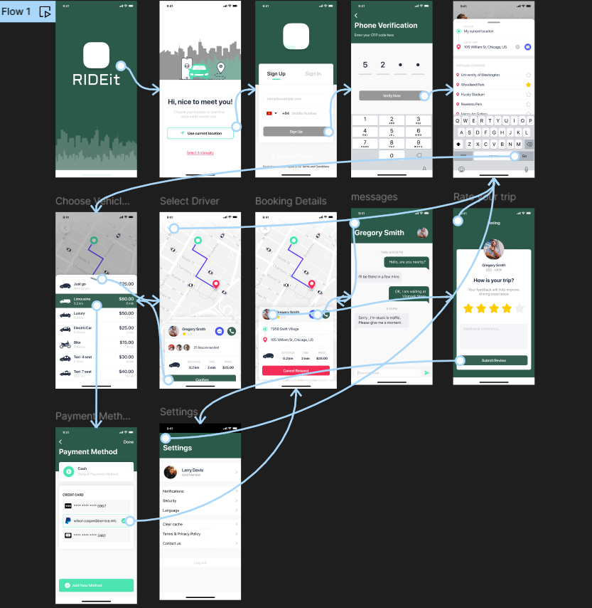
User Experience

Slide 14
Console Output Details
The link to the GitHub repository containing your solution :
https://github.com/Balamuruganhb/Rideshare-Application_velammal_inst

Slide 15
Thank You

