Slide 1


Implementation Of Huffman Algorithm For ECG SIGNAL
BALAN M, ECE
VENKATESA RAKSHAN S,ECE

Slide 2
Outline
Introduction
Problem Statement
Market Survey
Methodology
Results and Discussions
Conclusions
References
Acknowledgements

Slide 3
Introduction
This project focuses on the compression and analysis of an Electrocardiogram (ECG) signal using lossy compression and Huffman coding.
ECG signals, commonly used in medical diagnostics to monitor heart activity, can contain vast amounts of data that require efficient storage and transmission.
This project implements a method to reduce data size through quantization (a form of lossy compression), followed by Huffman encoding, an entropy-based algorithm that assigns shorter binary codes to frequently occurring values.

Slide 4
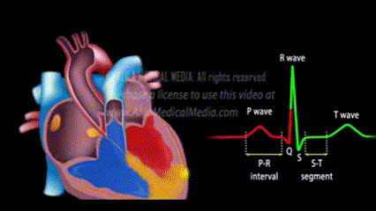
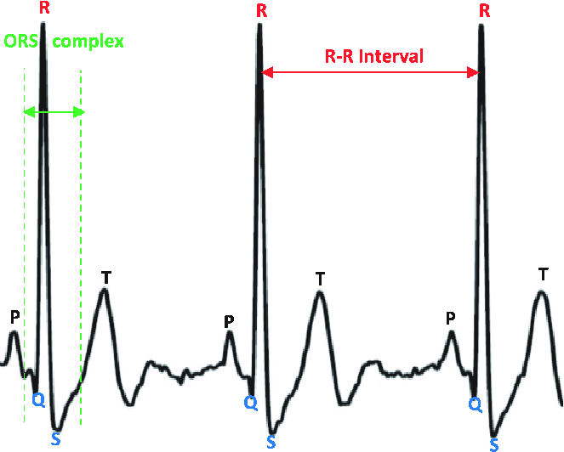
Introduction
About an ECG Signal
An ECG (Electrocardiogram) signal is a record of the heart's electrical activity over time, captured by electrodes placed on the skin to assess heart health.
The signal comprises waves and intervals that correspond to various phases of the heart's electrical cycle.

Slide 5
PROBLEM STATEMENT
Continuous ECG monitoring generates large data volumes, posing challenges in storage and transmission, especially in remote health and telemedicine.
This project utilizes Huffman coding for efficient, lossless compression of ECG signals, significantly reducing data size while maintaining quality.
This approach enables reliable, cost-effective data handling in healthcare systems.

Slide 6
Market Survey
Huffman Coding with Quantization for ECG Signals: This technique first applies quantization to reduce ECG signal precision, followed by encoding the quantized data with Huffman coding. It maintains a balance between data compression and signal fidelity, achieving a moderate compression ratio. This method is ideal for applications in telemedicine and remote monitoring devices where efficient data transmission and storage are critical but lossy compression is acceptable.
Adaptive Huffman Coding: Unlike standard Huffman coding, adaptive Huffman coding dynamically updates the symbol encoding based on real-time changes in ECG data. This adaptability provides efficient, lossless compression suited for continuous monitoring in wearable ECG devices, where data patterns may vary significantly during different cardiac activities.
Predictive Coding with Huffman Encoding: By using predictive coding to remove redundancy, followed by Huffman encoding of residuals, this technique optimizes compression ratios while preserving detailed ECG features. It’s particularly effective in applications where minimal data loss is critical, such as in early heart anomaly detection systems or critical care monitoring.

Slide 7
Huffman Coding (ALAP)
Collect and preprocess raw ECG signals from standard databases, filtering noise and normalizing data.
Analyze the frequency of data values to construct a frequency table of unique values.
Build a Huffman tree from the frequency table and generate corresponding Huffman codes.
Compress the ECG data by replacing original values with their Huffman codes.
Evaluate the compression ratio, storage savings, and quality of the original and compressed signals, documenting findings and potential improvements.

Slide 8
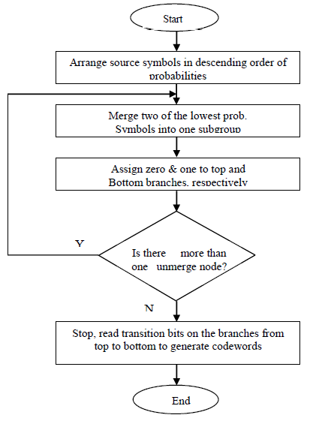
Flowchart

Slide 9
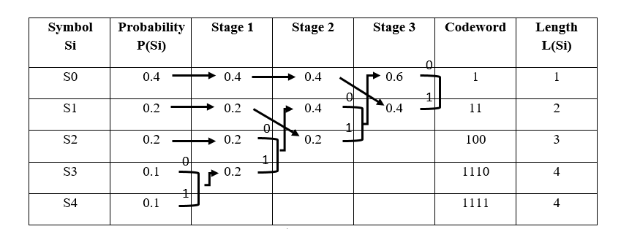
Mathematical model

Slide 10
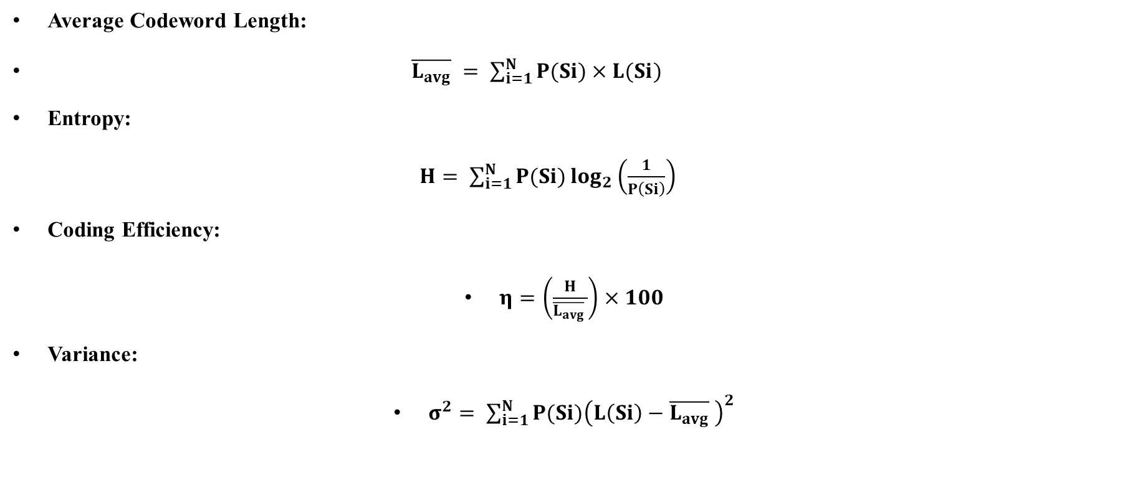
Huffman Coding (ALAP)
Average Codeword Length:
$\overline{L_{avg}} = \sum_{i=1}^{N}{P(Si)}×L(Si)$
Entropy:
$H= \sum_{i=1}^{N}{P(Si)\log_{2}\left(\frac{1}{P\left(Si\right)}\right)}$
Coding Efficiency:
$η=\left(\frac{H}{\overline{L_{avg}} }\right)×100$
Variance:
$σ^{2}= \sum_{i=1}^{N}{P(Si){\left(L\left(Si\right)−\overline{L_{avg}} \right)}^{2}}$

Slide 11

Methodology
Coding Efficiency:
$η=\left(\frac{H}{\overline{L_{avg}} }\right)×100$
Variance:
$σ^{2}= \sum_{i=1}^{N}{P(Si){\left(L\left(Si\right)−\overline{L_{avg}} \right)}^{2}}$

Slide 12
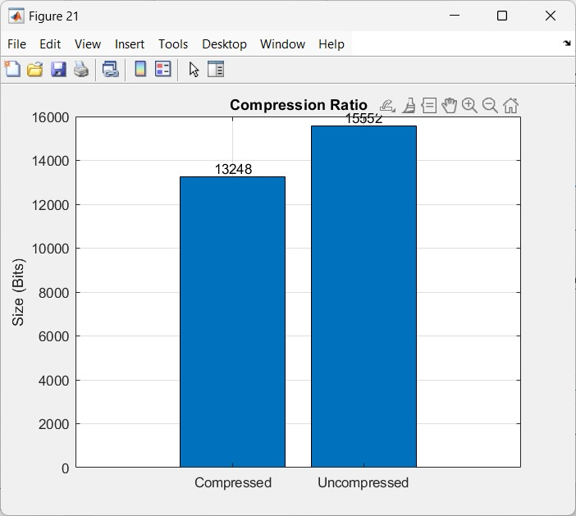
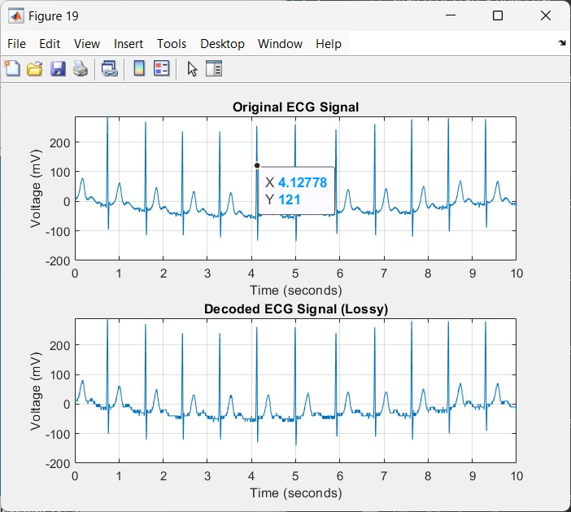
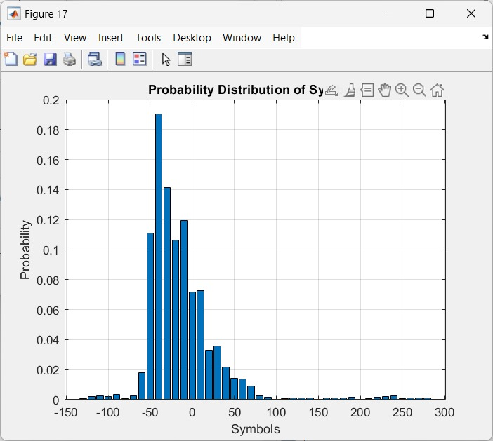

Results and Discussions

Slide 13
Results and Discussions
Input Data taken from PhysioNet
The data comprises 18 long-term recordings of single-lead ECGs and associated 3-axis accelerometer data, collected from 15 subjects (9 female, 6 male) aged between 21 to 83 years. Recordings were carried out between August 2018 and October 2019 while the subjects were undertaking ordinary everyday activities.

Slide 14
Conclusions
The Huffman algorithm effectively compresses ECG signals, enabling efficient storage and transmission while preserving data integrity. This approach enhances real-time monitoring and supports advancements in telemedicine.

Slide 15
References
https://ijettjournal.org/Volume-72/Issue-2/IJETT-V72I2P121.pdf
https://www.geeksforgeeks.org/huffman-coding-greedy-algo-3/
https://www.nature.com/articles/s41598-024-68022-5
https://pmc.ncbi.nlm.nih.gov/articles/PMC7147367/

Slide 16
Acknowledgements
We acknowledge my gratitude and thank to all my teacher, friends and my family members for their constant encouragement.

