Slide 1
Project Ideation
Wealth Weaver – Finance Manager
Balan Mihai-Stefan
Class RB03 – Advanced Software

Slide 2

Introduction
My project, Wealth Weaver envisions an international financial management service for a wide range of customers. The target audience of this service is people who would like to stay on top of their finances, learn about their spending habits and improve their lifestyle.
The project leverages scalable Cloud Solutions to provide spontaneous services for a large amount of customers, available at all times worldwide, and Distributed Systems architecture to ensure service uptime.

Slide 3
Main research question
What is the best way to implement scalable and secure IT systems in the area of internet banking?

Slide 4
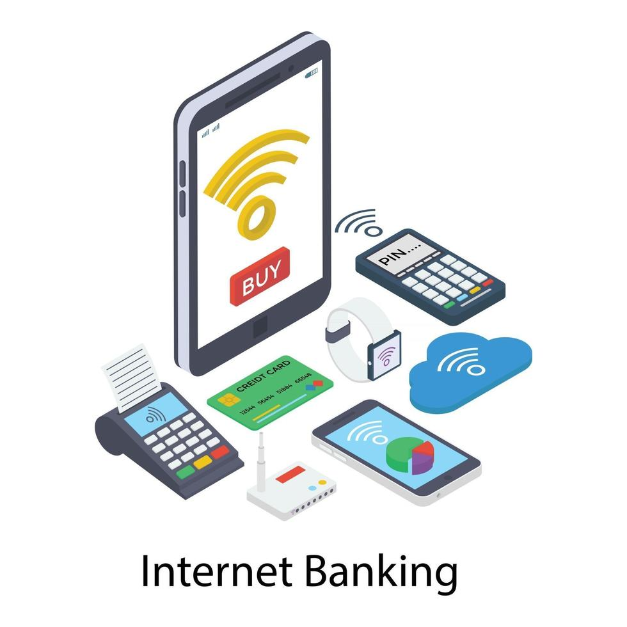
Risks and challenges
1. Banking integration systems tend to be very strict even in non-commercial environments.
Mitigation: create a mock service similar to Tikkie
2. Security compliance may not be met up to standards and criteria to work with banking: GDPR, PCI/DSS.
3. Deployment may prove challenging around new concepts like Kubernetes, Azure Cloud, scaling, etc.
4. Limited subscription time: 1-2 sprints for entire cloud infrastructure.

Slide 5
Non-functional requirements
1. Scalability
- Horizontal Scaling
- Microservice Architecture
- Stateless Design
2. Resilience
- Distributed workloads
- Load Balancing
- Failover Mechanisms
3. Data Security
- Strong Encryption Protocols
- Secure Authentication
4. Elasticity (scaling efficiently based on workload)
- Scale up and down according to demand

Slide 6
Architecture Ideas
- Service oriented architecture – split backend, C# .NET framework technology choice, with minimal ReactTS frontend
- Use Microsoft Azure as cloud provider
- Kubernetes as main deployment target
- Use FaaS, inline with microservice-based architecture
- Individual system scaling and management with cloud services: Load Balancers, Horizontal Pod Autoscaling.
- Azure CosmosDB for scalable and distributed data storage solution

Slide 7
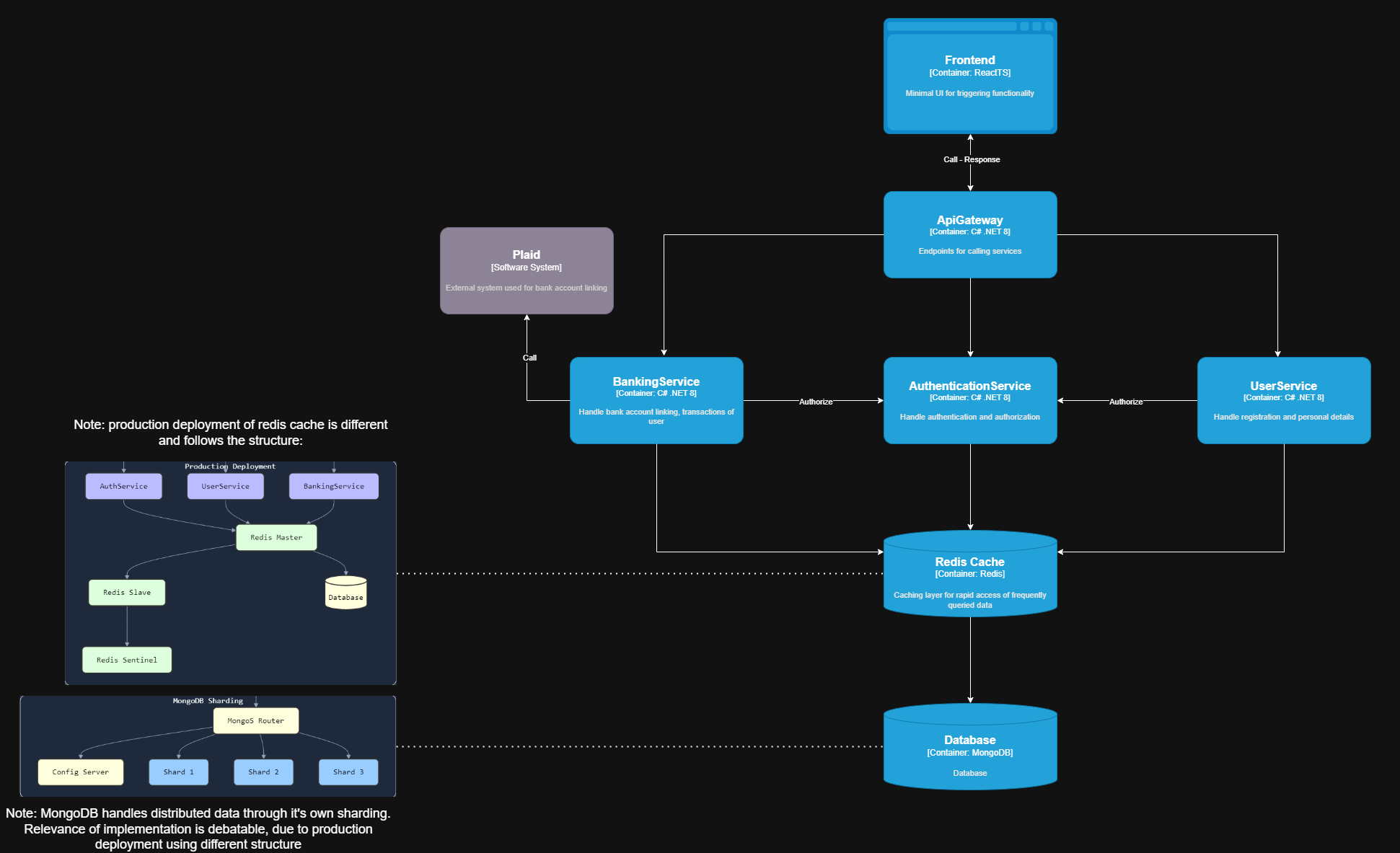
Diagram – Local Architecture

Slide 8
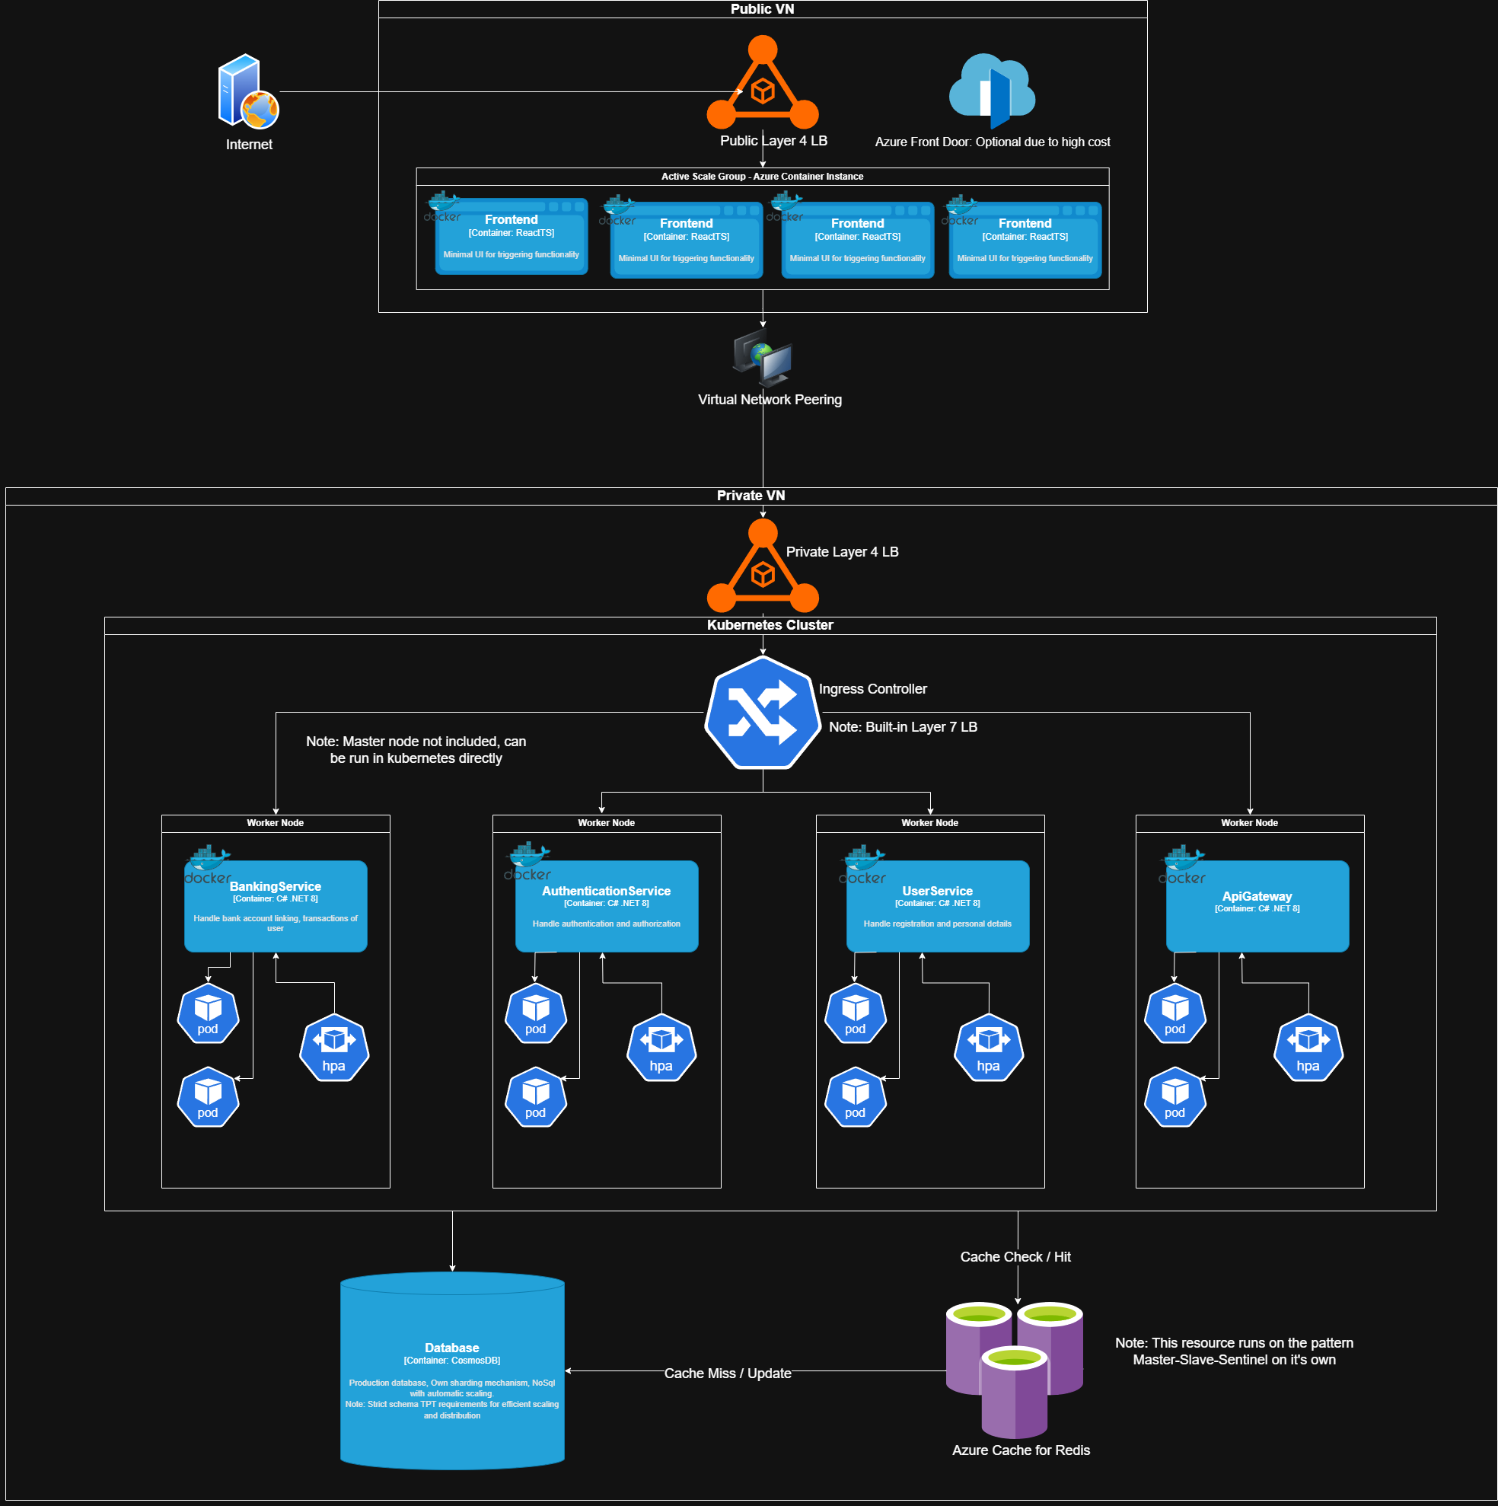
Diagram – Prod Architecture

