Slide 1
Project Ideation
Wealth Weaver – Finance Manager
Balan Mihai-Stefan
Class RB03 – Advanced Software
1

Slide 2
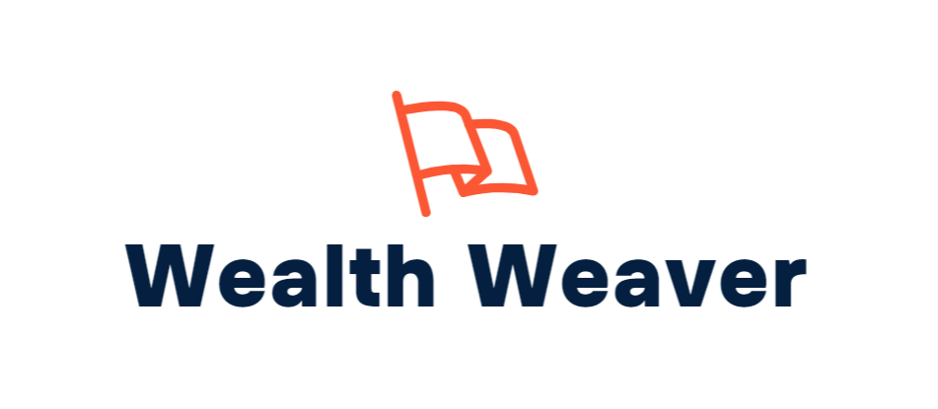
Table of contents
01
Introduction
03
Functional and Non-Functional Requirements
Introduction, Research approach
02
Challenges Expected
What can go wrong?
2

Slide 3
introduction
01
High-level overview
Research approach
Questions & sub-questions
3

Slide 4
Introduction
My project, Wealth Weaver envisions an international financial management service for a wide range of customers. The target audience of this service is people who would like to stay on top of their finances, learn about their spending habits and improve their lifestyle.
The project leverages scalable Cloud Solutions to provide spontaneous services for a large amount of customers, available at all times worldwide, and Distributed Systems architecture to ensure service uptime.
4

Slide 5
Main research question
What is the best way to implement scalable and secure IT systems in the area of internet banking?
5

Slide 6
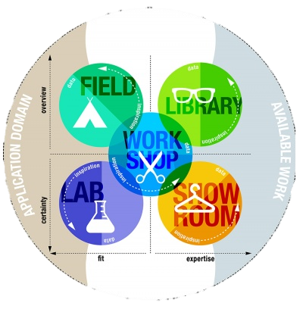
Sub-questions
What
6

Slide 7
Challenges Expected
02
What can go wrong with the project?
Mitigation plans for associated risks
15

Slide 8
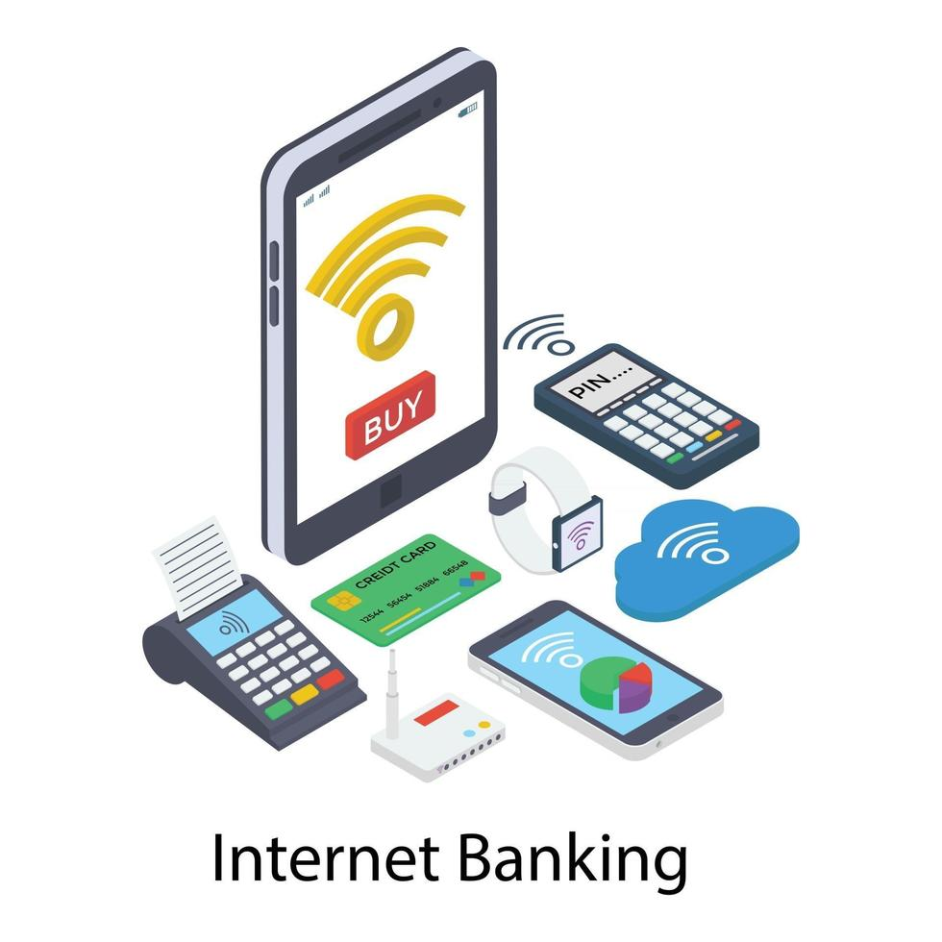
Risks – internet banking
1. Banking integration systems tend to be very strict even in non-commercial environments.
2. Security compliance may not be met up to standards and criteria to work with banking: GDPR, PCI/DSS.
3. Software development features may carry over to the next sprint if not completed within their assigned sprint, reducing time available for deployment and cloud integration.

Slide 9

FR’s & NFR’s
03
What needs to be achieved on a technical level?
Performance and Quallity envisioned for customer-facing systems.
3

Slide 10
Functional
requirements
Functional
Passive OSINT Tools: Shodan, Censys, Maltego - used for obtaining information on open ports and running services.
Active Scanning Tools: Nmap - utilized for scanning IP ranges for live hosts, open ports, and services.
Vulnerability Analysis Tools: Custom Python scripts, WPScan, sqlmap - employed for in-depth vulnerability discovery and testing.
Exploitation Frameworks: Metasploit (Meterpreter) - leveraged for exploiting discovered vulnerabilities.

