Slide 1
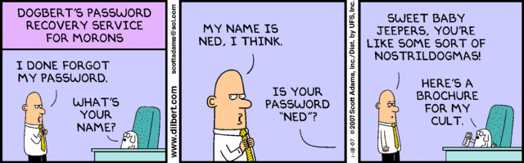
Go Hack Yourself 10 Pen Test Tactics for Blue Teamers
Jason Frank Brent Kennedy Will Schroeder

Slide 2
Introduction
@jasonjfrank (Jason Frank)
Manager of Veris Group’s Adaptive Threat Division
Builds and executes penetration testing programs
Black Hat Trainer: Adaptive Penetration Testing
@bk_up (Brent Kennedy)
Senior pentester at CERT/SEI/CMU
Project lead supporting government customers
@harmj0y (Will Schroeder)
Security Researcher of Veris Group’s ATD
Veil-Framework & PowerTools
12 years experience leading pen test engagements for private and government customers

Slide 3
Why Go Hack Yourself?
Customers want to learn
How do I get started with pentesting?
What tools do you use?
How did you find that site on our network?
Why don’t blue teamers have black hats?
Lack of knowledge/training
Different mindset. Think like an attacker.
Bad connotation. Will break network.

Slide 4
Defending the Castle
Common problems for defenders:
Inventory
Updating/Upgrading
Consistency
Special requests
Costs
Cannot verify (exploit) vulnerabilities
Politics

Slide 5
Attacking the Castle
What attackers want to discover:
Live hosts/Domain structure
Software/patch levels
Exploitable conditions
Crown jewels
Attackers and defenders commonly want the same information
Attackers take the path of least resistance

Slide 6
Pros of Hacking Tools
Smaller scripts, no messy installation
Some run in memory
Free is cheap
Straightforward, easy to use
Minimal network disruption
Valid system calls, traffic

Slide 7
Why Focus on Windows?
Most target organizations use Windows for their userland network enclave
Linux, DB, *, admins usually have Windows endpoints and domain accounts
Attack Path
Spear Phish to client Windows endpoint
Escalate in Windows domain
Identify your prey (crown jewels)
Use gained access to pivot
Databases, servers, appliances, fileshares
Admin workstations

Slide 8
PowerShell
Microsoft’s “post-exploitation language”
Lets you stay off of disk, access Windows APIs, access anything in .NET, and is installed by default on Windows 7+
Makes a phenomenal platform to write hacking tools
Note: many people think that execution policy restricts attackers from running unsigned scripts
but you can just turn off execution policy on launch with: powershell.exe -exec bypass

Slide 9
Our Arsenal
All free, all open source, and a lot PowerShell focused:
Nmap: still the best port-scanner, with lots of extensible scripts now implemented
EyeWitness: easy web service screenshotting
PowerSploit: the first open-source offensive PowerShell toolkit
PowerUp: check for Windows privesc in seconds
PowerView: dsquery/situational awareness on steroids
Egress-Assess: allows for the controlled simulation of the egress of sensitive data

Slide 10
Our Approach
Asset discovery (on the cheap)
Base image analysis
Open fileshares
Who are your admins?
Where are your admins?
How old are their passwords?
Do you trust your trusts?
Who can admin your DCs?
Group Policy Preferences
Border egress protections

Slide 11
Tactic 1: Asset Discovery
Mapping a network for targets can be a daunting task in large environments
Nmap
Cron Job - every 25 hours
Scripted alerts for detected deltas
Utilize latency/timeout features for large networks
Eyewitness
https://github.com/ChrisTruncer/EyeWitness
Rapid screen grabbing of web sites
Parses Nmap output for web ports
Categorizing sites (High value targets, printers, etc.)
Easy way to discover misconfigured/default installations of web applications

Slide 12
Tactic 1: Asset Discovery
Run Nmap to discover live hosts on the network
nmap -Pn -n -sS -p 21-23,25,53,111,137,139,445,80,443,3389,5900,8080,8443 --min-rtt-timeout --max-retries 1 --max-scan-delay 0 -oA discovery-scan -vvv --open -iL <Host List>
Get host list: cat discovery-scan.gnmap | grep “open” | cut -d “ “ -f 2 > discovery_ips.txt
Run Nmap on live hosts with more port checks
nmap -Pn -n --min-rtt-timeout --max-retries 1 --max-scan-delay 0 -oA top1000-scan -vvv --open -iL disovery_ips.txt
Get host list
Feed Nmap results to EyeWitness
./EyeWitness.py -f top1000-scan.xml --headless
Open EyeWitness results in web browser

Slide 13
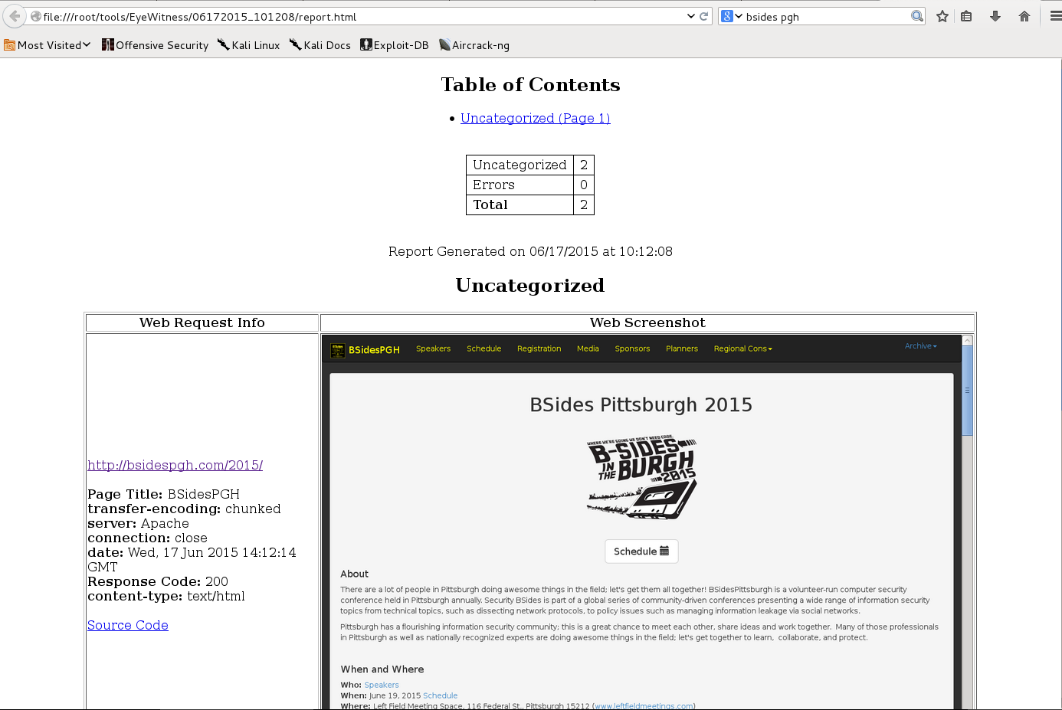

Slide 14
Tactic 2: Base Image Analysis
The first thing an attacker will do after achieving user access is try to escalate privileges
Many people think that if their system is patched, there’s no way to privesc
Many privilege escalation vectors are based on custom software and misconfigurations
Examine your base/SOE image for the same common vectors that attackers are going to look for!

Slide 15
Tactic 2: Base Image Analysis
PowerUp contains checks (and weaponizations) for the most common public Windows privesc vectors
The Invoke-AllChecks function will run through all current checks, highlighting anything that stands out
PS C:\> Import-Module PowerUp.ps1
PS C:\> Invoke-AllChecks

Slide 16
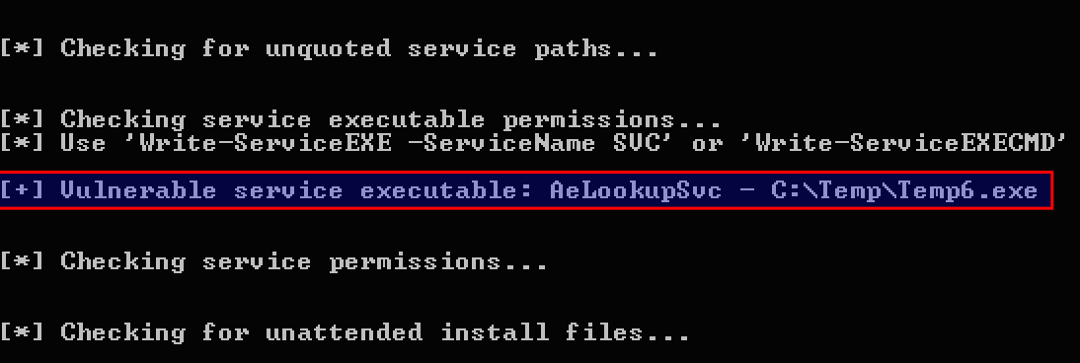
Tactic 2: Base Image Analysis

Slide 17
Tactic 3: Open Fileshares
Almost every organization has improperly secured Windows file shares
Common to find password lists, engineering plans, network diagrams, PII, etc.
It may be possible for users to create shares on their machines with little to no insight from IT
Audit these on a regular basis and from a variety of user contexts
i.e. basic no-domain-groups users, as well as users in a variety of common groups

Slide 18
Tactic 3: Open Fileshares
Running PowerView’s Invoke-ShareFinder will enumerate all domain machines and check for open file shares
the -CheckShareAccess flag checks if the current user can access the share
even finds hidden shares!
PS C:\> Import-Module powerview.ps1
PS C:\> Invoke-ShareFinder -CheckShareAccess

Slide 19
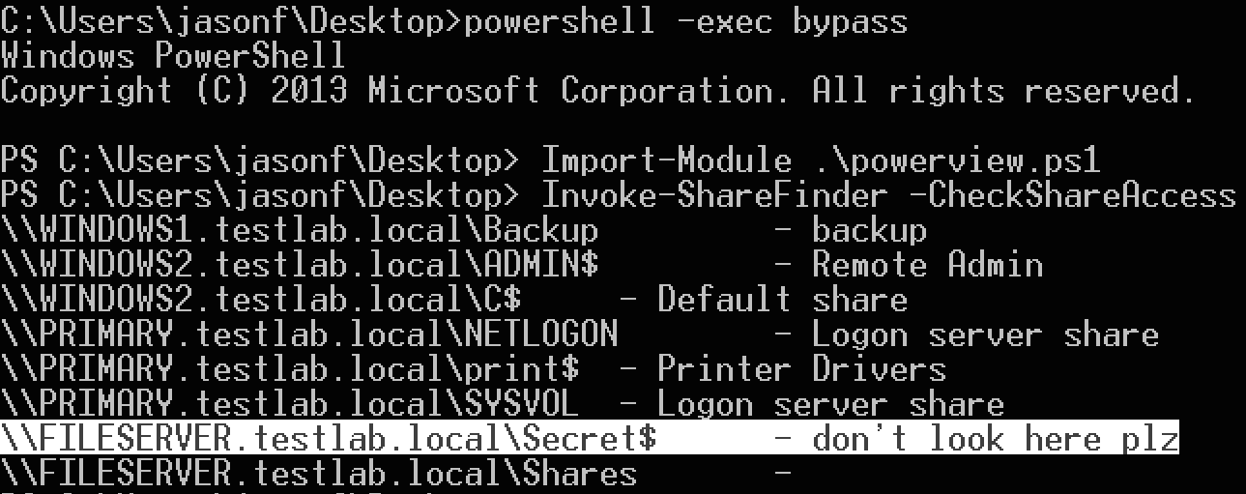
Tactic 3: Open Fileshares

Slide 20
Tactic 4: Who are your Admins?
If you have a complex Active Directory setup with lots of delegation, users can sometimes slip through the cracks
With highly nested groups, users might effectively have highly elevated rights without appearing so
Think something like “Domain Admins” → “Server Admins” → “SubGroup2”

Slide 21
Tactic 4: Who are your Admins?
PowerView’s group commands accept wildcards, meaning you can enumerate all users in a group’s membership
It can also resolve all sub groups recursively down to actual members (i.e. nested groups)
PS C:\> Import-Module powerview.ps1
PS C:\> Get-NetGroups *admin* | Get-NetGroup -Recurse

Slide 22
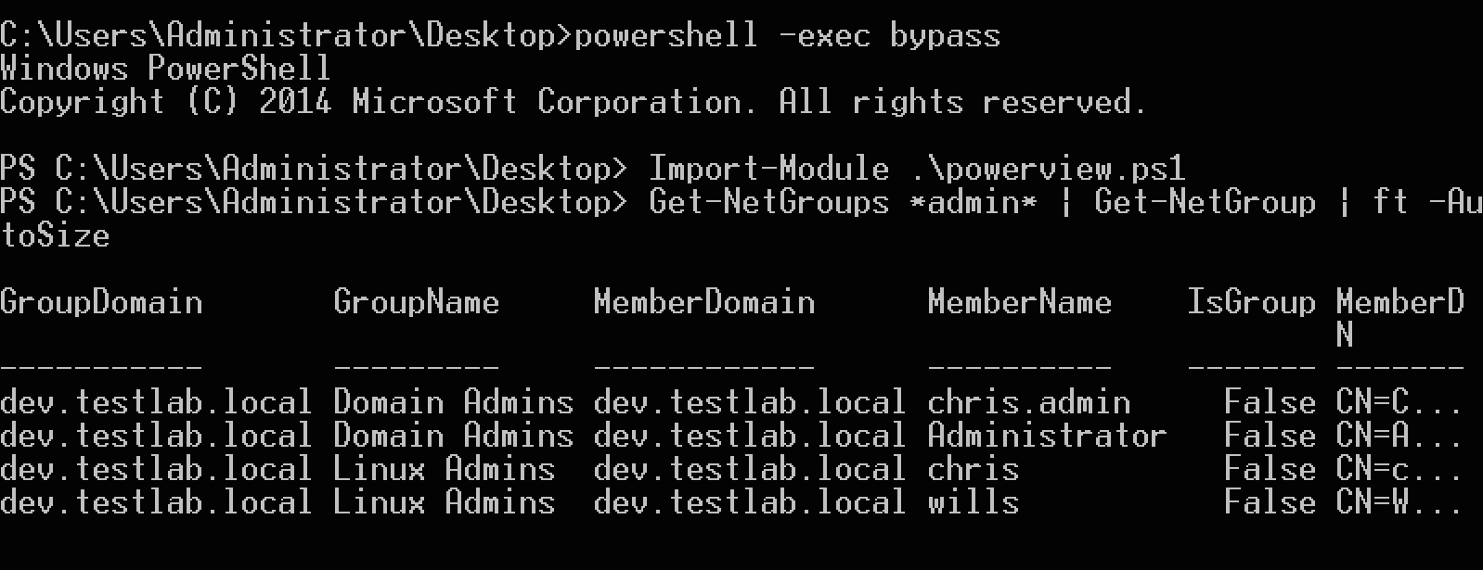
Tactic 4: Who are your Admins?

Slide 23
Tactic 5: Where are your Admins?
On almost every engagement, we “hunt” for where specific users are logged in
And again, attackers can pull lots of this information from a non-elevated user context!
Almost all organizations have “non-essential use of elevated access”
Translation: they have domain admins/other high value accounts logged in to lots of places they should not be

Slide 24
Tactic 5: Where are your Admins?
PowerView’s UserHunter modules can track down where specific groups or users are located
This information can be matched up against the group membership information from Tactic 4
PS C:\> Import-Module powerview.ps1
PS C:\> Invoke-UserHunter -ShowAll

Slide 25
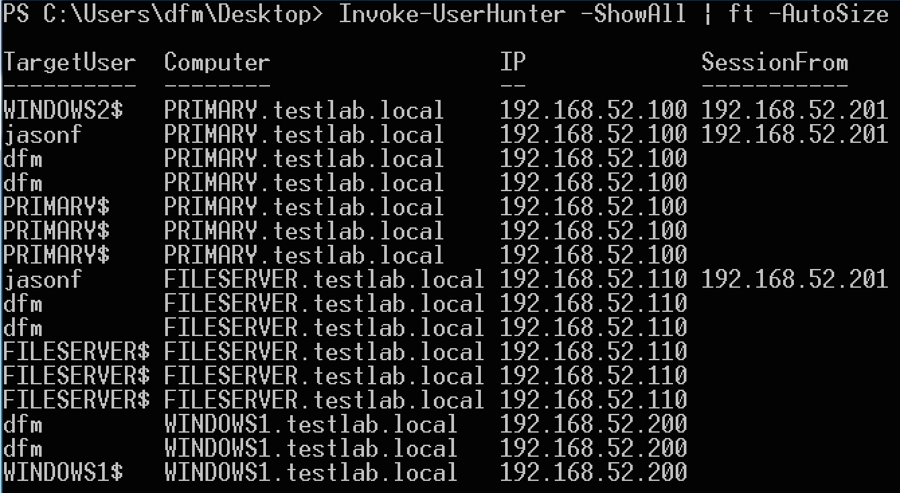
Tactic 5: Where are your Admins?

Slide 26
Tactic 6: Stale User Passwords
Users should be changing their passwords to prevent password compromise/reuse
Group Policy can enforce it, but users don’t always
It pays to audit your Active Directory setup
Still a bit of a manual process for most people
Another quick check is for enabled accounts with passwords older than a certain age

Slide 27
Tactic 6: Stale User Passwords
PowerView has your back:
PS C:\> Import-Module powerview.ps1
PS C:\> Get-NetUser | ? {$_.whenchanged -lt (Get-Date).AddMonths(-12)} | % {$_.samaccountname}

Slide 28
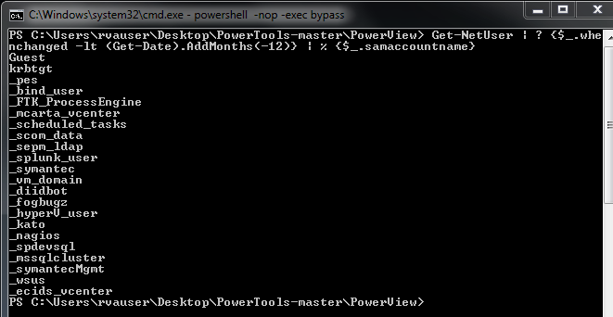
Tactic 6: Stale User Passwords

Slide 29
Tactic 7: Do You Trust Your Trusts?
Domain trusts are usually foreign to people without an AD administrator or a formalized red team background
If you’re admining a network with multiple domains, you should be aware of how they interact!

Slide 30
Tactic 7: Do You Trust Your Trusts?
PowerView can recursively crawl all reachable domain trust relationships and output to a .csv
yEd (also free) can be used to visualize this data
PS C:\> Import-Module powerview.ps1
PS C:\> Invoke-MapDomainTrusts | Export-CSV -NoTypeInformation trusts.csv
*visualize in yEd*

Slide 31
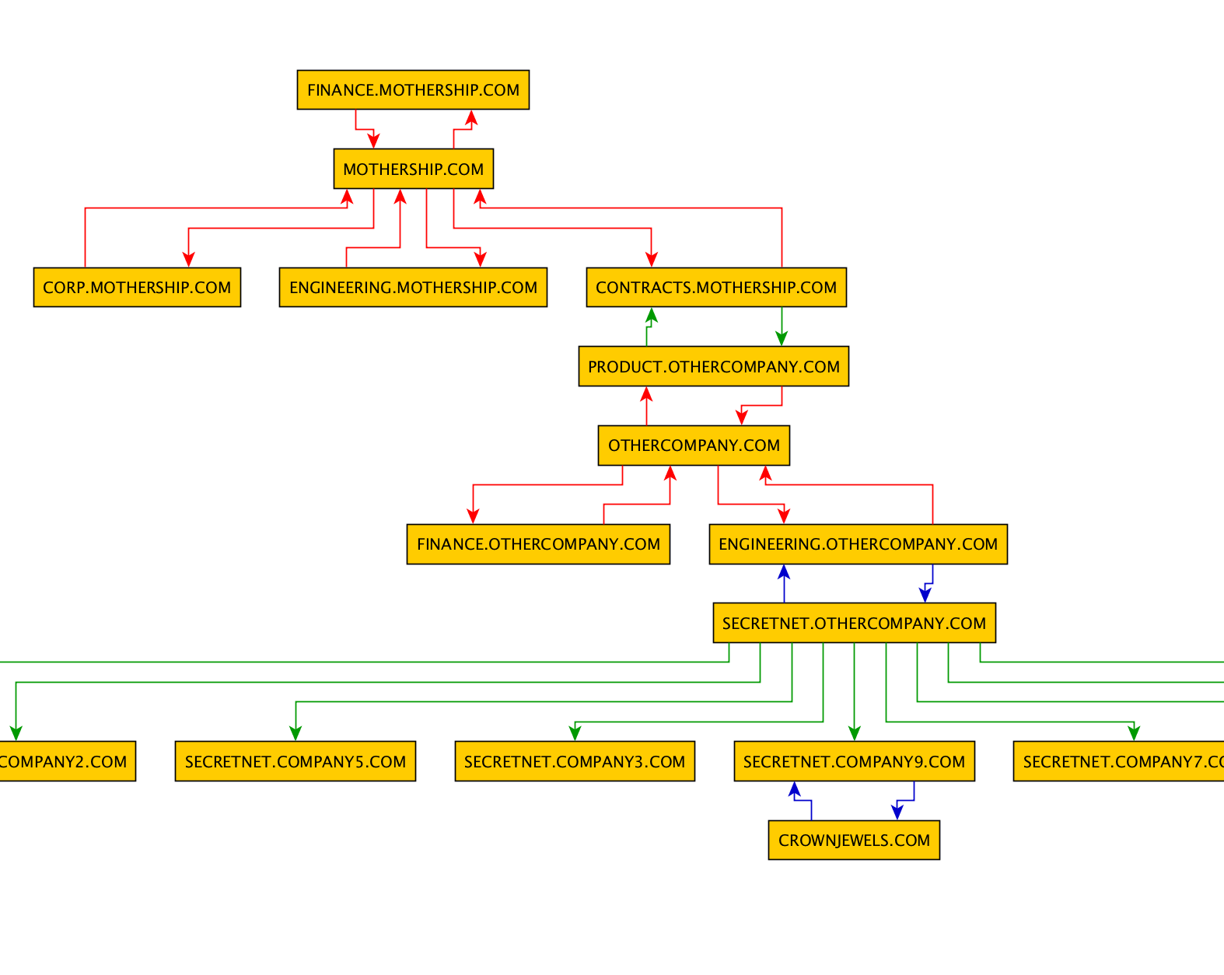

Slide 32
Tactic 8: Who Can Admin Your DCs?
Who has local administrative access on your domain controllers (and other high-value servers)?
Note: this is different than the domain admins group!
we’re talking about the BUILTIN Administrators group

Slide 33
Tactic 8: Who Can Admin Your DCs?
PowerView’s Get-NetLocalGroup can enumerate this information on remote systems, from an unprivileged user account!
We can pair this with the function that enumerates all domain controllers
PS C:\> Import-Module powerview.ps1
PS C:\> Get-NetDomainControllers | Get-NetLocalGroup

Slide 34
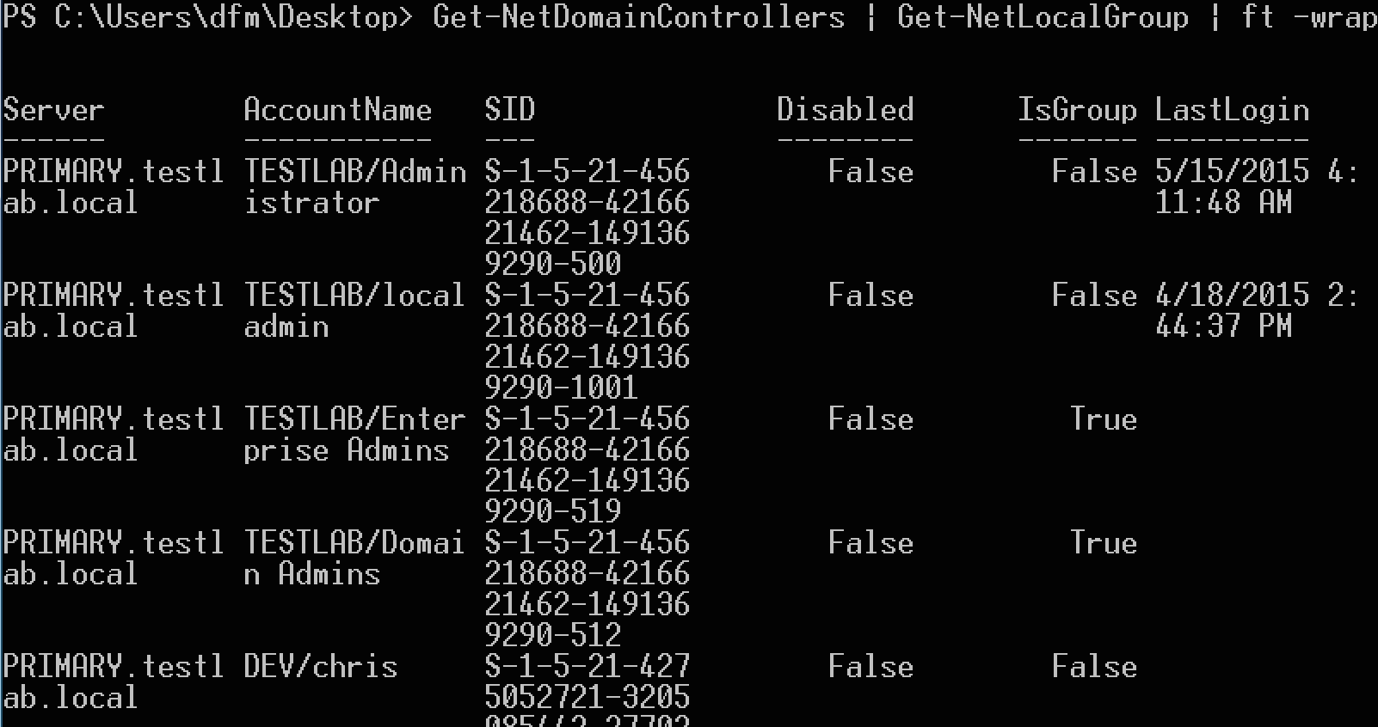
Tactic 8: Who Can Admin Your DCs?

Slide 35
Tactic 9: Group Policy Preferences
Group Policy Preferences is a mechanism used by some organizations to administer domain machines
Unfortunately, the key for the “encrypted passwords” in GPP is static, and was published online by Microsoft
This means that any user can pull and decrypt these passwords, if they are there

Slide 36
Tactic 9: Group Policy Preferences
PowerSploit has a module which will search domain controllers for the appropriate policy .xmls, extract any found passwords, and automatically decrypt them
PS C:\> Import-Module PowerSploit.ps1
PS C:\> Get-GPPPassword

Slide 37
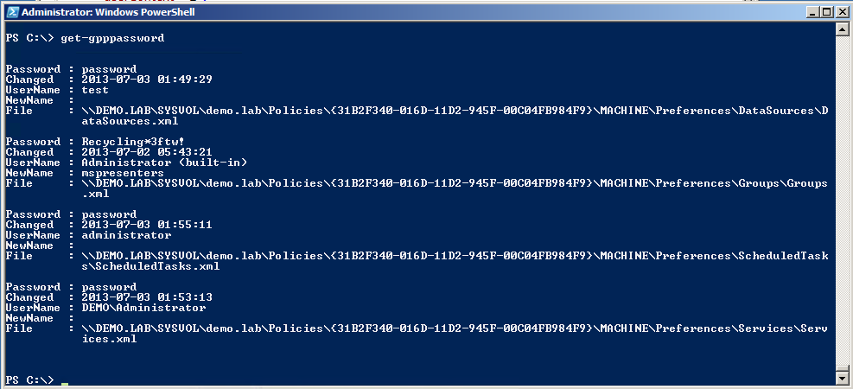
Tactic 9: Group Policy Preferences

Slide 38
Tactic 10: Border Egress Protections
Attackers often will move pilfered data to a single internal server and exfil in one swoop
Seeing massive exfil is often the first sign an organization sees that they’ve been owned
Many companies believe vendor claims that their border appliances will detect this behavior
But few bother (or know how) to test this
Blind spots often exist

Slide 39
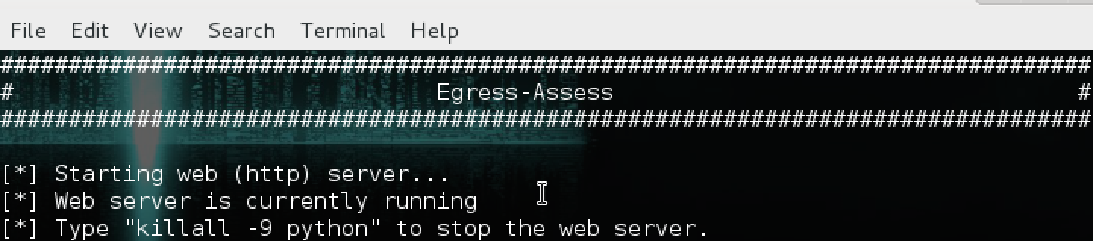
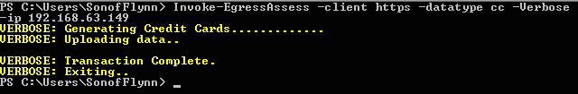
Tactic 10: Border Egress Protections
Server Syntax (Internet Border Host)
In Linux: ./Egress-Assess.py --server http
Client Syntax
On Windows Powershell once imported: Invoke-EgressAssess -client http -ip SERVER_IP -datatype

Slide 40
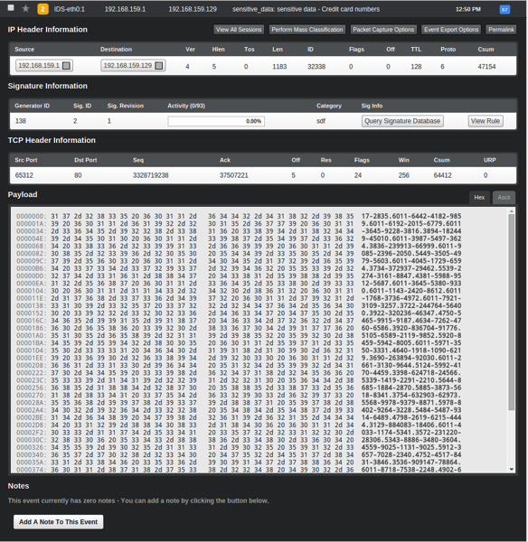

Slide 41
Go Hack Yourself! (Conclusion)
“Hacker” tools can be used to efficiently perform sysadmin and defender tasks
Tactics are repeatable actions that cause minimal network interference
Run them while drinking your coffee!
Finding misconfigurations with AD and other network resources can limit attack vectors
Free solutions that let blue teamers demonstrate immediate impact
Gain the political capital to spend money :)

Slide 42
Questions?
Contact Us:
Jason Frank - @jasonjfrank – jfrank@verisgroup.com
Brent Kennedy - @bk_up – bkennedy@cert.org
Will Schroeder - @harmj0y – will@harmj0y.net
Read More:
http://www.verisgroup.com/category/adaptive-threat-division/
http://blog.harmj0y.net
Get The Tools:
http://www.verisgroup.com/adaptive-threat-division/resources/
https://github.com/mattifestation/PowerSploit
https://nmap.org

