Slide 1

The Front Range’s Largest AppSec Conference is BACK February 18, 2016
Details & registration at www.snowfroc.com
Keynote by Jeremiah Grossman
Hands-on lab throughout the day

Slide 2
AppSec Blue Team Basics
How improving those Blue Team skills will give you an edge when playing for the Red Team … and just help you be more awesome in general.
Speaker: Tyler Bell
(We’ll use Kali toward the end of this)

Slide 3
Plug Time
Director, App Security at AppliedTrust
4 years at AT
@neiltylerbell
AppliedTrust
Infrastructure, Security, DevOps
We’re hiring … and not just in Colorado!
https://www.appliedtrust.com/jobs

Slide 4
Before We Begin…
Please ask questions if you have any throughout this talk (or any other 101 talk today).
Let’s make these talks interactive!
Let me know what you thought about the talk afterwards. Email, Twitter, yelling in my face about getting something wrong, etc.

Slide 5
What Is the Blue Team?
Defenders of the Organization
Developers
Infrastructure
Operations
Security
Everyone

Slide 6
What Does the Blue Team Do?
Confidentiality
Preventing disclosure of sensitive data
Integrity
Preventing corruption of data or services
Availability
Keeping the cogs turning

Slide 7
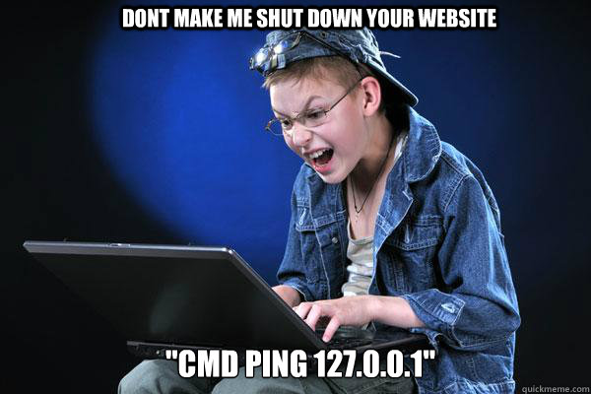
Importance of Gaining Blue Team Skillz Before Joining the Red Team
Everyone here has some interest in Security. It is a Security Conference.
Understand common platforms and services before trying to break them
Efficiency is key
Know how to adapt to your test environment
Meaningful communication
Notes:
Understanding a technology before trying to break it is key. Automated tools may give you something, but they also give a lot of false positives or just miss things completely.
Efficiency will give you an edge over someone familiar only with running an automated scanner. Having that Blue Team knowledge when scoping pen tests can lead to much smoother testing experiences, especially when you’re on a tight budget.
You won’t always get away with having just a Kali VM on hand during a pen test. While you may run into a lot of similar tests, sometimes you need the right tool for the job, and having that knowledge before testing will make things go much smoother.
Blue Team experience can help you communicate better. Say you just downloaded and ran Nessus or AppScan at your new job as a Security Analyst. It found something critical, but now what?
It’s key that you know what you’re testing and have found. You can tell that client or system owner what you found by reading the vulnerability description, but how is that meaningful?
Knowing what a service does will give you the edge to say, “Hey, I’ve identified this issue. I’ve verified it’s not a false positive by doing this, and you can fix by implementing A in your code, B in your infrastructure, or C in the service configuration.”

Slide 8










Common Blue Team Tools
Notes:
Some common tools used by the Blue Team for development, infrastructure/ops, or security.
There are so many more, but I’ve had much hands-on experience with the ones listed here in the past few years.
That is not important though—what’s important is realizing tools like these are being implemented by many organizations and knowledge of how they work (and others not listed) as a Blue Teamer only give you an advantage as a Red Teamer.
For example, Jenkins does not enable authentication in its default configuration. This allows anyone to build and run new jobs. Using Jenkins to deploy website code with default configuration? Let the games begin! Also, say you run into a host that builds and deploys containers on a pen test. Knowing how Docker build files work from building them yourself could lead to interesting results.
Many enterprise environments may not be running these tools, and are purely big name companies or proprietary application shops. Many of these come with vendor support. Don’t let these systems become a black box on your network. Do your research as you would with any other tool and be vigilant in requiring that they close a security gap. Due diligence documentation for these vendors and environments should always include secure development practices and security assessments. Don’t let them get off easy.

Slide 9
Utilize the Tools Available to You
Don’t let those pesky hackers or security consultants have all the fun at your expense
Find the low-hanging fruit
Most (hopefully) do this with common vulnerability scanning tools such as those mentioned previously, but there’s still so much more we could do…
Notes:
So, what about all these fun tools those Red Teamers are using to profile, assess, exploit, penetrate, and exfiltrate data from your environment?
Why not become a Blue Team superstar who can run some of these other tools we all read about and research to find the low-hanging fruit that may have been missed by your enterprise scanning tool?

Slide 10
Missing Pieces of the Blue Team Puzzle
Profiling
Exploitation/Post-Exploitation
OpenSource Intelligence (OSINT)
Publicly-disclosed information on your organization’s Web presence
Data being indexed by search engines
Public records
Gitrob
Recon-Ng
Excellent 2015 talk from creator Tim Tomes on Recon-Ng and AppSec: https://www.youtube.com/watch?v=zgz6QYpdzT8
Exploitation 101 coming up after lunch!
Metasploit (pro, msfconsole, msfvenom, etc.)
Powershell Empire
Powersploit
Too many to mention!
Your customized scripts
Notes:
Outside of just a vulnerability assessment, there are still many ways to gain more knowledge or access to your organization.
Obviously, you can patch all the identified problems found by an automated scanner, but what about the remaining gaps?
Two major techniques that may be missing from your Blue Team include profiling and exploitation.
Exploitation will be discussed a bit later in the day, but learning how to do this could provide some meaningful insight into your organization. What can Powersploit scripts find in your Windows platform?
Let’s focus a bit on profiling, which includes OpenSource Intelligence gathering—that publicly accessible data that *anyone* can gather and use against you. Includes:
Org charts hosted on your website.
Admin pages that shouldn’t be indexed by popular search engines.
Disclosed information in public record, including emails in domain registrations.
Social media like LinkedIn.
Tools like Gitrob that find sensitive info in GitHub like credentials, usernames, emails, etc.
Recon-Ng is a tool that makes it easy to gather a lot of this information. Excellent talk linked in the presentation from the creator.

Slide 11
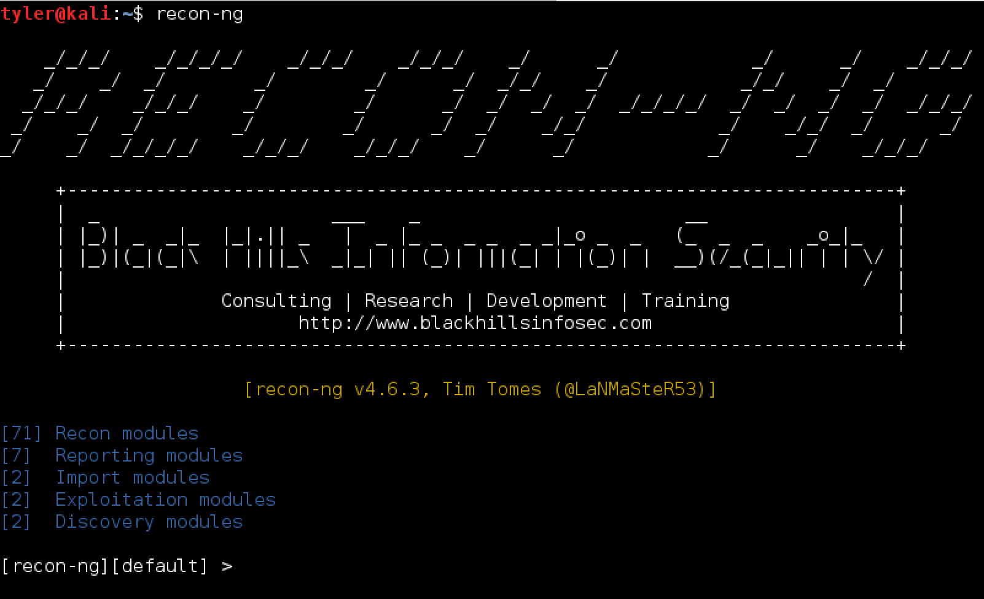
Profiling your Organization
Let’s explore
Find the gaps before the bad guys do
All info is public
Notes:
Lets see what Recon-Ng can find about your organization.
Why not? It’s free and all information collected is publicly available.
You could potentially find something that should be shared with your team that could be remediated.
Third-party assessors have stuff like Recon-Ng in their tool belt. Why pay them to run it? Make them work harder.

Slide 12
Demo: Recon-Ng
Boot up Kali and open up a shell
@kali:~$ recon-ng
Ta-da!

Slide 13
Notes:
Create a new workspace … because it’s clean!
>workspaces add owasp
Add a domain to begin profiling.
>add domains owasp.org
List added domains.
>show domains
Go through modules.
>show modules
Let’s use a couple modules to gather intel via popular search engines.
>use recon/domains-hosts/google_site_web
>run
>use recon/domains-hosts/bing_domain_web
>run
>use recon/domains-hosts/baidu_site
>run
>show hosts

Slide 14
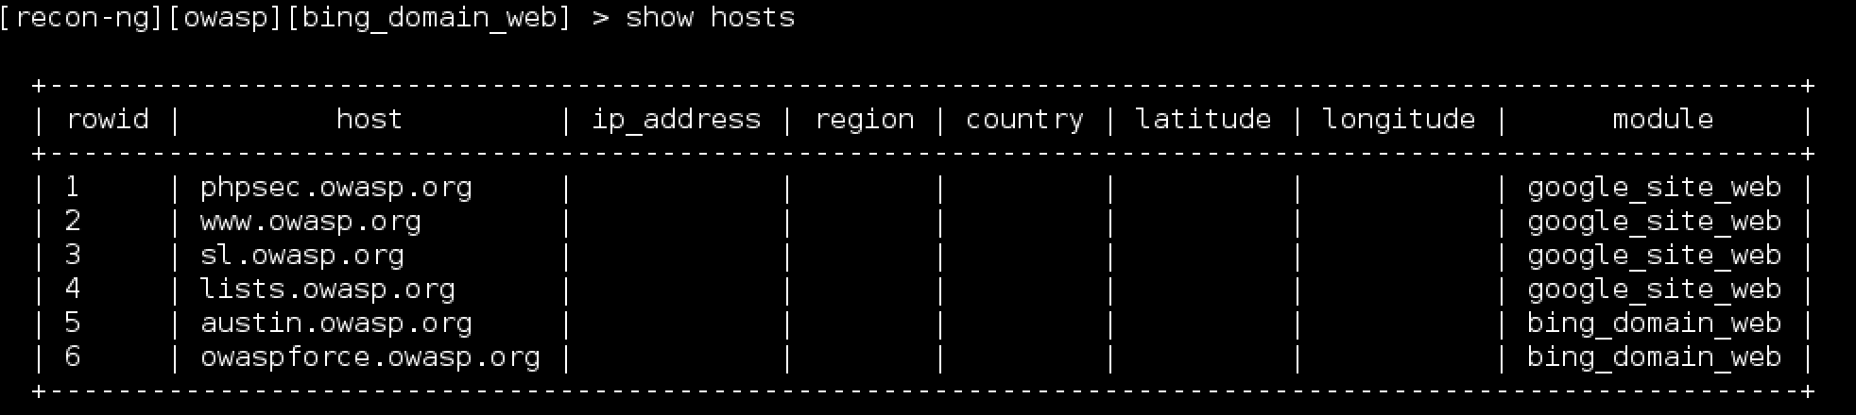
Commands
Create a new workspace … because it’s clean!
>workspaces add owasp
Add a domain to begin profiling.
>add domains owasp.org
List added domains.
>show domains
Go through modules.
>show modules
Let’s use a couple of modules to gather intel via popular search engines:
>use recon/domains-hosts/google_site_web
>run
>use recon/domains-hosts/bing_domain_web
>run
>show hosts
Notes:
First thing to ask yourself is should search engines be indexing these subdomains?

Slide 15
More Commands
You can harvest subdomains using the bruteforce module that brute-forces DNS using a specified wordlist.
>use recon/domains-hosts/brute_hosts
>show info
>run
Use Recon-Ng to resolve all these subdomains to IP addresses, and then do a reverse resolve to possibly identify even more subdomains.
>use recon/hosts-hosts/resolve
>run
>use recon/hosts-hosts/reverse_resolve
>run
Use Recon-Ng modules to identify potential users and email addresses related to your organization via identified hosts.
>use recon/domains-contacts/whois_pocs
>run
>use recon/domains-contacts/pgp_search
>run
Notes:
We’re starting to build a profile here on owasp.org. We have subdomains that could lead to pages that shouldn’t be exposed, email addresses that can be used for more targeted attacks or brute-forcing, and a plethora of other attacks.
This is a common start for intruders or security consulting companies performing a pen test against your organization. Get a leg up, lock down that low-hanging fruit, and make those other guys break a sweat.

Slide 16
Even More Commands
Run a cross-check on identified email addresses against the haveibeenpwned.com site to see if they have any disclosed credentials.
>use recon/contacts-credentials/hibp_paste
>run
Build yourself a nice report to reference later.
> Use reporting/html
>set CREATOR [Your name]
>set CUSTOMER [Your Org]
>run
Notes:
We’re starting to build a profile here on owasp.org. We have subdomains that could lead to pages that shouldn’t be exposed, email addresses that can be used for more targeted attacks or brute-forcing, and a plethora of other attacks.
This is a common start for intruders or security consulting companies performing a pen test against your organization. Get a leg up, lock down that low-hanging fruit, and make those other guys break a sweat.

Slide 17
AppSec Resources
OWASP is an excellent resource for AppSec.
Top 10 lists
Testing methodology guide
Cheat sheets and hardening guides
Zed Attack Proxy (ZAP)
Use Webgoat to work on those Red Team skills.
Many other insecure apps out there for working on skills including:
https://github.com/quantumfoam/DVNA - Damn Vunerable Node App
https://github.com/rapid7/hackazon - Hackazon
http://www.irongeek.com/ is an archive for many recorded talks at various security conferences.
Blogs, blogs, and more blogs
http://www.reddit.com/r/netsec
https://highon.coffee/blog/
Go get involved in your local community.
OWASP Chapters in Boulder and Denver
Meetup.com is a great resource for many organized tech meetups.
DevOps Boulder & Boulder Linux Users Group
Denver CitySec, DC303
Notes:
Some resources if you’d like to begin stepping out into the Red Team world.
So many blogs out there with great content. /r/netsec is usually a good resource for updated content. Twitter is great too.
Highon.coffee is a great resource for CTF walk-throughs. This is a more recent blog I’ve been introduced to.

