Slide 1

Presented @ RVASec
Grayson Walters

Slide 2
You can just go hack yourself!

Slide 3
And you are?
Grayson Walters - @GrandomThoughts
I've got a day job, it lends to my experience, but has nothing to do with this presentation. You know, the whole views and opinions expressed are my own and have no relation to where I work.
I’ve been a Pentester, Vulnerability analyst, Social Engineer, IT generalist Now I argue business cases for security implementations
Navy, HLS, Sec. Consulting, Commonwealth of Virginia

Slide 4
Level setting expectations
What this talk isn’t
What this talk is
What you should take away
How this will help in your day job

Slide 5
What are you trying to accomplish?
PENTEST
VULNERABILITY SCAN
Specific goal - Get a copy of the customer database
Find a way to meet that goal within your parameters
Exhaustive catalog of possible issues
Ranked by criticality
Manually reviewed if you are lucky
You know what, just go read @DanielMiessler
“The Difference Between a Vulnerability Assessment and a Penetration Test”

Slide 6
Get your priorities straight!
Do you know what software is installed on your systems?
Do you know what versions of software they are?
Are those software installations patched?
If you are answering no, you probably need to do a Vulnerability Scan.
Or talk to Jake about VulnDB
Does that Mean I shouldn’t be talking about a pentest?

Slide 7
Probably
I mean seriously, you have way too much work to be doing.

Slide 8
But let’s do it anyway, and here’s why…
NOTHING SAYS YOU NEED TO LET ME UPGRADE THAT DEVICE LIKE THE PHRASE:
“We got to your SSN from the Internet because… ”

Slide 9
So why this DIY pentest?
Shouldn’t we just get a firm to come do this for us?

Slide 10

So external tests are bad?

Slide 11
Let the battle begin!
Pushback
Response
It’s just too expensive to hire a firm to do a pentest.
It’s still going to cost money, and time we don’t have
We’ve got all of these projects that we never get to work on, and this is just one more.
I agree, we can do it ourselves much cheaper.
Not as much as you think, I saw a presentation where we can do it by repurposing a couple of old laptops and under a week of effort.
This is a small one, that gets us the data we need to know which others should be priorities.

Slide 12

Gather your team!

Slide 13

“So you mean like a red team?”

Slide 14

Pirates Vs Ninjas
Both have benefits, today we are talking pirates.
Check out Kirk Hayes’
“Penetration Test vs. Red Team Assessment: The Age Old Debate of Pirates vs. Ninjas Continues’
Image Attribution: Sarah Thomas

Slide 15
Yeah, yeah, I get it. Pentests are good.
Get
On
With
It!
One quick thing…
There are several standards for pentests available online.
The Penetration Testing Execution Standard,
ISECOM’s Open Source Security Testing Methodology Manual,
Even NIST has a version, but most of these are a little dated.
Review them, have a look and decide if they are right for you. Do some homework online.

Slide 16
Basics: Level 1
Assumptions
You have permission to work on this “In your spare time”
No Hardware Purchase
No Software Purchase
You can download the stuff you need to do this on your normal work computer

Slide 17

You have permission to work on this in your spare time…
Is that in writing?
https://www.owasp.org/index.php/Authorization_form

Slide 18
No, Seriously, without it you are just an Insider Threat…
GET
PERMISSION
IN
WRITING!

Slide 19
Non-Shopping list
VirtualBox Software - https://www.virtualbox.org/wiki/VirtualBox
Kali Linux - https://www.kali.org/
Pentest permission slip – Don’t play Mom & Dad against each other, get ink!
Pentest Documentation / Plan / Scope

Slide 20
Scoping and Goals
What are we going to test, and how do we know if it was successful?

Slide 21

Golden Tickets
These are your “Game Over” moments. Some examples are:
Key personnel login credentials with successful login.
Laying hands on the contents of a key sensitive database.
Root / Local Admin / Domain Admin access
Data from point of sale system
Stolen Laptop with data extraction

Slide 22
Example Pentest with the basics
Running Kali Linux on a VM under virtualbox
Doing an external pentest to include
Can we get in through phishing?
Can we get in through the network?
Can we get in through Outlook Web Access?
Can we get in through the webapps?
Even if we can’t get into the network can we get the golden ticket from the web?

Slide 23
Remember that this isn’t a Kali deep dive…
Tools
What we are doing
theHarvester
MetaGooFil
Social Engineering Toolkit
NMAP / SQL Map
Metasploit
Publicly available email addresses / websites
MetaData in Word, Excel, PDF files on the public website
Phishing exercise
Network devices and DB if possible
Launching attacks

Slide 24
Ok, one cool trick
Black Hills Information Security – Password Spraying Outlook Web Access
SilentBreak Security – Malicious Outlook Rules
In a nutshell:
Get a list of usernames / email addresses using theHarvester
Script to try 1 common password against EVERY account, think Summer2017!
With OWA access you have access to the Rules Engine for Desktop version of Outlook
Create new rule in outlook that runs an application when you receive an email from a specific address, say an Empire shell maybe?
Or, how about a command to turn the box into your own personal WIFI-Access Point?
netsh wlan set hostednetwork mode=allow ssid=totallynotabackdoor key=Summer2017! && netsh wlan start hostednetwork

Slide 25
Basics
Once it is built, you can run it at leisure.
Run your password spraying script once a day, hopefully you never catch anything but if you know that the helpdesk uses Letmein! …

Slide 26
Level 2
Assumptions
You have permission to work on this “In your spare time”
$250 petty cash for stuff
You can download the stuff you need to do this on your normal work computer, or even better a spare laptop laying around

Slide 27
Shopping list
Hak5 – Hakshop
1 – BashBunny - $99
1 – Rubber Ducky - $45
Cloud VM (optional) – about $20 for a month
Other source
2 – Raspberry Pi with sd card /cases / power – varies
1 - High gain wifi USB adapter - $30
All in, should be under $250

Slide 28
Pentest Scenario
Running Kali Linux on a VM under virtualbox, in the cloud, and on the Raspberry Pi
Doing an external pentest to include everything from the basic scenario
Doing an internal pentest to include
What happens if someone drops a malicious box on the network (Pi)
This can be a golden ticket – Social engineering options
What can a normal user do that they shouldn’t be able to?
What about a person with no user account, just access to a network port?
What about access to another user’s computer?

Slide 29
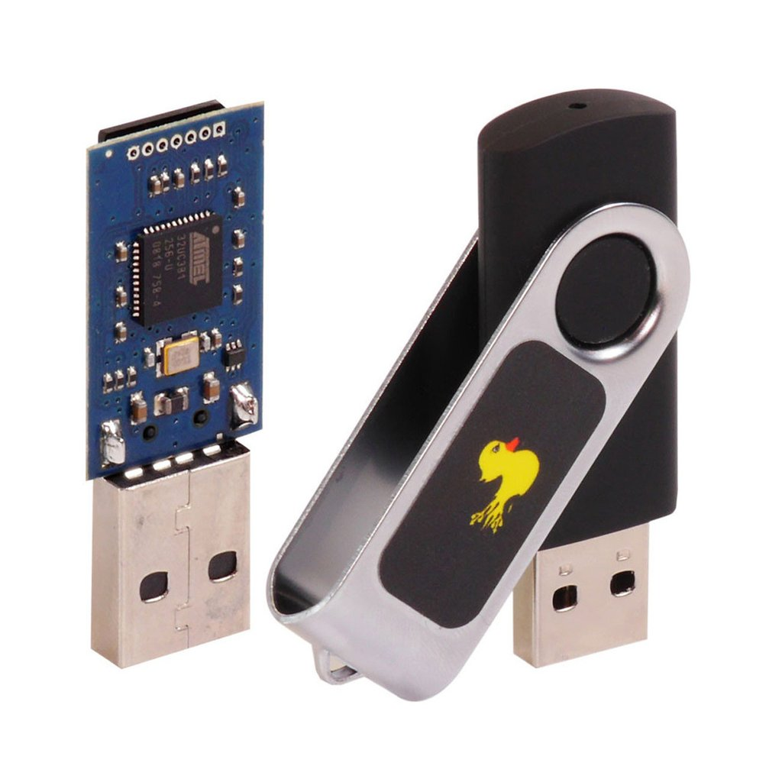
Tools and their uses
Is that a keyboard in your pocket?
Super quick keyboard emulator
No Drivers needed
Writes your payload on the fly
~20 seconds to take over

Slide 30

Tools and their uses
Like a Swiss Army Knife for pentests
Emulate a keyboard
Emulate a network
Steal credentials from a LOCKED windows PC
Does everything the rubber ducky can

Slide 31
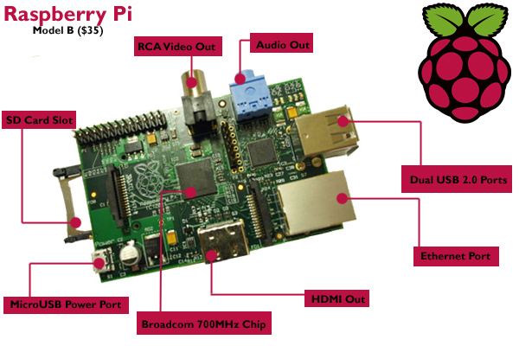
Tools and their uses
Mmm, Pi
Pentest drop box
Runs Kali
Primary use is running Responder
Collecting credentials

Slide 32
Level 3
Assumptions
You have permission to work on this using dedicated time.
$1,000 Dollars in the budget
You can download the stuff you need to do this on your normal work computer, or even better a spare laptop laying around

Slide 33
Shopping list
Level 2 Shopping List - $250
Burp Suite Pro - $349
Hak5 – Hakshop (in addition to Lvl2)
Hak5 Elite Field Kit - $399
Includes an extra bunny & ducky, accessories and adds a pineapple and a turtle
All in, should be under $1,000

Slide 34
Pentest Scenario
Running Kali Linux on a VM under virtualbox, in the cloud, and on the Raspberry Pi
Doing an external pentest to include everything from the basic scenario
Doing an internal pentest to include everything from the level 2 scenario
Adding advanced webapp testing using Burp Suite Pro
easier scans, deeper checks
Adding advanced wifi testing and the ability to man in the middle wifi devices easily with the pineapple

Slide 35

Tools and their uses
It’s a turtle!
USB Ethernet adapter
Forces traffic to your network
Think hardware lan tap

Slide 36
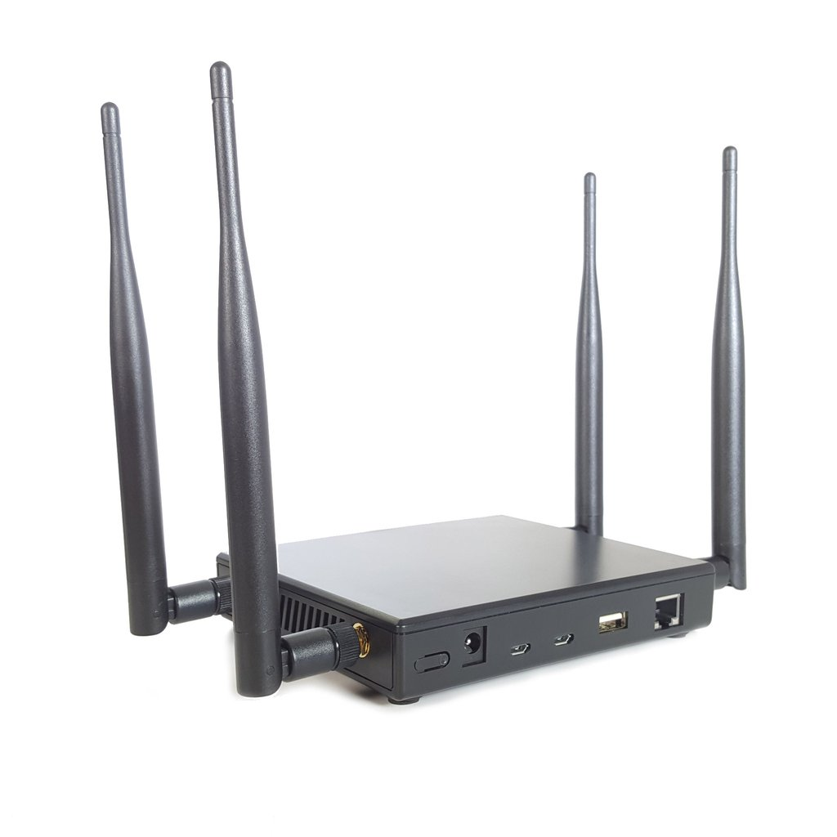
Tools and their uses
Who lives in a pineapple…
Simple Man in the Middle for WIFI
Bridges networks
Allows site spoofing
Collect credentials
Simply listen to the traffic

Slide 37
Building out your schedule
Week 1
Approximately one weeks worth of time spent across the month before the test
Build scope, write plan, GET PERMISSION, setup tools
Week 2
Pentest week – Stake out a conference room and hide for the week
Actively Testing
Week 3
You will forget what you learned if you don’t immediately write it down
Take a full day or two to properly document the test results

Slide 38
Rule 31
After the test, choose 3 findings that can be fixed.
The most critical issue
The easiest non-trivial issue to fix
The most visible issue

Slide 39
The bottom line
These are things you can do in your spare time to directly and significantly improve the security of your systems.

Slide 40

Questions

