Slide 1
Cyber Exercises
A Military Perspective

Slide 2
Disclaimer
The views expressed are my own and do not reflect the official policy or position of US European Command, Department of Defense, or the U.S. Government.

Slide 3
About Me
USC, M.Eng. Computer Science & Engineering
Fulbright Scholar
Major, US Army Reserves
15 years in military Cyber organizations
Cyber Exercises Planner, US European Command

Slide 4
Commercial Persona
Owner, NineFX, Inc.
Certifications
Security+, CompTIA
Defensive Cyberspace Operations Engineer Certified Instructor, CSFI
Certified Ethical Hacker, EC-Council
Exploit Researcher and Advanced Penetration Tester (GXPN), GIAC

Slide 5
Exercise Experience
Service Academies/NSA: Cyber Defense Exercise
US Strategic Command: Bulwark Defender
US European Command: Coalition/Cyber Endeavor
US Army Europe: Immediate Response
NATO: Coalition Warrior Interoperability eXploration, eXperimentation, eXamination, eXercise (CWIX)
Notes:
In some exercises, Cyber is just a component
In other exercises, Cyber is the focus
Challenge to educate non-technical leaders on value of Cyber
Challenge to educate Cyber professionals on how to achieve commanders' goals

Slide 6
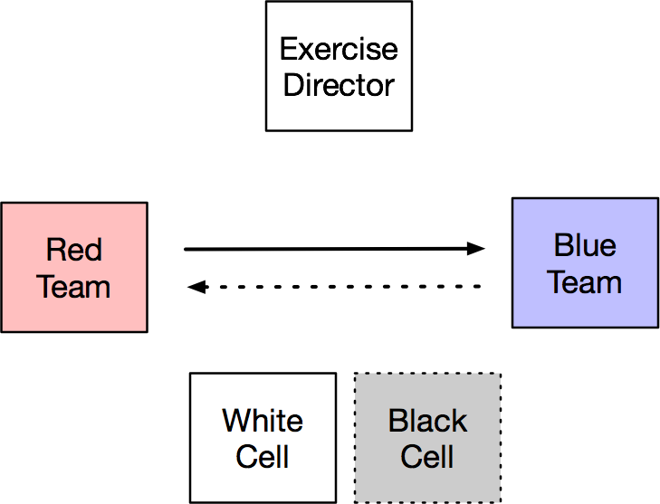
Exercise Roles
Notes:
Blue Team can rarely fight back, simply block aggressors
Black cell is optional

Slide 7
General Setup
Usually more than one organization participates
Exercise Director
Senior leader from sponsoring organization
Blue Team
Defend and operate systems as their day job
Typically have a subset of their organization at the exercise
Red Team: Dedicated Penetration Testers
White Cell: Often from simulations and exercise groups
Black Cell: Cyber specialists and maybe ORSAs
Notes:
Blue Team has a disadvantage. Imagine someone tells you to pick up your office and operate it without much of your supporting infrastructure for a 2 week exercise.
On an air gapped network, security updates are difficult
** These are problems military units regularly face.
Red Team often needs help gaining ground. Getting in is hard. People are paranoid during an exercise.
ORSA = operations research/systems analysis, math and analysis geeks

Slide 8
Blue/Red Teams
Blue Team
Defenders
Under evaluation
Executes TTPs
Tactics
Techniques
Procedures
Red Team
Attackers
Simulates an agressor
Often trained to emulate aggressor TTPs
Stimulates training, tied to objectives
Injects events into the exercise from the Master Scenario Events List (MSEL)

Slide 9
White/Black Cells
White Cell
Exercise Control (EXCON)
Evaluates outcomes
Synchronizes injects based on the exercise schedule
Collects lessons learned
Black Cell
Data collection
Event correlation
Provides data for reporting and visualization
Injects events into the exercise from the Master Scenario Events List (MSEL)
Often these responsibilities are merged into the White Cell

Slide 10
Red Team Tools of the Trade
Scanning | Malicious Traffic |  | Traffic Analysis
nmap | Scapy | hping3 | Wireshark
Frameworks
Metasploit | Powershell Empire | Cobalt Strike | Core Impact
Scripting
Python | Ruby | Powershell | Bash
Other
sqlmap | Burp Suite | AirCrack-NG | Kali Linux

Slide 11
Red Teaming vs. Penetration Testing
Red Team
Objective-driven
“Disrupt ability to launch counterattack”
Evasion
Often on air-gapped networks, can degrade and disable Blue Team systems
Often integrates social engineering and physical security
Penetration Testing
Designed to find vulnerabilities
Loud, scan the most devices in the shortest amount of time
Don’t damage production systems
See Rapid7 Pirates vs. Ninjas discussion
https://community.rapid7.com/community/infosec/blog/2016/06/23/penetration-testing-vs-red-teaming-the-age-old-debate-of-pirates-vs-ninja-continues

Slide 12
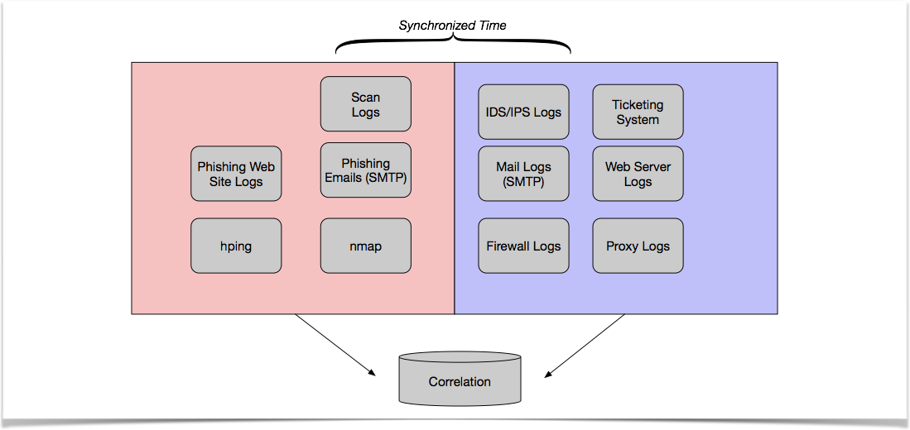
Black Cell

Slide 13
Vulnerability Assessments
Longer Time Period
System/Product focused
White/Gray/Black Box Testing
Rules of Engagement & Written Agreements

Slide 14
Common Attacker TTPs
The majority of hacks start with an email
Weakest link is user
Advanced Persistent Threats (APTs)
After exploitation, goal is to maintain access and escalate privileges (root)
Reverse shells
Command and Control nets
Covering your tracks

Slide 15
Offensive Security
Penetration Testing / Red Teaming
Vulnerability Assessment
Exploit Research
Tools Development

Slide 16
Exploit Research
Local
Desktop, mobile or similar applications
Often exploits poor memory management
You’re going to learn assembler
Remote
Exploits network/server applications
SQL Injections, Shell Injects, Cross Site Scripting (XSS), etc.
Bug Bounties
Contract Gigs
CVEs

Slide 17

Traditional Exploit Dev
Find
Memory
Vulnerability
Gain Control of EIP
Develop Payload
Debuggers/Decompilers/Tools
gdb | WinDBG | OllyDBG | Immunity
lddb | Radare2 | Hopper | IDAPro
Metasploit | Mona
Fuzzers
Sulley | AFL | hongfuzz | QuickFuzz

