Slide 1

Department of Computer Science and Engineering
VIDEO ENCRYPTION WITH MESSAGE EMBEDDING AND MOTION VECTORS
Presented by
Mr. Balaram R Chougale(2KD19CS024)
Mr. Basavaraj Sollapur(2KD19CS026)
Mr. Basavaraj Arjunagi(2KD19CS025)
Mr. Lakkappa Y Basidoni(2KD19CS044)
Under Guidance of
Dr. Bahubali Akiwate

Slide 2
Presentation Outline
Introduction
Problem Statement
Objectives
Methodology
Snapshots
Parameters to be considered
Hardware and Software Components
Expected Outcome of the Project
Conclusion
References

Slide 3
Introduction
The encryption is performed by altering various syntax elements such that the receiver extract embedded data in the encrypted domain using only the data-hiding key.
This is made possible through altering the picture reference indices and the motion vectors at the syntax level.
To authenticate digital video to ensure its confidentiality and integrity, video encryption and data embedding techniques are used.
Video encryption can be used to increase the difficulty of piracy in digital videos to protect privacy.

Slide 4
Problem Statement
To fulfill security and privacy needs in various applications, encryption of videos is very important to prevent malicious attacks from unauthorized attackers.
The security of multimedia data is provided by encryption is common for the traditional way to secure using Advance Encryption Standard (AES).

Slide 5
Objectives
To embed the message by altering the values of reference picture indices and motion vectors which results in scrambled video.
To avoid the illegal access of the data from unauthorized user and provide reliable data transmission in an effective manner.
To ensure the video security between sender and receiver with the fast growth communication and technology, security of sending confidential video information.
To protect the confidentiality of digital data stored on computer system or transmitted over the Internet or any other computer network.

Slide 6
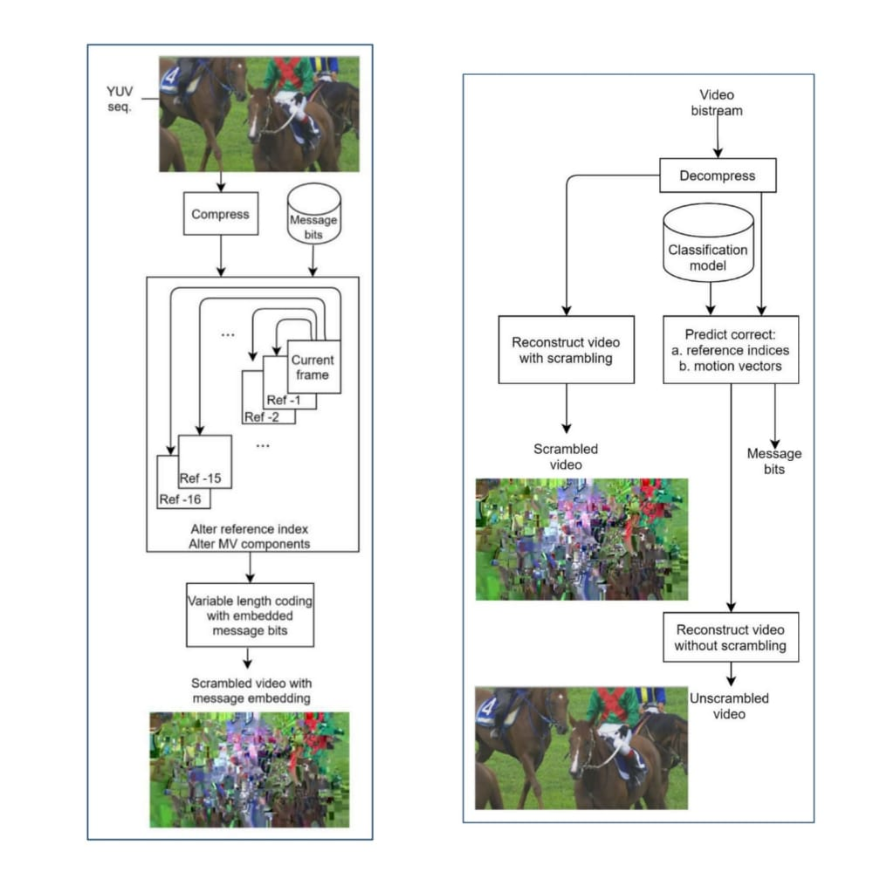
Methodology
Figure a. Encryption Figure b. Decryption

Slide 7
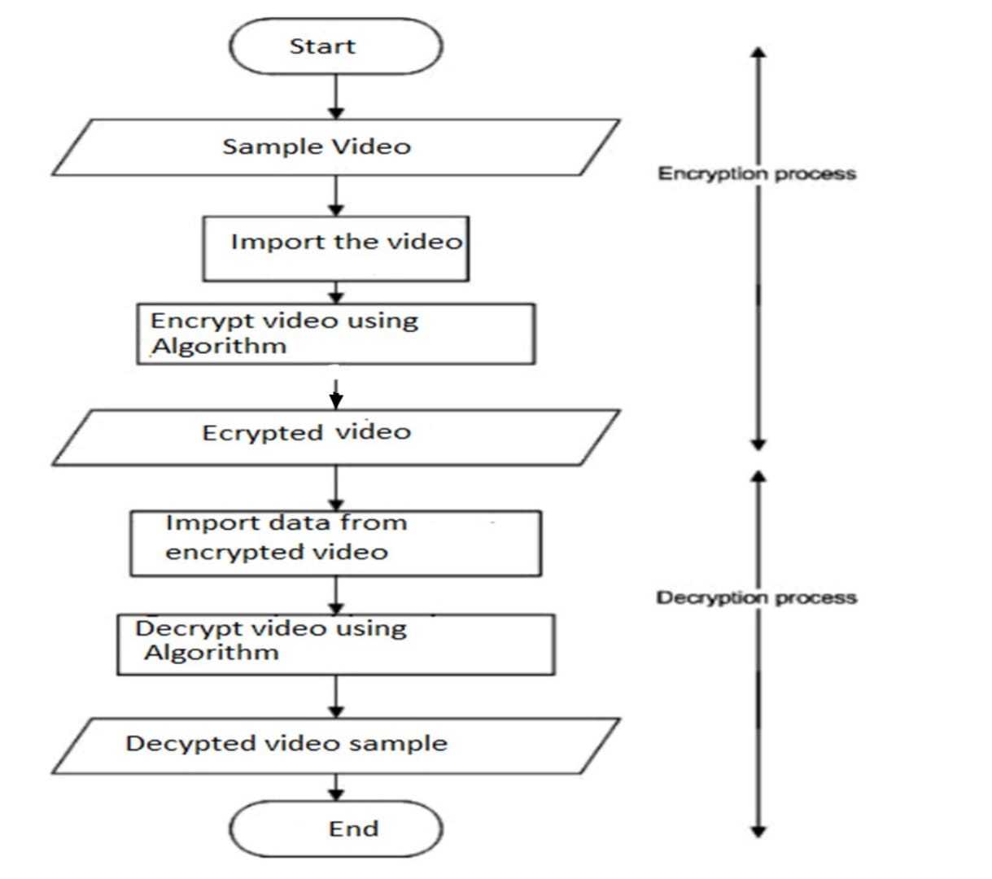
Data flow Diagram
Methodology

Slide 8
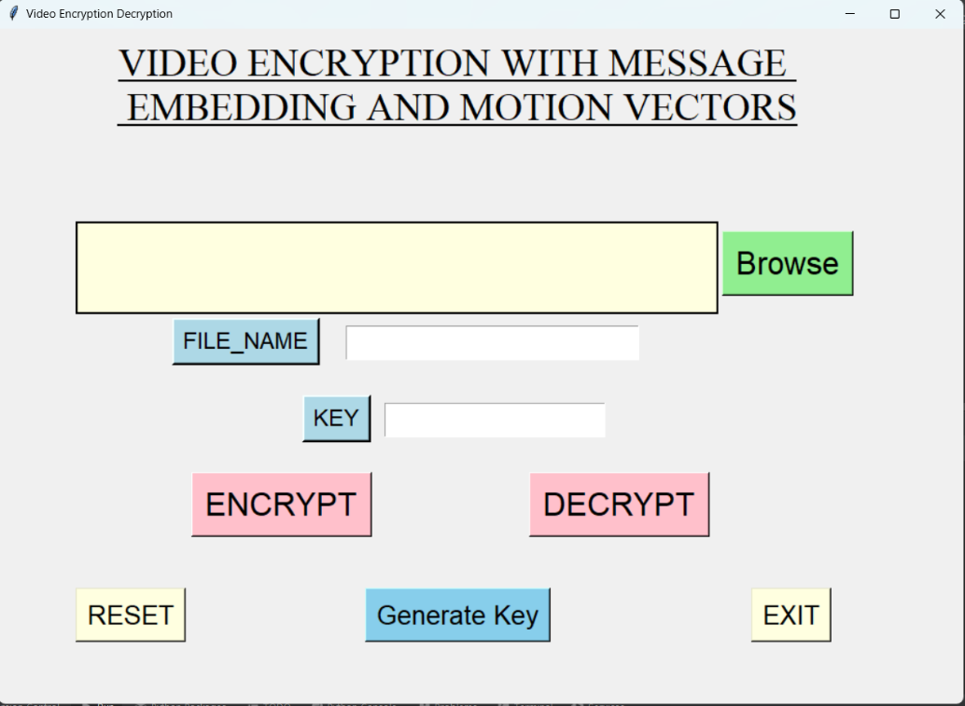
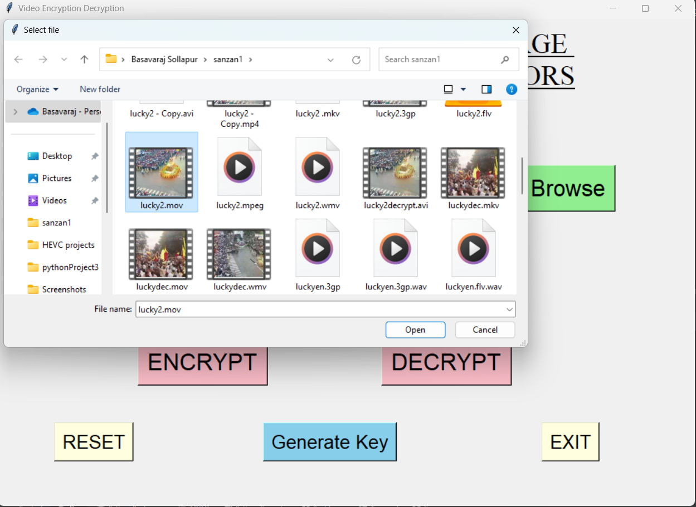
Snapshots
Home Page
Browse Video

Slide 9
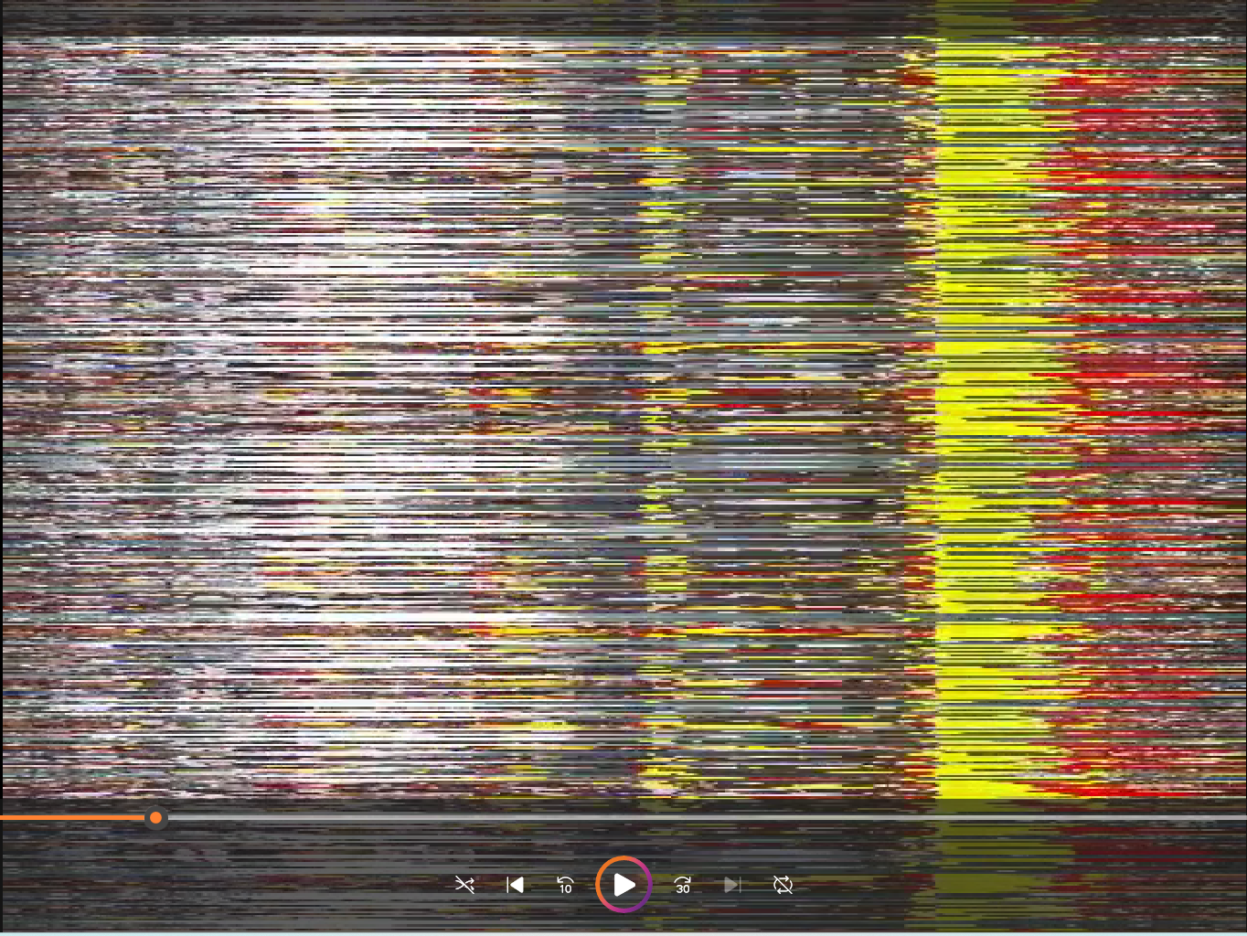
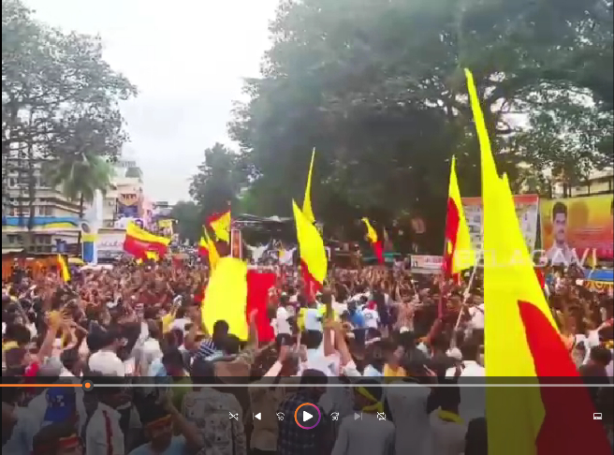
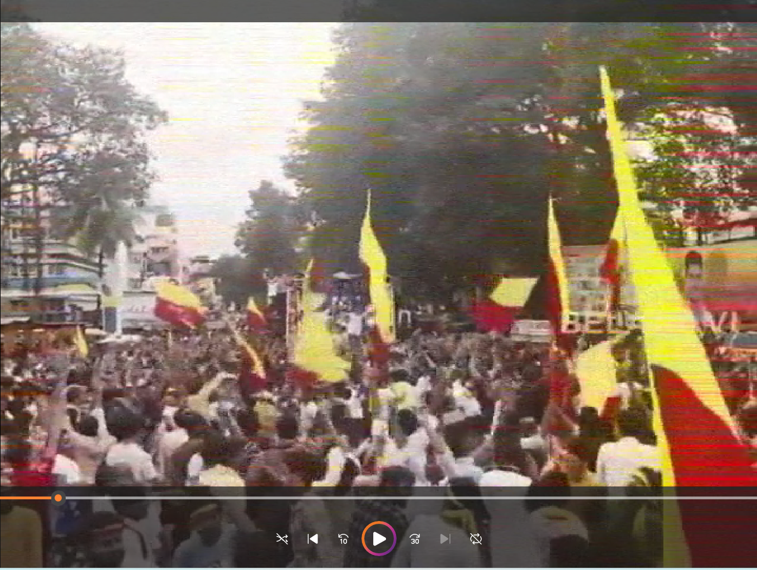
Cont..
Encryption
Original Video
Encrypted Video
Decryption
Decrypted Video

Slide 10
Parameters to be considered
Parameters Table:
Video Extensions | Original Video size | Encrypted Video size | Decrypted Video Size | Encrypted Time taken | Decrypted Time taken
Mp4 | 7434kb | 25112kb | 14540kb | 17.25Sec | 4.25sec
MKV | 7434kb | 24678kb | 14540kb | 12.87sec | 4.15sec
MOV | 7434kb | 24883kb | 14643kb | 12.66sec | 0.13sec
AVI | 7434kb | 9697kb | 3901kb | 9.35Sec | 4.15sec
WMV | 7434kb | 9984kb | 3789kb | 9.82sec | 4.15sec

Slide 11
AES algorithm:
AES is a symmetric key,block cipher algorithm.
The key size can be 128/192/256 bits.
Encrypts data in blocks of 128 bits each.
The number of rounds depends on the key length as follows :
128 bit key – 10 rounds
192 bit key – 12 rounds
256 bit key – 14 rounds
Each round comprises of 4 steps :
SubBytes
ShiftRows
MixColumns
Add Round Key

Slide 12
Hardware And Software Requirements:
Hardware Components:
Processor : Core i3 or above
ROM : 500GB or above
RAM : 8GB
Software Components:
Windows 9 or above
Pycharm IDE
Python

Slide 13
Expected outcome of Project
The expected outcome of video encryption with message embedding by altering picture reference indices and motion vectors is to provide a secure and efficient way to protect video content while also allowing for the embedding of hidden messages within the video stream.
By altering picture reference indices and motion vectors, the embedded messages can be hidden within the compressed video stream in a way that is difficult to detect or remove without the proper decryption key.

Slide 14
Conclusion
Video encryption is a technique used to protect the confidentiality of video content by transforming the video data into an encrypted form that can only be decoded with a proper decryption key.
Video encryption technique that combines message embedding with alterations to picture reference indices and motion vectors.

Slide 15
References
1. Tamer Shanableh,” HEVC Video Encryption With High Capacity Message Embedding by Altering Picture Reference Indices and Motion Vectors”,Mar.2022
2. Y. Tew, K. Wong, R. C.-W. Phan, and K. N. Ngan, ‘‘Separable authentication in encrypted HEVC video,’’ Multimedia Tools Appl., vol. 77, no. 18, pp. 24165– 24184, Sep. 2018.
3. M. Farajallah, W. Hamidouche, O. Déforges, and S. E. Assad, ‘‘ROI encryption for the HEVC coded video contents,’’ in Proc. IEEE Int. Conf. Image Process. (ICIP), Sep. 2015, pp. 3096– 3100.
4. M. A. Taha, N. Sidaty, W. Hamidouche, O. Dforges, J. Vanne, and M. Viitanen, ‘‘End-to- end real- time ROI-based encryption in HEVC videos,’’ in Proc. 26th Eur. Signal Process. Conf. (EUSIPCO), Sep. 2018, pp. 171–175.
5. P.-C. Su, T.-F. Tsai, and Y.-C. Chien, ‘‘Partial frame content scrambling in H.264/AVC by information hiding,’’ Multimedia Tools Appl., vol. 76, no. 5, pp. 7473–7496, Mar. 2017.
6.D. Xu and S. Su, ‘‘Reversible data hiding in encrypted images with separability and high embedding capacity,’’ Signal Process., Image Commun., vol. 95, Jul. 2021, Art. no. 116274.

Slide 16
Cont..
[7] Advanced Encryption Standard (AES), Federal Information Processing Standard 197, NIST, Nov. 2001 [8] Y. Wang, M. O’Neill, and F. Kurugollu, ‘‘A tunable encryption scheme and analysis of fast selective encryption for CAVLC and CABAC in H.264/AVC,’’ IEEE Trans. Circuits Syst. Video Technol., vol. 23, no. 9, pp. 1476–1490, Sep. 2013.
[9] B. Boyadjis, C. Bergeron, B. Pesquet-Popescu, and F. Dufaux, ‘‘Extended selective encryption of H.264/AVC (CABAC)- and HEVC-encoded video streams,’’ IEEE Trans. Circuits Syst. Video Technol., vol. 27, no. 4, pp. 892–906, Apr. 2017.
[10] Y. Wang, M. O’Neill, and F. Kurugollu, ‘‘The improved sign bit encryption of motion vectors for H.264/AVC,’’ in Proc. 20th Eur. Signal Process. Conf. (EUSIPCO), Romania, 2012, pp. 1752–1756.
[11] Y. Yao, W. Zhang, and N. Yu, ‘‘Inter-frame distortion drift analysis for reversible data hiding in encrypted H.264/AVC video bitstreams,’’ Signal Process., vol. 128, pp. 531–545, Nov. 2016.
[12] M. Long, F. Peng, and H.-Y. Li, ‘‘Separable reversible data hiding and encryption for HEVC video,’’ J. Real-Time Image Process., vol. 14, no. 1, pp. 171–182, Jan. 2018.

Slide 17
Thank You

