Slide 1
Domain: Machine Learning
Technology: Python
INTRUSION DETECTION SYSTEM USING PCA WITH MACHINE LEARNING CLASSIFIERS
By: <names here>

Slide 2
INDEX
Abstract
Problem Definition
Literature review
Hardware and Software Requirements
Existing Method
Disadvantage
Proposed method
Flow Diagram
Advantages
Applications
Implementation
Algorithms
UML Diagrams
References

Slide 3
ABSTRACT
We develop a Network Intrusion Detection System (NIDS), which uses a suite of machine learning techniques to automatically detect attacks against computer networks and systems.
It uses an approach to develop efficient NIDS by using the principal component analysis (PCA) along with different classification algorithms like Support Vector Machines, Random Forest and XgBoost.
The purpose of an intrusion detection system is to detect attacks. However, it is equally important to detect attacks at an early stage in order to minimize their impact

Slide 4
INTRODUCTION
In the 21st century the development of telecommunications networks has taken giant leaps from circuit and packet switched networks towards all-IP based networks.
This development has created a unified environment where communication of applications and services (data and voice) are being transferred on top of the IP-protocol.
Different attacks are seen on the system or the network. The attacks like a black hole, grey hole, wormhole etc. are seen on the network system. These attacks are to steal the information from the system.
So to prevent the system from such attacks, the intrusion detection system was introduced. IDS keep track of attacks on the system and to prevent the system from these attacks.

Slide 5
LITERATURE REVIEW
[1] S. Waskle, L. Parashar and U. Singh, "Intrusion Detection System Using PCA with Random Forest Approach," 2020 International Conference on Electronics and Sustainable Communication Systems (ICESC), 2020.
This journal discusses about intrusion classification using random forest and PCA.
[2] K. Park, Y. Song and Y. Cheong, "Classification of Attack Types for Intrusion Detection Systems Using a Machine Learning Algorithm," 2018 IEEE Fourth International Conference on Big Data Computing Service and Applications (BigDataService), 2018.
This paper explores different scenarios of machine learning implementation for type of intrusion classification.

Slide 6
[3] A. Tesfahun and D. L. Bhaskari, "Intrusion Detection Using Random Forests Classifier with SMOTE and Feature Reduction," 2013 International Conference on Cloud & Ubiquitous Computing & Emerging Technologies, 2013.
It discusses about intrusion detection with oversampling of data before implementing machine learning models.

Slide 7
SOFTWARE & HARDWARE REQUIREMENTS
Python v3.6+
PyCharm IDE.
RAM: 4GB minimum.
Processor: Intel I3 (min)
Hard Disk: 128 GB +
OS: Windows 7+
Libraries: pandas, numpy, scikit-learn, xgboost.

Slide 8
EXISTING METHOD
In existing system, models are build based on manual detections or rule based detections.
It requires enormous costs and high number of skilled people to detect such frauds.
The worst part of them is that the intrusions are most likely to get detected once the attack is happening instead of earlier to take action.

Slide 9
DISADVANTAGES
Low accuracy.
Time consuming.
High complexities.
Difficult to Scale.
Expensive

Slide 10
PROPOSED METHOD
We propose this system which uses Machine Learning Algorithms like SVM, Rnadom Forests and XgBoost for intrusion detections.
These techniques can determine the possibility of an attack faster than the existing methods hence enabling faster response to the threat.
Principal Component Analysis is used for reducing the high cardinality in this system.

Slide 11
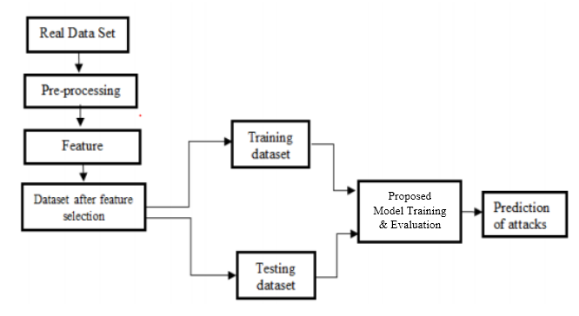

Slide 12
ADVANTAGES
High accuracy.
Time Saving.
Low complexities.
Inexpensive.
Easy to scale.

Slide 13
APPLICATIONS
Used for preventing unauthorized intrusions by banks and other financial institutions.
Governments and Intelligence agencies with sensitive information need such a system to safeguard their information.
B2C businesses and Tech companies also needs such a system to improve their users’ private information’s security.

Slide 14
IMPLEMENTATION
System:
Stores Data
Model Training
Model Predictions
User:
Load Dataset
View Dataset.
Select Model.
Evaluation

Slide 15
ALGORITHMS
Random Forest:
Random forests or random decision forests are an ensemble learning method for classification, regression and other tasks that operate by constructing a multitude of decision trees at training time and outputting the class that is the mode of the classes (classification) or mean/average prediction (regression) of the individual trees.
Random decision forests correct for decision trees' habit of over fitting to their training set.
Random forests generally outperform decision trees, but their accuracy is lower than gradient boosted trees. However, data characteristics can affect their performance.

Slide 16
Support Vector Machines:
The objective of the support vector machine algorithm is to find a hyperplane in an N-dimensional space (N- the number of features) that distinctly classifies the data points.
Support Vector Machine, abbreviated as SVM can be used for both regression and classification tasks. But, it is widely used in classification objectives.
Hyperplanes are decision boundaries that help classify the data points. Data points falling on either side of the hyperplane can be attributed to different classes.

Slide 17
XgBoost:
XGBoost is a decision-tree-based ensemble Machine Learning algorithm that uses a gradient boosting framework.
The implementation of the model supports the features of the scikit-learn and R implementations, with new additions like regularization. Three main forms of gradient boosting are supported:
Gradient Boosting algorithm also called gradient boosting machine including the learning rate.
Stochastic Gradient Boosting with sub-sampling at the row, column and column per split levels.
Regularized Gradient Boosting with both L1 and L2 regularization.

Slide 18
Principal Component Analysis :
Principal Component Analysis, or PCA, is a dimensionality-reduction method that is often used to reduce the dimensionality of large data sets, by transforming a large set of variables into a smaller one that still contains most of the information in the large set.
Reducing the number of variables of a data set naturally comes at the expense of accuracy, but the trick in dimensionality reduction is to trade a little accuracy for simplicity. Because smaller data sets are easier to explore and visualize and make analyzing data much easier and faster for machine learning algorithms without extraneous variables to process.
So to sum up, the idea of PCA is simple — reduce the number of variables of a data set, while preserving as much information as possible.

Slide 19
Decision Tree:
A tree has many analogies in real life, and turns out that it has influenced a wide area of machine learning, covering both classification and regression. In decision analysis, a decision tree can be used to visually and explicitly represent decisions and decision making. As the name goes, it uses a tree-like model of decisions. Though a commonly used tool in data mining for deriving a strategy to reach a particular goal.
A decision tree is drawn upside down with its root at the top. In the image on the left, the bold text in black represents a condition/internal node, based on which the tree splits into branches/ edges. The end of the branch that doesn’t split anymore is the decision/leaf, in this case, whether the passenger died or survived, represented as red and green text respectively.

Slide 20
K-Nearest Neighbor
K-Nearest Neighbor is one of the simplest Machine Learning algorithms based on Supervised Learning technique.
K-NN algorithm assumes the similarity between the new case/data and available cases and put the new case into the category that is most similar to the available categories.
K-NN algorithm stores all the available data and classifies a new data point based on the similarity. This means when new data appears then it can be easily classified into a well suite category by using K- NN algorithm.
K-NN algorithm can be used for Regression as well as for Classification but mostly it is used for the Classification problems.
K-NN is a non-parametric algorithm, which means it does not make any assumption on underlying data.
It is also called a lazy learner algorithm because it does not learn from the training set immediately instead it stores the dataset and at the time of classification, it performs an action on the dataset.

Slide 21
USE CASE DIAGRAM
A use case diagram in the Unified Modeling Language (UML) is a type of behavioral diagram defined by and created from a Use-case analysis.
Its purpose is to present a graphical overview of the functionality provided by a system in terms of actors, their goals (represented as use cases), and any dependencies between those use cases.
The main purpose of a use case diagram is to show what system functions are performed for which actor. Roles of the actors in the system can be depicted.

Slide 22
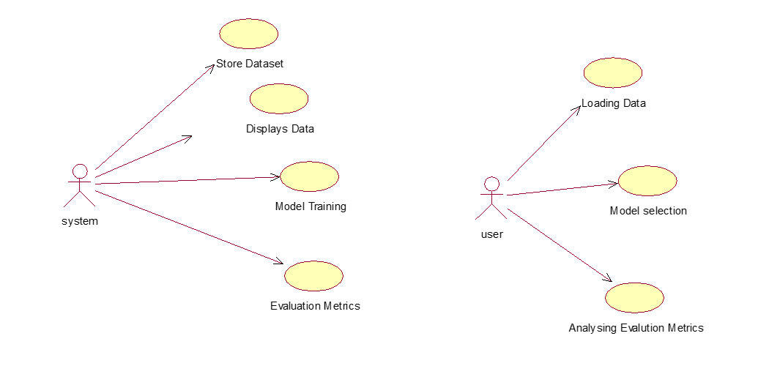
USE CASE DIAGRAM

Slide 23
CLASS DIAGRAM
In software engineering, a class diagram in the Unified Modeling Language (UML) is a type of static structure diagram that describes the structure of a system by showing the system's classes, their attributes, operations (or methods), and the relationships among the classes. It explains which class contains information.

Slide 24
SEQUENCE DIAGRAM
A sequence diagram in Unified Modeling Language (UML) is a kind of interaction diagram that shows how processes operate with one another and in what order.
It is a construct of a Message Sequence Chart. Sequence diagrams are sometimes called event diagrams, event scenarios, and timing diagrams.

Slide 25
SEQUENCE DIAGRAM

Slide 26
COLLABORATION DIAGRAM
In collaboration diagram the method call sequence is indicated by some numbering technique as shown below. The number indicates how the methods are called one after another. We have taken the same order management system to describe the collaboration diagram. The method calls are similar to that of a sequence diagram. But the difference is that the sequence diagram does not describe the object organization where as the collaboration diagram shows the object organization.

Slide 27
DEPLOYMENT DIAGRAM
Deployment diagram represents the deployment view of a system. It is related to the component diagram. Because the components are deployed using the deployment diagrams.
A deployment diagram consists of nodes. Nodes are nothing but physical hardware used to deploy the application.

Slide 28
COMPONENT DIAGRAM
A component diagram, also known as a UML component diagram, describes the organization and wiring of the physical components in a system.
Component diagrams are often drawn to help model implementation details and double-check that every aspect of the system's required functions is covered by planned development.

Slide 29
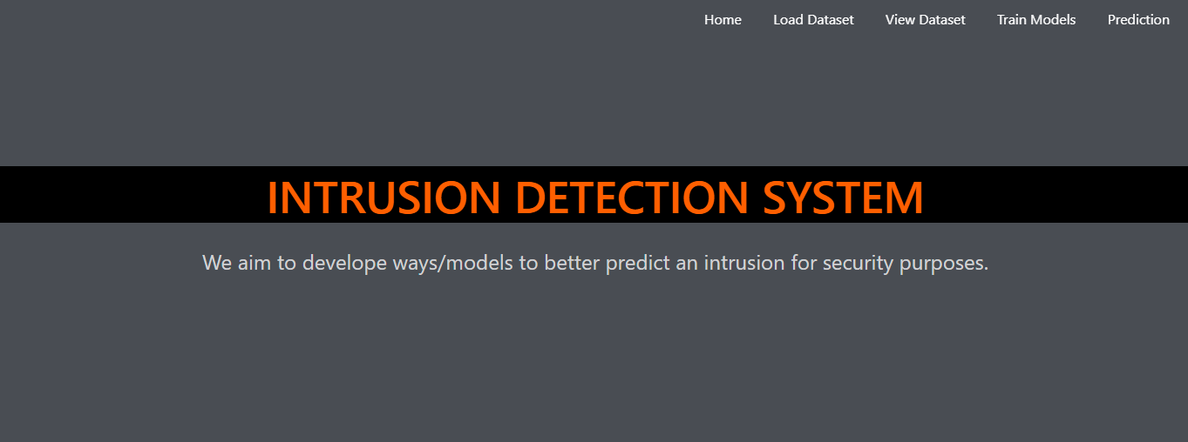
RESULTS
HOME

Slide 30
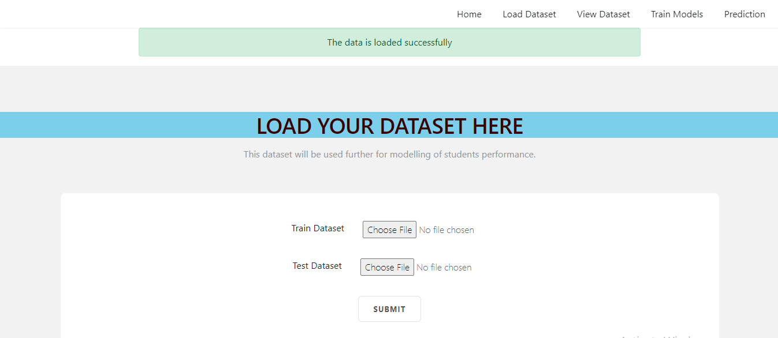
LOAD THE DATASET

Slide 31
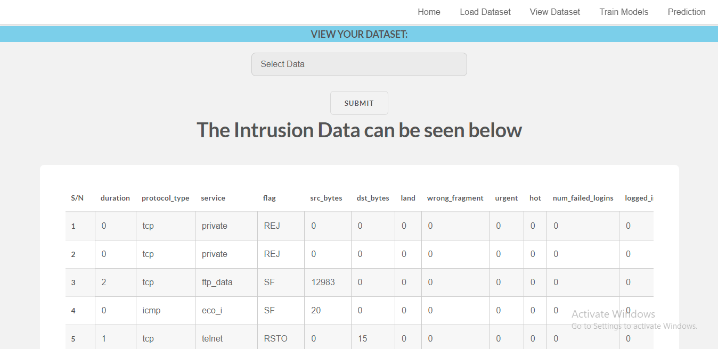
VIEW THE DATASET

Slide 32
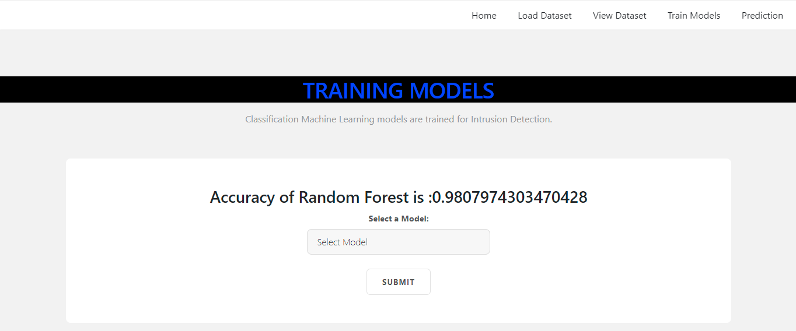
TRAIN THE MODEL

Slide 33
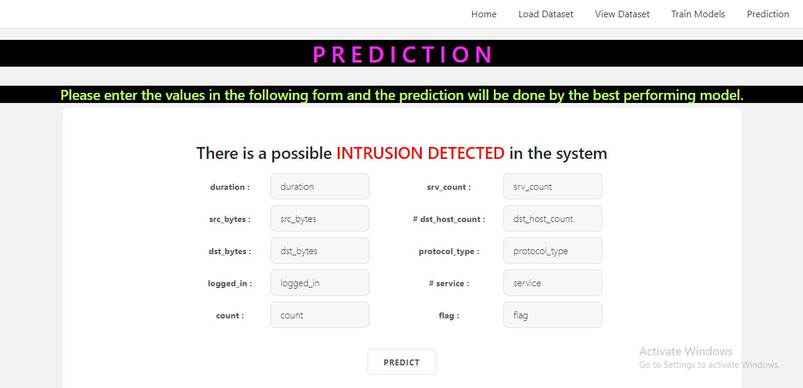
PREDICTION

Slide 34
REFERENCES
[1] Jafar Abo Nada; Mohammad Rasmi Al-Mosa, 2018 International Arab Conference on Information Technology (ACIT), A Proposed Wireless Intrusion Detection Prevention and Attack System.
[2] Kinam Park; Youngrok Song; Yun-Gyung Cheong, 2018 IEEE Fourth International Conference on Big Data Computing Service and Applications (BigDataService), Classification of Attack Types for Intrusion Detection Systems Using a Machine Learning Algorithm
[3] S. Bernard, L. Heutte and S. Adam “On the Selection of Decision Trees in Random Forests” Proceedings of International Joint Conference on Neural Networks, Atlanta, Georgia, USA, June 14-19, 2009, 978-1-4244-3553- 1/09/$25.00 ©2009 IEEE

Slide 35
REFERENCES
[4] A. Tesfahun, D. Lalitha Bhaskari, ” Intrusion Detection using Random Forests Classifier with SMOTE and Feature Reduction” 2013 International Conference on Cloud & Ubiquitous Computing & Emerging Technologies, 978-0- 4799-2235-2/13 $26.00 © 2013 IEEE
[5] Le, T.-T.-H., Kang, H., & Kim, H. (2019).The Impact of PCA-Scale Improving GRU Performance for Intrusion Detection. 2019 International Conference on Platform Technology and Service (PlatCon). Doi:10.1109/platcon.2019.8668960
[6] Anish Halimaa A, Dr K.Sundarakantham: Proceedings of the Third International Conference on Trends in Electronics and Informatics (ICOEI 2019) 978-1-5386-9439-8/19/$31.00 ©2019 IEEE “MACHINE LEARNING BASED INTRUSION DETECTION SYSTEM.”

Slide 36
Thank You

