Slide 1
Domain: Machine Learning
Technology: Python
MACHINE LEARNING‑BASED EFFECTIVE FINE‑GRAINED WEATHER FORECASTING MODEL
By: <names here>

Slide 2
INDEX
Abstract
Problem Definition
Literature review
Hardware and Software Requirements
Existing Method
Disadvantage
Proposed method
Flow Diagram
Advantages
Applications
Implementation
Algorithms
UML Diagrams
References

Slide 3
ABSTRACT
It is well-known that numerical weather prediction (NWP) models require considerable computer power to solve complex mathematical equations to obtain a forecast based on current weather conditions. In this article, we propose a novel light weight data-driven weather forecasting model by exploring temporal modelling approaches of More specifically LSTM, Standard Linear Regression (SR), Ridge Regression (RR), Support Vector Regression (SVR), and Random Forest Regressor (RF), Decision Tree Regressor (DT) are implemented as the classical machine learning approaches, and Autoregressive Integrated Moving Average (ARIMA) is implemented as the statistical forecasting approaches. Furthermore, Weather information is captured by time-series data. Our experiment shows that the proposed lightweight model produces better results.

Slide 4
INTRODUCTION
Weather forecasting and Prediction is the process of predicting the state of the atmosphere based on the temperature values and specific time and locations. Numerical weather prediction (NWP) utilizes computer algorithms to provide a forecast based on current weather conditions.
Machine learning models and time-series forecasting are used for predicting and seeing the data according to the time and atmosphere parameters and it will built the models on its superior performance.
Weather forecasts are made by collecting as much data as possible about the current state of the atmosphere (particularly the temperature, humidity and wind) and using understanding of atmospheric processes (through meteorology) to determine how the atmosphere evolves in the future.

Slide 5
LITERATURE REVIEW
[1] Basak D, Pal S, Patranabis D (2007) “Support vector regression.” Neural Inf Process Lett Rev 11(10):203–224
Instead of minimizing the observed training error, Support Vector Regression (SVR) attempts to minimize the generalization error bound so as to achieve generalized performance. The idea of SVR is based on the computation of a linear regression function in a high dimensional feature space where the input data are mapped via a nonlinear function. SVR has been applied in various fields – time series and financial (noisy and risky) prediction, approximation of complex engineering analyses, convex quadratic programming and choices of loss functions, etc. In this paper, an attempt has been made to review the existing theory, methods, recent developments and scopes of SVR.

Slide 6
[2] Kavitha S, Varuna S, Ramya R (2016) “A comparative analysis on linear regression and support vector regression.” In: 2016 online international conference on green engineering and technologies (IC-GET), November 2016, pp 1–5.
In business, consumer’s interest, behavior, product profits are the insights required to predict the future of business with the current data or historical data. These insights can be generated with the statistical techniques for the purpose of forecasting. The statistical techniques can be evaluated for the predictive model based on the requirements of the data. The prediction and forecasting are done widely with time series data. Most of the applications such as weather forecasting, finance and stock market combine historical data with the current streaming data for better accuracy. However the time series data is analyzed with regression models. In this paper, linear regression and support vector regression model is compared using the training data set in order to use the correct model for better prediction and accuracy.

Slide 7
[3]. Sanchez-Fernandez M, de-Prado-Cumplido M, Arenas-Garcia J, Perez-Cruz F (2004) “SVM multi regression for nonlinear channel estimation in multiple-input multiple-output systems.” IEEE Trans Signal Process 52(8):2298–2307.
This paper addresses the problem of multiple-input multiple-output (MIMO) frequency nonselective channel estimation. We develop a new method for multiple variable regression estimation based on Support Vector Machines (SVMs): a state-of-the-art technique within the machine learning community for regression estimation. We show how this new method, which we call M-SVR, can be efficiently applied. The proposed regression method is evaluated in a MIMO system under a channel estimation scenario, showing its benefits in comparison to previous proposals when nonlinearities are present in either the transmitter or the receiver sides of the MIMO system.

Slide 8
[4]. Sharaf A, Roy SR (2018) “Comparative analysis of temperature prediction using regression methods and back propagation neural network.” In: 2018 2nd international conference on trends in electronics and informatics (ICOEI), May 2018, pp 739–742.
Weather forecasting is very important for our day to day life as the prediction of climatic parameters like temperature, humidity, rainfall, etc. is important for agriculture, forestry, commercial companies etc. It is known that the climatic conditions are irregular in nature and may be often unpredictable. In previous years most of the work was done on finding a linear equation to predict climatic parameters. It is now known that climatic conditions are nonlinear in nature and thus Artificial Neural Network is now considered to be an efficient nonlinear method for weather prediction. In this paper a comparative analysis has been done between regression methods and nonlinear method like artificial neural network to analyze the difference between the performance of linear and nonlinear models for prediction of temperature.

Slide 9
SOFTWARE & HARDWARE REQUIREMENTS
Python v3.6+
PyCharm IDE.
RAM: 4GB minimum.
Processor: Intel I3 (min)
Hard Disk: 128 GB +
OS: Windows 7+
Libraries: Pandas, Numpy, scikit-learn, stats-model, seaborn, Matplotlib.

Slide 10
EXISTING METHOD
In existing system, Observational data collected by Doppler radar, Radiosonde, weather satellites, buoys and other instruments are fed into computerized NWS numerical forecast models.
The models use equations, along with past weather data, to provide forecast guidance to our meteorologists.

Slide 11
DISADVANTAGES
DISADVANTAGES:
The primary problem with Numerical Weather Prediction (NWP) models is it takes a long time to produce its results.
Forecasts are Never Completely Accurate.
Forecasts are never 100% and it is almost impossible to predict the future with certainty.
Problems concern availability, timeliness, and quality of observational data.

Slide 12
PROPOSED METHOD
We propose this system which uses Machine Learning Algorithms like SVR, Random Forests, Decision Tree, Ridge, Linear Regression for prediction and LSTM and ARIMA for Weather Forecasting.
These techniques can determine the possibility of weather condition. Due to limitation in to get live data we done forecasting on the old data.

Slide 13
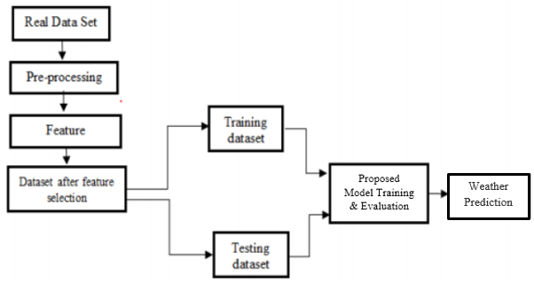
FLOW CHART:

Slide 14
ADVANTAGES
Reduce weather-related losses and enhance societal benefits.
Protection of life and property.
Public health and safety.
Avoid forest fires.
Farmers to know when to apply the pests and chemicals to avoid the crop wastage.

Slide 15
APPLICATIONS
A major part of modern weather forecasting is the severe weather alerts and advisories, which the national weather service issue in the case that severe or hazardous weather is expected. This is done to protect life and property.
The aviation industry is especially sensitive to the weather, accurate weather forecasting is essential considering the fact that a greater number of plane crashes so to avoid accidents it is useful.
Farmers rely on weather forecasts to decide what work to do on any particular day.
Military weather forecasters present weather conditions to the war fighters, community.

Slide 16
IMPLEMENTATION
System:
Stores Data
Model Training
Model Predictions
User:
Load Dataset
View Dataset.
Select Model.
Evaluation

Slide 17
ALGORITHMS
LSTM
It is special kind of recurrent neural network that is capable of learning long term dependencies in data. This is achieved because the recurring module of the model has a combination of four layers interacting with each other.
The picture above depicts four neural network layers in yellow boxes, point wise operators in green circles, input in yellow circles and cell state in blue circles. An LSTM module has a cell state and three gates which provides them with the power to selectively learn, unlearn or retain information from each of the units. The cell state in LSTM helps the information to flow through the units without being altered by allowing only a few linear interactions. Each unit has an input, output and a forget gate which can add or remove the information to the cell state. The forget gate decides which information from the previous cell state should be forgotten for which it uses a sigmoid function.

Slide 18
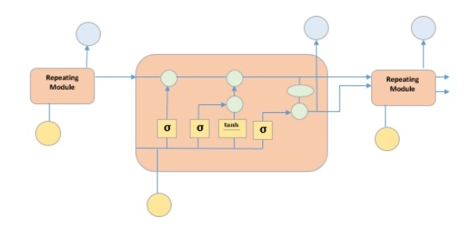
LSTM
The input gate controls the information flow to the current cell state using a point-wise multiplication operation of ‘sigmoid’ and ‘tanh’ respectively. Finally, the output gate decides which information should be passed on to the next hidden state.

Slide 19
Random Forest:
Random forests or random decision forests are an ensemble learning method for classification, regression and other tasks that operate by constructing a multitude of decision trees at training time and outputting the class that is the mode of the classes (classification) or mean/average prediction (regression) of the individual trees.
Random decision forests correct for decision trees' habit of over fitting to their training set.
Random forests generally outperform decision trees, but their accuracy is lower than gradient boosted trees. However, data characteristics can affect their performance.

Slide 20
Support Vector Regressor:
Support Vector Regression is a supervised learning algorithm that is used to predict discrete values. Support Vector Regression uses the same principle as the SVMs. The basic idea behind SVR is to find the best fit line. In SVR, the best fit line is the hyperplane that has the maximum number of points.
Unlike other Regression models that try to minimize the error between the real and predicted value, the SVR tries to fit the best line within a threshold value. The threshold value is the distance between the hyperplane and boundary line. The fit time complexity of SVR is more than quadratic with the number of samples which makes it hard to scale to datasets with more than a couple of 10000 samples.

Slide 21
Simple Linear Regression:
Regression models describe the relationship between variables by fitting a line to the observed data. Linear regression models use a straight line, while logistic and nonlinear regression models use a curved line. Regression allows you to estimate how a dependent variable changes as the independent variable(s) change.
Simple linear regression is used to estimate the relationship between two quantitative variable.
Simple linear regression is used to find out the best relationship between a single input variable (predictor, independent variable, input feature and input parameter) & output variable (predicted, dependent variable, output feature and output parameter) provided that both variables are continuous in nature. This relationship represents how an input variable is related to the output variable and how it is represented by a straight line.

Slide 22
Ridge Regression:
Ridge Regression is a model tuning method that is used to analyses any data that suffers from multi-collinearity. This method performs L2 regularization. When the issue of multi-collinearity occurs, least-squares are unbiased, and variances are large, this results in predicted values to be far away from the actual values.
Lambda is the penalty term. λ given here is denoted by an alpha parameter in the ridge function. So, by changing the values of alpha, we are controlling the penalty term. Higher the values of alpha, bigger is the penalty and therefore the magnitude of coefficients is reduced. It shrinks the parameters. Therefore, it is used to prevent multi-collinearity. It reduces the model complexity by coefficient shrinkage.

Slide 23
Decision Tree:
A tree has many analogies in real life, and turns out that it has influenced a wide area of machine learning, covering both classification and regression. In decision analysis, a decision tree can be used to visually and explicitly represent decisions and decision making. As the name goes, it uses a tree-like model of decisions. Though a commonly used tool in data mining for deriving a strategy to reach a particular goal.
A decision tree is drawn upside down with its root at the top. In the image on the left, the bold text in black represents a condition/internal node, based on which the tree splits into branches/ edges. The end of the branch that doesn’t split anymore is the decision/leaf, in this case, whether the passenger died or survived, represented as red and green text respectively.

Slide 24
ARIMA:
ARIMA is a very popular technique for time series modeling. It describes the correlation between data points and takes into account the difference of the values. An improvement over ARIMA is SARIMA (or seasonal ARIMA). A detailed explanation of Arima, parameters (p,q,d), plots (ACF PACF)
ARIMA is a very popular statistical method for time series forecasting. ARIMA stands for Auto-Regressive Integrated Moving Averages.
ARIMA has three components – AR (autoregressive term), I (differencing term) and MA (moving average term). Let us understand each of these components – AR term refers to the past values used for forecasting the next value. The AR term is defined by the parameter ‘p’ in arima. The value of ‘p’ is determined using the PACF plot. MA term is used to define number of past forecast errors used to predict the future values. The parameter ‘q’ in arima represents the MA term. ACF plot is used to identify the correct ‘q’ value.

Slide 25
USE CASE DIAGRAM
A use case diagram in the Unified Modeling Language (UML) is a type of behavioral diagram defined by and created from a Use-case analysis.
Its purpose is to present a graphical overview of the functionality provided by a system in terms of actors, their goals (represented as use cases), and any dependencies between those use cases.
The main purpose of a use case diagram is to show what system functions are performed for which actor. Roles of the actors in the system can be depicted.

Slide 26
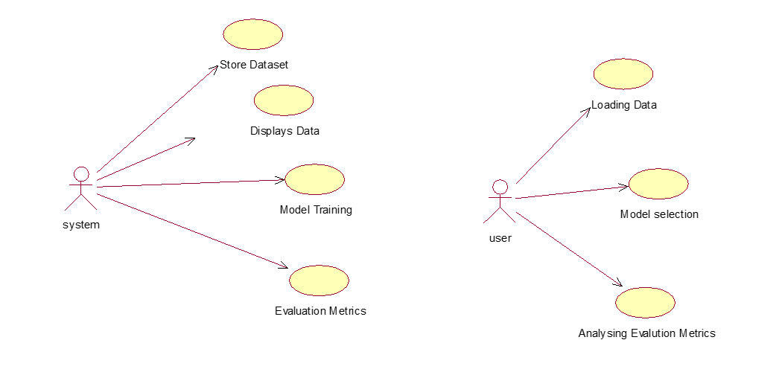
USE CASE DIAGRAM

Slide 27
CLASS DIAGRAM
In software engineering, a class diagram in the Unified Modeling Language (UML) is a type of static structure diagram that describes the structure of a system by showing the system's classes, their attributes, operations (or methods), and the relationships among the classes. It explains which class contains information.

Slide 28
SEQUENCE DIAGRAM
A sequence diagram in Unified Modeling Language (UML) is a kind of interaction diagram that shows how processes operate with one another and in what order.
It is a construct of a Message Sequence Chart. Sequence diagrams are sometimes called event diagrams, event scenarios, and timing diagrams.

Slide 29
SEQUENCE DIAGRAM

Slide 30
COLLABORATION DIAGRAM
In collaboration diagram the method call sequence is indicated by some numbering technique as shown below. The number indicates how the methods are called one after another. We have taken the same order management system to describe the collaboration diagram. The method calls are similar to that of a sequence diagram. But the difference is that the sequence diagram does not describe the object organization where as the collaboration diagram shows the object organization.

Slide 31
DEPLOYMENT DIAGRAM
Deployment diagram represents the deployment view of a system. It is related to the component diagram. Because the components are deployed using the deployment diagrams.
A deployment diagram consists of nodes. Nodes are nothing but physical hardware used to deploy the application.

Slide 32
COMPONENT DIAGRAM
A component diagram, also known as a UML component diagram, describes the organization and wiring of the physical components in a system.
Component diagrams are often drawn to help model implementation details and double-check that every aspect of the system's required functions is covered by planned development.

Slide 33

RESULTS
HOME

Slide 34
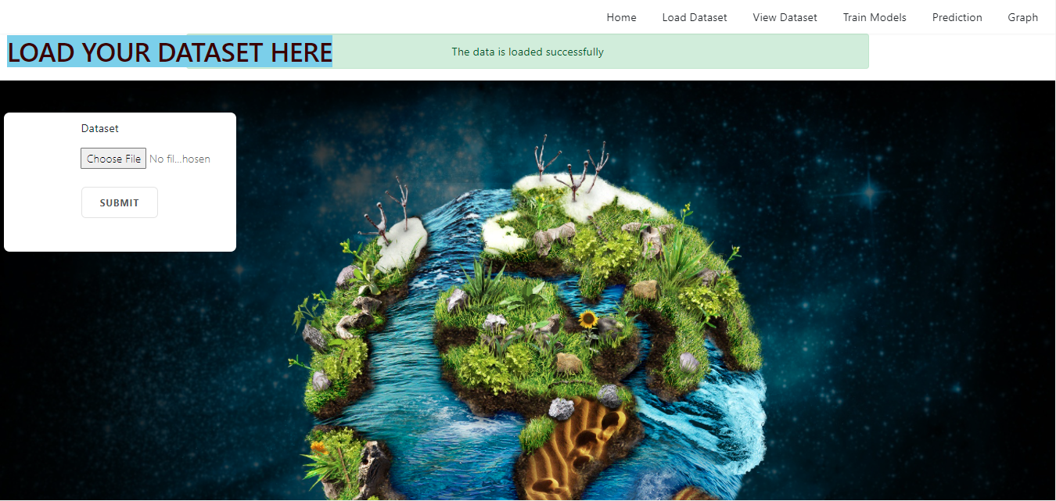
LOAD THE DATASET

Slide 35
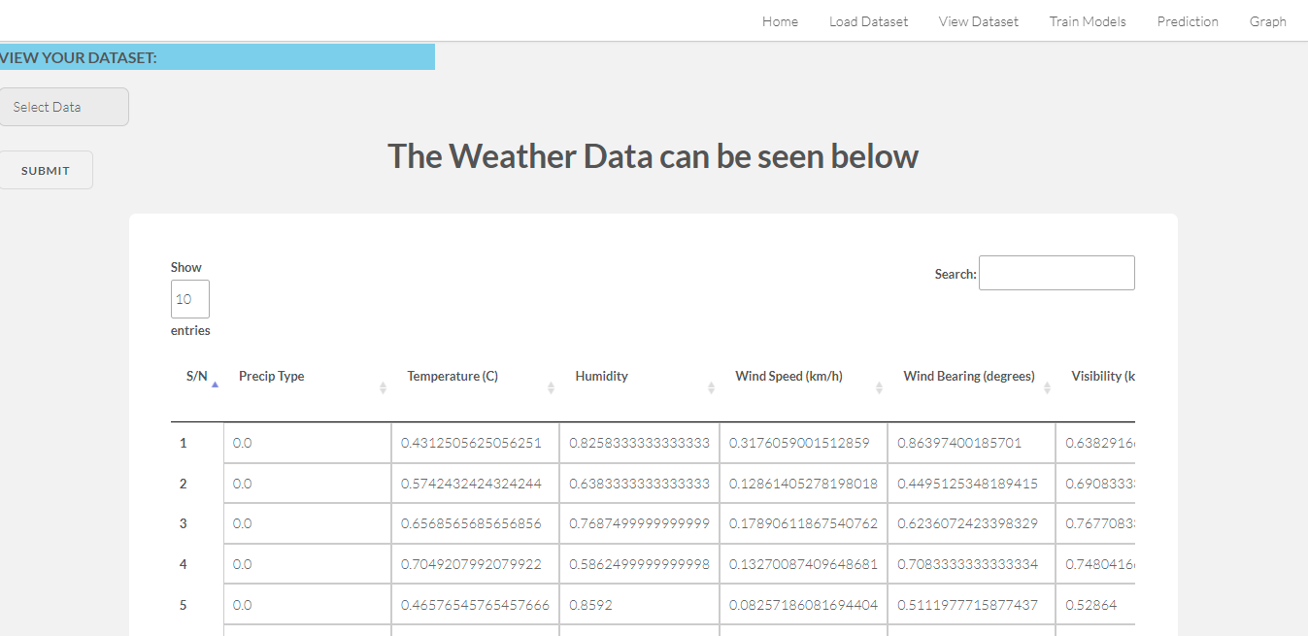
VIEW THE DATASET

Slide 36
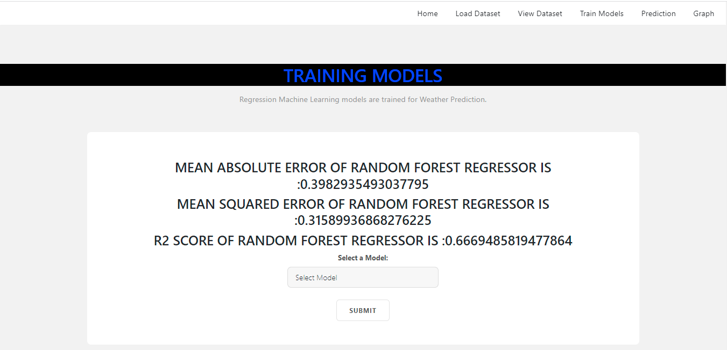
TRAIN THE MODEL

Slide 37
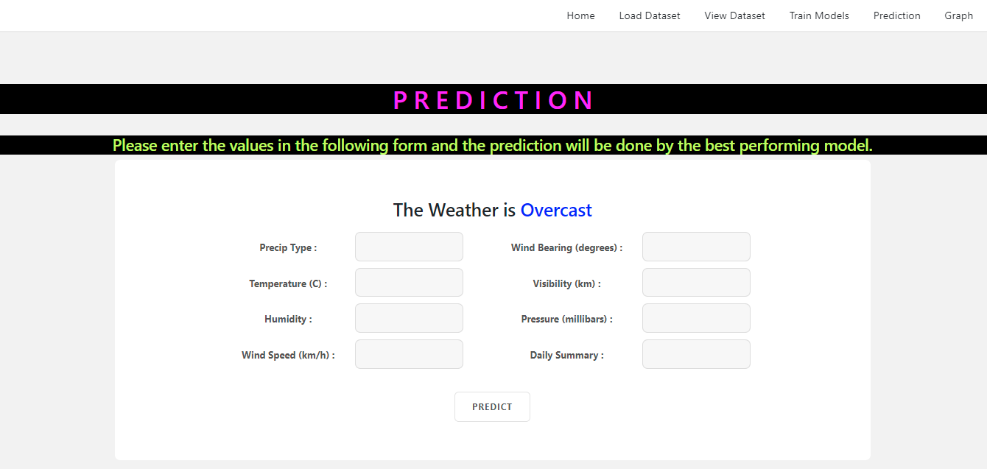
PREDICTION

Slide 38
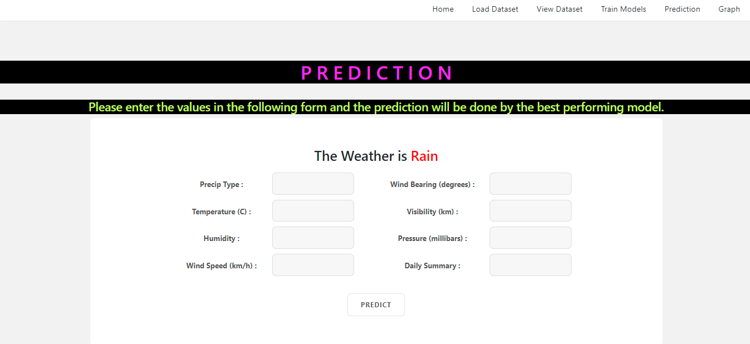
PREDICTION

Slide 39
REFERENCES
[1] Basak D, Pal S, Patranabis D (2007) “Support vector regression.” Neural Inf Process Lett Rev 11(10):203–224
[2] Kavitha S, Varuna S, Ramya R (2016) “A comparative analysis on linear regression and support vector regression.” In: 2016 online international conference on green engineering and technologies (IC-GET), November 2016, pp 1–5.
[3]. Sanchez-Fernandez M, de-Prado-Cumplido M, Arenas-Garcia J, Perez-Cruz F (2004) “SVM multi regression for nonlinear channel estimation in multiple-input multiple-output systems.” IEEE Trans Signal Process 52(8):2298–2307.

Slide 40
REFERENCES
[4]. Sharaf A, Roy SR (2018) “Comparative analysis of temperature prediction using regression methods and back propagation neural network.” In: 2018 2nd international conference on trends in electronics and informatics (ICOEI), May 2018, pp 739–742.
[5]. Weather Research and Forecasting Model | MMM: Mesoscale & Micro scale Meteorology Laboratory (2019)
[6]. Troncoso A, Salcedo-Sanz S, Casanova-Mateo C, Riquelme JC, Prieto L (2015) Local models-based regression trees for very short-term wind speed prediction. Renew Energy 81:589–598.

Slide 41
Thank You

