Slide 1
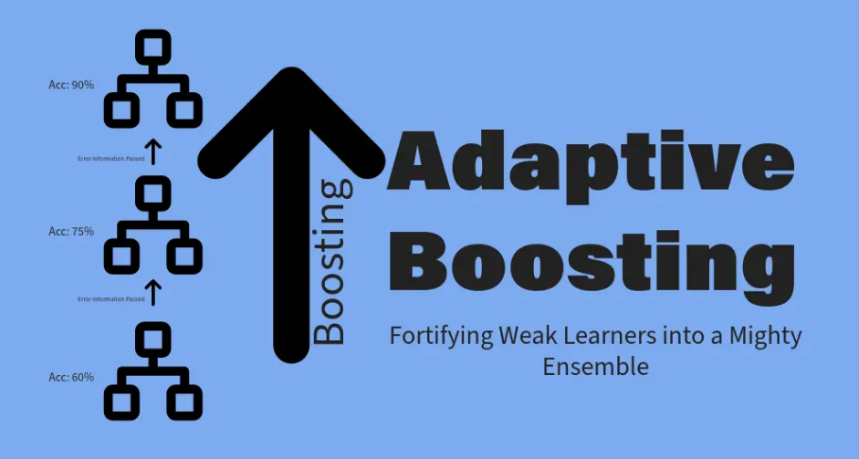

Slide 2

Introduction to AdaBoost Regression
AdaBoost stands for Adaptive Boosting.
It is an ensemble learning technique that combines multiple weak models to create a strong predictive model.
Used for both classification and regression tasks.
Focus: Improve prediction accuracy by reducing errors step by step.

Slide 3
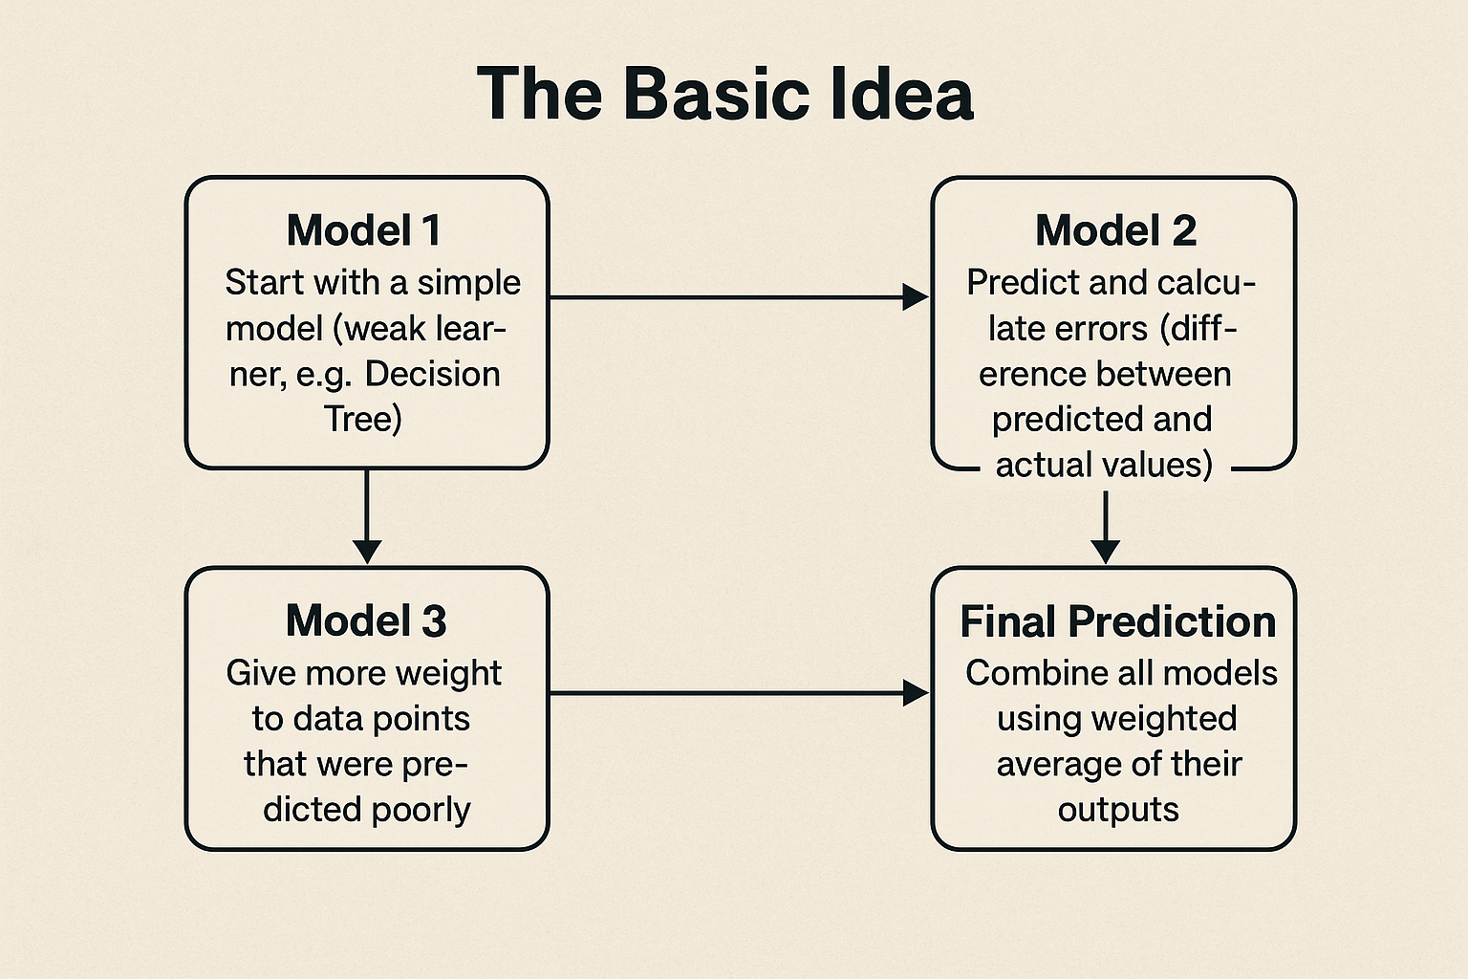
How AdaBoost Regression Works

Slide 4
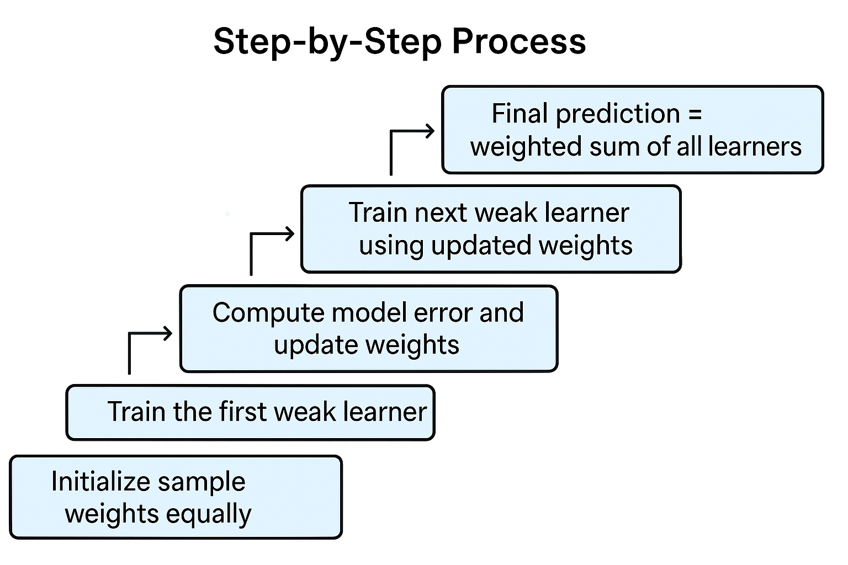
Algorithm Steps

Slide 5
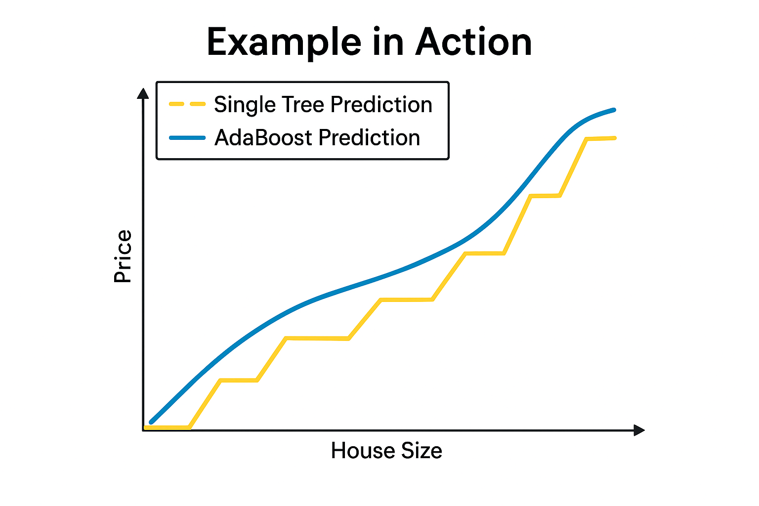
Example and Output
Suppose we predict house prices using AdaBoost Regressor.
Base model: Decision Tree Regressor (max depth = 1).
AdaBoost combines multiple such trees to reduce overall error.
Result: smoother, more accurate prediction curve.

Slide 6
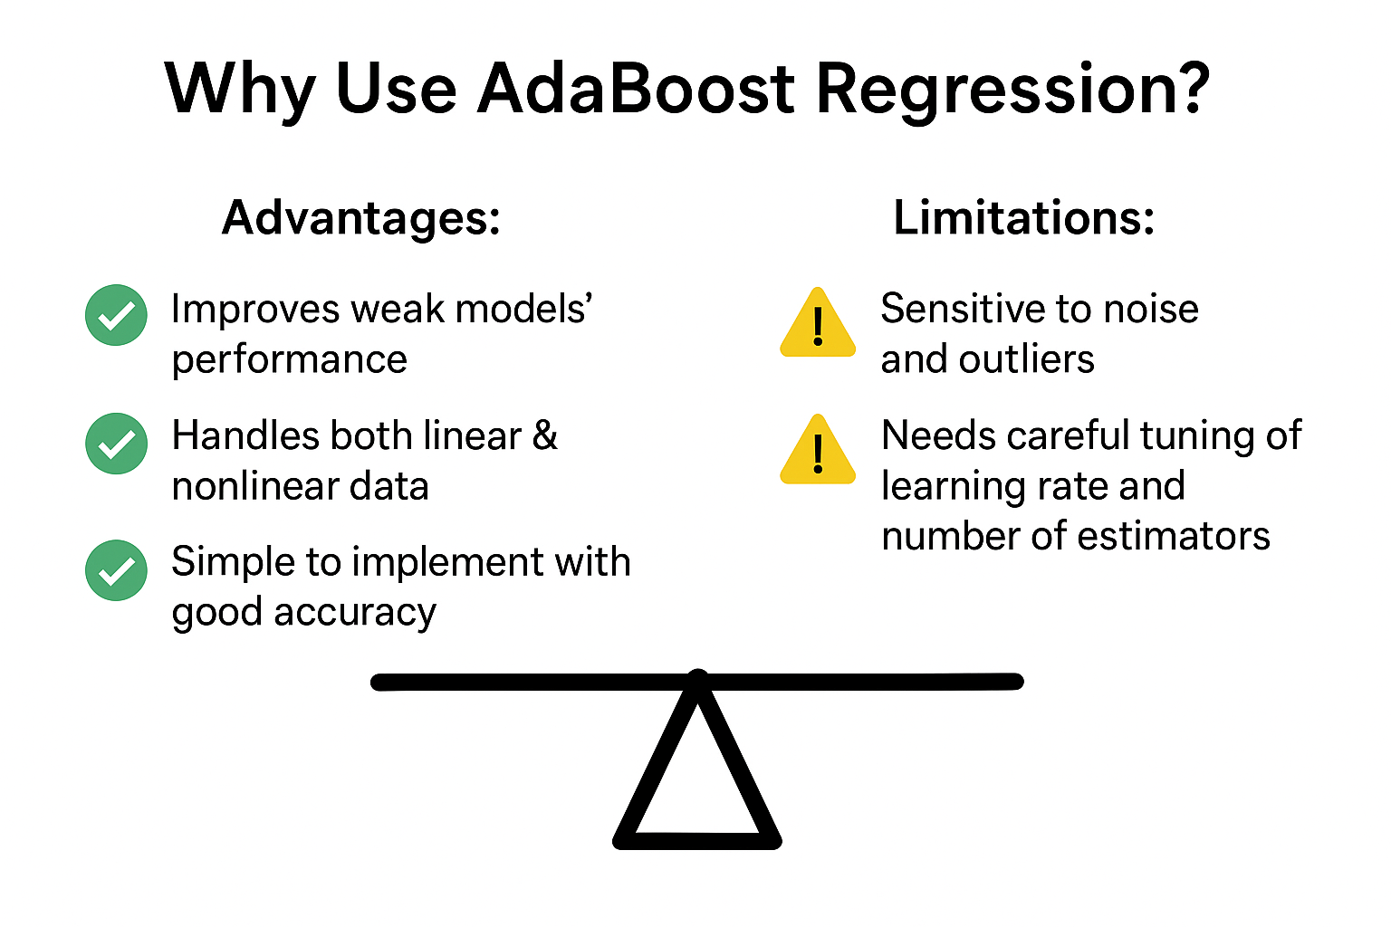
Key Advantages & Limitations

