Slide 1
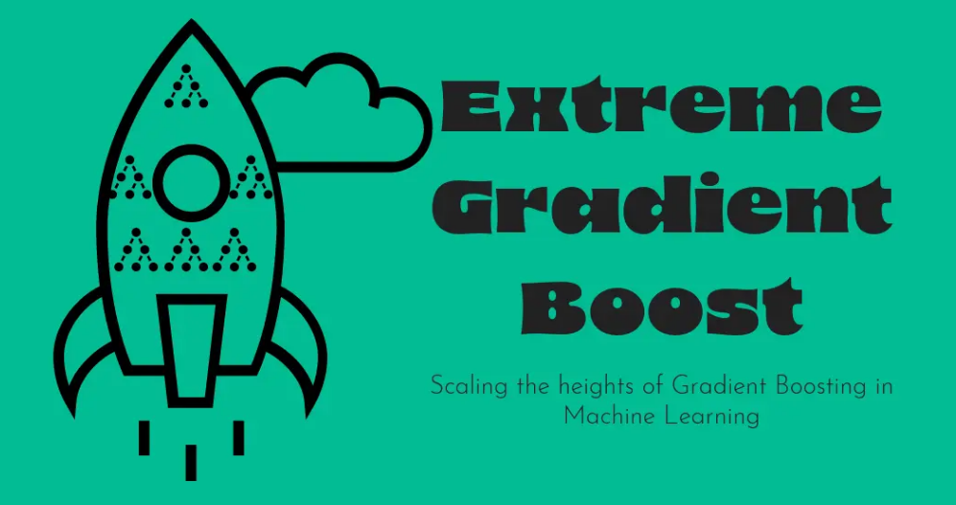

Slide 2
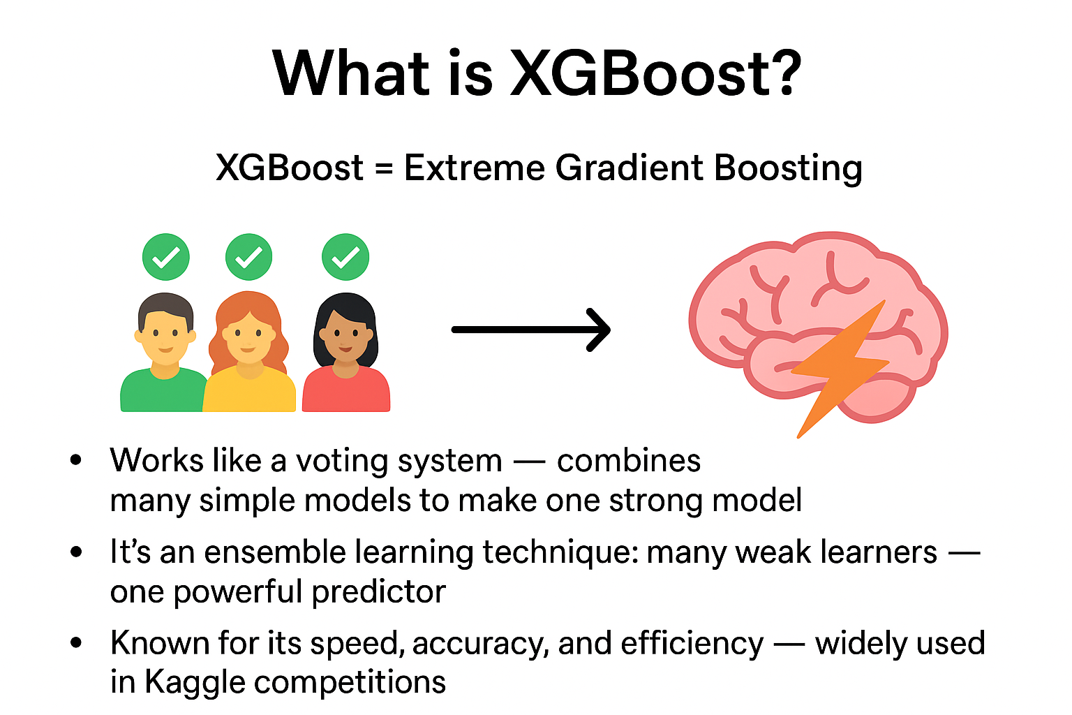
Introduction to XGBOOST

Slide 3
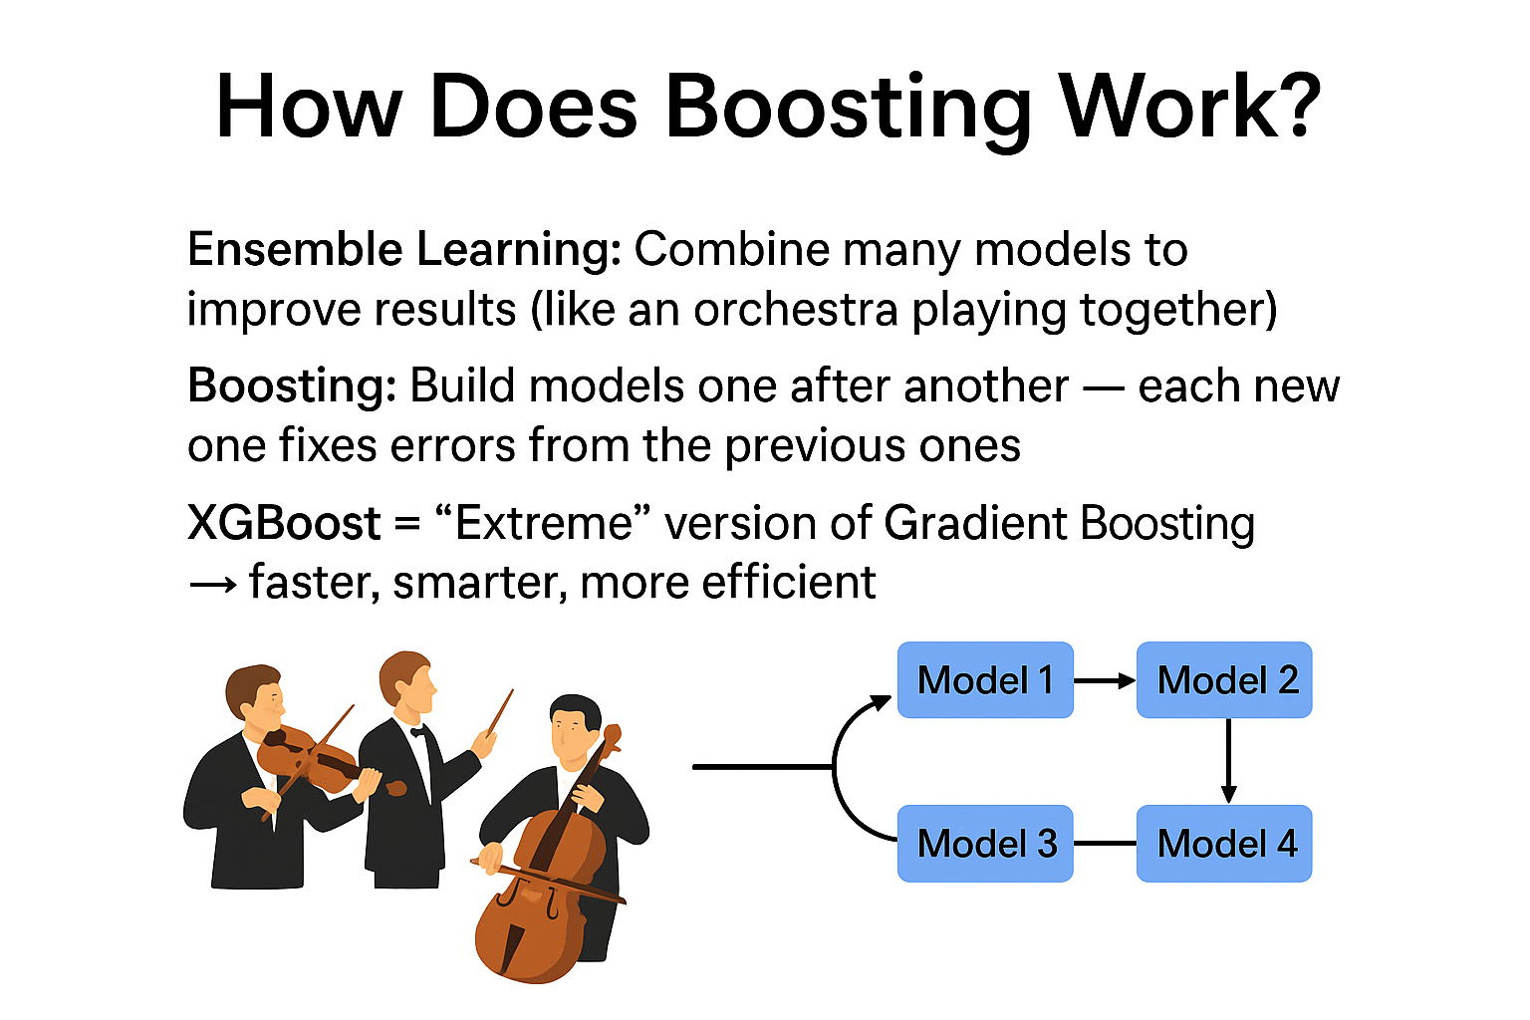
BACKGROUND – boosting & ensemble learning

Slide 4
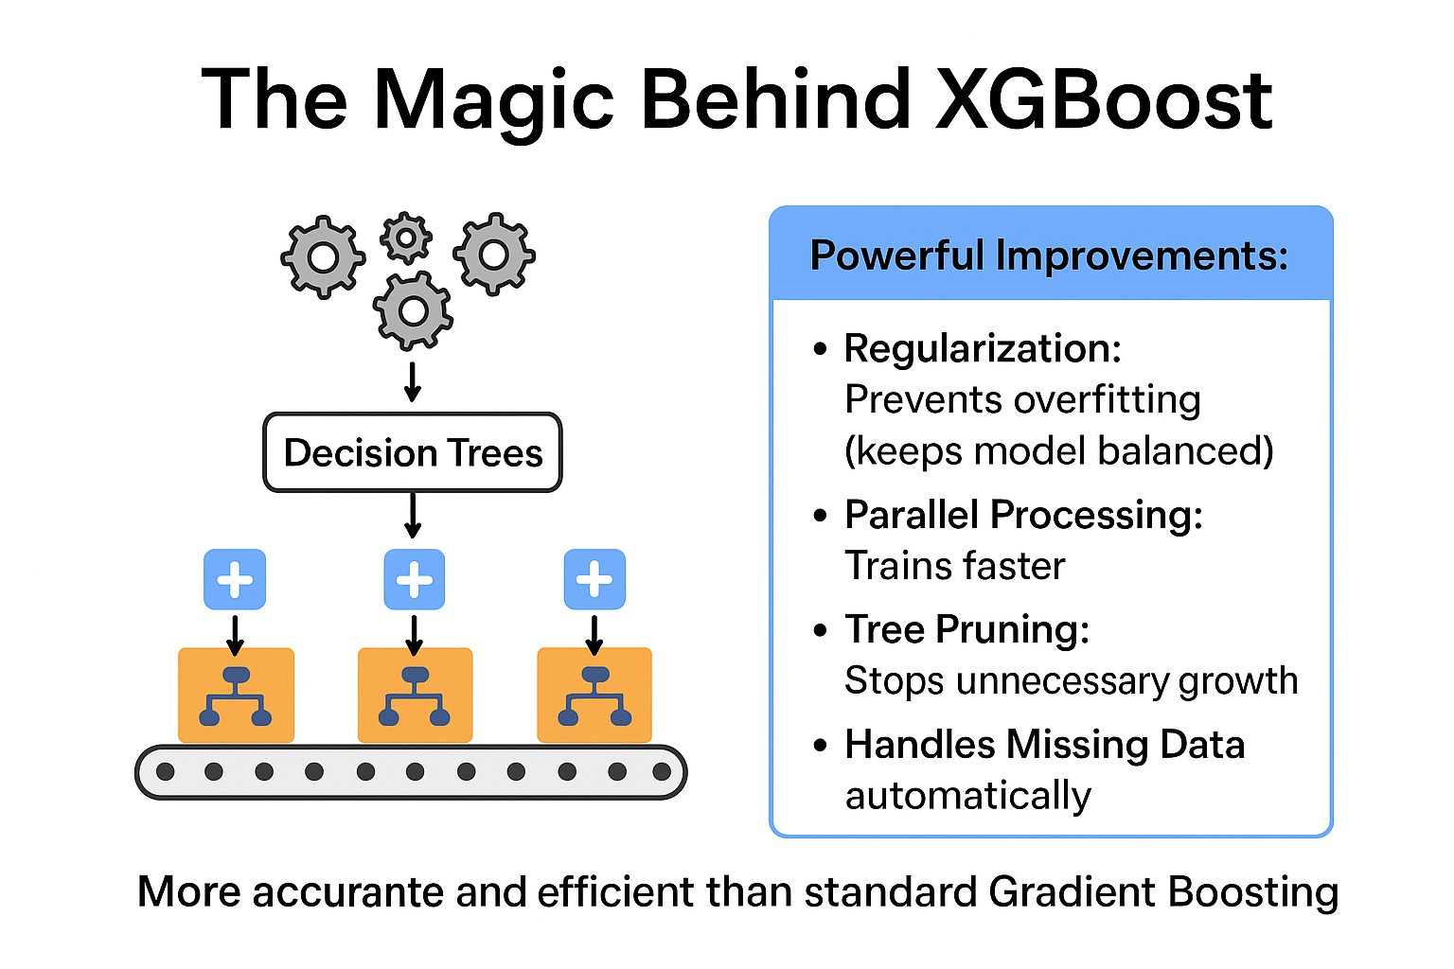
How XGBOOST WORKS

Slide 5
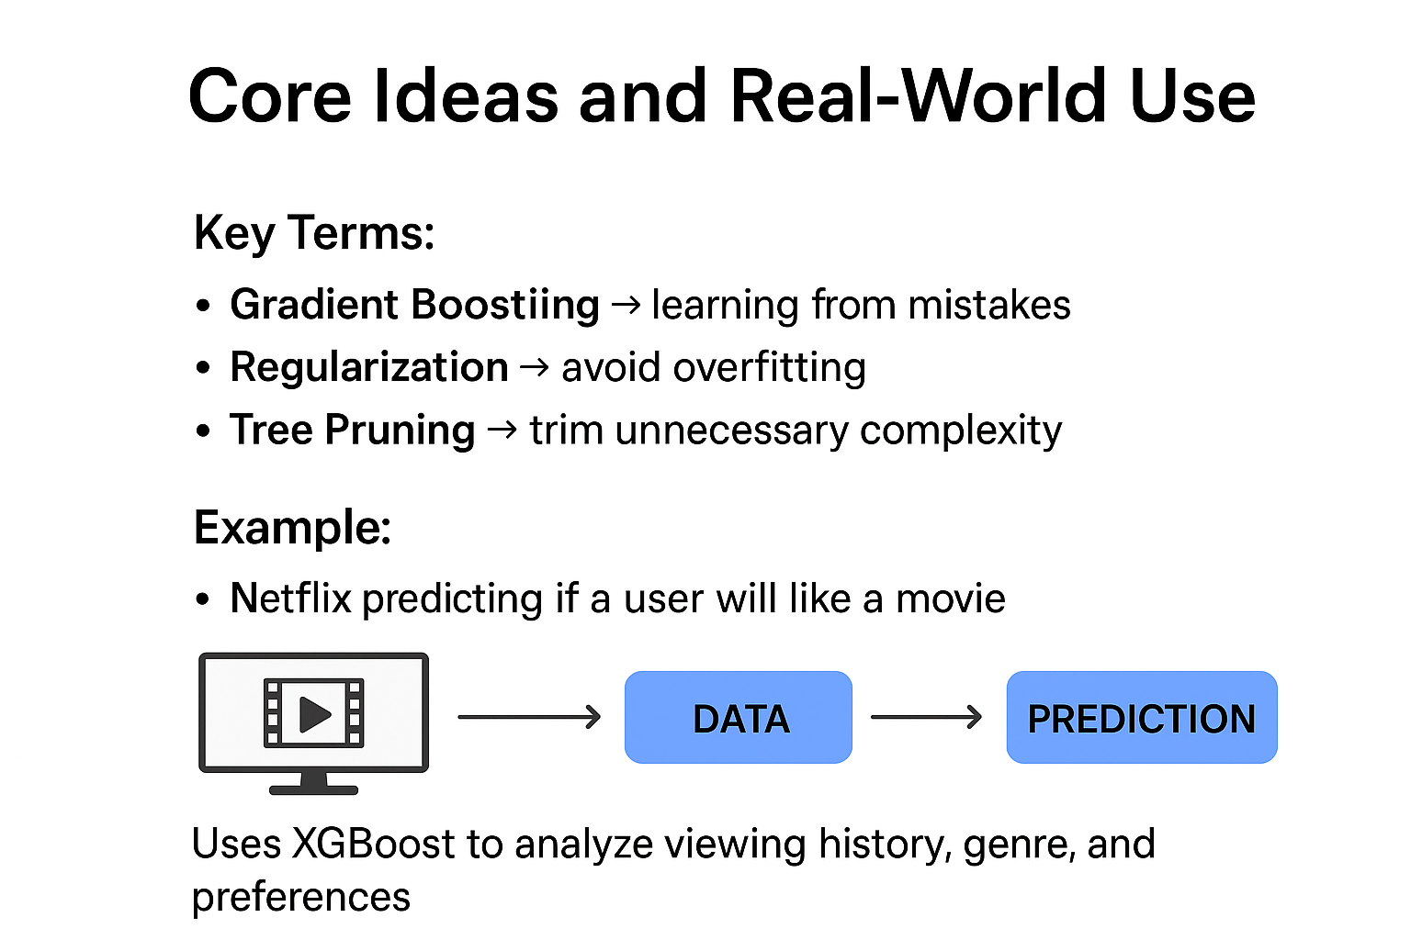
Key concepts & Example

Slide 6
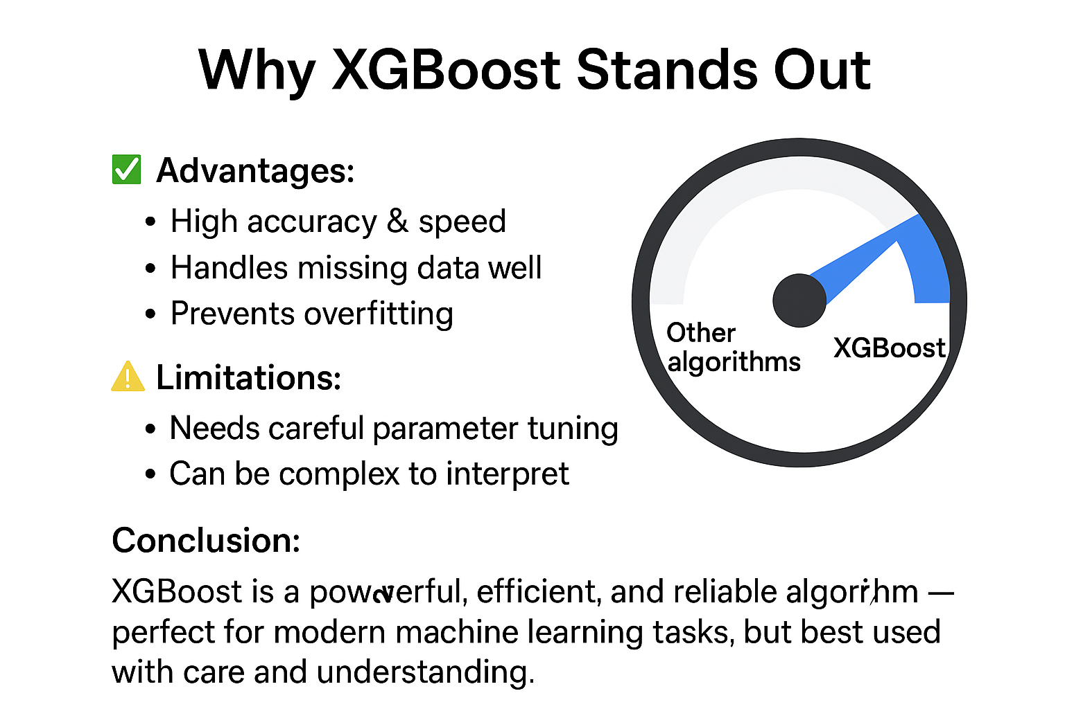
Advantages & conclusion

