Slide 2
DDS Analytics Talent Management Attrition EDA
By Balasubramaniam Dakshinamoorthi

Slide 3
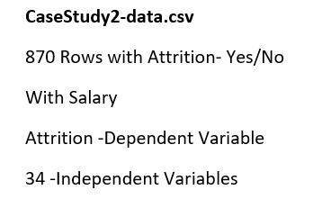

Data Description

Slide 4
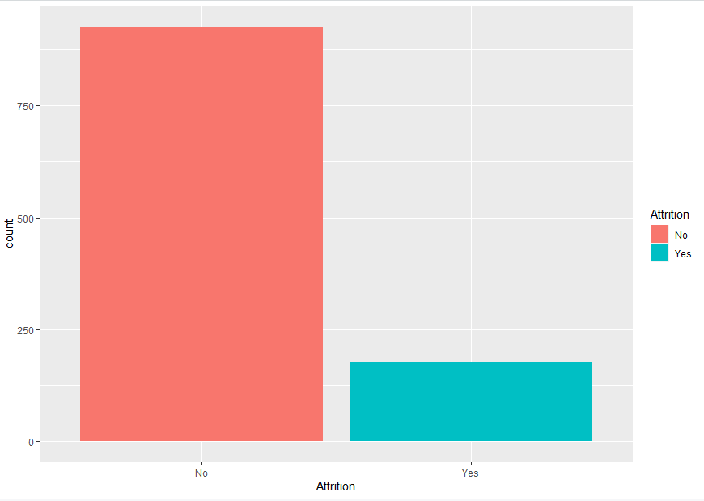
Attrition Population[84 %-No, 16%-Yes]

Slide 5
EDA –Areas of Interest
1. To do a data analysis to identify factors that lead to attrition.
2. Top three factors that contribute to turnover (backed up by evidence provided by analysis.
3. Job role specific trends that may exist in the data set
4. Any other interesting trends and observations from your analysis

Slide 6
EDA –Areas of Interest
Question 1.
To do a data analysis to identify factors that lead to attrition.

Slide 7
Feature Extraction
Overall
Age 3.37097096
BusinessTravelTravel_Frequently 3.39733632
BusinessTravelTravel_Rarely 2.31469603
DepartmentResearch & Development 0.02522449
DepartmentSales 0.02332101
DistanceFromHome 3.60951514
Education 0.11556529
EducationFieldLife Sciences 0.05170160
EducationFieldMarketing 0.53532419
EducationFieldMedical 0.05877836
EducationFieldOther 0.30116975
EducationFieldTechnical Degree 0.93258088
EnvironmentSatisfaction 4.16432953
GenderMale 1.86094740
JobInvolvement 3.85797696
JobLevel 0.27218782
JobRoleHuman Resources 0.02915125
JobRoleLaboratory Technician 2.94205866
JobRoleManager 0.94174152
JobRoleManufacturing Director 0.24557120

Slide 8
Feature Extraction
Overall
JobRoleResearch Director 0.06293447
JobRoleResearch Scientist 1.68219281
JobRoleSales Executive 1.57859760
JobRoleSales Representative 2.18420868
JobSatisfaction 3.59627140
MaritalStatusMarried 1.68189531
MaritalStatusSingle 4.92826681
MonthlyIncome 0.31957312
NumCompaniesWorked 3.83038235
OverTimeYes 8.02574274
PercentSalaryHike 0.48017347
PerformanceRating 0.46448923
RelationshipSatisfaction 2.64289543
TotalWorkingYears 0.36628186
TrainingTimesLastYear 1.15222224
WorkLifeBalance 2.87355896
YearsAtCompany 1.81867995
YearsInCurrentRole 2.61057126
YearsSinceLastPromotion 3.19963362
YearsWithCurrManager 2.26107988

Slide 9
EDA –Areas of Interest
Question 2.
Top three factors that contribute to turnover (backed up by evidence provided by analysis.

Slide 10
Top Three Factors contribute to turnover
Factor Name | Value | Overall
OverTime | Yes | 8.02574274
Marital Status | Single | 4.92826
EnvironmentSatisfaction |  | 4.16432

Slide 11
EDA –Areas of Interest
Question 3.
Job role specific trends that may exist in the data set.

Slide 12
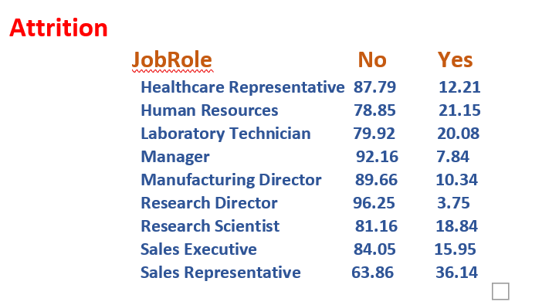
Question 4: Job Role Specific Trends Exists In the Dataset

Slide 13
Job Role Specific Leaving Company[ Attrition-Yes]
Role | Percentage | Yes/Rank
Sales Representative | 36.4 | 1
Human Resources | 21.25 | 2

Slide 14
EDA –Areas of Interest
Question 4.
Any Other Interesting Trends and Observation from your Analysis

Slide 15
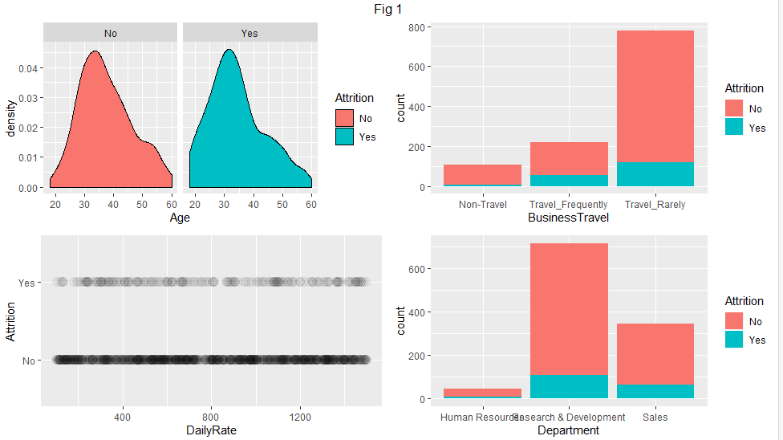
Age-Business Travel-Daily Rate-Department

Slide 16
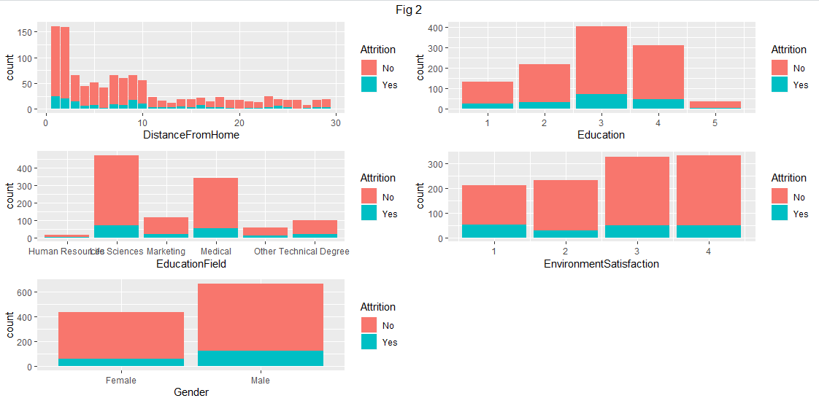
DistanceFromHome-Education-EducationField-EnvironmentSatisfaction-Gender

Slide 17
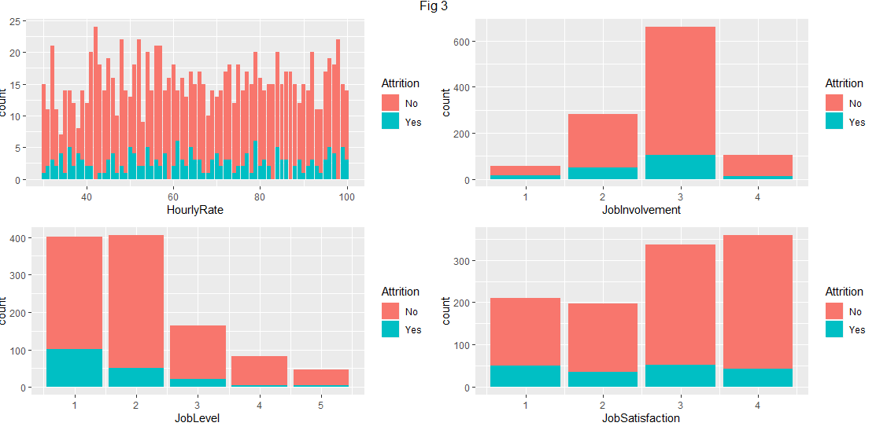
HourlyRate-JobInvolvement-JobLevel-JobSatisfaction

Slide 18
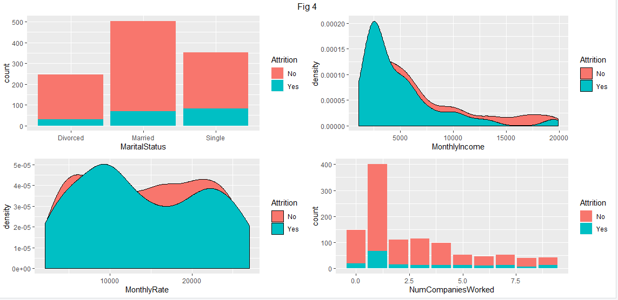
MartialStatus-MonthlyIncome-Monthly Rate-NumCompaniesWorked

Slide 19
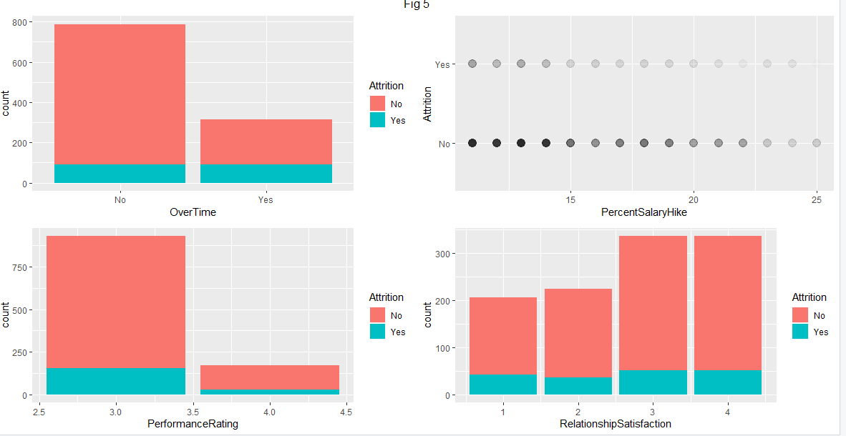
OverTime-PercentSalaryHike-PerformanceRating-RelationshipSatisfaction

Slide 20
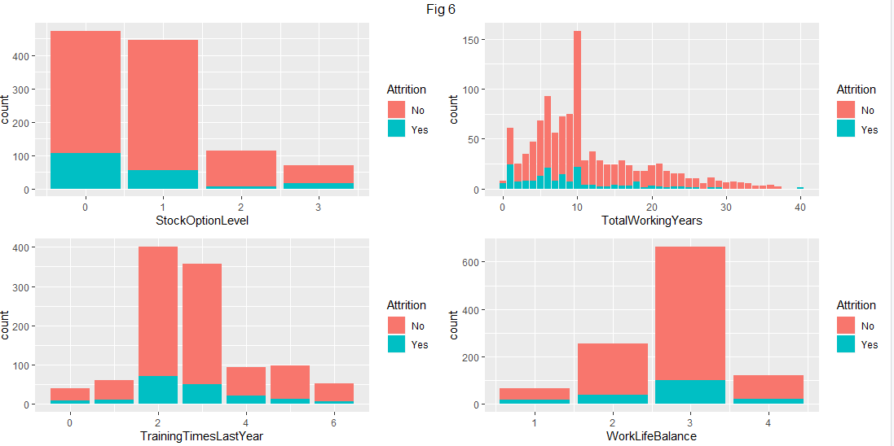
StockOptionLevel-TotalWorkingYears-TrainingTimesLastYear-WorkLifeBalance

Slide 21
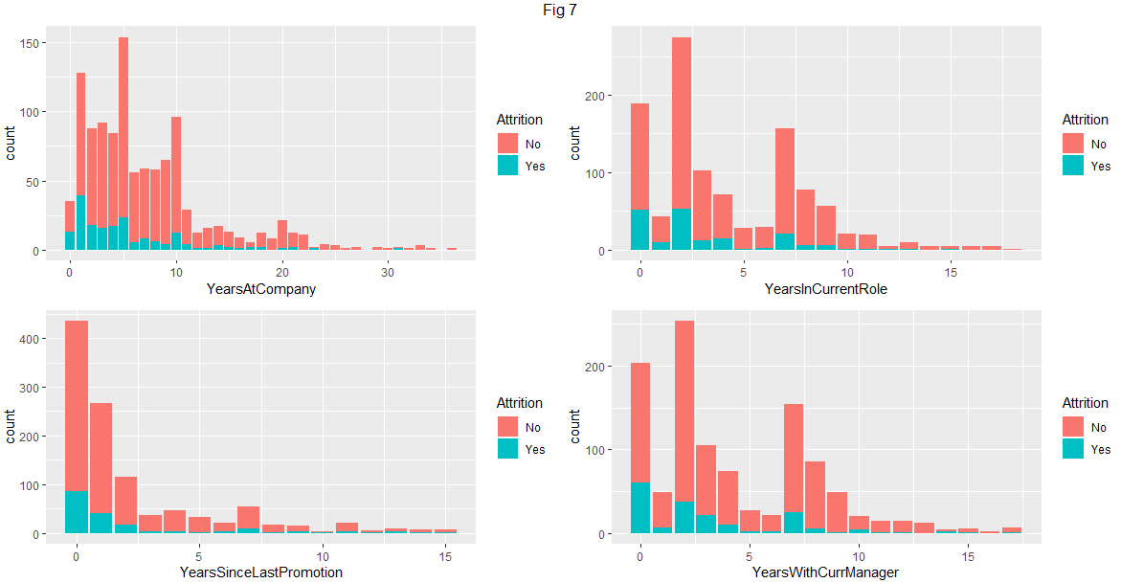
YearsAtCompany-YearsInCurrentRole-YearsSinceLastPromotion-YearsWithCurManager

Slide 22
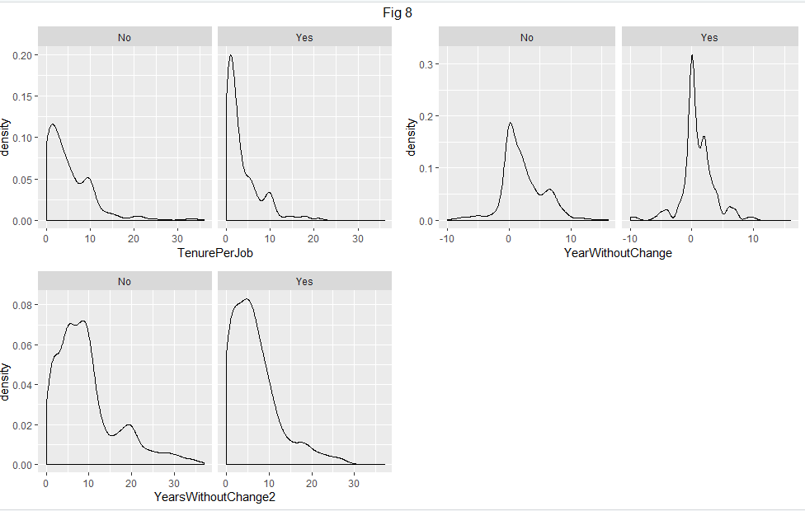
NumberOfCompaniesWorked-TotalWorkingYears-YearsInCurrentRole-YearsSinceLastPromotion

Slide 23
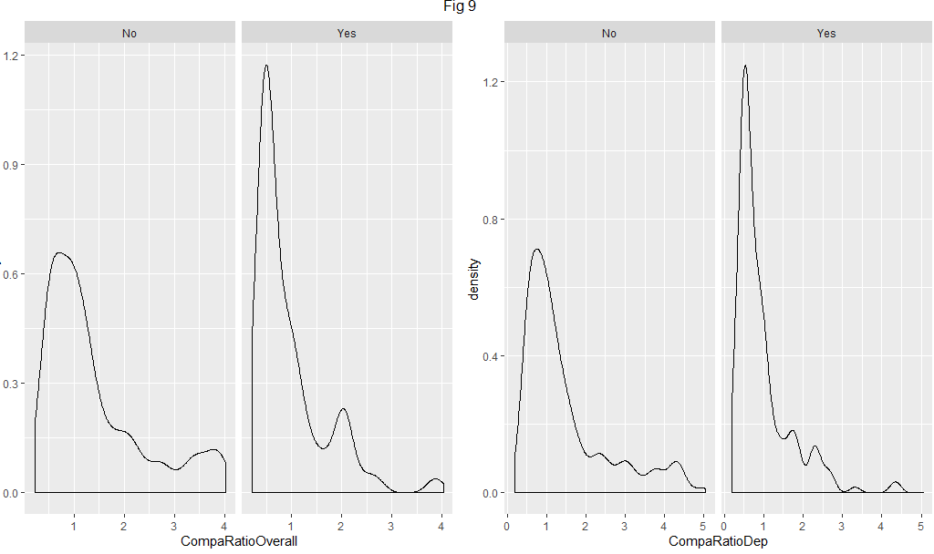
Attrition Population[84 %-No, 16%-Yes]

Slide 24
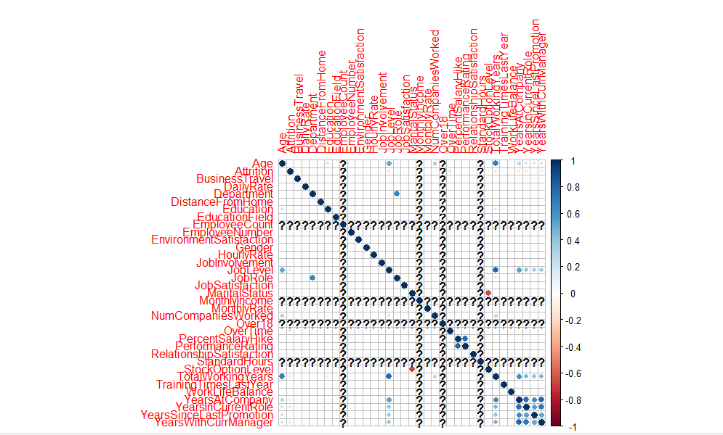
Correlation Plot [Positive/Negative]

Slide 25
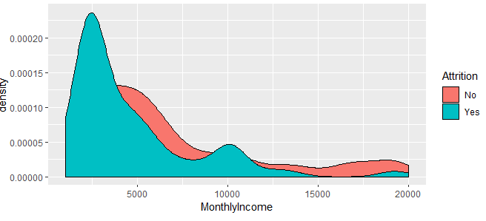
Validation Requirement for Salary
Salary-Monthly Income $3000/Attrition Yes

Slide 26
Different Predictive Model Analysis
1)KNN
2)NB
3)GLM

Slide 27
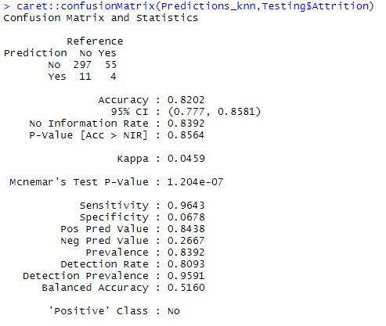
KNN [Accuracy=0.8202,Sensitivity=0.9643,
Specificity=0.0678]

Slide 28
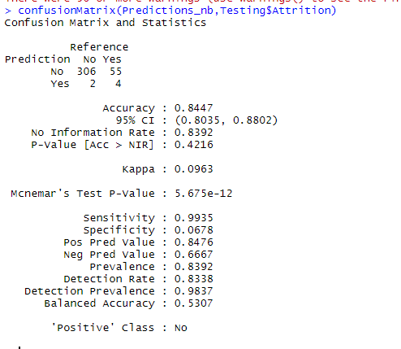
NB [Accuracy=0.8447,Sensitivity=0.9935,
Specificity=0.0678]

Slide 29
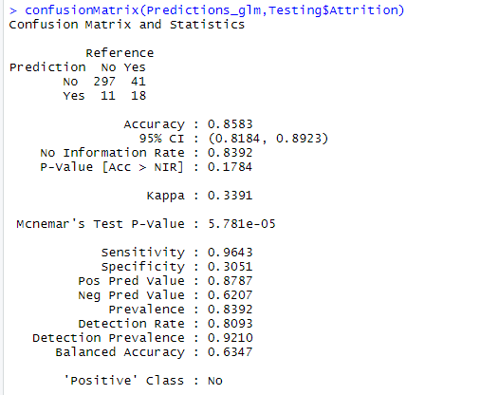
GLM[Accuracy=0.8583,Sensitivity=.9643,
Specificity=0.3051]

Slide 30
Best Predictor- Accuracy, Sensitivity and Specificity
GLM Best
Predictor | Accuracy | Sensitivity | Specificity
GLM | 0.8583 | 0.9643 | 0.3051
NB | 0.8447 | 0.9935 | 0.0678
KNN | 0.8202 | 0.9643 | 0.0678

Slide 31
EDA Conclusion Findings
The dataset does not feature any missing or erroneous data values, and all features are of the correct data type.
The strongest positive correlations with the target features are: Performance Rating, Monthly Rate, Num Companies Worked, Distance From Home.
The strongest negative correlations with the target features are: Total Working Years, Job Level, Years In Current Role, and Monthly Income.

Slide 32
EDA Conclusion Findings 2
The dataset is imbalanced with the majoriy of observations describing Currently Active Employees[1228/242].
Single employees show the largest proportion of leavers, compared to Married and Divorced counterparts.
About 10% of leavers left when they reach their 2-year anniversary at the company.
People who live further away from their work show higher proportion of leavers compared to their counterparts.
People who travel frequently show higher proportion of leavers compared to their counterparts.
People who have to work overtime show higher proportion of leavers compared to their counterparts.
Employees that have already worked at several companies previously (already “bounced” between workplaces) show higher proportion of leavers compared to their counterparts.

