Slide 1

Javascript Task Day 01
04/09/2022

Slide 2
Difference between HTTP 1.1 vs HTTP2
HTTP stands for hypertext transfer protocol & it is used in client-server communication. By using HTTP user sends the request to the server & the server sends the response to the user. There are several stages of development of HTTP but we will focus mainly on HTTP/1.1 which was created in 1997 & the new one is HTTP/2 which was created in 2015.
HTTP2 is much faster and more reliable than HTTP1. HTTP1 loads a single request for every TCP connection, while HTTP2 avoids network delay by using multiplexing. HTTP is a network delay sensitive protocol in the sense that if there is less network delay, then the page loads faster.

Slide 3
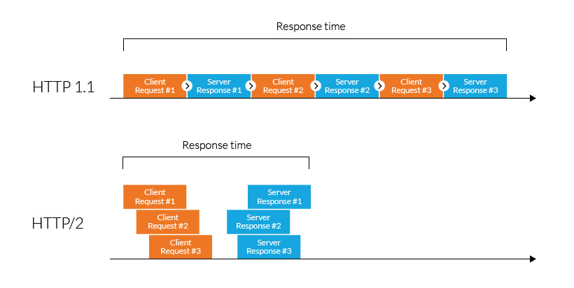
Difference between HTTP 1.1 vs HTTP2

Slide 4
What are objects and its internal representation in JavaScript?
Objects are important data types in javascript. Objects are different than primitive datatypes (i.e. number, string, boolean, etc.). Primitive data types contain one value but Objects can hold many values in form of Key: value pair. These keys can be variables or functions and are called properties and methods, respectively, in the context of an object.
Every object has some property associated with some value. These values can be accessed using these properties associated with them.
var car = { // car is an Object
make: “Toyota", // with two key-value pairs
model: “Innova",
};

