Slide 1


Slide 2
Northwind Dataset – Business Overview
Northwind is a sample business dataset representing a trading company that deals in food and beverage products.
It covers multiple product categories such as Beverages, Dairy, Seafood, Produce, and Confections.
The dataset contains structured business data including Customers, Employees, Products, Orders, and Order Details, commonly used for SQL and BI analysis.

Slide 3
Technology Stack
• SQL – Data Extraction & Transformation
• Power BI – Visualization & Reporting

Slide 4
Steps Followed:
Imported the Northwind sample database into SQL Server to establish the data source.
Applied SQL queries and functions (such as joins, filters, and aggregations) to analyze the data and answer business-related questions.
Loaded the processed data into Power BI to design interactive dashboards and visualizations for insights.

Slide 5
1. Write a SQL query to display the first name, last name, and hiring date of all employees who are designated as Sales Representatives.
Select Firstname, lastname , Hiredate
from [dbo].[Employees]
where title = 'sales Representative’
First name Last name Hire Date
Nancy Davolio 2010-05-01 00:00:00.000
Janet Leverling 2010-04-01 00:00:00.000
Margaret Peacock 2011-05-03 00:00:00.000
Michael Suyama 2011-10-17 00:00:00.000
Robert King 2012-01-02 00:00:00.000
Anne Dodsworth 2012-11-15 00:00:00.000

Slide 6
2 How would you extract supplier details (Supplier ID, Contact Name, Contact Title) for all suppliers except those with the title Marketing Manager ?
Select SupplierID,ContactName,ContactTitle
from [dbo].[Suppliers]
where ContactTitle <> 'Marketing Manager’ -------- (24 rows affected)
Supplier ID Contact Name ContactTitle
1 Charlotte Cooper Purchasing Manager
2 Shelley Burke Order Administrator
3 Regina Murphy Sales Representative
5 Antonio del Valle Saavedra Export Administrator
6 Mayumi Ohno Marketing Representative
8 Peter Wilson Sales Representative
9 Lars Peterson Sales Agent

Slide 7
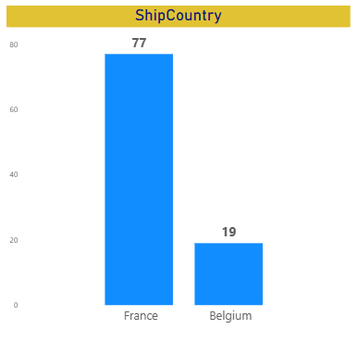
4.A company wants to analyze orders delivered to France and Belgium. Using the Orders table, write a SQL query that displays Order ID, Customer ID, and Ship Country for those shipments.
Select OrderID,CustomerID,ShipCountry
from [dbo].[Orders]
where ShipCountry in ('France','Belgium’) --- (96 rows affected)
Order ID Customer ID Ship Country
10248 VINET France
10251 VICTE France
10252 SUPRD Belgium
10265 BLONP France
10274 VINET France
10295 VINET France
10297 BLONP France
10302 SUPRD Belgium
10311 DUMON France
10331 BONAP France

Slide 8
5.Show only the FirstName, Last Name, and Birth Date of employees, but display only the date portion.
Select FirstName,LastName,Title, CONVERT(VARCHAR(10), BirthDate, 120) as DataonlyBirthdata
from [dbo].[Employees] order By BirthDate
FirstName Last Name Title Birth data
Margaret Peacock Sales Representative 1955-09-19
Nancy Davolio Sales Representative 1966-12-08
Andrew Fuller Vice President, Sales 1970-02-19
Steven Buchanan Sales Manager 1973-03-04
Laura Callahan Inside Sales Coordinator 1976-01-09
Robert King Sales Representative 1978-05-29
Michael Suyama Sales Representative 1981-07-02
Janet Leverling Sales Representative 1981-08-30
Anne Dodsworth Sales Representative 1984-01-27

Slide 9

6.How many customers do we have in the Customers table? Show one value only, and don’t rely on getting the record count at the end of a result set. Give the result in power bi dax query and sql syntax
SQL Query
Select count (ContactName) as Totalcustomers
from [dbo].[Customers]
Total customers
91
DAX Query
1 Customer Count COUNT(Customers[CompanyName])

Slide 10
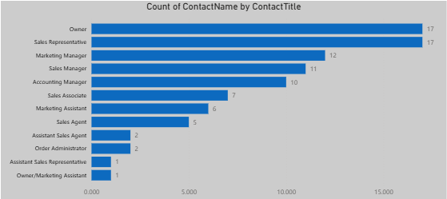
7.Display a list of all unique Contact Title values from the Customers table along with the count of customers for each Contact Title.
Select ContactTitle, count (ContactTitle) as TotalContactTitle
from [dbo].[Customers]
Group By contactTitle
Order By TotalContactTitle Desc
ContactTitle TotalContactTitle
Owner 17
Sales Representative 17
Marketing Manager 12
Sales Manager 11
Accounting Manager 10
Sales Associate 7
Marketing Assistant 6
Sales Agent 5
Assistant Sales Agent 2
Order Administrator 2
Assistant Sales Representative 1
Owner/Marketing Assistant 1

Slide 11
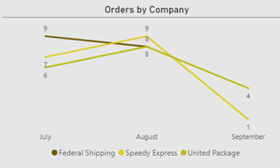
8.Retrieve the OrderID, OrderDate (displaying only the date portion), and the Shipper’s CompanyName for all orders. Include only orders with an OrderID less than 10300 and sort the results by OrderID.
Select Orders.OrderID,orderdate, Shippers.CompanyName
from [dbo].[Orders]
inner Join [dbo].[Shippers]
on Orders.ShipVia = Shippers.ShipperID
where OrderID < 10300 ----(52 rows affected)
Orders ID Order Date Company Name
10248 2014-07-04 08:00:00.000 Federal Shipping
10249 2014-07-05 04:00:00.000 Speedy Express
10250 2014-07-08 15:00:00.000 United Package
10251 2014-07-08 14:00:00.000 Speedy Express
10252 2014-07-09 01:00:00.000 United Package
10297 2014-09-04 21:00:00.000 United Package
10298 2014-09-05 16:00:00.000 United Package
10299 2014-09-06 01:00:00.000 United Package

Slide 12
9.Analyze the inventory data to determine which products have fallen below their reorder level,
considering only Units In Stock and Reorder Level.
Select ProductID,ProductName,UnitsInStock,ReorderLevel
from [dbo].[Products]
where UnitsInStock < ReorderLevel ----(18 rows affected)
Product ID Product Name Unit in Stock Record Level
2 Chang 17 25
3 Aniseed Syrup 13 25
11 Queso Cabrales 22 30
21 Sir Rodney's Scones 3 5
30 Nord-Ost Matjeshering 10 15
56 Gnocchi di nonna Alice 21 30
64 Wimmers gute Semmelknödel 22 30
66 Louisiana Hot Spiced Okra 4 20
68 Scottish Longbreads 6 15
70 Outback Lager 15 30
74 Longlife Tofu 4 5

Slide 13
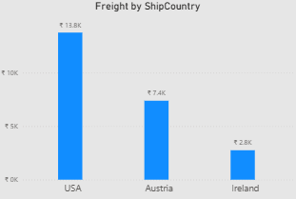
10.Analyze the Orders data to determine the three ship countries with the highest overall average freight charges, ordered in descending order by average freight.
Select top 3 ShipCountry,avg (Freight) as Averagefreight
from [dbo].[Orders]
group by ShipCountry
order by averagefreight desc
Ship Country Average freight
Austria 184.7875
Ireland 145.0126
USA 112.8794

Slide 14
