Slide 1
Adidas US Sales Dashboard
Created by Balasubramanya

Slide 2
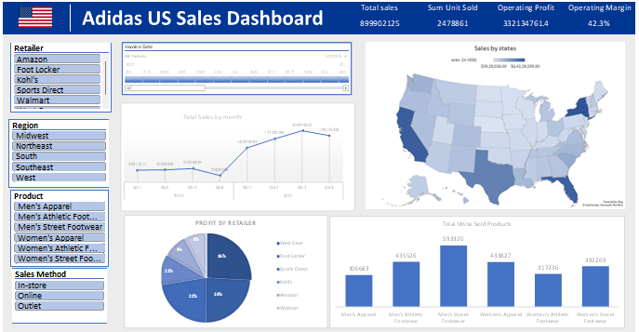

Slide 3
Key Performance Indicators (KPIs)
Total Sales : Represents the overall revenue generated from Adidas product sales across the United States. This KPI reflects the company’s market reach, customer demand, and overall sales performance.
Units Sold : Indicates the total number of products sold during the selected period. It helps measure sales volume, product demand, and consumer purchasing behavior.
Operating Profit: Shows the profit earned after deducting operating expenses such as manufacturing, logistics, and marketing costs.This metric highlights operational efficiency and cost management effectiveness.
Operating Margin: Expressed as a percentage, it measures operating profit relative to total sales.A higher margin indicates stronger profitability and better operational performance.

Slide 4
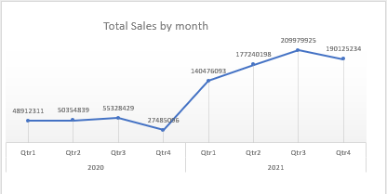
Monthly Sales Trend
The line chart shows total sales by month, highlighting growth patterns and seasonal fluctuations.
Mid-year dip Some months show a slight slowdown, suggesting seasonal or demand-related fluctuations.
Sales generally increase toward the later months, indicating strong end-of-year performance.

Slide 5
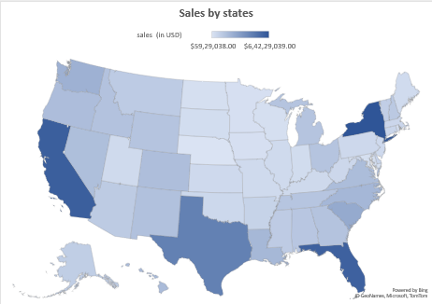
Sales by State
The US map visual illustrates state-wise sales distribution.
Darker shades represent higher sales, with key contributions from major states.
Certain regions consistently outperform others, highlighting areas of strong market presence.

Slide 6
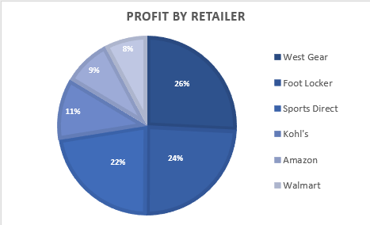
Profit by Retailer
This pie chart compares profit contribution by retailer.
Major retailers such as West Gear, Foot Locker, and Sports Direct contribute significantly to overall profit.
Smaller retailers together make up a notable portion of the profit, indicating that while major retailers dominate, the combined contribution of minor players is still important to overall profitability.

Slide 7
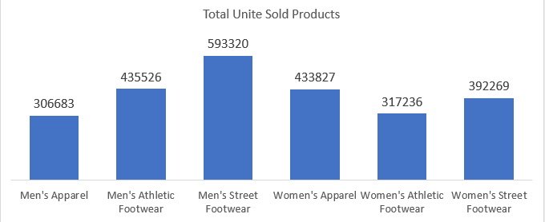
Units Sold by Product Category
Bar charts display total units sold across product categories.
Men’s and Women’s apparel and streetwear show strong demand.
Some categories, like accessories or footwear, show moderate but growing sales potential.

Slide 8
Regional Performance
Sales performance varies by region, reflecting customer demand and market penetration.
High-performing regions contribute a major share of total revenue, highlighting strong market penetration.
Underperforming regions reveal untapped potential and opportunities for targeted growth initiatives.
Regional insights enable better allocation of marketing budgets and promotional efforts.
Distribution and supply chain strategies can be optimized by focusing on regions with higher demand and growth potential.

Slide 9
Key Business Insights
Top Product Categories: Men’s and Women’s apparel consistently lead in units sold, indicating strong customer preference.
Seasonal Trends: Sales show noticeable peaks during specific months, highlighting opportunities for targeted promotions.
Emerging Markets: Certain regions or product categories show steady growth, suggesting areas for expansion.
Operational Efficiency: Effective supply chain and inventory management support consistent sales performance
Customer Engagement: Promotional campaigns and marketing efforts significantly boost monthly sales.

Slide 10
Conclusion
The Adidas US Sales Dashboard enables data-driven decision-making.
Performance Monitoring: Provides a clear view of sales trends across months, states, and product categories.
Opportunity Identification: Highlights high-performing regions and emerging product categories for growth focus.
Opportunity Identification: Highlights high-performing regions and emerging product categories for growth focus.
Resource Optimization: Helps allocate resources effectively to maximize revenue and profitability.
Data-Driven Insights: Empowers stakeholders with actionable insights for improving overall business performance.

