Slide 1

ScriptChain Health Assessment - Summer 2023 ML Internship
ScriptChain Health
Technical Interview
Balasubramanyam Evani
MS ECE, Carnegie Mellon University
Email ID: bevani@andrew.cmu.edu
LinkedIn: https://www.linkedin.com/in/balasubramanyam-evani/

Slide 2
Outline
Questions
Hypotheses | For Question 1
Learnable Positional Encoding | For Question 2
Experiment Setup | Dummy Dataset, Stacked Multi-Head Self Attention Deep Net Architecture,
Results
Code Walkthrough

Slide 3
Questions
Question 1: Suppose that we design a deep architecture to represent a sequence by stacking self-attention layers with positional encoding. What could be issues?
Question 2: Can you design a learnable positional encoding method?

Slide 4
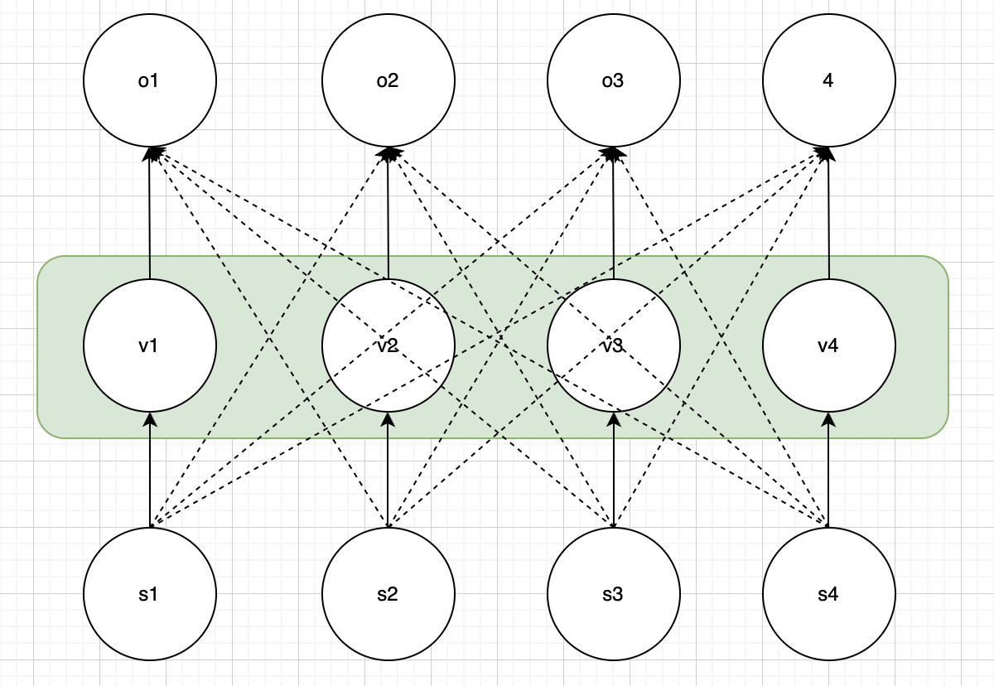

Hypotheses – Question 1
a14
a11
a12
a13
Hypothesis 1: Increase in Compute Complexity
Considers full context
O_{t} = $Σatt′ vt′$_{, where} a_{tt are attention scores}
Parallelizable. Good!
But Computational Cost: O(T²) where T is the sequence length. This is very expensive. Stacking would multiply it by number of stacked layers
Necessitate the use of significant computational resources

Slide 5
Hypotheses – Question 1
Hypothesis 2: Vanishing Gradient
It’s a fact that Deep architectures are susceptible to vanishing gradient problem
Only stacking MHSA layers would hinder gradient updates in lower layers
Need other techniques like: Residual Connections, Layer Normalization to make it work!

Slide 6
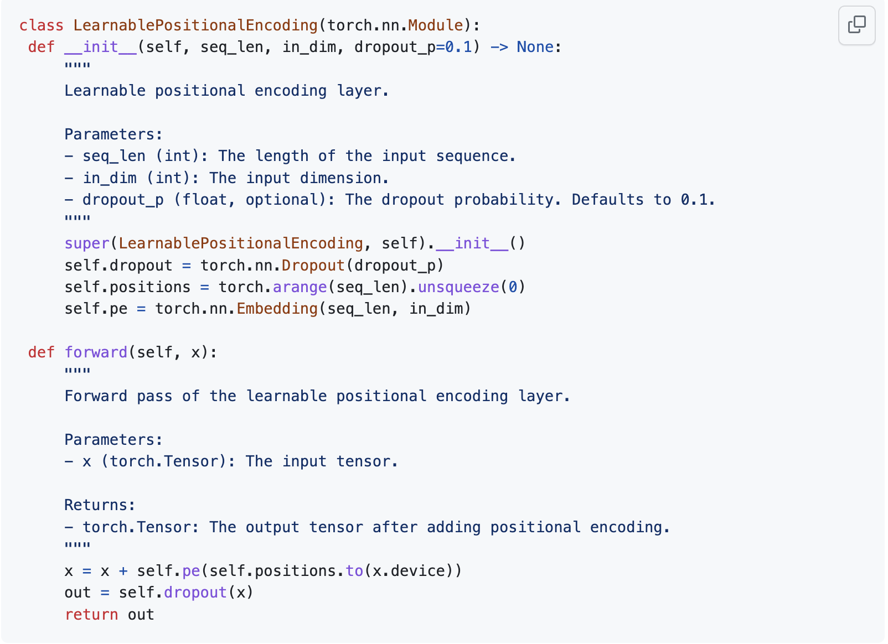
Learnable Positional Encoding
Question 2: Can you design a learnable positional encoding method?
Use torch.nn.Embedding with num_embeddings as the sequence length.
Embeddings are learnable with requires_grad=True for optimization during training.
Simple lookup table for efficient and effective representation learning.

Slide 7
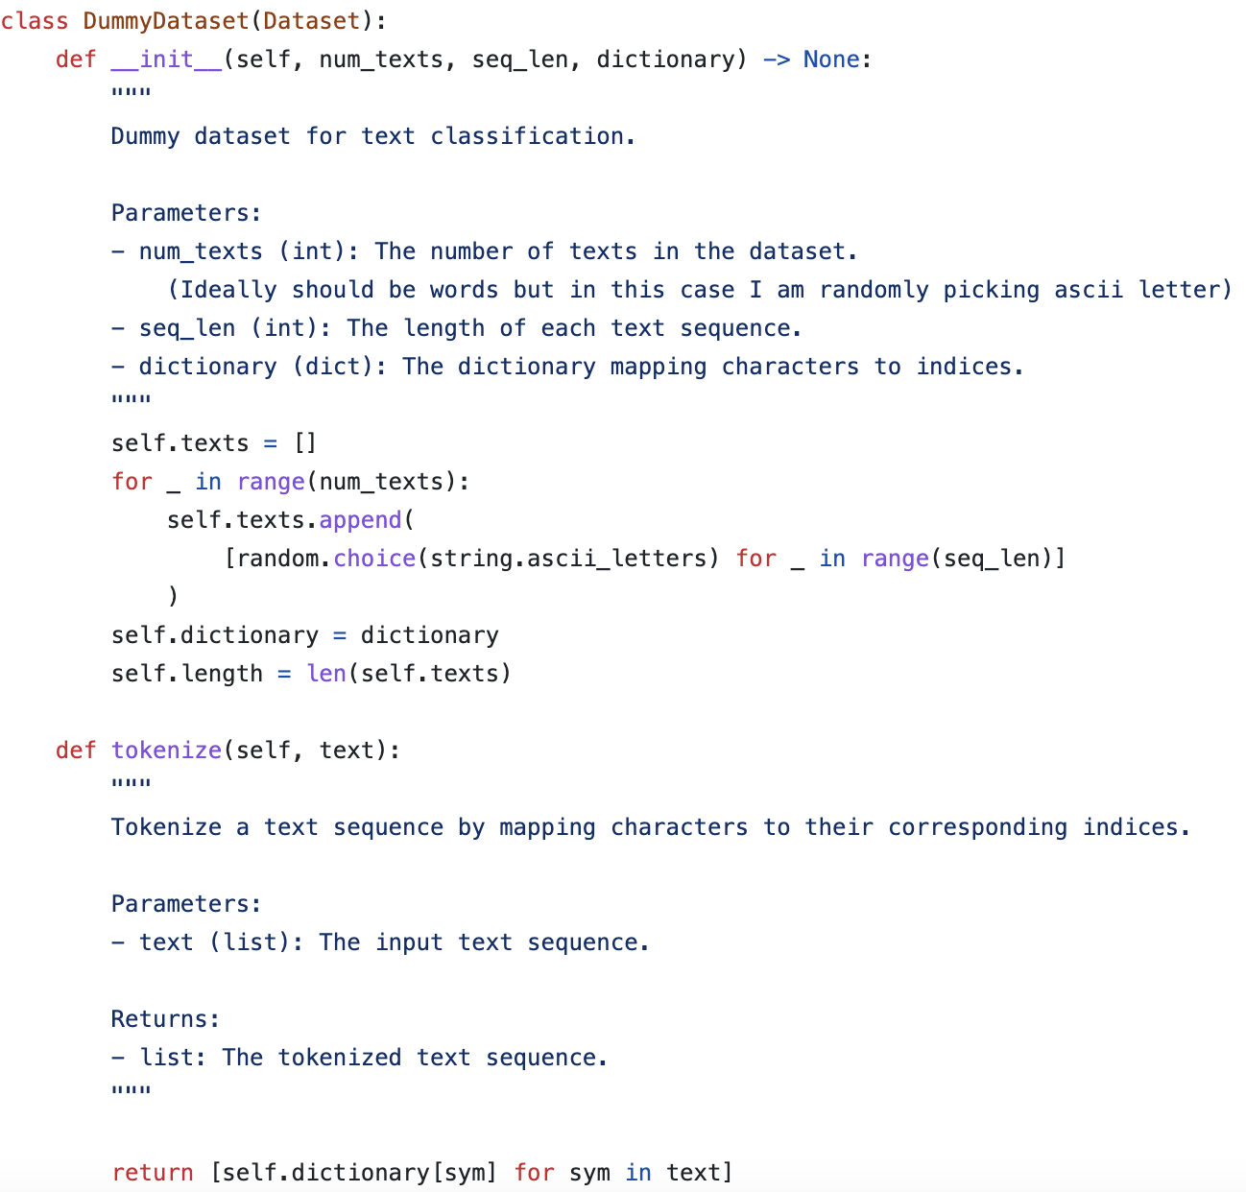
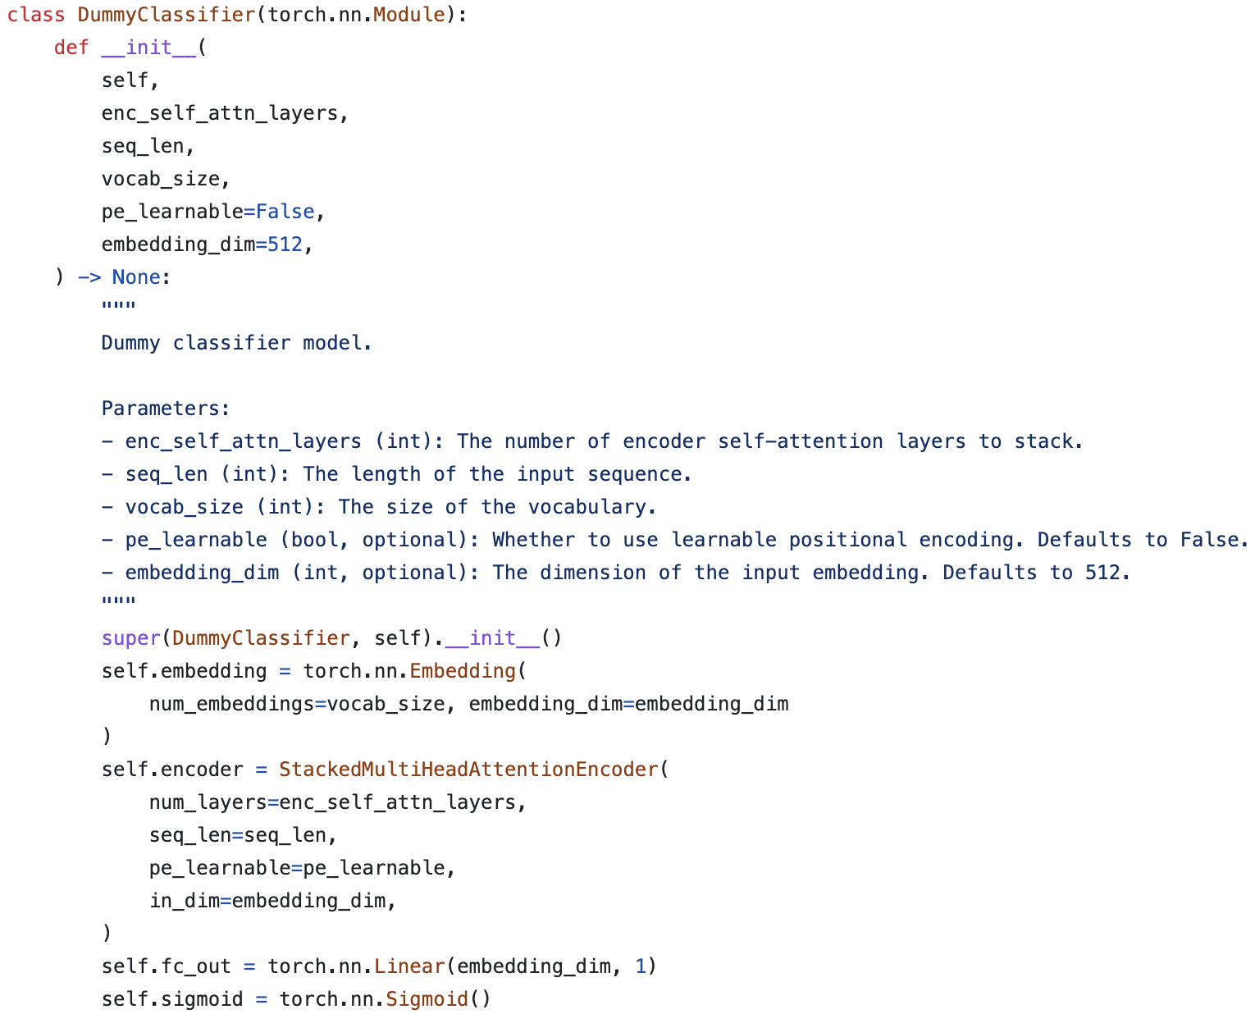
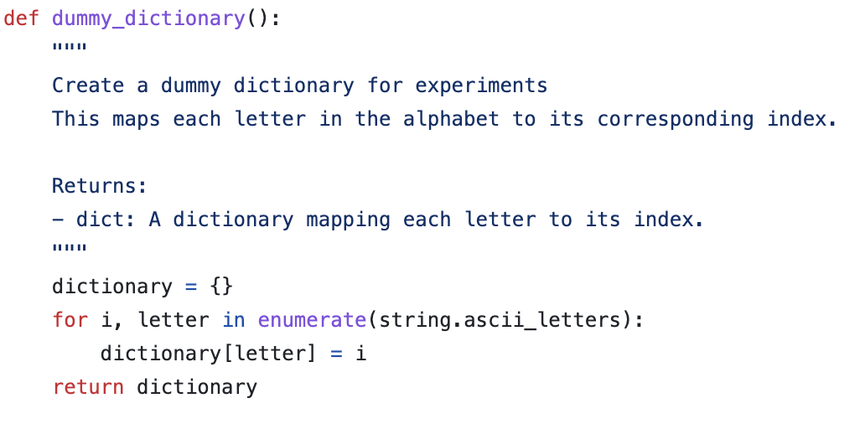
Experimental Setup
For all experiments I have used a dummy dataset which represents sequence that we might get during various tasks such as text classification, ASR systems
The above shows the code snippets of the dummy dataset and dummy classifier which uses stacked MHSA layers

Slide 8
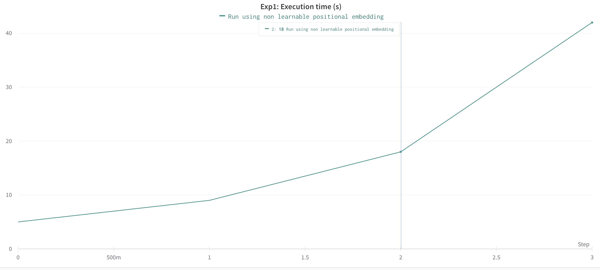
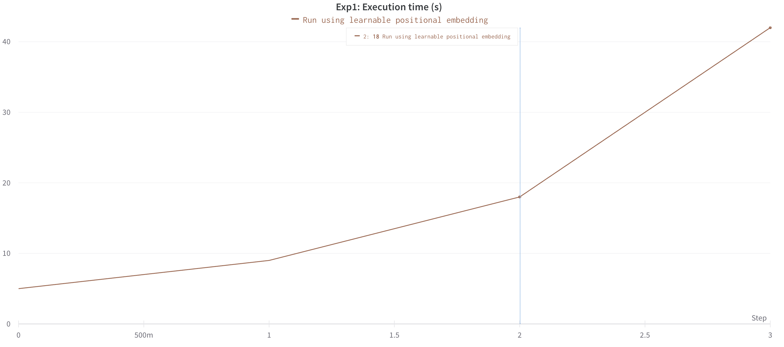
Results: Hypothesis 1
Input Sequence Length | Run Time (s)
64 | 5
128 | 9
256 | 18
512 | 42

Slide 9
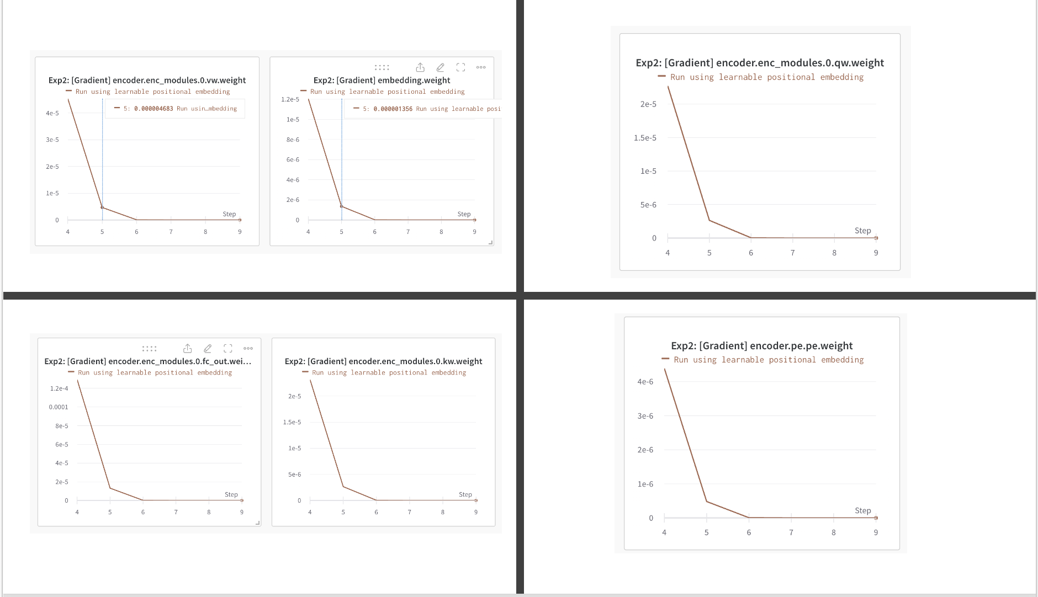
Results: Hypothesis 2
Number of stacked MHSA layers at each step: [2,4,8,16,32,64]
The graphs shown are mean abs gradient for the lower encoder layer.
We can see that the mean abs gradient value decreases as we stack more MHSA layers
Note: The step value in the graph has an offset of 4. This happened because of the exp 1 results which was logged in wandb

Slide 10
Code Walkthrough Link: https://github.com/BalasubramanyamEvani/ScriptChain-Health-Assessment

Slide 11
Thank you!

