Slide 1
MVNO Customer Revenue & Churn Analysis
Understanding financial trends and customer retention metrics
Notes:
AI-generated content may be incorrect. ---

Slide 2
Understanding MVNO Business Challenges
Notes:
Telecom Churn Problem and Business Need, Objectives of MVNO Churn and Revenue Analysis

Slide 3

Objectives of MVNO Churn and Revenue Analysis
Measure and Analyze Churn
Accurately measure churn rates and quantify the financial impact of losing customers to improve retention strategies.
Revenue Dynamics and ARPU
Analyze Average Revenue Per User and total revenue to understand financial contributions and losses from churned customers.
Customer Behavior Insights
Uncover customer usage patterns such as data, calls, and SMS to identify satisfied and at-risk user groups.
Segmented Retention Strategies
Use segmentation by region, plan type, and tenure to develop personalized strategies targeting specific customer groups at risk of churn.
Notes:
The purpose of conducting churn and revenue analysis within an MVNO framework is to gain strategic clarity on customer behavior and enhance long-term profitability. One of the core objectives is to accurately measure churn rates, helping the business quantify how many users leave and determine the financial impact of this loss. Another crucial objective is understanding the revenue dynamics by analyzing Average Revenue Per User (ARPU), total revenue contributions, and revenue loss attributed specifically to churned customers. These financial performance indicators support more informed decision-making across pricing, marketing, and customer lifecycle initiatives. The analysis also aims to uncover behavioral insights from customer usage patterns, including their data consumption, call activity, and SMS preferences. These insights help the company understand which customer groups are satisfied and which may be at risk. In addition, segmentation by region, plan type, payment behavior, and tenure offers granular visibility into variations across customer groups. This enables the creation of personalized retention strategies, allowing MVNOs to target specific segments such as new customers, low-engagement users, or high-value subscribers who show signs of churn risk. Ultimately, the overarching objective is to integrate quantitative insights into actionable business strategies that reduce churn, improve customer satisfaction, optimize pricing models, and enhance the lifetime value of each subscriber.

Slide 4
Data Structure and Key Performance Metrics
Notes:
Dataset Components Used in Telecom Churn Analysis, KPIs: Churn Rate, ARPU, Revenue Loss, and Usage Metrics

Slide 5

Dataset Components Used in Telecom Churn Analysis
Customer Dataset Details
Contains key customer data including ID, region, age, join date, and churn status for segmentation.
Plan Dataset Attributes
Includes plan name, type, and pricing to enable detailed analysis of customer subscription types.
Usage Dataset Insights
Captures monthly data usage, call minutes, and SMS counts to analyze customer engagement behavior.
Billing Dataset Information
Records monthly charges, payment status, and revenue details for each subscriber to evaluate financial impact.
Notes:
A comprehensive churn study in the telecom domain requires multiple interconnected datasets that collectively capture customer demographics, usage behavior, service plans, and revenue flows. In this analysis, four primary datasets were utilized. The Customer dataset serves as a dimension table that includes key information such as Customer ID, region, age, join date, and status, which is essential for identifying active versus churned customers. The Plan dataset provides additional dimensional attributes like plan name, plan type (prepaid or postpaid), and pricing, enabling detailed plan-based segmentation. The Usage dataset functions as a fact table capturing monthly data usage, total call minutes, and SMS counts, offering insights into how customers engage with the service. The Billing dataset is another fact layer containing monthly charges, payment status, and total revenue contribution for each subscriber. By merging these datasets using the Customer ID as the primary key, a holistic analytical model is formed that enables cross-functional evaluation of churn drivers. This integrated dataset structure supports multi-dimensional analysis across behavioral, demographic, financial, and plan-level variables. The approach helps uncover patterns such as whether low usage correlates with churn or if certain regions consistently underperform. The combination of all four datasets provides the necessary visibility to diagnose churn accurately and form tactical recommendations for retention and revenue optimization.

Slide 6

KPIs: Churn Rate, ARPU, Revenue Loss, and Usage Metrics
Churn Rate Importance
Churn rate measures lost customers relative to total base, highlighting subscriber health and enabling attrition forecasting.
Average Revenue Per User
ARPU reveals average revenue contribution per customer, helping identify high-value segments and optimize revenue.
Revenue Loss and Total Revenue
Tracking total revenue alongside revenue loss from churned users measures financial impact and business performance.
Usage Metrics and Customer Engagement
Usage metrics like data, calls, and SMS reveal customer behavior and engagement, aiding in churn risk identification.
Notes:
Key Performance Indicators (KPIs) are essential for measuring telecom business performance and diagnosing customer churn risks. The most critical KPI is the churn rate, calculated by dividing the number of inactive or lost customers by the total customer base. This metric helps assess the health of the subscriber base and enables forecasting future attrition trends. Another core KPI is the Average Revenue Per User (ARPU), which offers insight into how much revenue each customer contributes on average, allowing MVNOs to identify high-value segments. In addition to ARPU, total revenue is tracked to monitor overall financial performance, while revenue loss quantifies the monetary impact caused by churned customers. Usage metrics—including average monthly data consumption, call minutes, and SMS frequency—provide behavioral insights that help categorize customers based on engagement. Customers with consistently low usage may indicate dissatisfaction or misalignment with current plans, making them more susceptible to churn. Conversely, high usage customers often reflect stronger engagement. These KPIs, when analyzed together, form the foundation for business decisions, such as redesigning plans, improving customer engagement initiatives, optimizing pricing structures, or targeting high-risk customer segments with specialized offers. Understanding and tracking these core KPIs empowers MVNOs to predict churn, develop retention strategies, and maximize subscriber lifetime value.

Slide 7
Insights from Usage, Pricing, and Customer Segmentation
Notes:
Customer Usage Behavior and Its Impact on Churn, Pricing Sensitivity, Plan Performance, and Regional Trends

Slide 8

Customer Usage Behavior and Its Impact on Churn
Usage as Churn Indicator
Low or declining usage signals disengagement and higher churn risk among telecom customers.
High Usage and Retention
Customers with high data, call, and SMS usage show stronger engagement and lower churn rates.
Plan Type Impact
Postpaid customers usually have lower churn due to higher engagement than prepaid customers.
Retention Strategies
Proactive usage-based incentives and personalized offers help increase customer retention.
Notes:
Usage behavior is one of the earliest and strongest signals of churn risk in the telecom industry. Customers with low or declining usage patterns—such as minimal data consumption, fewer call minutes, or very limited SMS activity—often exhibit disengagement, which can indicate dissatisfaction or lack of perceived value in their plan. This project’s analysis showed that churned customers generally demonstrated lower monthly usage across all categories compared to active subscribers. This trend suggests that low-engagement users may find alternative providers or decide the service is no longer worth the cost. On the contrary, customers with high data usage, high call minutes, or frequent SMS activity tended to remain active, reflecting deeper integration with the service. Additionally, analyzing usage across plan types revealed that postpaid customers typically show higher engagement and lower churn likelihood, whereas prepaid customers, who face fewer switching barriers, tend to churn more often. These insights highlight the importance of monitoring engagement metrics and developing proactive strategies such as targeted usage-based incentives, personalized offers, or plan recommendations. Encouraging even moderate increases in usage can strengthen customer retention and improve overall customer lifetime value.

Slide 9

Pricing Sensitivity, Plan Performance, and Regional Trends
Impact of Pricing on Churn
Mid-tier and under-structured plans lead to higher churn due to misaligned benefits and customer expectations.
Higher-Value Plan Retention
High-value plans have better retention by meeting heavier usage demands with bundled services.
Regional Churn Variations
Churn rates vary by region due to factors like local competition, network quality, and socio-economic conditions.
Tailored Strategies to Reduce Churn
Combining pricing and regional data helps MVNOs customize promotions and pricing to reduce customer churn.
Notes:
Pricing and plan structure significantly influence customer churn, especially in MVNO environments where cost competitiveness is crucial. The analysis revealed that customers subscribed to certain mid-tier or under-structured plans were more prone to churn, likely due to misalignment between plan benefits and customer expectations. Plans with limited data or insufficient bundled services can lead customers to switch to competitors offering better value. Meanwhile, higher-value plans often demonstrated stronger retention, as they cater to customers with heavier usage demands who benefit more directly from bundled offerings. Pricing impact was also evident when analyzing churn by price brackets; specific price ranges recorded substantially higher churn rates, indicating points of customer dissatisfaction or lack of perceived value. Region-based analysis further uncovered diverse churn patterns, showing that some regions experienced disproportionately high churn compared to others. These disparities can stem from localized competition, network quality concerns, or socio-economic factors affecting usage and price sensitivity. By combining pricing and region-based insights, MVNOs can tailor promotional strategies, adjust pricing tiers, and implement region-specific engagements to reduce churn effectively.

Slide 10
Churn Drivers and Strategic Implications
Notes:
Key Drivers of Customer Churn, Strategic Recommendations for Reducing Churn

Slide 11

Key Drivers of Customer Churn
Behavioral and Usage Factors
Low service usage often signals dissatisfaction or perceived low value, leading to higher churn rates among customers.
Pricing and Plan Types
Pricing mismatches and plan flexibility impact churn, with prepaid customers more likely to switch than postpaid customers.
Customer Tenure and Onboarding
New customers within their first months show higher churn, indicating onboarding experience and initial value perception gaps.
Regional and Financial Impact
Regional churn differences suggest local competition effects; high-value customers churning amplify financial consequences.
Notes:
This analysis identified churn as a multi-factor phenomenon driven by a combination of behavioral, financial, demographic, and experiential elements. Key drivers include low service usage, which often reflects dissatisfaction or lack of value from current plans, and pricing mismatches where customers feel they are paying more than the value received. Customer tenure also played a significant role, with newer customers—those within their first few months—showing higher churn likelihood, suggesting onboarding experience or initial value perception gaps. Plan type differences were also notable: prepaid customers had higher churn due to flexible switching options, whereas postpaid users, often bound by commitments or reliant on consistent service levels, showed greater loyalty. Regional differences surfaced as well, with certain locations exhibiting higher churn intensity, possibly due to stronger local competition or network coverage variations. High-value customers were another important segment, as some contributed significantly to revenue yet still churned, amplifying financial impact. Collectively, these drivers emphasize the need for MVNOs to adopt a holistic churn prevention strategy integrating behavioral monitoring, pricing optimization, improved onboarding, and targeted retention initiatives.

Slide 12
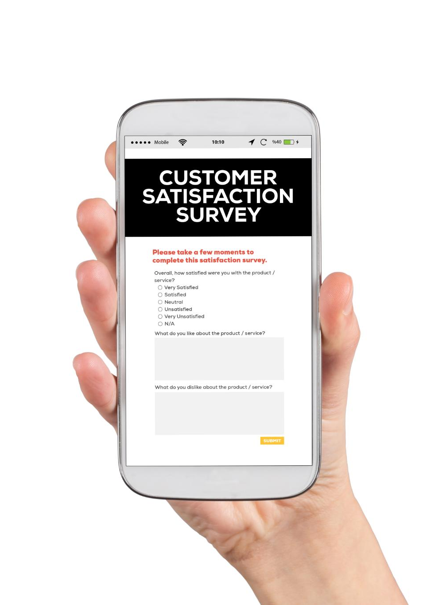
Strategic Recommendations for Reducing Churn
Personalized Customer Engagement
Identify low-usage users early and offer targeted incentives like bonus data and tailored plans to boost engagement.
Enhanced Onboarding Experience
Provide guided setup, welcome benefits, and proactive check-ins to reduce early tenure churn and improve satisfaction.
Pricing Optimization and Loyalty
Revise plans, offer flexible choices, and reward high-value customers with loyalty programs and priority support.
Predictive Analytics for Retention
Use machine learning models to identify at-risk customers early and enable proactive retention actions.
Notes:
Reducing churn requires a data-driven, multi-layered strategy centered on personalized engagement and product optimization. First, MVNOs should focus on increasing customer engagement by identifying low-usage users early and offering targeted incentives such as bonus data, temporary discounts, or tailored plan recommendations. Improving onboarding for new customers is essential, as early tenure churn is often related to poor initial experiences; providing guided setup, welcome benefits, or proactive check-ins can strengthen early satisfaction. Pricing optimization plays a crucial role, including revising underperforming plans, offering flexible mid-tier choices, or bundling attractive add-ons. High-value customers should receive special attention with loyalty rewards, personalized communication, and priority support to prevent revenue-heavy churn. Region-specific strategies can help address geographic disparities by improving service quality, boosting localized marketing, or offering region-exclusive promotions. Additionally, integrating predictive analytics or machine learning models can help identify at-risk customers before they leave, enabling proactive retention. Together, these strategies create a robust framework that minimizes churn, boosts customer lifetime value, and reinforces long-term business stability.

