Slide 1



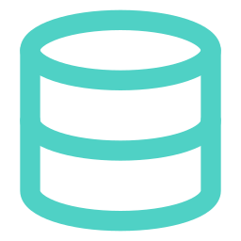


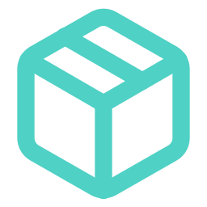
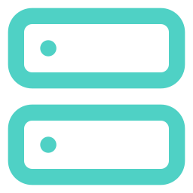
Container architecture
One docker-compose.yml · three containers · two networks · two volumes — identical on the laptop and the VM
DOCKER HOST · MacBook (local) = gridpulse-vm (us-central1-a)
frontend
:80
backend
:8000
db
HTTP :80
/api/*
SQL 5432
gridpulse-frontend:v1
gridpulse-backend:v1
postgres:16-alpine
Browser
nginx 1.27 + React build
web-net
FastAPI + baked XGBoost model
data-net
official image, not ours
firewall: team IPs only
serves UI · proxies /api/*
seeds DB on 1st boot · /docs
no host port (internal only)
Separate networks: nginx has no route to Postgres
uploads
→ /app/uploads
pgdata
→ /var/lib/postgresql/data
BUILD ONCE → SHIP → RUN ANYWHERE · the same image digest on both machines
Laptop (M-series Mac)
docker compose build
platform: linux/amd64 = VM's CPU
Artifact Registry · us-central1
gridpulse-backend:v1
gridpulse-frontend:v1
gridpulse-vm
compose pull · up --no-build
http://23.251.144.238
Notes:
Three containers from one compose file. Browser hits nginx on port 80; nginx serves the React build and forwards /api/* to the backend over web-net. The backend talks to Postgres over data-net; the database has no host port, and the frontend cannot reach it. Two named volumes keep the database and uploaded PDFs across restarts and upgrades. The images are built for linux/amd64 on the laptop, pushed to Artifact Registry as v1, and pulled unchanged on the VM, so the digest matches on both machines.

Slide 2

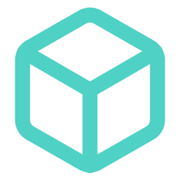


Before and after
Milestone 2 hand-built the VM. Milestone 3 ships one versioned image to it.
BEFORE — 6 manual stages on the VM
AFTER — 2 commands, one image
1
Install PostgreSQL, create the role and database
LAPTOP — ONCE PER RELEASE
./deploy/build_and_push.sh v1
2
Install Python 3.11 + venv, pip install the ML stack
3
Install Node, rebuild React with the VM's IP baked in
VM — DOCKER COMPOSE PULL + UP --NO-BUILD
git pull && ./deploy/vm_deploy.sh
4
Copy the code and the .env file to the VM
Seed the database and train the model on the VM
Postgres from .env; the DB seeds itself on first boot
5
Python deps, React build and model ship in the images
6
Start Postgres, uvicorn and the UI by hand
Health checks + restart: unless-stopped keep it up
Repeat all of it, by hand, on every new machine
Same sha256 digest on the laptop and the VM
The problem containerization solved: a build that only worked on one host
Vite bakes the API URL into the React bundle at build time. Ours said http://localhost:8000, so a laptop build sent the VM's dashboard looking for the API on the viewer's own machine — every environment needed its own rebuild and CORS list. Now the bundle calls relative /api/ paths and nginx proxies them across the compose network: one image, any host.
Notes:
Left: what Milestone 2 took — six manual stages on the VM, all of which had to be repeated on any new machine. Right: Milestone 3 — build and push once from the laptop, then git pull and one deploy script on the VM. The VM only needs Docker. The specific problem this solved for us was the hard-coded API URL in the React build; relative /api paths plus the nginx proxy mean the exact same frontend image works on localhost and on the VM. Also mention: our M-series Macs build arm64 by default, so we pin linux/amd64 to match the VM.

