Slide 1

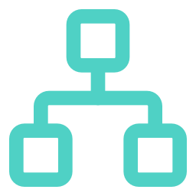


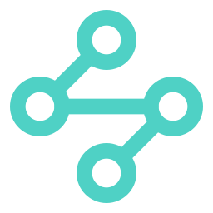









Orchestration topology: hostname to pods
Kubernetes runs the containers now: replicas heal themselves, scale with load, and sit behind one HTTPS address.
GKE AUTOPILOT · GRIDPULSE-GKE · US-CENTRAL1
GOOGLE-MANAGED STATE
Google Cloud load balancer
backend pod
Cloud SQL
Browser
external Application LB (classic), created by the Ingress
Ingress
Service
backend pod
PostgreSQL 16 · private IP 10.60.0.3 · TLS
https://
gridpulse-9.duckdns.org
gridpulse
backend :8000
STATIC IP
+2 under load
gridpulse-gke-ip
/api/*
→ backend
ClusterIP · NEG
Cloud Storage
HPA 2–4 · 60 % CPU
PDB: ≤ 1 pod evicted
DNS
TLS CERTIFICATE
gridpulse-509202-uploads (PDFs)
Google-managed · Active
frontend pod
DuckDNS A record → reserved global IP gridpulse-gke-ip
HTTP → HTTPS
frontend pod
Secret Manager
301 (FrontendConfig)
/*
→ frontend
Service
HEALTH CHECKS
frontend :80
+2 under load
gridpulse-db-password
http:// → 301 →
https://
/api/health/ready · /healthz
ClusterIP · NEG
HPA 2–4 · 70 % CPU
PDB: ≤ 1 pod evicted
backend pods act as gridpulse-gke-app via Workload Identity · 0 keys
Self-healing
Autoscaling
Disruption budget
HTTPS only
The Deployment keeps 2+ Ready pods; a deleted or crashed pod is replaced in seconds.
The HPA adds backend pods (2 → 4) when CPU passes 60 % of the request.
Upgrades and node moves may evict only one pod of each app at a time.
Managed certificate on a real hostname; plain http:// gets a 301 to https://.
Notes:
Follow one request left to right. The browser resolves our DuckDNS name to a reserved global IP. That IP belongs to a Google Cloud load balancer that the GKE Ingress created for us: it terminates TLS with a Google-managed certificate and answers plain http with a 301 to https. The Ingress sends /api/* to the backend Service and everything else to the frontend Service. Each Service load-balances straight to pod IPs (NEG) and only to pods that pass their readiness probe. Each app runs at least two replicas; the HPA adds up to two more under load, and a PodDisruptionBudget stops maintenance from taking more than one down at a time. All state is still outside the cluster from Milestone 4: Cloud SQL on a private IP, the uploads bucket and Secret Manager, reached as gridpulse-gke-app through Workload Identity, with no key files.

Slide 2

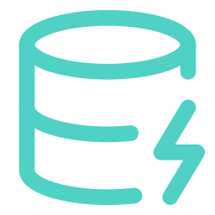



Health probe design: alive is not the same as ready
The backend has two probe endpoints. They test different things, and Kubernetes reacts differently when each one fails.
Liveness GET /api/health/live
Readiness GET /api/health/ready
WHAT IT CHECKS
WHAT IT CHECKS
The process answers from its own event loop. No database, no Google APIs, no disk.
Everything liveness checks, plus SELECT 1 on Cloud SQL over the private IP with TLS, on its own one-connection pool, with a 2 s limit.
WHEN IT FAILS
WHEN IT FAILS
Kubernetes restarts the container: the fix for a deadlock or a stuck event loop, and for nothing else.
The pod leaves the Service and the load balancer. It is not restarted, and it rejoins by itself once the database answers.
every 10 s · 5 s timeout · restarted only after 6 misses (~1 min)
every 5 s · 5 s timeout · out after 3 misses (~15 s) · the LB health check uses this path too
Startup probe uses the same /live path but allows up to 3 min, so a booting pod (secret read, migration check, loading pandas and XGBoost) is never restarted.
WHY THEY MUST DIFFER: A 30-SECOND CLOUD SQL MAINTENANCE BLIP
If liveness also checked the database
With the split we deployed
Every replica fails at the same moment and all of them restart together. Each restart re-reads Secret Manager, re-runs the migration check and starts cold, so 30 s of database trouble turns into minutes of 502s.
Readiness fails, so the pods leave the load balancer. Liveness stays green, so nothing restarts. When SELECT 1 works again the same warm pods are back in rotation within about 5 s.
Notes:
Liveness answers one question: is this process still able to run code? It never touches the database, because a restart cannot fix a database problem. Readiness answers: can this pod serve a real request right now? It runs SELECT 1 on Cloud SQL with a 2-second limit on a dedicated one-connection pool, so a busy pod is not wrongly marked unready. If readiness fails, the pod only stops getting traffic. If liveness fails, the container is restarted. The startup probe gives a new pod up to three minutes before liveness applies. The nginx frontend has no dependencies, so both of its probes use /healthz.

