Slide 1


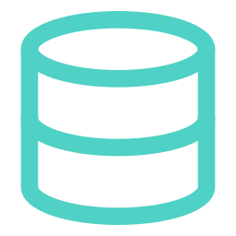



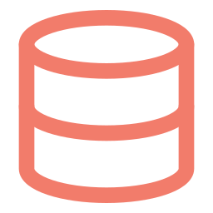





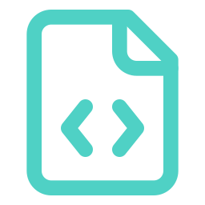
Before and after: where the state lives
Milestone 3 kept every byte of state on gridpulse-vm. Milestone 4 moves all of it into managed services, so the VM is disposable.
BEFORE — Milestone 3: state lives on the VM
AFTER — Milestone 4: the VM is stateless
GRIDPULSE-VM · ITS DISK IS THE ONLY COPY
GRIDPULSE-VM
Cloud SQL
frontend
backend
db
PostgreSQL 16 · private IP only
frontend
nginx + React
Cloud Storage
STATE ON THE VM'S DISK
gs://gridpulse-509202-uploads
backend
pgdata
uploads
.env
read-only filesystem
volume · all 7 tables
volume · uploaded PDFs
DB password in plain text
Secret Manager
no volumes · no .env
no key files
gridpulse-db-password
Delete the VM: the data, the PDFs and the password are gone.
Delete the VM: only downtime. Data, files, secrets and images live on.
Database
Uploaded PDFs
DB password
Schema
pgdata volume → Cloud SQL, private IP, TLS required
uploads volume → Cloud Storage bucket
.env file → Secret Manager, read at runtime
create_all() → Alembic migration 0001_initial_schema
Notes:
Milestone 3 ran three containers on gridpulse-vm, and every piece of state sat on that VM's disk: the Postgres data in the pgdata volume, uploaded PDFs in the uploads volume, and the database password in a .env file. If the VM was deleted, all three were lost. In Milestone 4 the VM only runs the two stateless containers. The database moved to Cloud SQL for PostgreSQL 16, reachable only on a private IP with TLS required. Uploaded PDFs go straight from memory to a Cloud Storage bucket. The password lives in Secret Manager and is read into memory at start-up by the VM's service account. The tables are now created by an Alembic migration instead of by the app. The backend container even runs with a read-only filesystem, so it physically cannot keep state. We copied the Milestone 3 data across with pg_dump and psql; row counts and checksums matched on all seven tables.

Slide 2

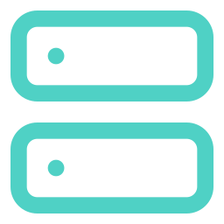


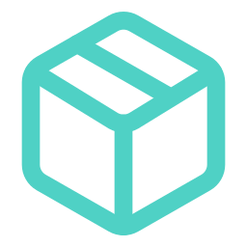
Identity and network
One least-privilege service account with no key files. The only public address is the VM's, and only team IPs can reach it.
VPC · DEFAULT · US-CENTRAL1
GOOGLE APIs · IAM CHECKS EVERY CALL
SUBNET DEFAULT · 10.128.0.0/20
Secret Manager
Team browsers
secret gridpulse-db-password only
4 team IPs (/32)
gridpulse-vm
e2-medium · us-central1-a
roles/secretmanager.secretAccessor
PUBLIC 35.184.90.182 (static) internal 10.128.0.x
Firewall
Cloud Storage
runs as gridpulse-vm-sa · scope cloud-platform · 0 key files
bucket gridpulse-509202-uploads only
gridpulse-team-access
tcp 22 · 80 · 8000
team /32s only, not 0.0.0.0/0
storage.objectCreator + objectViewer
TLS :5432
Cloud SQL Admin API
PRIVATE RANGE 10.60.0.0/20 · VPC PEERING
project · looks up the private IP
PUBLIC
only the VM's static IP, behind the firewall
PRIVATE
Cloud SQL has no public IP; bucket and secrets refuse anonymous access
roles/cloudsql.client
Cloud SQL · gridpulse-db
PostgreSQL 16
PRIVATE 10.60.0.3 public IPv4: disabled
Artifact Registry
db-f1-micro · TLS only (ENCRYPTED_ONLY) · daily backups
repository gridpulse only
roles/artifactregistry.reader
Not granted: the root-password secret, bucket admin, deleting objects, project Editor.
Notes:
The VM now runs as a dedicated service account, gridpulse-vm-sa, instead of the default compute account, which has Editor on the whole project. It gets short-lived tokens from the metadata server, so there is no key file anywhere. Each role is granted on the one resource it is needed for: Secret Manager Secret Accessor on the app's DB password secret only, Storage Object Creator and Viewer on the uploads bucket only, Cloud SQL Client so the backend can look up the instance's private IP, and Artifact Registry Reader on our repository so the VM can pull images. Network: the VM sits in the default VPC's us-central1 subnet. Its static external IP is the only public address, and the firewall allows only our four team IPs on ports 22, 80 and 8000. Cloud SQL has no public IP at all: it takes an address from the 10.60.0.0/20 range that is peered into our VPC through private services access, and it only accepts TLS connections. The bucket has public access prevention and uniform bucket-level access, so nothing in it can be made public.

