Slide 1
Volkswagen Diesel EPA Voilation
Bala Vignesh B
Spring 2021
Roger Engle

Slide 2
Agenda
What is this all about?
Defect Device
Affected Models
Engineering Team Ethics
Damage to VW
Settlements
Conclusion
Questions.

Slide 3
What is this all about?
Environment Protection Agency (EPA) charged Civil case against Volkswagen, Audi, Porsche group which violated the Clean Air Act. Nearly 590000 diesel vehicles impacted which sold from 2009-2015. All these vehicles have a software called Defect Devices which suppress pollutants under federal emission test. The pollutant we are talking about is Oxides of Nitrogen which can cause serious health effects.

Slide 4
Defect Device
Defeat device is a Software/hardware design to Change/Delay the emissions system of vehicle in order to save fuel or to improve the Performance. One Such Device was installed in Diesel cars solve by Volkswagen group.

Slide 5
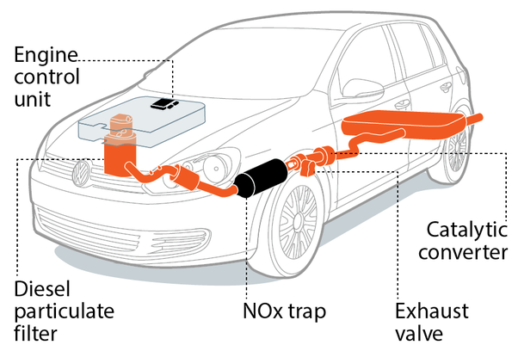
Defect Device layout

Slide 6
Defect Device Design
Software System
Factors Analyzed
Position of Steering
Speed
Duration of Engine Operation
Barometric Pressure
Mode of the vehicle
Under Test
Normal
EPA Compliance
Emission of NOx more than 10 - 40 times

Slide 7
Affected Models
2.0 L
3.0 L
Jetta (2009 – 2015)
Jetta Sportwagen (2009 - 2014)
Beetle (2013 – 2015)
Beetle Convertible (2013 - 2015)
Audi A3 (2010 – 2015)
Golf (2010 – 2015)
Golf Sportwagen (2015)
Passat (2012 - 2015)
Volkswagen Touareg (2009 - 2016)
Porsche Cayenne (2013 - 2016)
Audi A6 Quattro (2014 - 2016)
Audi A7 Quattro (MY 2014 - 2016)
Audi A8 (2014 - 2016)
Audi A8L (2014 - 2016)
Audi Q5 (2014 - 2016)
Audi Q7 (2009 - 2016)

Slide 8
Engineering Team Ethics
When Engineering team realized that they were not able to hit the emission target for diesel Engine For US Market using the inhouse filter. They did an un-ethical activity by implementing the Defect Device.
Ideally either they could have tried another popular method by spraying Urea or communicate to the management regarding the failed approach.

Slide 9
Damages to VW
Legal Action Against VW
Drop in Share Price
Decrease in future Sale
Lose of credibility
Increase Corporate Social responsibility

Slide 10
Conclusions
If VW followed a Business ethics and monitored the employees to following that principles, Violation such kind wouldn’t have happened. With the Ethics principal on training, employees can take better decision for the benefit of the company along with making Money and Reputation.

Slide 11
References
Learn About Volkswagen Violations. (2019, September 27). Retrieved from https://www.epa.gov/vw/learn-about-volkswagen-violations
What is a defeat device in auto making? (2021, March 20). Retrieved from https://www.quora.com/What-is-a-defeat-device-in-auto-making
VW admits emissions scandal was caused by 'whole chain' of failures. (2015, December 10). Retrieved from https://www.theguardian.com/business/2015/dec/10/volkswagen-emissions-scandal-systematic-failures-hans-dieter-potsch

Slide 12
Questions?

Slide 13
Amazon AI Recruiting Tool Gender Bias
Bala Vignesh B
Spring 2021
Roger Engle

Slide 14
Agenda
What is this all about?
AI Recruiting Tool
Objective
Data
Affected Community
Engineering Team Ethics
Conclusion
Questions.

Slide 15
What is this all about?
In 2014, Amazon explored to automate the Hiring process using Artificial Intelligence by giving stars from one to five for their candidates. By 2014 Company realized their new system is not giving proper rating for Software jobs in Gender Neutral ways. This is all because of the training data where most resume comes from the Male in the organization.

Slide 16
AI Recruiting Tool - Objective
First Step of any Recruiting process is to identify the Potential candidate for a position. In amazon, each job might get 1000+ job applications, in order to review those 1000+ resumes, an AI tool was explored to filter the top 100 Resumes.
Human Recruiter never trust resume alone, But not sure why Amazon thinks information in resume is sufficient.

Slide 17

AI Recruiting Tool - Data
AI
Past 10 years Successful Resumes

Slide 18
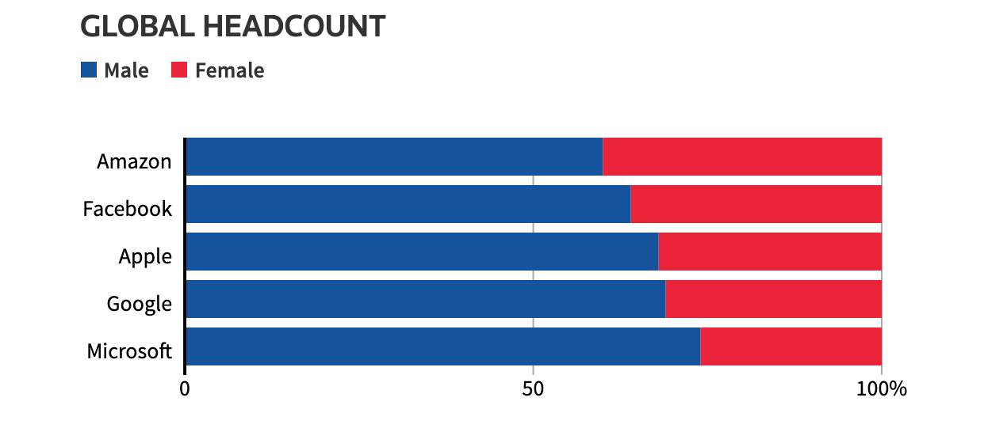
Affected Community
In 2015 Amazon realized that their new tool is not Gender-neutral way. It unwittingly taught its AI to replicate the bias towards selecting male candidates that already existed in the overall hiring practice. It started penalizing the resumes with words like “Women” as in “Women Chess Club Captain” and graduates from all-women’s College’s.

Slide 19
Engineering Team Ethics
When the engineering team monitor the performance of the AI tool, they found that system is biased based on the training data they feed. They did a right thing to escalate the matter and edited the program to make them neutral, But that was not enough for the Engineering team, Finally they disbanded the team because of the executives lost hope and Culture of the Amazon for the ethics.

Slide 20
Conclusions
“Failure is an option here. If things are not failing, you’re not innovating.”
- Elon Musk
We don’t have to blame the AI for the Bias, this happened because the training data was biased. The most important thing Amazon did is once they find the issue they tried to resolve, Since this issue is not able to resolve, they dissolved the project which means lot to amazon.

Slide 21
References
Amazon scraps secret AI recruiting tool that showed bias against women. (2018, October 10). Retrieved from https://www.reuters.com/article/us-amazon-com-jobs-automation-insight/amazon-scraps-secret-ai-recruiting-tool-that-showed-bias-against-women-idUSKCN1MK08G
Lauret, J. (2019, August 16). Amazon’s sexist AI recruiting tool: how did it go so wrong? Medium. https://becominghuman.ai/amazons-sexist-ai-recruiting-tool-how-did-it-go-so-wrong-e3d14816d98e
Bika, N. (2020, May 27). Don’t blame AI for gender bias – blame the data. Recruiting Resources: How to Recruit and Hire Better. https://resources.workable.com/stories-and-insights/ai-in-recruitment-amazon
Hsu, J. (2020, July 29). AI Recruiting Tools Aim to Reduce Bias in the Hiring Process. IEEE Spectrum: Technology, Engineering, and Science News. https://spectrum.ieee.org/tech-talk/at-work/tech-careers/ai-tools-bias-hiring

Slide 22
Questions?

Slide 23
Satyam Financial Fraud
Bala Vignesh B
Spring 2021
Roger Engle

Slide 24
Agenda
What is this all about?
Financial Fraud
Stagging
Auditor
Aftermath
Corporate Ethics
Conclusion
Questions.

Slide 25
What is this all about?
In 2009, India-based company Satyam Computer Services Chairman Byrraju Ramalinga Raju confessed about falsified account details. Securities and Exchange Commission charged Satyam with fraudulently overstating more than $1 billion over five years. Actions of Indian and U.S. authorities have transformed Satyam into a new company with new management and directors.

Slide 26
Financial Fraud - Stagging
Large amount in non-Interests Bearing Accounts.
6000 false invoices
$1 Billion in fictitious cash balances vs 66 million
Created False Bank statements
False Record-Keeping
Planning to buy other Companies owned

Slide 27
Financial Fraud - Auditor
PricewaterhouseCoopers was the auditor involved in the Financial Fraud.
PWC was given two years ban by SEBI (Securities and Exchange Board of India) for their involvement in the scandal
SEC fined 6 million.
SEBI ordered disgorgement of over Rs 13 crore wrongful gains from the firm and 2 partners

Slide 28
Financial Fraud - Aftermath
Board of Directors Bared
CEO and CFO in Judiciary Custody
Stock market freeze
Regulatory Fines
Shareholders lost 2.3B $
Merger to form Mahindra Satyam

Slide 29
Corporate Ethics
Ethics in financial reporting is must for the organization and Economy. Four most important principles are
Consistency
Full disclosure
Materiality(Not Missing the Significant Amount)
Conservatism

Slide 30
Conclusions
Satyam Fraud which was started as a small marginal gap between the operating profit and the actuals. Gap started to grow over the years and Management finally not able to hide no longer from the public. Each firm has to-be very good in their financial report auditing else white-collar crimes will be there always.

Slide 31
References
SEC Vs Satyam Computer Services (2011, April 5). The Securities and Exchange Commission. https://www.sec.gov/divisions/enforce/claims/docs/satyam-complaint.pdf
SEC Charges Satyam Computer Services With Financial Fraud. (2011, April 5). The Securities and Exchange Commission. https://www.sec.gov/news/press/2011/2011-81.htm
Wikipedia contributors. (2021, March 13). Satyam scandal. Wikipedia. https://en.wikipedia.org/wiki/Satyam_scandal
BBC News. (2015, April 9). India Satyam Computers: B Ramalinga Raju jailed for fraud. https://www.bbc.com/news/world-asia-india-32229847
Chen, G. (2009, January 8). Satyam scandal rattles confidence in accounting Big Four. U.S. https://www.reuters.com/article/satyam-accounting/satyam-scandal-rattles-confidence-in-accounting-big-four-idINHKG30879120090108

Slide 32
Questions?

Slide 33
Wells Fargo Fake Account Scandal
Bala Vignesh B
Spring 2021
Roger Engle

Slide 34
Agenda
What is this all about?
Fake Account Scandal
Cross-sell
Pinning
Team Ethics
Lose to Wells Fargo
Conclusion
Questions.

Slide 35
What is this all about?
The Wells Fargo provide incentive to employee who cross-sell products to their customers. Under pressure to meet steep sales goals and incentives, Wells Fargo employees created over a million fraudulent accounts in their customers’ names. Between 2011 and 2015, company employees opened more than 1.5 million bank accounts and applied for over 565,000 credit cards in customers’ names that may not have been authorized.

Slide 36
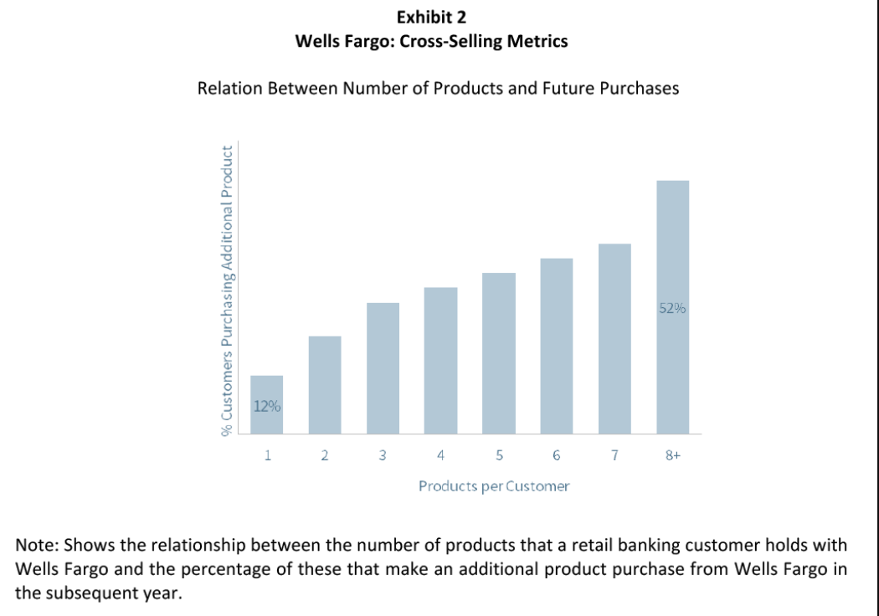
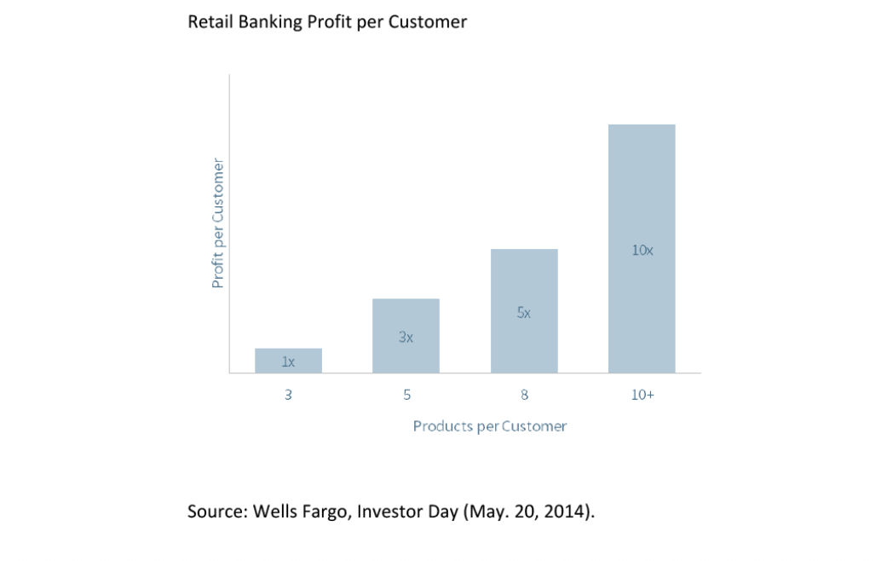
Fake Account Scandal - Cross-sell
If a customer bought one service, employees were urged to “cross-sell” several more products to them. “Eight is great” was the company mantra.

Slide 37
Fake Account Scandal - Pinning
Creation of these additional products was made possible in part through a process known as "pinning". By setting the client's PIN to "0000", bankers were able to control client accounts and were able to enroll them in programs such as online banking. They able to open 3,500,000 accounts. Employees even created unwanted insurance policies like Life Insurance, Auto Insurance and Renters Insurance.

Slide 38
Corporate and Team Ethics
Wells Fargo set unrealistic sales goals for their employees that led thousands of employees to provide millions of fake accounts or products to customers without consent by misusing customers identities.
Employees fabricated millions of fraudulent accounts in order to keep their bosses happy and remain employed.

Slide 39
Lose to Wells Fargo
$185 million for fraudulent activity.
5,300 employees were fired for fraudulent sales practices
$3 billion to civil and criminal probe
Reputation issues
Unresolved legal matters have weighed on the bank’s stock price and profitability.
$2.6 million was refunded to customers who incurred wrongly because of such accounts

Slide 40
Conclusions
The Wells Fargo compensation system emphasized cross-selling as a performance metric for awarding incentive pay to employees is completely backfired. Which leads to ethical violation at the Corporate and Individual level. Strong Risk Management Team along with Audit should have prevented such issues.

Slide 41
References
Prentice, C. P. S. (2020, February 22). Wells Fargo to pay $3 billion to U.S., admits pressuring workers in fake-accounts scandal. U.S. https://www.reuters.com/article/us-wells-fargo-scandal-deal/wells-fargo-to-pay-3-billion-to-u-s-admits-pressuring-workers-in-fake-accounts-scandal-idUSKBN20F2KN
The Wells Fargo Cross-Selling Scandal. (2019, February 6). The Harvard Law School Forum on Corporate Governance. https://corpgov.law.harvard.edu/2019/02/06/the-wells-fargo-cross-selling-scandal-2/
Wikipedia contributors. (2021, January 21). Wells Fargo account fraud scandal. Wikipedia. https://en.wikipedia.org/wiki/Wells_Fargo_account_fraud_scandal

Slide 42
Questions?

Slide 43
Equifax Data Breach
Bala Vignesh B
Spring 2021
Roger Engle

Slide 44
Agenda
What is this all about?
Software Vulnerability
Process
Hacking
Affected People
Engineering Team Ethics
Damages By Number
Conclusion
Questions.

Slide 45
What is this all about?
In September of 2017, Equifax announced a data breach that exposed the personal information of 147 million people. The company has agreed to a global settlement with the Federal Trade Commission, the Consumer Financial Protection Bureau, and 50 U.S. states and territories. The settlement includes up to $425 million to help people affected by the data breach.

Slide 46
Software Vulnerability
Equifax acknowledged that the criminals who gained access to its customer data exploited a website application vulnerability known as Apache Struts CVE-2017-5638. This was first discovered in March of 2017, attackers can sent HTTP requests with malicious code tucked into the content-type header, Struts could be tricked into executing that code, and potentially opening up the system Struts was running on to further intrusion.

Slide 47
Process
On March 7, the Apache Software Foundation released a patch for the vulnerabilities; on March 9, Equifax administrators were told to apply the patch to any affected systems, but the employee didn’t do it. Equifax's IT department ran a series of scans that were supposed to identify unpatched systems on March 15 and none of the vulnerable systems were flagged or patched.

Slide 48
Hacking - I
As per the forensic, initial Equifax data breach date was March 10, 2017 via consumer complaint web portal. After May 13, 2017 attackers began moving from the compromised server into other parts of the network. From May through July of 2017, the attackers were able to gain access to multiple Equifax databases containing information on hundreds of millions of people.

Slide 49
Hacking - II
Equifax had failed to renew one of their certificates nearly 10 months. So hacker used to transfer used this to transfer huge data. The expired certificate wasn't discovered and renewed until July 29, 2019. Many top Equifax executives sold company stock in early August, raising suspicions. Equifax publicized the breach on September 8, 2017

Slide 50
Affected People
Breach affected 143 million people — more than 40 percent of the population of the United States — whose names, addresses, dates of birth, Social Security numbers, and drivers' licenses numbers were exposed. Around 200,000 credit card numbers; this group probably consisted of people who had paid Equifax directly in order to order to see their own credit report

Slide 51
Ethics
Negligence of Employee to Patch the Vulnerability
Failure to renew the Security Certificate
Insider Trading by executives by selling huge shares
Management delayed the Information to public
Design issues
Separation of machines by design to avoid the huge damage
Database Specific user roles
System didn’t raise flag when 9000+ queries run

Slide 52
Damages By Number
76 days: attackers were active within Equifax's networks without being discovered
147m: consumers affected by the breach
$125: Compensation to each customers
$1.4b: Spend on upgrading Security
0: Fraud or Identity theft cases

Slide 53
Conclusions
Equifax data compromise was due to (Equifax’s) failure to install the security updates provided in a timely manner. Data Governance is a huge responsibility for a corporation which collects information about customers. Ethics at various stages failed. equifaxsecurity2017.com was created for litigation.

Slide 54
References
Bomey, N. U. T. (2020, February 11). How Chinese military hackers allegedly pulled off the Equifax data breach, stealing data from 145 million Americans. USA TODAY. https://eu.usatoday.com/story/tech/2020/02/10/2017-equifax-data-breach-chinese-military-hack/4712788002/
Center, E. P. I. (2017). EPIC - Equifax Data Breach. Epic. https://epic.org/privacy/data-breach/equifax/
Equifax Data Breach Settlement. (2020, July 15). Federal Trade Commission. https://www.ftc.gov/enforcement/cases-proceedings/refunds/equifax-data-breach-settlement
Fruhlinger, J. (2020, February 12). Equifax data breach FAQ: What happened, who was affected, what was the impact? CSO Online. https://www.csoonline.com/article/3444488/equifax-data-breach-faq-what-happened-who-was-affected-what-was-the-impact.html
Wikipedia contributors. (2021, April 7). 2017 Equifax data breach. Wikipedia. https://en.wikipedia.org/wiki/2017_Equifax_data_breach

Slide 55
Questions?

