Slide 1
SALCOMP MANUFACTURING INDIA PRIVATE LIMITED
BALAVIGNESH S
MECHATRONICS
BANNARI AMMAN INSTITUTE OF TECHNOLOGY

Slide 2
CHARGER MANUFACTURING
1)PCB LOADING 2)GLUE PRINTING AND VISUAL INSPECTION
4)REFLOW OVEN 3)PICK AND PLACE
5)THROUGHTH HOLE COMPONENT MANUAL ASSEMBLY AND GLUE APPLYING

Slide 3
6)WAVE SOLDERING
7)WAVE PALLET UNLOADING
8)VISUAL INSPECTION AND TOUCHUP
9)PWBA CLEANING AND DEPANELISING
10)PWBA TEST

Slide 4
11)PSIP ASSEMBLY
12)WHITE GLUE APPLY
13)SPRING RIVETING
14)LASER MARKING(OFFLINE AND INLINE)
15)PWBA FIXING B COVER

Slide 5
16)SCANNING
17)WHITE GLUE APPLY-2
18)A-COVER ASSEMBLY
19)ULTRA SONIC WELDING
20)UNIT LOADING IN PALLET AND SCANNING

Slide 6
21)AGING TEST
22)UNIT LOADING
23)ATE TEST
24)UNIT UNLOADING
25)NOISE CHECKING

Slide 7
26)CMN TEST
27)LED TEST
28)VISUAL TEST
29)TEAR OFF PE FILM AND PET PROTECTION FILM
30)UNIT 2d SCANNING

Slide 8
31)PACKING ASSEMBLY AND LABEL
32)PALLETIZING

Slide 9
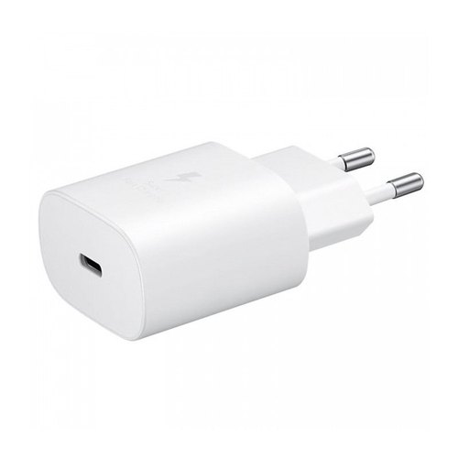
STAGE WISE PROCESS EXPLANATION:
1)PCB LOADING
PCB BOARDS ANE LOADED .
PCB BOARDS ARE AUTOMATICALLY TAKEN INSIDE ONE BY ONE.
2)GLUE PRINTING AND VISUAL INSPECTION
RED GLUE IS APPLIED OVER THE BOARD.
3)PICK AND PLACE
PLACES THE COMPONENTS AUTOMATICALLY BY SUCKING PROCESS.
IC,CAPACITORS,RESISTORS,TRANSISTORS ARE PLACED OVER THERE.

Slide 10
4)REFLOW OVEN
FIVE COMPARTMENTS FOUR FOR HEAT AND ONE FOR COOL.
TO STIFF THE PLACEMENT OF COMPONENTS BY GLUE/SOLDER PASTE.
5)THROUGHT HOLE COMPONENT MANUAL ASSEMBLY AND GLUE APPLYING
MANUAL PLACING OF THE COMPONENTS.
CAPACITOR,RESISTOR,TRANSISTOR,TRANSFORMER,INDUCTOR,CHOCK,FUSE,USB.
WHITE GLUE PASTEING FOR AVOID HEAT AND THE DISPLACEMENTS OF COMPONENTS.
6)WAVE SOLDERING
PCB BOARDS ARE LOADED IN THE PALETE
AND MADE TO MOVE INTO THE WAVE SOLDERING MACHINE
THEY CONSIST OF TWO PARTS BUBBLE SOLDER AND WAVE SOLDER

Slide 11
7)WAVE PALLET UNLOADING
AFTER THE WAVE SOLDERING THE BOARD IS UNLOADED FROM THE PANEL.
8)VISUAL INSPECTION AND TOUCHUP
AFTER UNLOADING FROM THE PALETE ,BOARDS ARE MOVED TO THE VISUAL INSPECTION,
THEN MOVED TO THE TOUCH UP STAGE FOR SOLDER TOUCH UP.
9)PWBA CLEANING AND DEPANELISING
AFTER TOUCHUP STAGE ,BRUSHING WILL TAKES PLACE BY THIS STAGE THE SOLDER BALLS WILL BE REMOVED TO AVOID THE NOISE MAKING.
FOLLOWED BY BRUSHING DEPANELISING WILL TAKES PLACE BOTH IN MANUAL & AUTOMATIC.
10)PWBA TEST
FUNTIONAL TEST WILL TAKE PLACE MUNUALLY AND AUTOMATICALLY.
11)PSIP ASSEMBLY
PRIMARY SECONDARY INSULATOR PACKAGE IS ASSEMBLED,IT COVERS THE TRAFO TO PROTECT OTHER COMPONENT FROM GETTING DAMAGED.

Slide 12
12)WHITE GLUE APPLY
WHITE GLUE IS APPLIED 2 TIMES TO AVOID HEATING.
1ST GLUE IS APPLIED AROUND THE TRAFO
2ND GLUE IS APPLIED AROUND THE CAPACITORS
13)SPRING RIVETING
SPRING INSERSION WILL TAKE PLACE IN THE B-COVER
THIS IS FOR THE CONNECTION BETWEEN THE PCB TO THE EXTERNAL PIN
14)LASER MARKING(OFFLINE AND INLINE)
LASER PRINTING OVER THE B-COVER WILL TAKE PLACE
THIS IS USED FOR THE PRINTING OF THE COMPANY LOGO AND MANUFACTURING DETAILS
15)PWBA FIXING B COVER
THEN PCB IS INSERTED INTO THE B-COVER

Slide 13
16)SCANNING
THEN SCAN THE PCB AND THE B-COVER BEFORE CLOSING.
17)WHITE GLUE APPLY-2
WHITE GLUE IS APPLIED INSIDE THE B-COVER TO AVOID THE MOMENTS OF THE COMPONENTS AND TO AVOID THE HEAT.
18)A-COVER ASSEMBLY
THEN A-COVER IS FIXED OVER THE B-COVER.
19)ULTRA SONIC WELDING
ULTRA SONIC WELDING WILL TAKE PLACE TO CONNECT THE A-COVER TO B-COVER.
ONCE IF WEILDING TOOK PLACE WE CANNOT REMOVE THE COVER SEPERATELY
20)UNIT LOADING IN PALLET AND SCANNING
THEN THE PCB ARE LOADED IN THE PALETE AND SCANNED BEFORE THE AGING TEST

Slide 14
21)AGING TEST
THEN THE LOADED PALETES ARE LOADED IN THE AGING CHAMBER.
AGEING PROCESS LASTS FOR ONE HOUR WITH 2 BARS.
22)UNIT LOADING
THEN THE UNIT IS LOADED FOR THE ATE TEST.
23)ATE TEST
AUTOMATIC TEST EQUIPMENT CHECKS THE CONNECTIVITY OF THE BOARD AT THE PARTICULAR STAGE.
24)UNIT UNLOADING
AFTER THE ATE TEST THE UNIT IS UNLOADED FOR THE NOISE CHECKING STAGE.
25)NOISE CHECKING
IN THIS STAGE THE CHARGER HEAD IS TAPPED OVER THE TABLE AND SHAKE TO DETECT WHETHER THE SOUND IS FORMED OR NOT.
IF ANY SOUND DETECTED THEN IT IS MOVED FOR BREAKING.

Slide 15
26)CMN TEST
COMMON MODE NOISE TEST IS HAPPENED FOR VERIFYING THE QUALITY OF THE NOISE TEST.
27)LED TEST
LIGHT EMITTING DIODE TEST, IN THIS STAGE MOST OF THE DETECTED BOARDS FOUND AND ONLY THE QUALITY PRODUCTS WILL PASS THROUGH.
28)VISUAL TEST
VISUAL TEST WILL TAKE PLACE WHETHER THERE ANY DAMAGE OVER THE A-COVER AND B-COVER.
29)TEAR OFF PE FILM AND PET PROTECTION FILM
AFTER VISUAL INSPECTION, THE TEMPORARY PE FILM IS REMOVED AND THE PERMANENT PET PROTECTION FILM IS WRAPPED TO AVOID SCRATCHES AND DAMAGES.
30)UNIT 2D SCANNING
THEN THE CHARGER QR CODE IS SCANNED TO KNOW THE OUTPUT NUMBER OF CHARGER.

Slide 16
31)PACKING ASSEMBLY AND LABEL
AFTER SCANNING THE CHARGER IS PACKED IN THE CASES AND THE LABELLED.
32)PALLETIZING
FINALLY THE PACKED CHARGER BOXES ARE PALLETIZED ON THE TROLLY.

Slide 17
Transformer manufacturing
1)PRIMARY WINDING W1
2)PRIMARY WINDING W2
3)PRIMARY WINDING W3
4)SECONDARY WINDING w1
5)SECONDARY WINDING w2
6)SECONDARY WINDING w3

Slide 18
7)SECONDARY Wrapping and cutting (w4)
8)LASER LOADING
9)TINNING
10)VISUAL INSPECTION
11)NO GAP CORE ASSEMBLY
12)GAP CORE ASSEMBLY WITH GLUE APPLICATION

Slide 19
13)PLACING THE WIRE ON CORE ASSEMBLY
14)CORE TAPPING
15)INDUCTANCE TEST
16)CONDUCTIVE GLUE APLLICATION
17)OVEN STAGE
18)CONTACT RESIDENCE TEST
19)VARNISH BOOTH

Slide 20
20)OVEN STAGE
21)VISUAL STAGE 2
22)FUNCTIONAL TEST 1
23)PRINTING
24)BALANCE VOLTAGE TEST
25)PIN CHECKING
26)SCANNING AND PACKING

Slide 21
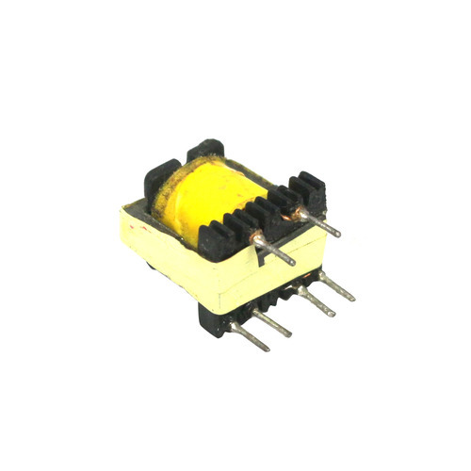
Stepwise process explanation
*) IN PRIMARY WINDING COPPER WIRE WITH A DIAMETER OF 0.18MM IS WINDED IN BOBBIN . NO TURNS VARIES WITH MODELS . INPUT IS GIVEN IN PRIMARY WINDING .
PRIMARY WINDING W1:
WHICH CONSISTS OF 60 TURNS WHERE THE WINDING TAKES PLACE ON
3RD AND 4TH PIN .
PRIMARY WINDING W2:
THIS CONSIST OF 10 TURNS WHERE THE WINDING TAKES PLACE ON 1ST AND 2ND PIN .
PRIMARY WINDING W3:
THIS CONSIST OF 12.5 TURNS WITH COPPER WIRE WITH A DIA OF 0.18MM
2.5 TURNS OF TAPING IS DONE HERE FOR INSULATION PURPOSE .
WINDING TAKES PLACE ON 5TH

Slide 22
* IN SECONDARY WINDING TRIPLE INSULATED WIRE WITH A DIAMETER OF 0.70MM. WE GET OUTPUT FROM SECONDARY WINDINGS.
SECONDARY WINDING W4:
HERE 6TH AND 7TH PIN ARE WINDED WITH TRIPLE INSULATED WIRE. WHICH CONSIST OF LEPHLON TUBE AND IT IS USED FOR INSULATION PURPOSE.
*LASER LEADING : IT REMOVES ENAMEL OVER 6TH AND 7TH PIN.
*TINNING : IT PROVIDES FLUX FOR SOLDERING PURPOSE. ITS TEMPRATURE IS FROM (420 – 440 DEGREE)
*VISUAL INSPECTION : WE CHECKS SOLDERING OF TRAFO
* NO GAP CORE ASSEMBLY : * INSERTED ON PRIMARY OR BOTTOM SIDE
* GAP CORE APPLIED WITH GLUE
* PLACING THE WIRE ON CORE

Slide 23
* CORE TAPPING : CORE IS TAPPED FOR INSULATION PURPOSE
* INDUCTANCE TEST : LEAKAGE CAPACTINCE RESISTANT
* CONDUCTIVE GLUE APPLY : TO APPLY GLUE FOR CONNECTION BETWEEN FG WIRE AND CORE.
* OVEN STAGE : ( 1 HR PROCESS APPROX) IT HAS 4 CHAMBERS OF 4 DIFFERENT TEMPRATURE AND WE KEPT OUTSIDE FOR COOLING OF 10 MINS
* CONTACT RESIDENCE TEST : ( LED TEST ) CORE AND FG WIRE CONTACT CHECKING
* VARNISH BOOTH : CONSIST OF MIXABLE THINNER AND VARNISH IN THE RATIO OF 1:3 . ITS DURATION IS 30 SECONDS. VISCOSITY OF VARNISH MEASURED BY ZHON CUP(21 – 25)
* OVEN STAGE : AFTER THE VARNISH WE AGAIN PLACE IN THE OVEN FOR 1 HOURS

Slide 24
* VISUAL INSPECTION : WE CHECKS THE TRAFO
* FUNCTIONAL TEST 1 : HYPOT TEST ( PRODUCT LIABILITY STAGE) 4000 VOLT MAX VOLTAGE WITHSTAND
* PRINTING : IN THIS PROCESS WE PROVIDE THE DATE , YEAR , WORKER AND SHIFT DETAILS
* BALANCE VOLTAGE : NOISE CHECKING PURPOSE
* PIN CHECKING : PIN SEATING PURPOSE
* SCANNING AND PACKING : FINAL PROCESS SEALED

Slide 25
THANKYOU

