Slide 1
Introduction
Accurate detection and localization of eye diseases are essential for timely diagnosis and treatment. In this project, we adopt a classification-first approach to address these challenges.
Using the DenseNet model, we classify eye diseases efficiently, ensuring robust predictions. Once classified, U-Net is employed to segment the affected regions, providing precise localization of abnormalities.
This two-stage methodology not only enhances diagnostic accuracy but also offers visual evidence of the disease, aiding medical professionals in making informed decisions.
By combining advanced classification and segmentation techniques, our project aims to improve the reliability and effectiveness of automated eye disease diagnosis systems.

Slide 2
Problem Statement, Objectives and Programming Language
Problem Statement- To develop a deep learning model for the detection and classification of medical diseases including diabetic retinopathy, cataract, and glaucoma, from medical images.
Objectives- To classify and segment medical images for abnormality detection.
To implement a deep learning model for accurate disease detection.
Programming Language- The language used is Python and packages such as – TensorFlow, Keras, OpenCV, and NumPy.

Slide 3
Methodology
Our methodology had multiple steps which are-
Data Collection and Preprocessing
Classification with DenseNet
Segmentation
Model Training and Evaluation

Slide 4
Data Collection and Preprocessing
We begin by collecting a large dataset of medical images
These images undergo preprocessing steps :
Resizing (256*256)
Normalization
Data augmentation to improve model robustness
Flipping, rotating

Slide 5
Classification with DenseNet
To classify the eye diseases, we use the DenseNet-201 model, a deep convolutional neural network known for its efficient feature reuse.
DenseNet's architecture allows for better performance in medical image classification, as it effectively handles complex patterns within the eye images.
Freezing and fine tuning.
The model is trained using labeled data, with categorical cross-entropy loss function and Adam optimizer.

Slide 6
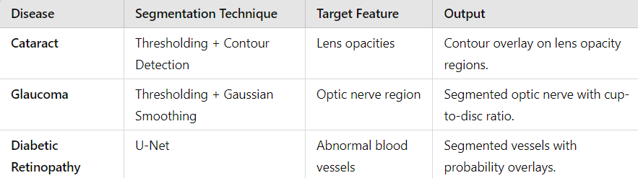
Segmentation
Once the classification model is trained, we use U-Net for segmentation. (Only for DR)
This model is particularly designed for pixel-level segmentation tasks, enabling it to accurately detect and highlight key regions in the image, such as the retina.
Segmentation allows us to identify affected areas of the eye, which can then be correlated with the classification output for further diagnostic purposes.

Slide 7
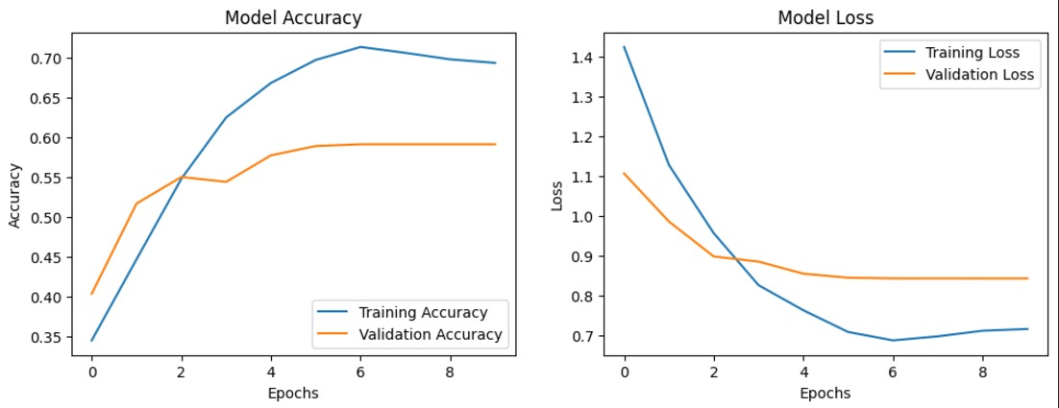
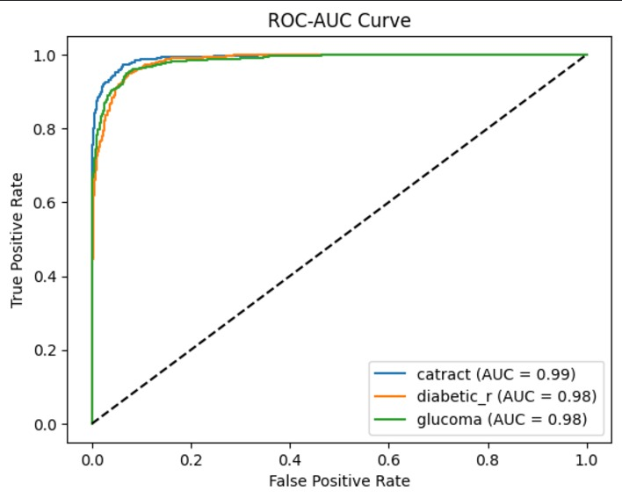
Model Training and Evaluation
After segmentation, we ensure that the output regions align with the classification predictions, improving the interpretability and reliability of the results.

Slide 8
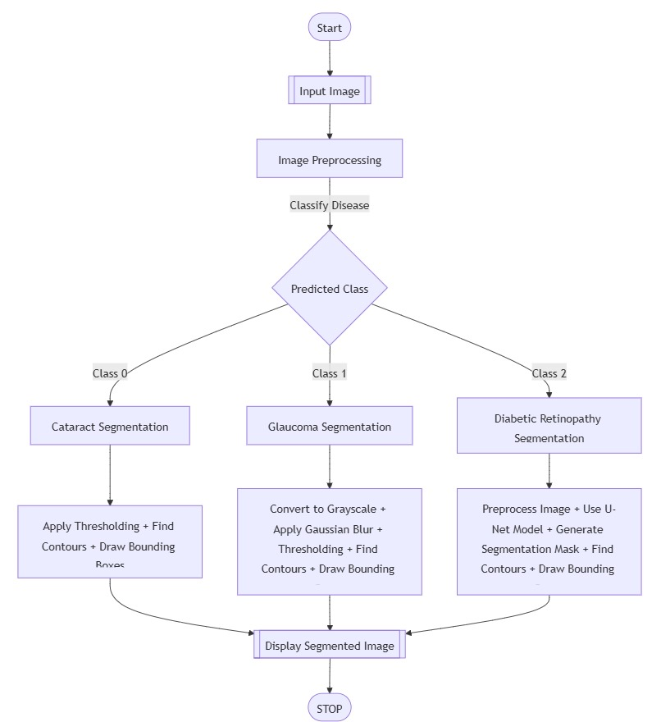
Flow-chart:

Slide 9
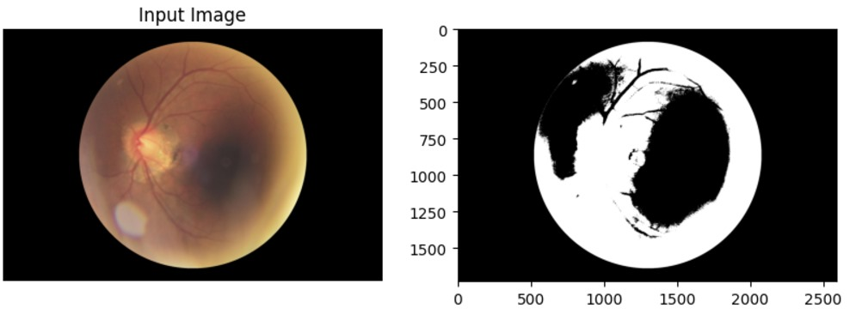
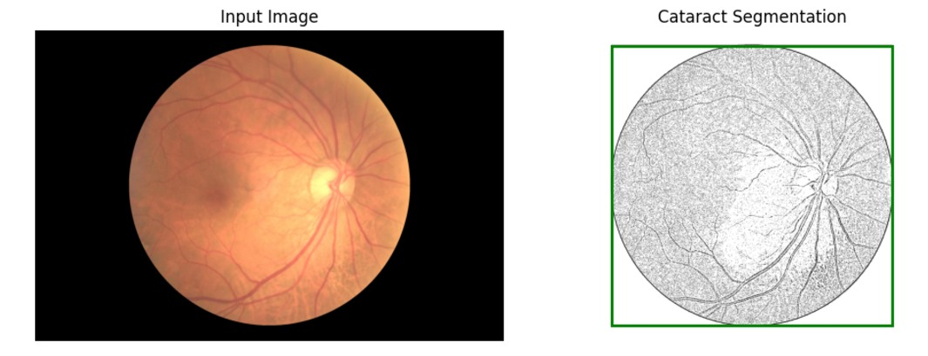
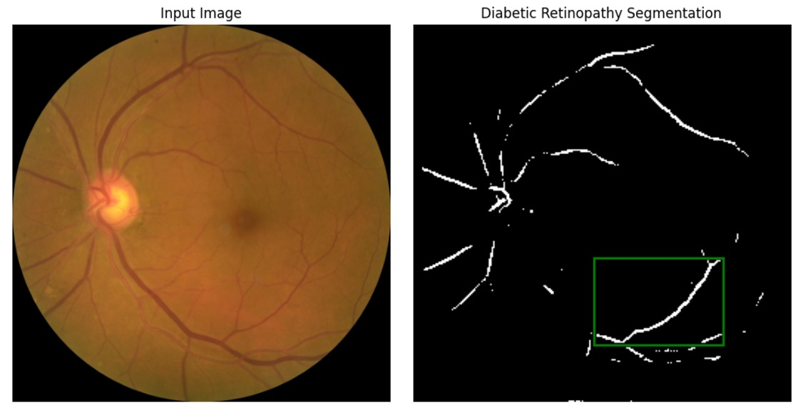
Simulation Result

Slide 10
Conclusion
Accuracy Achieved: Displayed final accuracy and other relevant metrics. An accuracy of 87 percent was achieved.
The classification-first approach followed by segmentation effectively detects and localizes eye diseases. Using DenseNet for classification and U-Net for segmentation enhances diagnostic accuracy and interpretability, providing valuable insights for medical professionals.
This integrated methodology offers a robust solution for automated, reliable eye disease detection.

Slide 11
Thank You

