Slide 1

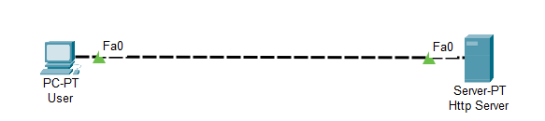
HTTP Protocol
Hypertext transfer protocol
Balayogi G

Slide 2
HTTP Overview
Application layer protocol.
TCP/IP based communication protocol, delivers data such as Image, Video, Audio, HTML pages, etc.,
Distributed, collabrative and hypermedia transmission system.
Foundation for World wide web(WWW) since 1990.
Generic and stateless protocol.
Standard port for HTTP protocol on TCP is 80(Other ports can also be used).
Connectionless protocol.
Media independent.
Stateless protocol.
Types: HTTP/1 and HTTP/2.

Slide 3
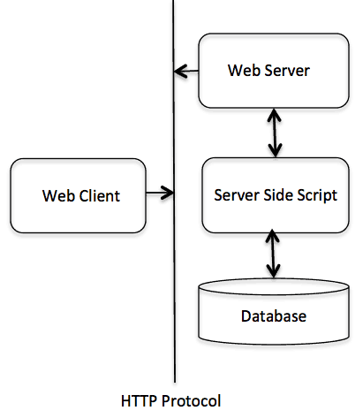
HTTP Overview(cont.)
HTTP/1.0 uses a new connection for each request/response exchange, where as HTTP/1.1 connection may be used for one or more request/response exchanges.
Request / Response based protocol.
For example, web browsers, robots, search engines and more.

Slide 4
HTTP Parameters
HTTP version
URI – Uniform resource locator
Date / time format
Character sets
Content encoding
Media types
Language tags

Slide 5
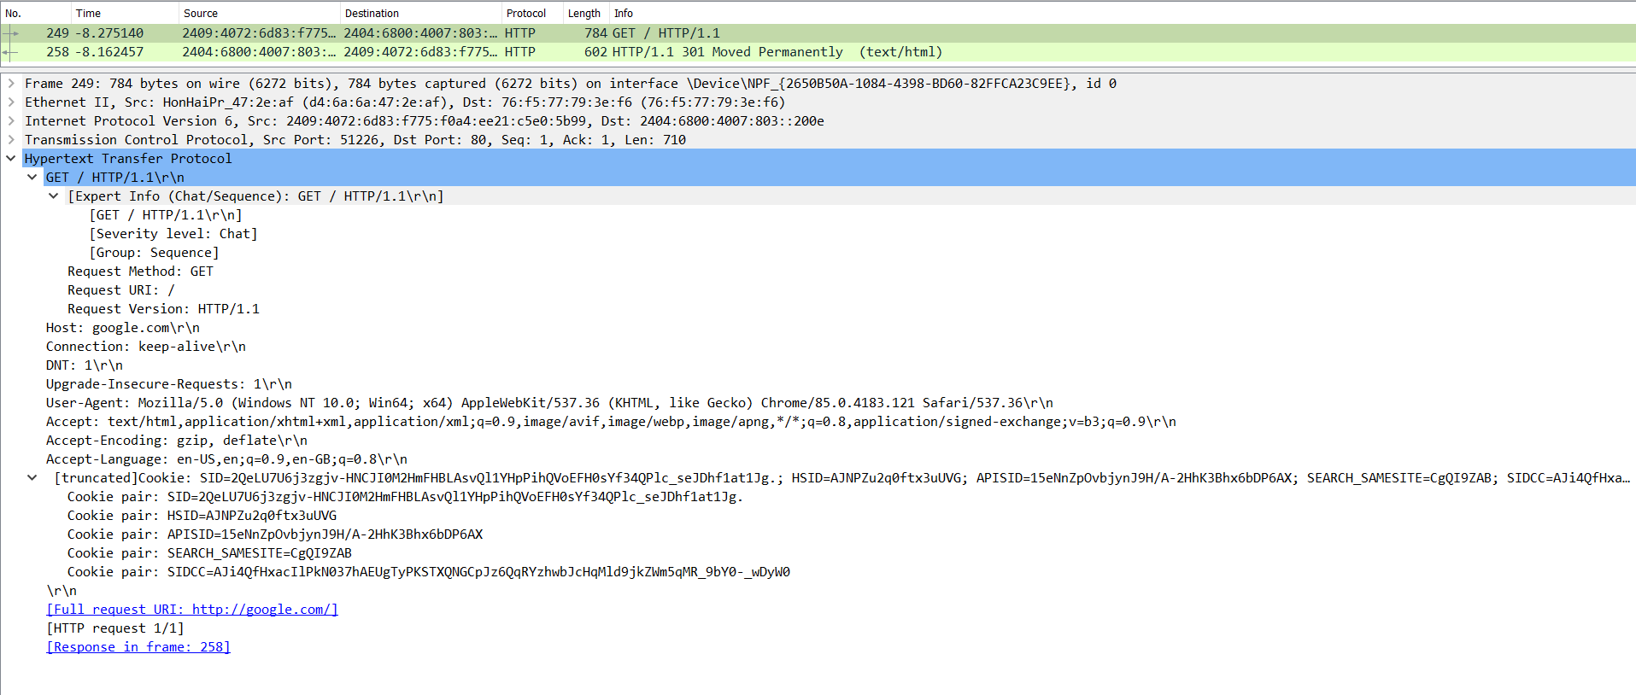
HTTP Request packet capture

Slide 6
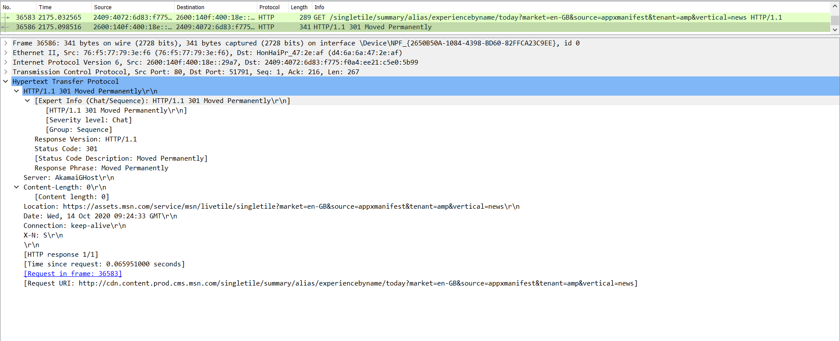
HTTP Response Packet capture

Slide 7
HTTP Messages
HTTP requests and HTTP responses use a generic message format of RFC 822 for transferring the required data. This generic message format consists of the following four items.
  A Start-line
  Zero or more header fields followed by CRLF(\r or carriage return)
  An empty line (i.e., a line with nothing preceding the CRLF) indicating the end of the header fields
  Optionally a message-body

Slide 8
HTTP Methods
Method | Description
GET | To retrive information from server.
HEAD | Similar to GET, but retrives only status line and header sections.
POST | To send information to server.
PUT | Replacing all the current representation of target resource in the server.
DELETE | Removes all current representations of the target resource given by a URI.
CONNECT | Establish the tunnel to the server given by URI.
OPTIONS | Describes the communication options for the target resource.
TRACE | Performs a message loop-back test along the path to the target resource.

Slide 9
HTTP Status codes
Status code | Description
1XX | Informational Error It means the request has been received and the process is continuing.
2XX | Success It means the action was successfully received, understood, and accepted.
3XX | Redirection It means further action must be taken in order to complete the request.
4XX | Client Error It means the request contains incorrect syntax or cannot be fulfilled.
5XX | Server Error It means the server failed to fulfill an apparently valid request.

Slide 10
HTTP – Information Error
Error Message | Description
100 Continue | When only a part of the request has been received by the server, but until the request is not been rejected, client can continue sending other parts of request.
101 Switching protocols | When the server switch protocols.

Slide 11
HTTP – Success
Error Message | Description
200 OK | Request is OK
201 Created | Request is complete and a new resource is created
202 Accepted | Request is accepted for processing, but the processing is not complete.
203 Non-authoritative information | Information in the entity header is from local or third party copy and not from the original server.
204 No content | Status code and a header are given in the response, but there is not entity body in the reply.
205 Reset content | Browser should clear the form used for this transaction for additional input.
206 Partial content | Server returned a partial data of the size of requested. The requested range is given in Range header, and the content-Range header will be in response.

Slide 12
HTTP – Redirection
Error Message | Description
300 Multiple choices | A link list. The user can select a link and go to that location. Maximum five addresses.
301 Moved permanently | The requested page has moved to a new url .
302 Found | The requested page has moved temporarily to a new url .
303 See other | The requested page can be found under a different url .
304 Not modified | This is the response code to an If-Modified-Since or If-None-Match header, where the URL has not been modified since the specified date.
305 use proxy | The requested URL must be accessed through the proxy mentioned in the Location header.
306 unused | This code was used in a previous version. It is no longer used, but the code is reserved.
307 Temporiary redirect | The requested page has moved temporarily to a new url .

Slide 13
HTTP – Client Error
Error Message | Description
400 Bad Request | The server did not understand the request.
401 Unauthorized | The requested page needs a username and a password.
402 Payment required | You can not use this code yet.
403 Forbidden | Access is forbidden to the requested page.
404 Not found | The server can not find the requested page.
405 Method not found | The method specified in the request is not allowed.
406 Not acceptable | The server can only generate a response that is not accepted by the client.
407 Proxy authentication required | You must authenticate with a proxy server before this request can be served.
408 Request Time out | The request took longer than the server was prepared to wait.

Slide 14
HTTP – Client Error(Cont.)
Error Message | Description
409 Conflict | The request could not be completed because of a conflict.
410 Gone | The requested page is no longer available .
411 Length Required | The "Content-Length" is not defined. The server will not accept the request without it .
412 Precondition failed | The pre condition given in the request evaluated to false by the server.
413 Request Entity too large | The server will not accept the request, because the request entity is too large.
414 Request URL too long | The server will not accept the request, because the url is too long. Occurs when you convert a "post" request to a "get" request with a long query information .

Slide 15
415 Unsupported Media type
415 Unsupported Media type
HTTP – Client Error(Cont.)
HTTP – Client Error(Cont.)
Error Message | Description
415 Unsupported Media type | The server will not accept the request, because the mediatype is not supported .
416 Requested range not satisfiable | The requested byte range is not available and is out of bounds.
417 Expectation failed | The expectation given in an Expect request-header field could not be met by this server.

Slide 16
HTTP – Server Error
Error Message | Description
500 Internal server error | The request was not completed. The server met an unexpected condition.
501 Not implemented | The request was not completed. The server did not support the functionality required.
502 Bad gateway | The request was not completed. The server received an invalid response from the upstream server
503 Service Unavaiable | The request was not completed. The server is temporarily overloading or down.
504 Gateway time out | The gateway has timed out.
505 HTTP version not supported | The server does not support the "http protocol" version.

Slide 17
HTTP – Headers
HTTP header fields provide required information about the request or response, or about the object sent in the message body. There are four types of HTTP message headers:
General-header: These header fields have general applicability for both request and response messages.
Client Request-header: These header fields have applicability only for request messages.
Server Response-header: These header fields have applicability only for response messages.
Entity-header: These header fields define meta information about the entity-body or, if no body is present, about the resource identified by the request.

Slide 18
HTTP Security
Personal information leakage
  HTTP clients are often privy to large amount of personal information such as the user's name, location, mail address, passwords, encryption keys, etc. So you should be very careful to prevent unintentional leakage of this information via the HTTP protocol to other sources.
File and Path name based attack or Directory traversal
  Directory traversal (also known as file path traversal) is a web security vulnerability that allows an attacker to read arbitrary files on the server that is running an application. This might include application code and data, credentials for back-end systems, and sensitive operating system files.
DNS Spoofing
  DNS spoofing occurs when a particular DNS server's records of "spoofed" or altered maliciously to redirect traffic to the attacker. This redirection of traffic allows the attacker to spread malware, steal data, etc
Location Header and Spoofing
  Header spoofing is when a URL appears to be downloaded from a certain domain, but in reality it is downloaded from a different and (very likely) malicious one. Unlike other types of spoofing techniques, this action is done without any system or file modification.

Slide 19
HTTP Security(Cont.)
Authentication credientals
  Existing HTTP clients and user agents typically retain authentication information indefinitely. HTTP/1.1 does not provide a method for a server to direct clients to discard these cached credentials which is a big security risk.
Proxies and cacheing
  HTTP proxies are men-in-the-middle, and represent an opportunity for man-in-the-middle attacks. Proxies have access to security-related information, personal information about individual users and organizations, and proprietary information belonging to users and content providers.
  Proxy operators should protect the systems on which proxies run, as they would protect any system that contains or transports sensitive information.
  Caching proxies provide additional potential vulnerabilities, since the contents of the cache represent an attractive target for malicious exploitation. Therefore, cache contents should be protected as sensitive information.

Slide 20
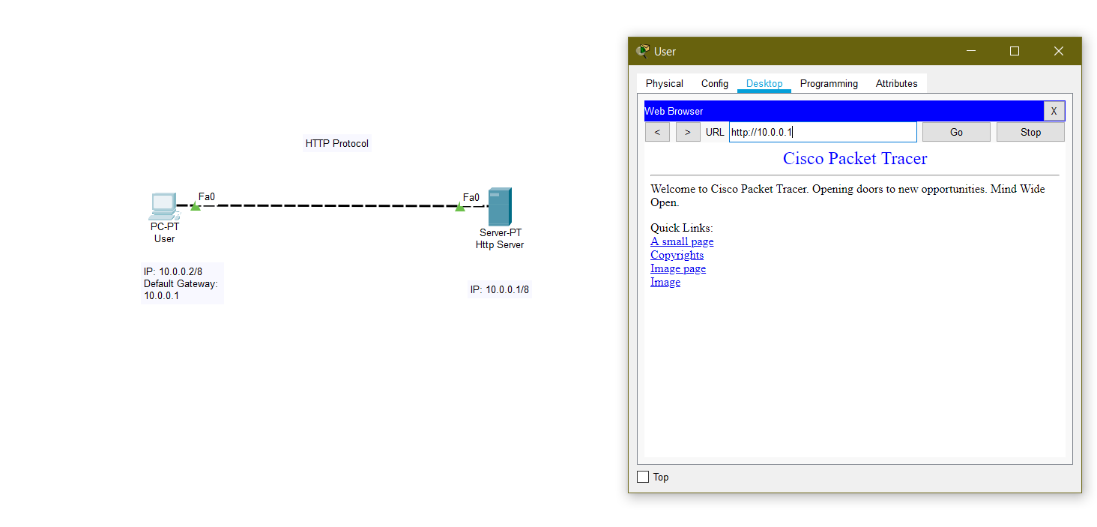
HTTP Implementation

Slide 21

Thanks for watching…☺

