Slide 1
Numerical investigation of coincidence-correction in gamma spectroscopy
By Bogye Balázs
Supervisor: Horváth Ákos
Goal: simulate HPGE detector →get efficiency curve + get data from literature → calculate coincidence correction for given isotope → analyze spectrum of an old experiment → investigate effect of correction

Slide 2


Coincidence summing
Radioactive decay → nucleus in excited state → deexcitation - not necessarily 1 step, multiple deexcitations → gamma cascades
Fast (ps) transitions to ground (/isomer) state
Usually gamma emission
Can be internal conversion (e⁻ instead of gamma), internal pair production (e⁻ + e⁺)
Multiple transitions detected as one (ps delay << μs detector time resol.)
Coincidences sum up as real transition peak → summing-in
Coincidences sum up → single peaks not detected → summing-out

Slide 3
Model: Semkow matrix formalism, a bit modified
Goal: coincidence corrected detection chance of j → i transitions
Inputs:
Transition probability matrix (X=G+E+W, actually 3 matrices) (from literature)
Efficiency matrices ( μ(E) , total, photopeak) (from simulation)
Feeding rates (f) (from literature) (distribution of starting levels)
Full, Partial, Null detection probabilities for each transition
→ F, P, N detection chains (from E level j to i, through all possible routes)
Summing up as E_{j→i} = f_{t} * N_{t→j} * F_{j→i} * N_{i→1}
http://atomfizika.elte.hu/akos/orak/mkm/coszu.pdf

Slide 4
Geant4 simulation
Geant4 - simulation of the passage of particles through matter
Geometry of HPGE detector:
Ge crystal (technical datasheet)
Outer Al shell (measured)
Inner positions, other elements (technical drawing from internet)
Penelope physics (good at low energy too)
Params:
source distance
gamma E, angle (mono energy, distribution)
geometry complexity
²³⁸U decay simulation
CaCO₃ sample simulation
Various validation (/fun) simulations
Technical drawing
Simulation geometry with point source

Slide 5
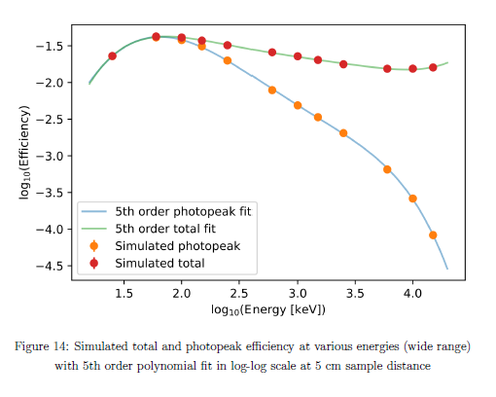
Efficiencies – energy dependence

Slide 6
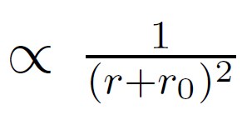
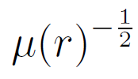
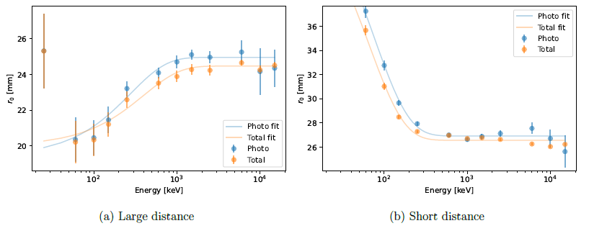
Efficiencies – distance dependence
r⁻² with r₀ effective distance (in detector) →
Fit lines to get r₀ intercepts
r₀ is energy dependent, different at low (<10 mm) and large (10-100 mm) distances
Fitted with empirical formula from literature

Slide 7
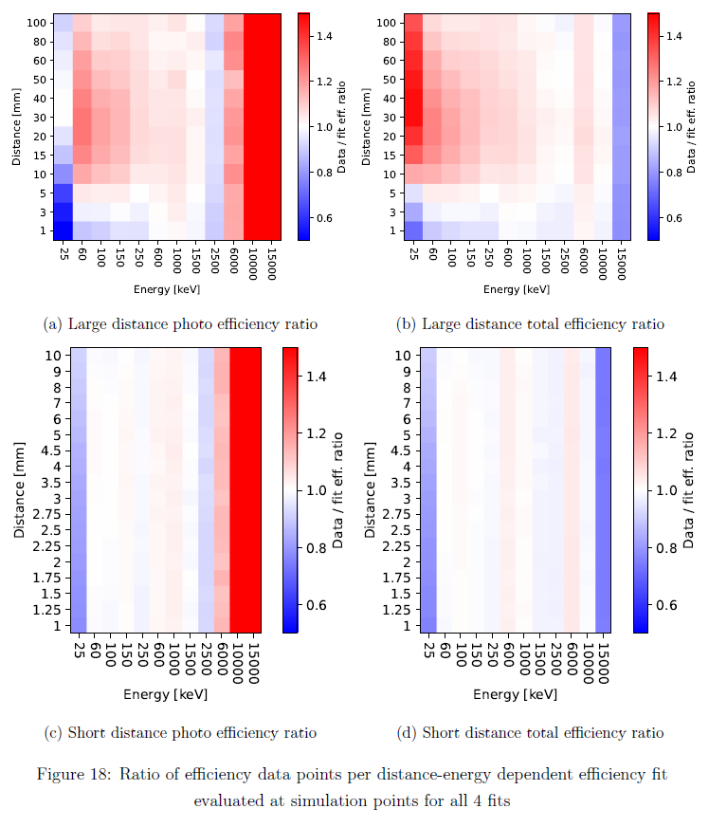
Energy and distance dependent error
Could be better but is good enough at 100 keV – 3 MeV

Slide 8
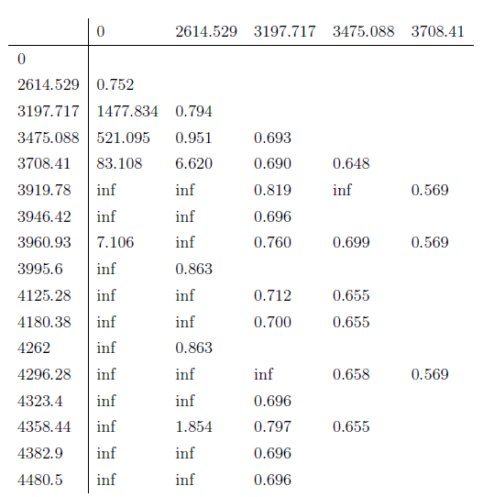
²⁰⁸Tl
To E level [keV]
Data from NuDat2 (x (I_{g}), f, alpha)
Good because:
feeding factor of 2614 keV = 0
almost all cascades go through 2614 keV
guaranteed coincidences
Calculated corrected intensities:
Summing-in
Impossible transitions
3 strong summing-in effects
Summing-out
From E level [keV]
Coincidence corrected / uncorrected intensities for ²⁰⁸Tl

Slide 9
Measurement
1-day measurement of mineral deposit from thermal pipe from Bük
5-day background measurement
Calculated ²⁰⁸Tl peak areas (← only this done by me)
Spill spectrum analyzer software, spectrum of sample
Multipeak fitting in python (Spill can’t handle it)

Slide 10
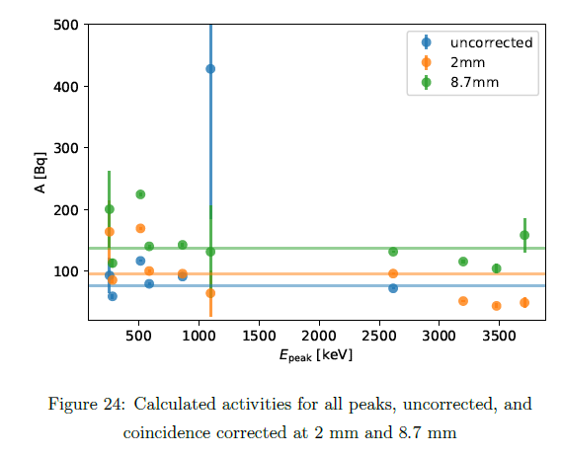
Result
3 Blue dots at 1000s of Bq
Uncorrected activity: 76.4 ± 5 Bq
Corrected activity: 96 ± 7.6 Bq
≈+25%
Last 3 points much better fit
4 000 - 80 000 Bq → ≈50 Bq
8.7 mm was minimal std dev. of activity
(not realistic distance)

Slide 11
Possible further research
Sample self-absorption (significant at low energies)
Better distance dependence (exact solid angle)
Simulate dead layer of detector
Calculate activity for all isotopes
Simulate readout
Simulation validation with experiment

Slide 12
Thank you for your attention

