Slide 1
Cross-National Differences in Market Response Line-Length, Price, and Distribution Elasticities in Fourteen Indo-Pacific Rim Economies
Hannes Datta
Harald van Heerde
Marnik Dekimpe
Jan-Benedict Steenkamp
Paper (open access): https://doi.org/10.1177/00222437211058102

Slide 2
Emerging economies account for 3/5th of world gdp
63.1
57.9
36.9
42.1
Source: IMF 2022, based on World Economic Outlook (April 2022), retrieved from https://www.imf.org/external/datamapper/PPPSH@WEO/OEMDC/ADVEC?year=1990&yaxis=lin

Slide 3

What do we know about market-response parameters in emerging markets?
Most research on marketing effectiveness focused on developed world & CPGs
Bijmolt, Van Heerde, Pieters (JMR 2005)
Sethuraman, Tellis, Briesch (JMR 2011)
Limited research on marketing effectiveness in emerging countries
Clashing conceptual discussions
Very little systematic empirical research (except Bahadir et al. 2015 in 4 soft drink markets)

Slide 4
Problem context
Knowledge of the effectiveness of marketing instruments is crucial for developing marketing strategies
Price elasticities are widely studied… but 96% of the price elasticities are derived from the North-Atlantic region, albeit other regions, especially Indo-Pacific Rim have become increasingly dominant
Much less is known about distribution and line length

Slide 5
Research questions
What are the effects of line length, price, and distribution on brand sales?
Are there systematic cross-national differences in line-length, price, and distribution elasticities, and if so, what is their magnitude?
Which brand, category, and country factors influence the variation in line-length, price, and distribution elasticities?
Controlling for brand and category factors, are there systematic differences in marketing responsiveness between emerging and developed economies?

Slide 6
Study framework
Brand Factors
Brand equity
Country of origin
Marketing intensity
Line length
Price
Distribution
Innovativeness
Category Factors
Market concentration
Market growth
Type of product
Brand Elasticities
Line length
Price
Distribution
Country Factors
Economic
Market size
GDP per capita
GDP growth
Income inequality
Cultural
Power distance
Uncertainty avoidance
Masculinity*
* based on Hofstede’s traditional gender-role descriptions.

Slide 7

Empirical setting
Data: GfK (monthly SKU-level data; 2004-2014)
14 countries: Southeast Asia & Australasia
14 categories: Electronics & Appliances
1600+ market-brands (329 unique)
Model for a brand’s sales
price
distribution line length
Comparisons by...
marketing-mix instrument
characteristics of the brand, category and country
marketing-mix elasticities

Slide 8
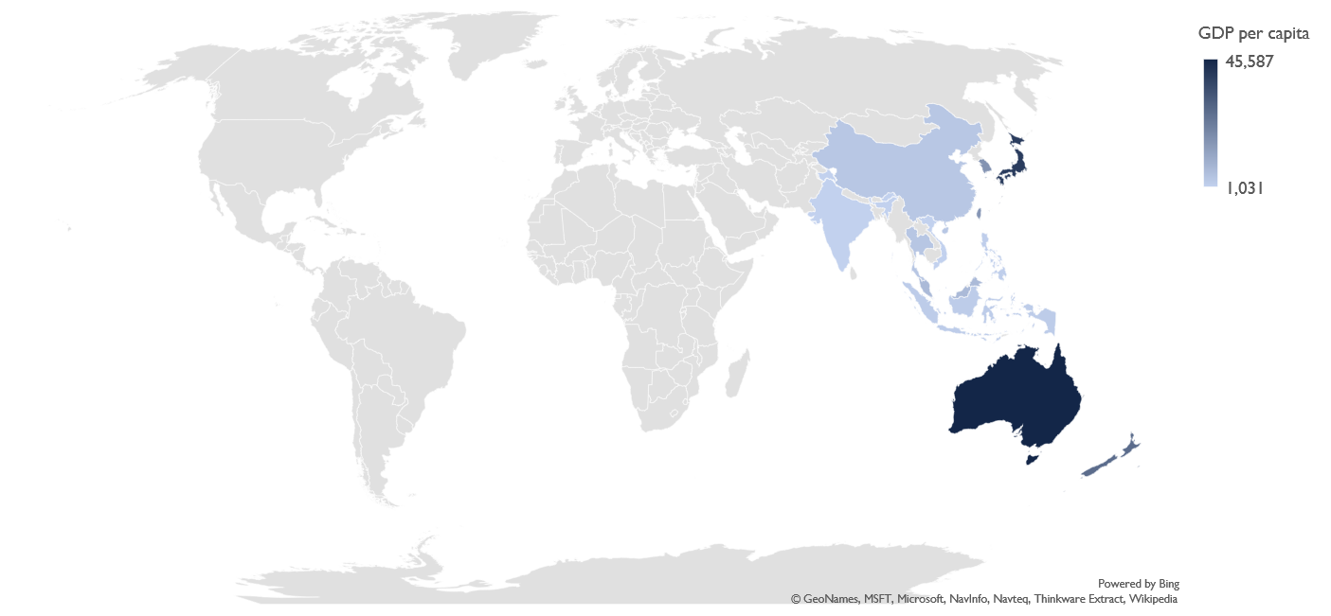
Our data covers ~47% OF world population and ~30% of world GDP
GDP per capita
Seven developed economies
Australia, Hong Kong, Japan, New Zealand, Singapore, South Korea, and Taiwan
Seven emerging economies
China, India, Indonesia, Malaysia, the Philippines, Thailand, and Vietnam

Slide 9
Countries vary on Economic and cultural indicators
Country | Market size (mil.) | GDP per capita ($) | GDP growth (%) | Income inequality | Power distance | Uncertainty avoidance | Masculinity*
Australia | 21.77 | 42,025 | 2.75 | 34.7 | 38 | 51 | 61
China | 1,333.94 | 8,970 | 8.8 | 42.2 | 80 | 30 | 66
Hong Kong | 6.98 | 47,502 | 3.34 | 53.7 | 68 | 29 | 57
India | 1,212.78 | 3,847 | 9.2 | 35.1 | 77 | 40 | 56
Indonesia | 238.64 | 6,814 | 10.58 | 39.5 | 78 | 48 | 46
Japan | 127.12 | 34,725 | 0.48 | 32.1 | 54 | 92 | 95
Malaysia | 27.64 | 19,333 | 6.36 | 43.9 | 104 | 36 | 50
New Zealand | 4.31 | 31,240 | 2.7 | 34.9 | 22 | 49 | 58
Philippines | 91.77 | 5,196 | 6.29 | 46 | 94 | 44 | 64
Singapore | 4.96 | 64,543 | 7.76 | 47.9 | 74 | 8 | 48
South Korea | 48.76 | 31,096 | 3.37 | 32 | 60 | 85 | 39
Taiwan | 23.05 | 38,977 | 2.81 | 33.6 | 58 | 69 | 45
Thailand | 66.61 | 12,031 | 5.06 | 39.4 | 64 | 64 | 34
Vietnam | 87.66 | 3,970 | 8.45 | 39.3 | 70 | 30 | 40
Notes: Color scales: from low (light blue) to high (dark blue). * based on Hofstede’s traditional gender-role descriptions.

Slide 10
Broad coverage of product categories and brands
Category | Category type | Number of countries with data | Number of brands | Top 3 brands
Compact cameras | Electronics | 13 | 21 | Canon, Sony, Samsung
CRT TVs | Electronics | 13 | 65 | Sampo, Samsung, LG
Desktop computers | Electronics | 11 | 27 | Samsung, NEC, Fujitsu
DVD players and recorders | Electronics | 14 | 129 | Arirang, AJ, California
Laptop computers | Electronics | 12 | 20 | NEC, Acer, LG
LCD TVs | Electronics | 14 | 47 | Samsung, LG, Sony
Microwaves | Appliances | 13 | 51 | Galanz, Sampo, American Home
Mobile phones | Electronics | 14 | 55 | Nokia, Samsung, Sharp
Plasma TVs | Electronics | 14 | 46 | Samsung, LG, Sony
Refrigerators | Appliances | 13 | 54 | Zipel, Dios, Westinghouse
SLR cameras | Electronics | 13 | 5 | Canon, Nikon, Sony
Smartphones | Electronics | 14 | 13 | Samsung, Sharp, Apple
Tablets | Electronics | 11 | 3 | Samsung, Apple, Taiwan Mobile
Washing machines | Appliances | 13 | 67 | Tromm, Simpson, LG

Slide 11
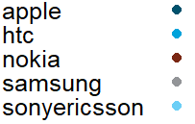
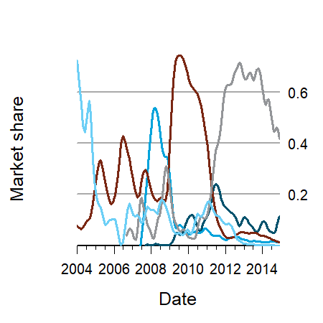
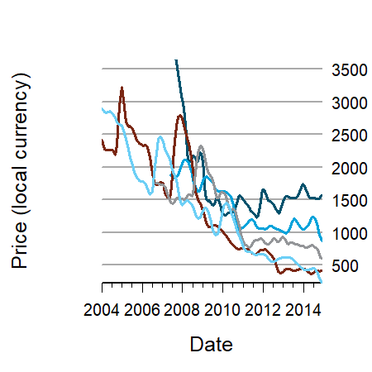
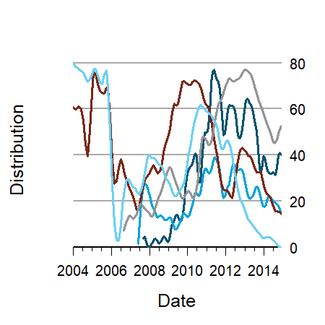
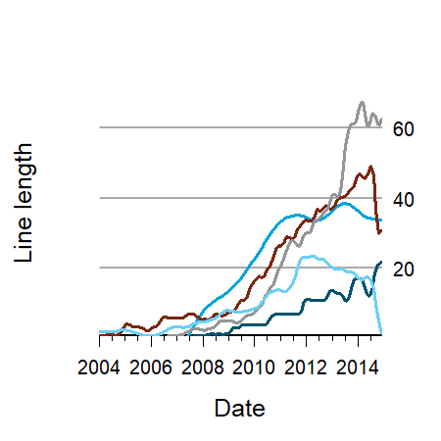
Detailed Metrics for1600+ brands
Example category: Smartphones in Malaysia (top 5 brands)
For each brand up to 11 years of monthly data on:
Volume share: Unit sales divided by total sales
Price: Sales-weighted average price (most recent quarter), in local currency (deflated by country-specific consumer price indices)
Distribution: Sales-weighted and store-weighted distribution (0 to 100; 100 = full market coverage)
Line length: No. of unique SKUs
Advertising: for China & Hong Kong (used as a robustness check)
Plots smoothened using spline functions.

Slide 12
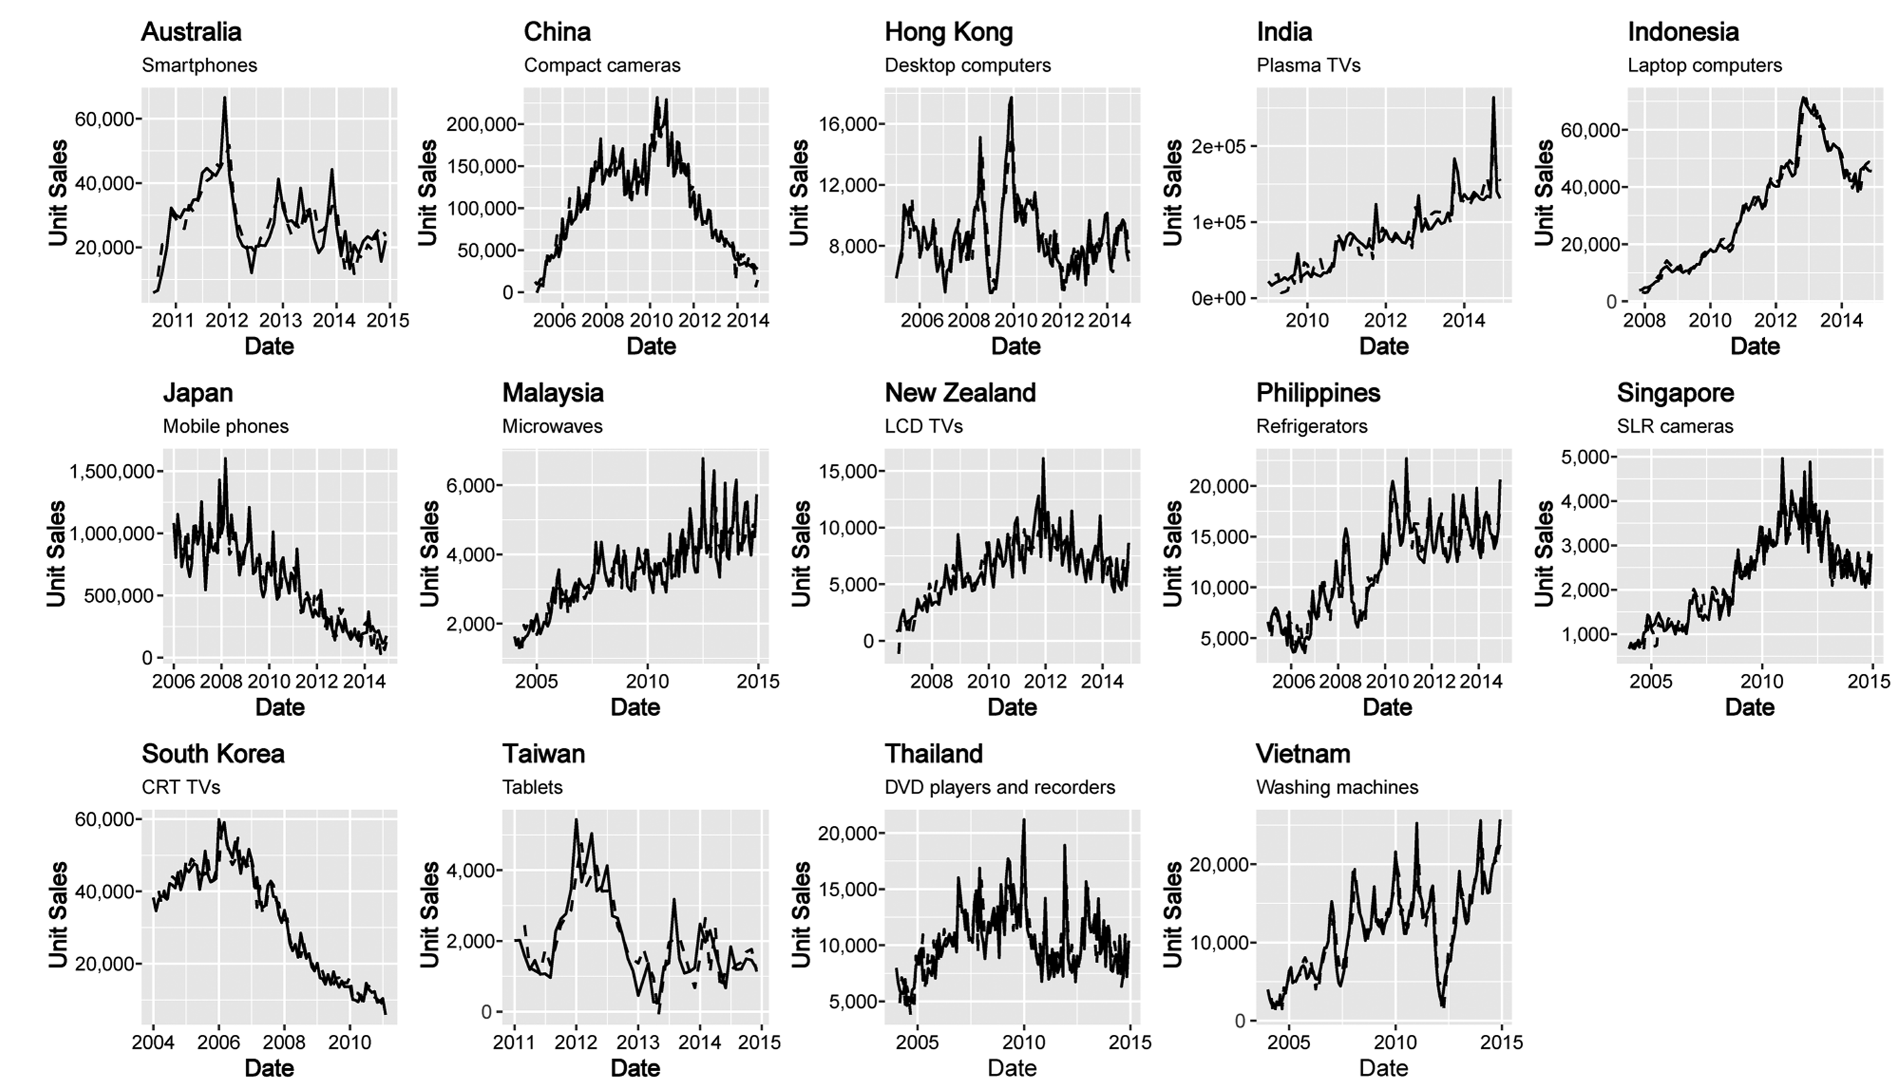
Variation across 14 countries and 14 categories

Slide 13
Method
Estimation of MM elasticities with error-correction model
Estimates long-term effects
Accounts for competitive effects
Controls for seasonality
Regression of MM elasticities on brand characteristics, category characteristics, and/or country characteristics
Explores how MM elasticities vary

Slide 14
Estimated (long-term) Elasticities across countries
Country | N | Line length | Price | Distribution
Australia | 146 | .315 | -.352 | .419
China | 134 | .420 | -.605 | .383
Hong Kong | 133 | .471 | -.468 | .411
India | 80 | .273 | -.321 | .137
Indonesia | 122 | .732 | -.767 | .371
Japan | 98 | .261 | -.262 | .305
Malaysia | 127 | .510 | -.406 | .441
New Zealand | 79 | .405 | -.483 | .624
Philippines | 129 | .448 | -.161 | .400
Singapore | 118 | .588 | -.400 | .457
South Korea | 70 | .440 | -.559 | .294
Taiwan | 149 | .552 | -.377 | .255
Thailand | 125 | .472 | -.531 | .441
Vietnam | 107 | .513 | -.217 | .414
Total | 1,617 | 0.459 | -0.422 | 0.368
Notes: Color scales: from low (light blue) to high (dark blue). Reversed for price.

Slide 15
Comparing Elasticities Across countries
Notes: Countries shown in decreasing order of total marketing-mix responsiveness.

Slide 16
Factors affecting long-term elasticities
Predictors of Marketing-Mix Elasticities¹
 | Line-length elasticity | Price elasticity | Distribution elasticity
Brand Equity | -.028 | -.145*** | -.018
Country Of Origin Image | .049 | -.075 | .031
Log Avg Line Length | -.010 | .020 | -.071**
Log Avg Price | -.055 | .016 | .023
Log Avg Distribution | -.056 | .023 | .010
Log Avg Innovativeness | .058 | .207 | .111*
Log Market Concentration | .116* | .033 | .025
Log Market Growth | .011 | -.106 | .147***
Appliances (versus Electronics) | -.234*** | -.001 | -.019
Log Market Size | -.020 | -.121*** | -.023
Log GDP per Capita | .047 | -.199*** | -.028
Log GDP Growth | .094*** | -.076 | .006
Log Income Inequality | .020 | -.769*** | .419
Log Power Distance | .147** | .257*** | -.175**
Log Uncertainty Avoidance | .043 | -.102 | -.013
Log Masculinity | -.071 | .353** | -.005
Constant | .509*** | -.376*** | .371***
Observations | 1,616 | 1,617 | 1,617
¹ Significance levels: * p < .10, ** p < .05, *** p < .01 (two-sided). Elasticities are winsorized at the 1% and 99% levels, and weighted by inverse standard errors.

Slide 17
Discussion

Slide 18
Price elasticities are relatively small
Average price elasticity of -.422 much lower than past meta-analyses (Bijmolt et al. JMR 2005). Why?
Our price elasticities are estimated at the national level, not chain or store level. National-level elasticities are likely lower than chain-level ones, given that they are not affected by within-brand store switching
Publication bias; studies with nonsignificant or mixed price elasticities may be underrepresented in published work
Several more recent papers that analyze large numbers of categories find considerably lower price elasticities
86% of the price elasticities in Bijmolt, van Heerde, and Pieters (2005) are based on North American data. Might the U.S. respond more strongly to price than the Indian-Pacific Rim countries?

Slide 19
Price elasticities stronger for high equity brands
Price pattern for electronics: start high, decrease over time and at specials
Hence price elasticity represents response to price decreases
High equity brands are highly sought after but out of financial reach for many consumers
If a high equity brand reduces its price, there is a strong demand response, and hence a strong (more negative) price elasticity

Slide 20
Price sensitivity higher in richer countries
Country | Price-quality schema in CPG
Argentina | 3.45
Austria | 2.73
Belgium | 2.87
Brazil | 3.16
China | 3.45
Czech Rep. | 3.19
Denmark | 2.69
France | 2.97
Germany | 2.72
Hungary | 3.16
India | 3.37
Italy | 2.95
Japan | 3.11
Netherlands | 2.71
Norway | 2.94
Poland | 3.37
Portugal | 2.85
Romania | 3.57
Russia | 3.55
Slovakia | 3.14
Spain | 3.02
Sweden | 3.02
Switzerland | 2.73
Taiwan | 3.27
Thailand | 3.39
Ukraine | 3.56
United Kingdom | 2.97
United States | 2.80
Average price sensitivity is larger (i.e., price elasticity more negative) in richer countries. Why?
Richer consumers have the financial means to act on price discounts
In richer countries, price is less seen as indicator of quality (see table). Hence lower prices do not create quality concerns in richer countries.

Slide 21
Role of Societal stratification
Societal stratification (power distance & income inequality) is the most important phenomenon for explaining cross-national differences in marketing-mix elasticities
Power Distance only factor affecting all three MM elasticities.
Power Distance enhances line length elasticity yet reduces role of price and distribution
Power Distance results are in line with a strong focus on displaying status through product possession in high power distance countries.
Price sensitivity is considerably lower in masculine countries such as Japan. In these countries, the ability to afford high prices, as a measure of success and achievement is relatively more pronounced.

Slide 22
Favorable Country-of-origin (COO) image
Country of Origin: 1 if a brand’s headquarter is located in the U.S., Japan, Germany, Switzerland or Sweden, 0 if not
Favorable COO does not affect effectiveness of marketing. Why?
Does brand equity eliminate the COO effect? But without BE, also no effect
Might strong COO effects in experimental studies and surveys be a method artifact?
Or does the country of manufacturing matter more than COO?

Slide 23
No differences between emerging & developed economies
We find no systematic differences between emerging and developed economies on market responsiveness. Why?
Distinction too crude? China ≠ India
Countervailing influences, e.g., emerging economies on average have lower incomes (increases price sensitivity) and higher power distance (decreases price sensitivity)

Slide 24
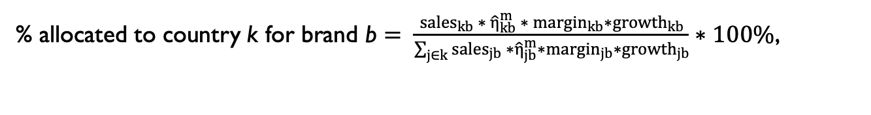
Illustrative application Expenditure allocation based on distribution elasticities
% allocated to country k for brand b $= \frac{sales_{kb} ∗ {\hat{η}}_{kb}^{m} ∗ margin_{kb}∗growth_{kb}}{\sum_{j∈k}{{sales}_{jb} ∗{\hat{η}}_{jb}^{m}∗margin_{jb}}∗growth_{jb}}∗100\%$,
 |  |  |  |  |  |  | Allocation rule
Country | Unit sales | Unit sales | Distribution elasticity | Distribution elasticity | Expected brand growth index | Expected brand growth index | Unit sales (%) | Distribution elasticity (%) | “Optimal” (%)
Australia | 10,282 | 10,282 | .346 | 0.346 | 1.095 | 1.095 | 4.7 | 9.7 | 6.3
China | 25,008 | 25,008 | .337 | 0.337 | 1.153 | 1.153 | 11.4 | 9.4 | 15.6
Hong Kong | 1,297 | 1,297 | .472 | 0.472 | 1.064 | 1.064 | 0.6 | 13.2 | 1.0
India | 82,089 | 82,089 | .206 | 0.206 | 1.049 | 1.049 | 37.6 | 5.7 | 28.5
Indonesia | 19,174 | 19,174 | .301 | 0.301 | 1.177 | 1.177 | 8.8 | 8.4 | 10.9
Malaysia | 8,994 | 8,994 | .280 | 0.28 | 1.136 | 1.136 | 4.1 | 7.8 | 4.6
Philippines | 3,424 | 3,424 | .411 | 0.411 | 1.213 | 1.213 | 1.6 | 11.5 | 2.7
Singapore | 3,787 | 3,787 | .381 | 0.381 | .993 | 0.993 | 1.7 | 10.6 | 2.3
South Korea | 31,448 | 31,448 | .224 | 0.224 | 1.006 | 1.006 | 14.4 | 6.2 | 11.4
Thailand | 25,929 | 25,929 | .299 | 0.299 | .971 | 0.971 | 11.9 | 8.3 | 12.1
Vietnam | 7,125 | 7,125 | .331 | 0.331 | 1.218 | 1.218 | 3.3 | 9.2 | 4.6

Slide 25
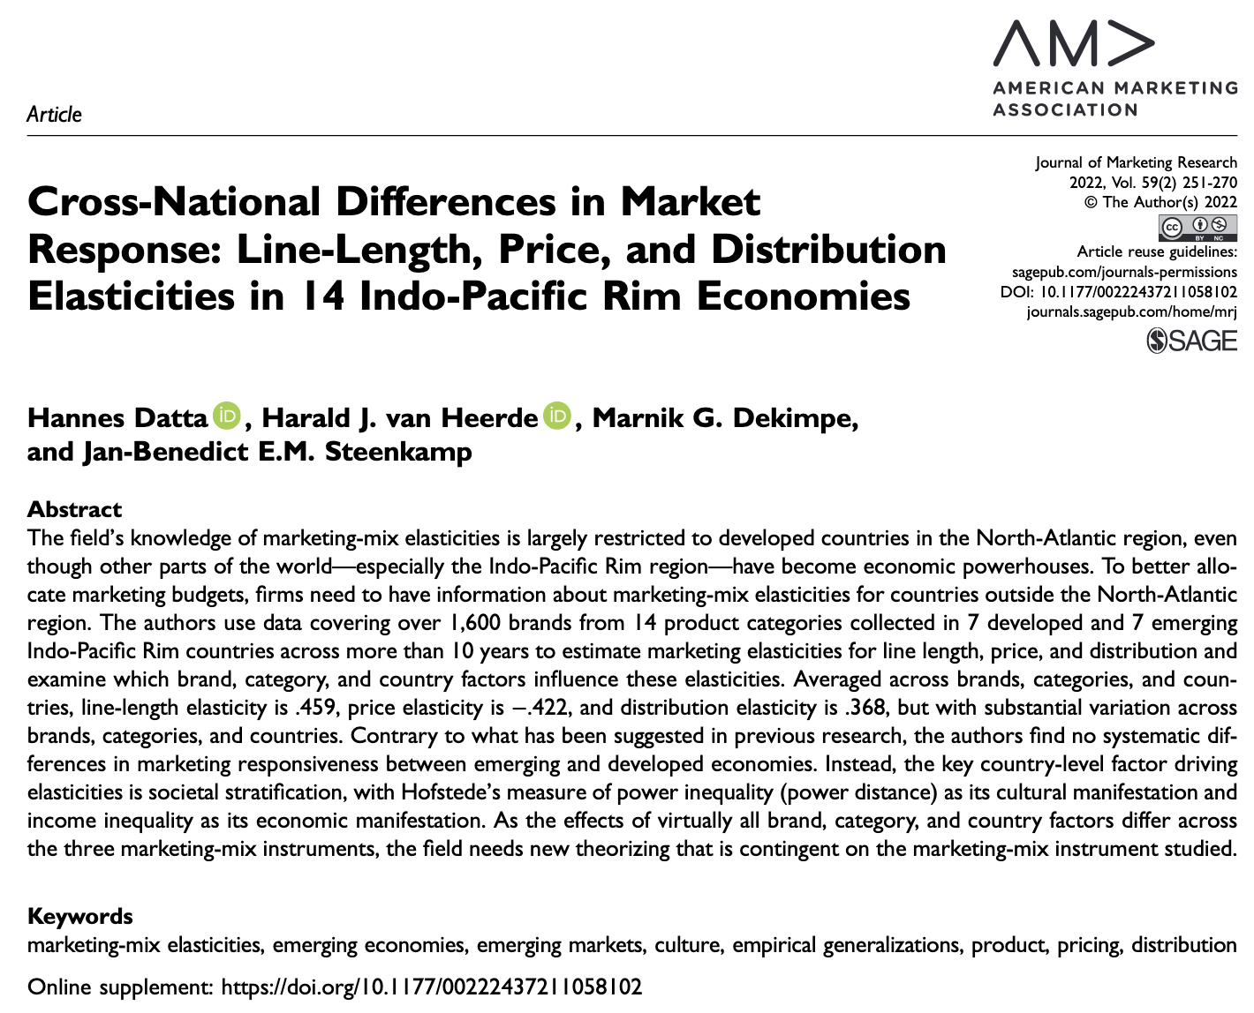

Thanks!
Paper (open access): https://doi.org/10.1177/00222437211058102
Replication package: https://github.com/hannesdatta/marketingmix-journal-of-marketing-research (archived at https://doi.org/10.34894/EVPJTY)

Slide 26
