Slide 1


Reconsidering the marketing analytics curriculum
Focusing on (open science) skills to succeed on the job market
Hannes Datta
Tilburg University

Slide 2
Motivation
Integration of analytics at business schools is challenging (Kurtzke and Setkute 2021)
essential to stay relevant
unlikely to be achieved easily (e.g., single course, introducing tools)
Strategic decision to re-brand and develop Tilburg’s “Marketing Analytics program”
Re-branding (research → analytics) & dedicated academic director
Gradually develop and introduce new content
Grow from 25 to 125 students per year
This presentation
Sharing experiences, challenges, and full course materials
Seeking to build a community – talk to me, drop an email, contribute material (e.g., Tilburg Science Hub)
Will share presentation + all relevant links/materials

Slide 3
Disclaimer
I’m just one of many teachers in Tilburg’s marketing analytics program
I’m new to the marketing education community
It’s not all my own stuff – sought inspiration from many (both inside and outside of marketing)
I may not have satisfactory solutions to all challenges (but would love to get your feedback!)

Slide 4
Developing the Marketing Analytics Curriculum

Slide 5
Design principles
Student requirements
Faculty requirements
Introduce and make directly usable a wide range of coding tools (e.g., R, Python)
Train on large, real-life data sets
Complement existing curriculum
Build on existing content where possible & allow for scalability
Incorporate and maintain content easily
Generate synergies between teaching and research

Slide 6
Developing the Marketing Analytics Curriculum
Marketing analytics involves collection, management, and analysis […] of data to obtain [marketing] insights […]”
(Wedel and Kannan 2016)
Notes:
Add animation that many courses are offered only around these

Slide 7
Developing the Marketing Analytics Curriculum
Marketing analytics workflow
Marketing analytics involves collection, management, and analysis […] of data to obtain [marketing] insights […]”
(Wedel and Kannan 2016)
Data collection
Data exploration
Data
preparation
Analysis
Reporting and deployment
Notes:
Add animation that many courses are offered only around these

Slide 8
Developing the Marketing Analytics Curriculum
Marketing analytics workflow
Marketing analytics involves collection, management, and analysis […] of data to obtain [marketing] insights […]”
(Wedel and Kannan 2016)
Data collection
Data exploration
Data
preparation
Analysis
Reporting and deployment
Notes:
Add animation that many courses are offered only around these

Slide 9
Developing the Marketing Analytics Curriculum
Marketing analytics workflow
Marketing analytics involves collection, management, and analysis […] of data to obtain [marketing] insights […]”
(Wedel and Kannan 2016)
Data collection
Data exploration
Data
preparation
Analysis
Reporting and deployment
Notes:
Add animation that many courses are offered only around these

Slide 10
Developing the Marketing Analytics Curriculum
Marketing analytics workflow
Data collection
Data exploration
Data
preparation
Analysis
Reporting and deployment
Challenge 1
Cover all steps in the marketing analytics workflow
Notes:
Add animation that many courses are offered only around these

Slide 11
Developing the Marketing Analytics Curriculum
Way of working
Code
Marketing analytics workflow
Data collection
Data exploration
Data
preparation
Analysis
Reporting and deployment
Collaborate
Automate
Challenge 1
Cover all steps in the marketing analytics workflow
Notes:
Add animation that many courses are offered only around these

Slide 12
Developing the Marketing Analytics Curriculum
Way of working
Code
Marketing analytics workflow
Data collection
Data exploration
Data
preparation
Analysis
Reporting and deployment
Collaborate
Automate
Challenge 1
Cover all steps in the marketing analytics workflow
Challenge 2
Professionalize project management
Notes:
Add animation that many courses are offered only around these

Slide 13
Developing the Marketing Analytics Curriculum
Way of working
Code
Marketing analytics workflow
Data collection
Data exploration
Data
preparation
Analysis
Reporting and deployment
Collaborate
Automate
Challenge 1
Cover all steps in the marketing analytics workflow
Challenge 2
Professionalize project management
Challenge 3
Embracing a diverse student population
Notes:
Add animation that many courses are offered only around these

Slide 14
Challenge 1
Cover all steps in the marketing analytics workflow

Slide 15






Web scraping and APIs
20% of all marketing studies in top 5 marketing journals in 2020 were based on web data (Boegershausen et al. 2022)
Web scraping: automatically collect data from websites
APIs: official interfaces w/ databases of firms, obtain data programmatically
Technical skills vastly documented, but inaccessible to starters (e.g., lack of Python training)
“Conceptual” thinking about web data not commonplace
How to select websites or APIs for research projects?
What are important design decisions in building web scrapers? (e.g., sampling)
How to monitor data collections while there are running to ensure the collected data is valid?

Slide 16







Highly versatile data collection technique for marketers
Studying new phenomena
Boosting ecological value
Pathway ①
Pathway ②
e.g., Zervas et al. (2017); Datta et al. (2018)
e.g., Du et al. (2015); Ludwig et al. (2013)
Facilitating methodological advancement
Improving measurement
Pathway ③
Pathway ④
e.g., Netzer et al. (2012); Liu et al. (2020)
e.g., Li et al. (2017); Datta et al. (2022)

Slide 17
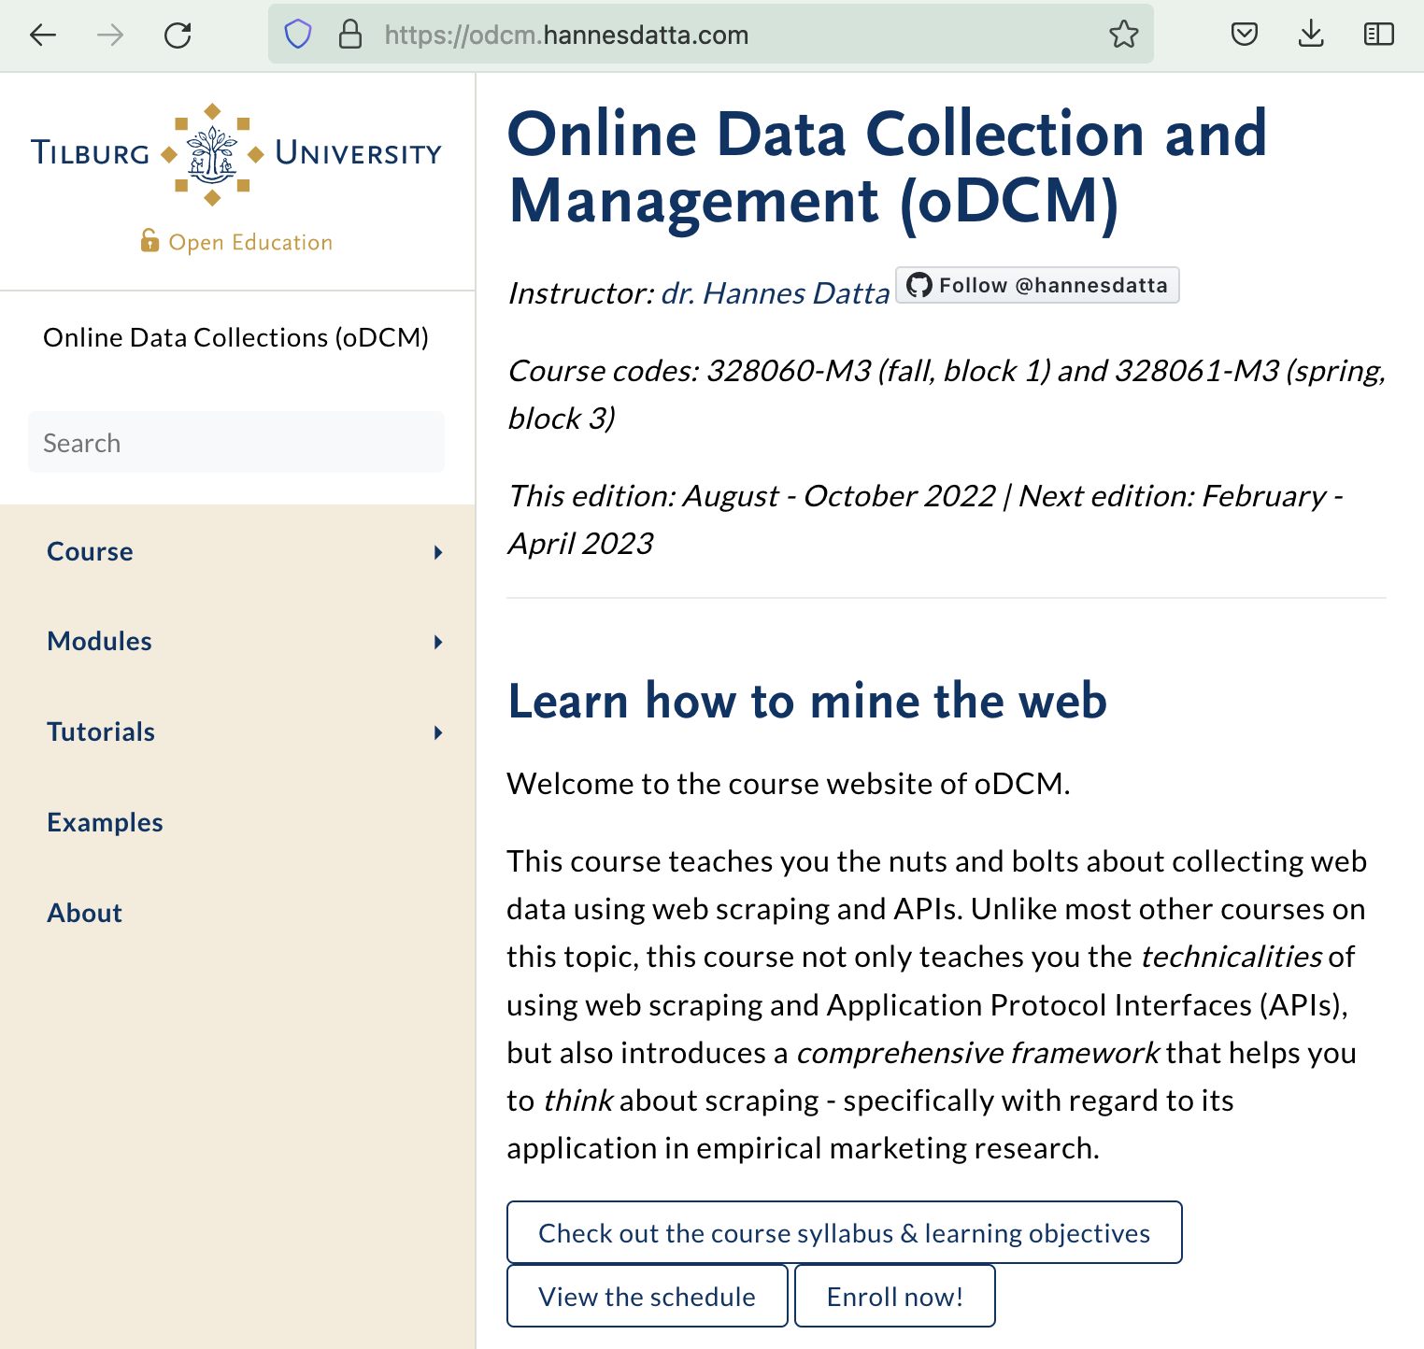
From zero to hero…
Developed “Online Data Collection and Management” (3 ECTS, 7-week course)
Five self-paced (technical) tutorials on web scraping and APIs in Google Colab
Team project to collect web data for marketing insights (e.g., reddit, kayak, bol.com) + coaching sessions
Taught fully on Zoom initially; course material and code is open source and available at https://odcm.hannesdatta.com
Obtain synergies between teaching and research
Used classroom to test & develop paper, now forthcoming at the Journal of Marketing
Developed searchable database of web data papers in marketing (https://web-scraping.org)
Tested and piloted documentation templates, solving typical challenges in scraping, etc.
Code from student projects publicly available at Zenodo

Slide 18
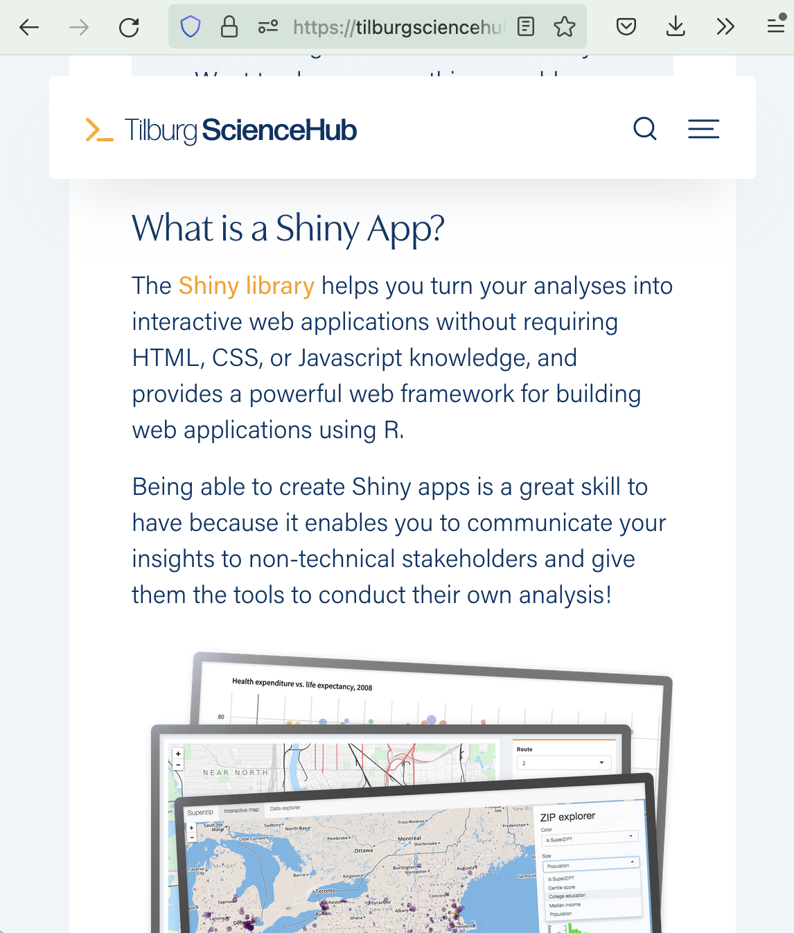
Reporting and deployment
Much of what we do stops with printing out a regression table or writing a report
Let’s teach novel ways of deploying insights
How to illustrate research findings using an app
Publish e-books and interactive articles
Operate own APIs for marketing insights

Slide 19
Challenge 2
Professionalizing project management for empirical research

Slide 20
Limited focus on “way of working”
Maintaining code and files
Unfamiliarity with coding conventions
No experience with file and directory management
Using industry best practices
Versioning code (e.g., Git)
Automation of research pipelines (e.g., make)
Project management techniques
Keeping notes, tracking progress, organizing meetings (e.g., Scrum)

Slide 21
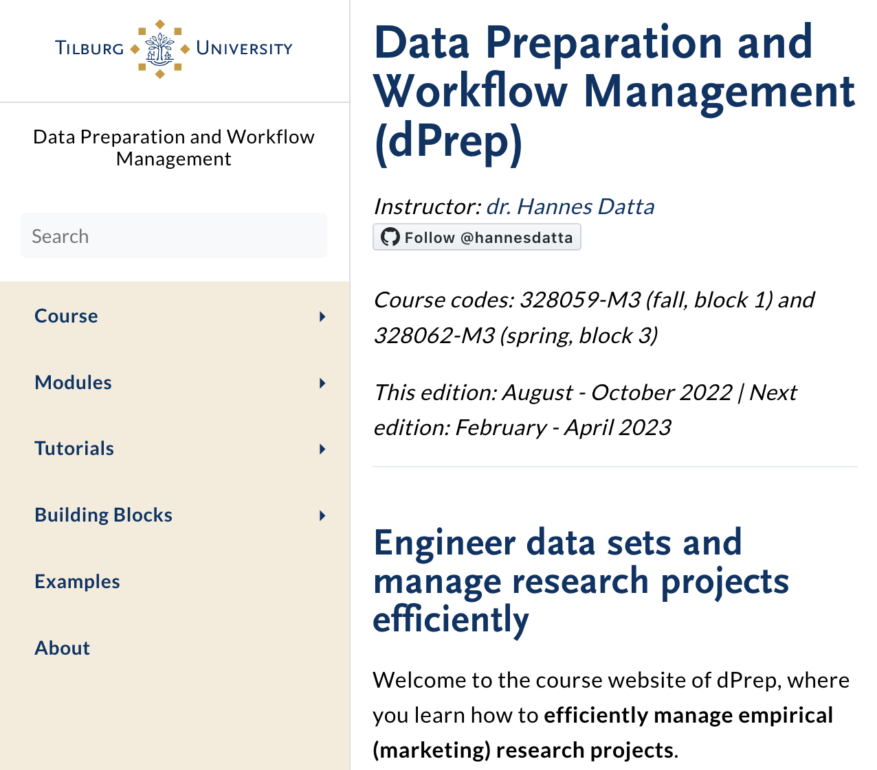
From zero to hero…
Developed “Data Preparation and Workflow Management” (3 ECTS, 7-week course)
Maintaining code and files; inspired by Gentzkow’s and Shapiro’s “Code and Data for the Social Sciences” (2014)
Project management using the Scrum method
Usage of version control with GitHub
Automating research pipelines (re-run code repeatedly)
Material openly available at https://dprep.hannesdatta.com
Synergies between teaching and research
Onboarding made easier for colleagues and coauthors
Porting content to https://tilburgsciencehub.com, “code snippets” to use in research projects

Slide 22
Challenge 3
Embracing a diverse student population

Slide 23
Skill diversity
Some students enter well-trained; others have limited to no experience with coding
Minimize student setup costs
Cloud-based Jupyter Notebooks (e.g., colab.google.com)
Sharing interactive code snippets w/ comments (e.g., gist.github.com)
Recorded installation tutorials (e.g., youtube.com/c/hannesdatta)

Slide 24
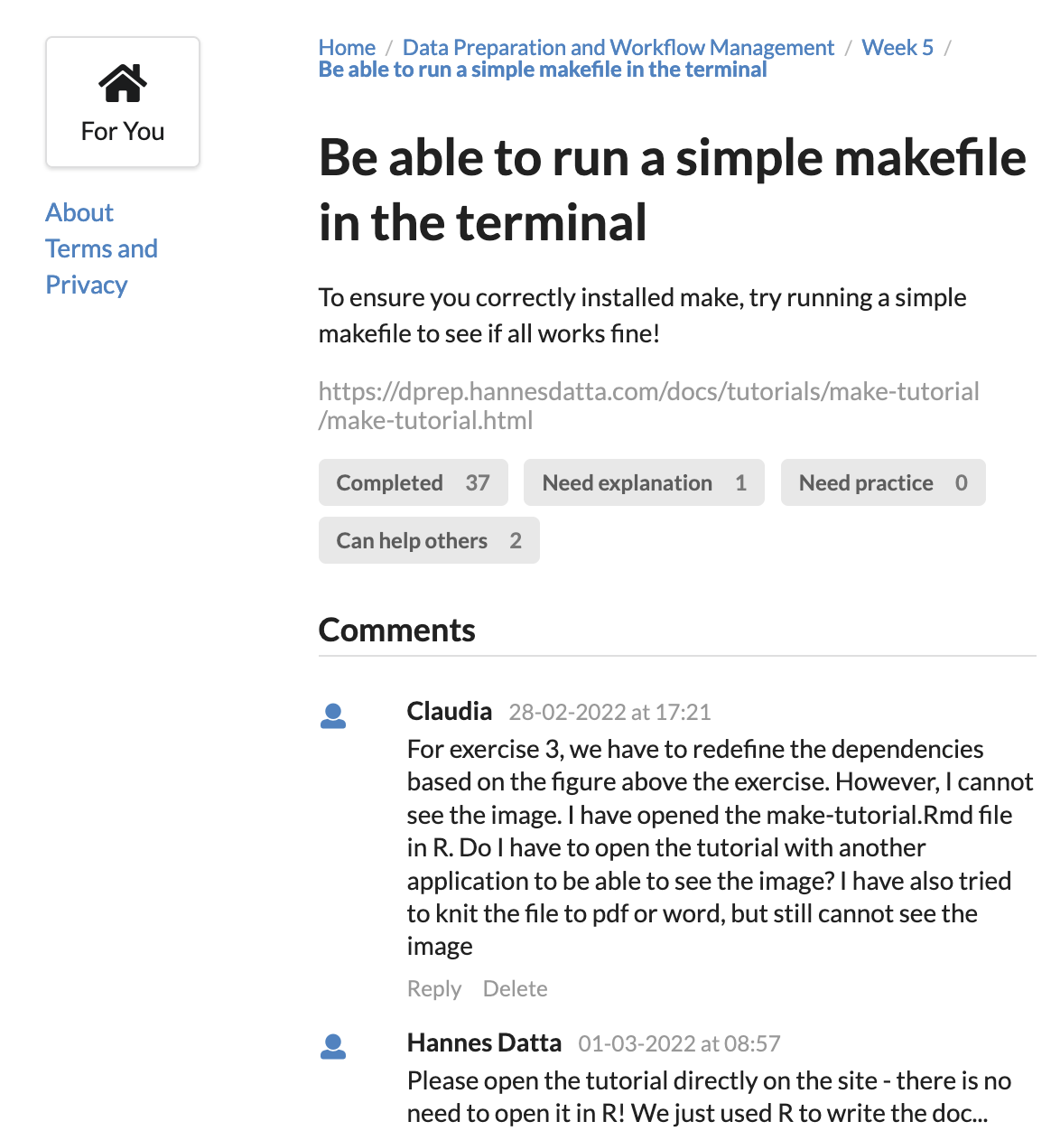
Managing Engagement using Pulse
Track learning progress with a (self-developed) web app
Students “tick off” weekly to do’s
Can view each others learning progress in a leaderboard
Teacher knows how far students have advanced (at any moment)
Ability to target students for extra coaching or advanced material

Slide 25
Next steps
Building an open science community in marketing
Share and make teaching methods & material broadly accessible
Open can range from sharing syllabi to sharing entire courses
Manage student engagement and workload
Further develop tool to track students’ learning progress
Tackle lower-tier student motivation
Manage expectations and deal w/ mismatch with previous skills
Keep on investing into new skills (and tell others about how it works)
Docker for reproducible research
Cloud computing to solve research- and teaching bottlenecks

Slide 26
Summary
Shared experience of teaching Marketing Analytics at Tilburg
Discovered opportunities to integrate teaching in research (and vice versa)
Provide a foundation for developing own (open access) classes
https://odcm.hannesdatta.com (Online Data Collection and Management)
https://dprep.hannesdatta.com (Data Preparation and Workflow Management)
tilburgsciencehub.com

Slide 27

Thanks.
hannesdatta.com
tilburgsciencehub.com
web-scraping.org

Slide 28
BACKUP SLIDES

Slide 29
Developing the Marketing Analytics Curriculum
Way of working
Code
Marketing analytics workflow
Data collection
Data exploration
Data
preparation
Analysis
Reporting and deployment
Collaborate
Automate
Challenge 1
Cover all steps in the marketing analytics workflow
Challenge 2
Professionalize project management
Challenge 3
Embracing a diverse student population
Notes:
Add animation that many courses are offered only around these

Slide 30



Websites vs. APIs
Web Scraping
… the process of developing software to automatically collect information displayed in a web browser
…extract data at scale from a firm’s official databases, using Application Programming Interfaces
EXAMPLE SOURCES
EXAMPLE SOURCES
Example articles: Chevalier and Mayzlin (2006); Ludwig et al. (2013)
Example articles: Tellis et al. (2019); Toubia and Stephen (2013)

Slide 31
Design principles
Student requirements
Faculty requirements
Introduce and make directly usable a wide range of coding tools (e.g., R, Python)
Train on large, real-life data sets
Complement existing curriculum
Build on existing content where possible & allow for scalability
Incorporate and maintain content easily
Generate synergies between teaching and research
Developed two new classes (source code on GitHub)
https://odcm.hannesdatta.com (Online Data Collection and Management)
https://dprep.hannesdatta.com (Data Preparation and Workflow Management)
Developed tilburgsciencehub.com (joint initiative at the school)
visited by 4,000 monthly users, covering dozens of code snippets and 10+ research productivity tutorials

