Slide 1
SharePoint 2013 Design Manager Tutorials
Add an Html Master Page to SharePoint 2013 using Design Manager

Slide 2
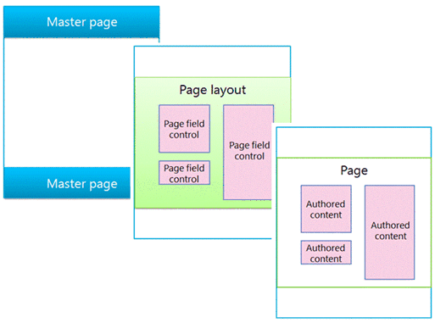
Reading assignment
SharePoint 2013 Page Model
https://msdn.microsoft.com/en-us/library/office/jj191506.aspx

Slide 3
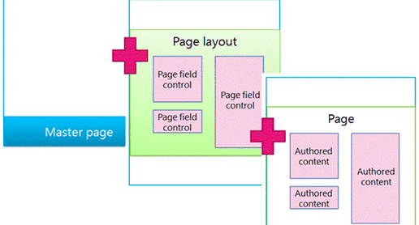
SharePoint 2013 Rendered Page

Slide 4
SP2013 Design Manager
Design Manager is a Cool new addition as it lets you Convert a simple HTML Template into a SharePoint Master Page(along with an awesome Preview functionality), Create a Layout Page, Get Code Snippets for SharePoint Components, Manage Design Templates for Search webparts and more.
With Design Manager, you can now Create a SharePoint Master Page out of a simple Html Page Template that can reuse from an existing public site or download from Internet.

Slide 5
Features & Benefits of using Design Manager
Design Manager can only be used on Publishing sites(or sites with Publishing Feature turned-on).
You can Navigate to Design Manager from Site Settings menu and from Site Settings Page under Look and Feel.
You can upload the entire Design Package using “Import Design Package” option or you can Create Design Package using “Create Design Package” option.
You can Manage Device Channels – Create and Edit Channels.
Upload an HTML Master Page and Create a minimal master page.
Create and Edit Page Layouts.
Edit Display Templates.
Change Site and System Master Page
Lets you Preview Master Pages, Layout Pages and navigate to Snippet Gallery.
Lets you get Code from Snippet Gallery(for SharePoint Components) to be added to Master Pages & Layouts.

Slide 6
Getting Started
Before you are ready to convert a general HTML Page to a html master page, you will have to prepare
Html
Css
Images
Js
And other artifacts that the design uses
For Demo Use responsive html from:
https://github.com/BlackrockDigital/startbootstrap-agency

Slide 7
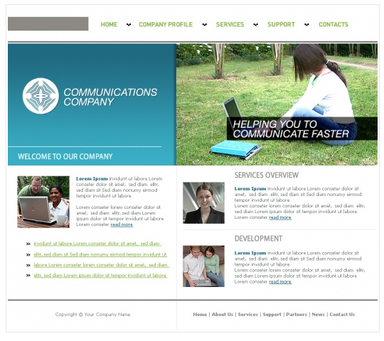
Scenario
Suppose we want to design a master page, for a page which looks like as follows step by step

Slide 8
Html Master Page
Before we begin, make sure you have your HTML template ready.
A good option is to start is to download one from Internet a starter HTML page or build your html template. Some of the free samples are Templatebox.com , a website that provides free HTML templates along with Images. Or you can also use bootstrap starter which is responsive and modern or a template of your choice. [Samples at the end of the slide]
Once you have your templates and Images upload the entire folder in your Master Page Gallery.
Easiest way to do this is to Map your Master Page gallery as a Network drive and then Copy the folder in it.

Slide 9
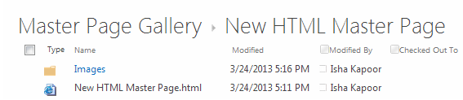
Html Master Page…
Create a new Folder “New HTML Master Page” and Copy the HTML Template and an Images folder (with Images in it) in Master Page gallery. This is how our Master Page Gallery looks like
So now we have our Template in Master Page gallery. Lets Convert it to a SharePoint Master Page.

Slide 10
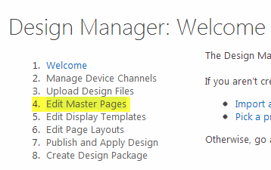
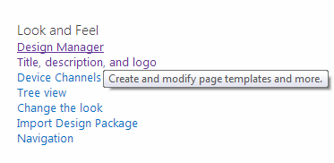
Steps
Html Master Page…
Navigate to Design Manager (Settings -> Look and Feel -> Design Manager)
In Design Manager select “4. Edit Master Pages” on the left.

Slide 11
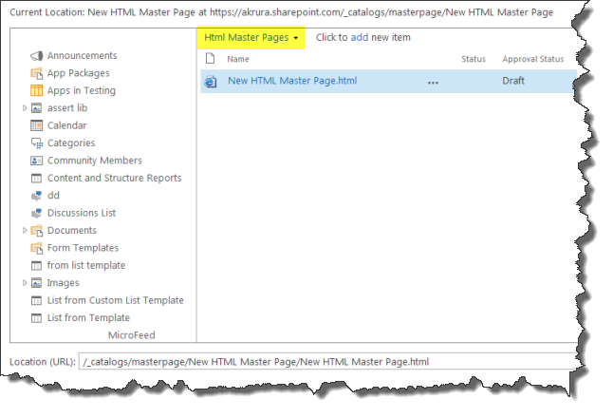
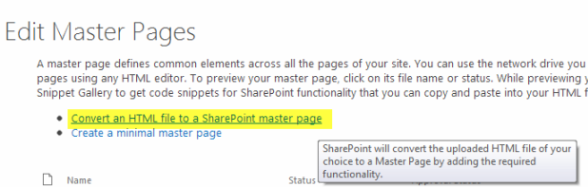
Steps
Html Master Page…
3. Next Select “Convert an HTML file to a SharePoint master page”
4. Select the new Uploaded Master Page from Master Page Gallery.

Slide 12
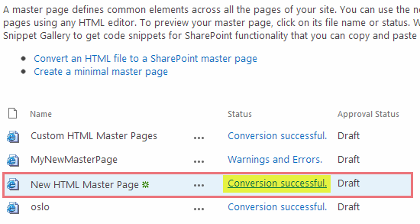
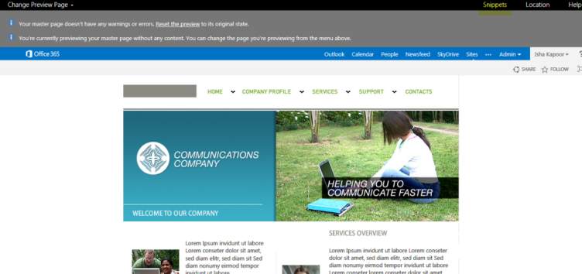
Steps
Html Master Page…
5, Once uploaded verify the status as “Conversion Successful”.
6. Next Click on Master Page itself to open the Master Page Preview window. Your Preview should look like below

Slide 13
Steps
Html Master Page…
Notice the “Snippet” at the Top. This will take you to the new Snippet Gallery where you can select a SharePoint Components such as Navigation, Search box, webparts etc. and Copy it’s Code Snippet to be added to your Master Page.
For now lets just publish the new Master Page and then in next post we will learn how to edit it to embed various SharePoint Controls in it.
7. Navigate back to the Edit Master Page in Design Manager and Select the call-up menu of the new Master Page. Publish it as a Major version and verify that the Status is “Approved”.

Slide 14
Steps
Html Master Page…
Even though we have Published this HTML Template Page and its not available as one the SharePoint Master Pages, it is not yet ready to be used as a site Master Page. You need to Open the HTML of this Master Page in a Notepad\Visual Studio\Designer and edit it to remove some of the unwanted text and Images so that the “Place Holder Main” (name=”ContentPlaceHolderMain”) is aligned in Middle (so that Every Page in SharePoint has a Master Page and a Content area).

Slide 15
Steps
Html Master Page…
To make our Master Page look nicer, we have to download the copy of this Master Page and edited it in the notepad. Remove the Service Overview, development and other Images (in the middle) and verify that only <div data-name=”ContentPlaceHolderMain”> is aligned in the center. Finally, uploaded and published it back to Master Page gallery.
8. Once you are done modifying HTML, Set this Master Page as default for your site. Go to “Publish and Apply Design” in Design Manager and Select “Assign master pages to your site based on device channel”. Next select your new Master Page as a default Site Master Page.

Slide 16
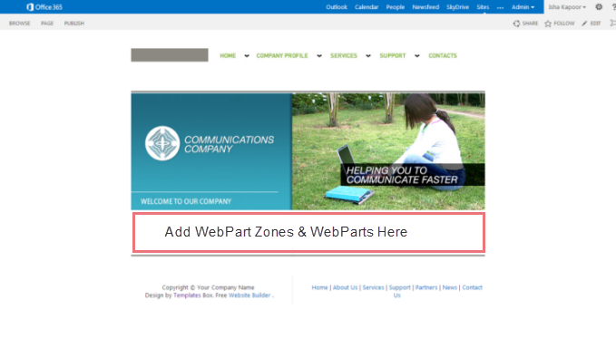
Steps
Html Master Page…
This is not the end of it, the master page needs its search, Navigation and other SharePoint Components to be ready for use. You can add these using Snippet Gallery

Slide 17
Starter Html Template
https://html5up.net/ HTML5Up site is one of the best place to find nice looking responsive starter html for our web development starter
https://startbootstrap.com/template-categories/all/ -- Startbootstrap is another place to look for the responsive starter html
http://www.w3schools.com/bootstrap/bootstrap_templates.asp one other place to look for bootstrap starter and learning place

Slide 18
Custom Page layout in SP 2013
We will use the new Design Manager to Create a Layout (from an existing one) and then edit it in one of the editors like Notepad. Once the layout is Created and Uploaded to Master Page Gallery, you can edit the generated html file in an editor of your choice and upload it back to the Master Page Gallery.
If you need to add SharePoint Field Controls or any other SharePoint Controls such as search box, navigation etc. in your custom layout, you can use the Snippet gallery to Copy the required field Control code and paste it into your custom Layout’s html file.

Slide 19
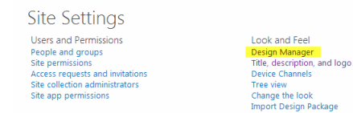
Steps to Create Page Layout
Before you begin make sure that you have Publishing Feature enabled on your site and you see “Design Manager” under Look and feel.
1. Navigate to Site Settings -> Design Manager (under look and feel).

Slide 20
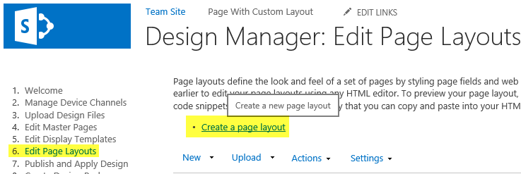
Steps…
2. Next in Design Manager select “6. Edit Page Layouts” and then “Create a page layout”
3. Now Create a Custom Page layout using the Article Page Content type.

Slide 21
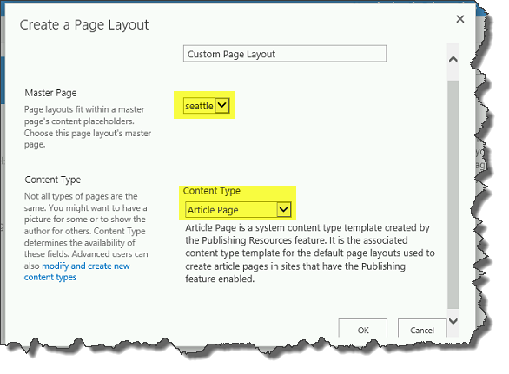

Steps…
4. When the Layout is Created, it gets available in “Edit Page Layouts” list and the “Master Page gallery” of the site. The Layout Page will be in Drafts mode until you publish it as a major version.

Slide 22

Steps…
5. Next Edit the New Layout Page and save the Changes. In SharePoint 2013 for every Layout page two files – .aspx and html are created by default.
For making Changes to the Custom Layout, you need to download the html file (see above – Custom page Layout.html) of your layout page and make Changes to it. The modified html file is then saved back to the MasterPage Page gallery where the corresponding .aspx file gets updated automatically.

Slide 23
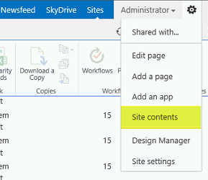
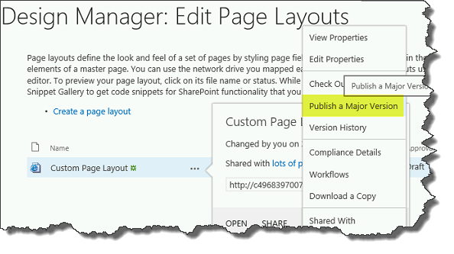
Steps…
6. Once you have updated and saved the Layout page, you need to Publish the Layout page as a major version to make it available in Layouts list.
7. Finally, Create a new Page with your Custom Layout.

Slide 24
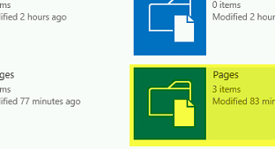
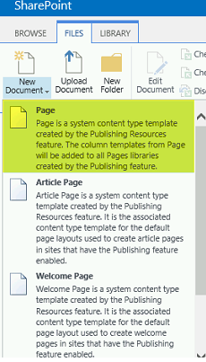
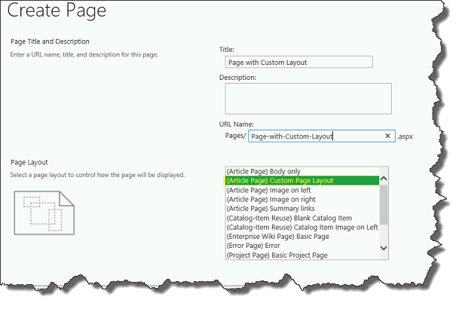
Create Pages from the new page layout
Click on Pages and the ‘FILES’ tab and select Page.
Finally Create a new Page with your Custom Layout.

Slide 25
How to add Snippets from Snippet Gallery in Master Pages & Layout Pages in SharePoint 2013
How to Edit Page Layout
In SharePoint 2013 for every Layout page two files – .aspx and html are Created by default. For making Changes to the Custom Layout, you need to download the html file of the layout page and make Changes to it.
The modified html file is then saved back to the Master Page gallery and the corresponding .aspx file gets updated automatically.
In our case below are two files created.

Slide 26
Editing Page Layouts
To work with these files you can either navigate to the Master Page gallery of your site or you can download them by Mapping the Master Page Gallery as a Network drive.
Once your download a copy of “Custom Page Layout.html” file, you can simply add\remove the desired code snippets from the file and save it.
Lets look at an example of adding a SharePoint field Control copied from the new Snippet Gallery feature into our Custom Layout page.

Slide 27
Adding Snipet to Page layout
By Definition –Snippet Gallery is a feature that lets you add SharePoint Components to your HTML or Master Page Design file. Users can select a component like Navigation or Search box from the Gallery and configure its properties. They can then copy the HTML snippet that’s generated and add it to the HTML design file\Master page. After you add SharePoint components to your HTML files, you can use CSS to fully brand them
To Open the Layout page in the Snippet Gallery click on the Custom page layout in Design Manager in “Edit Page Layout’s” list. See the screen below

Slide 28
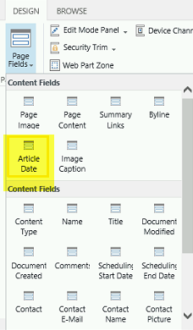
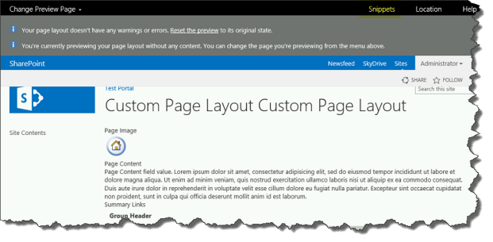
To Open a Master Page in Snippet Gallery select the Master Page from Design Manager -> “Edit Master Pages”.
When you click on the layout you will be taken to the Preview page of your layout. Click on “Snippets” top right corner. See below
Next in the “Page Field” select “Article Date” field.

Slide 29
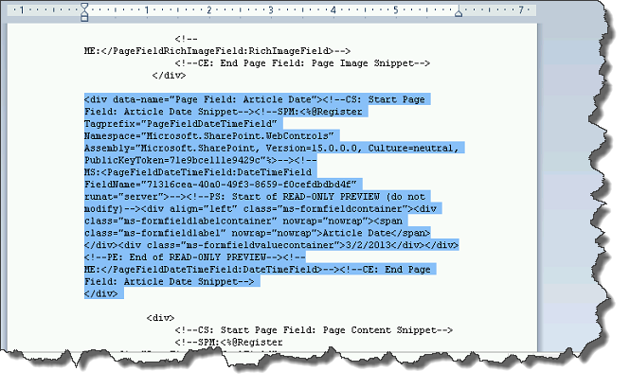
Once you select the Field, a preview of the Field and the corresponding HTML Code gets displayed. Copy the HMTL code for this field to clipboard and add it to our Layout Page’s HTML. Open the Layout Page in an editor of your choice and paste the Copied Code in it. See below

Slide 30
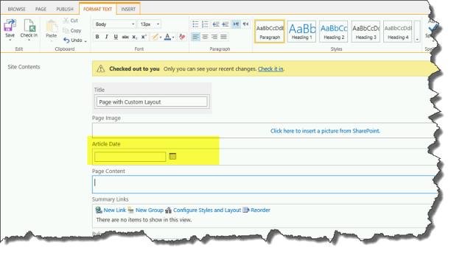
Save the Page and upload it back to Master Page Gallery.
Once the Layout is Updated you must Publish it again as a Major Version before using it.
Next Create a Page using the new Custom Layout (See Steps Here) or edit the existing Layout for a page.
Finally, Edit the page and View the Changes. Notice the “Article Date” field added to the layout of the page in the screen below.

Slide 31
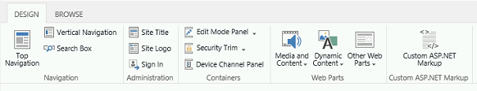
Add Navigation, Security Trimming and more Snippets in Master Page in SharePoint 2013
Editing Master Page
For a typical Master Page you can add Snippets for the following –

Slide 32
Containers –
Edit Mode Panel :To display content, including snippets, to contributing site authors only, place it inside an Edit Mode Panel. (For example, an Edit Mode Panel might contain instructions and notes for page authors.)
Show Only in Edit Mode
Show Only in Regular Mode
Security Trim :To display content only to those users who have a specified level of security permissions, you can use a Security Trim Control.
Show to Authors
Show to Authenticated Users
Show to Administrators
Device Channel Panel : A Device Channel Panel displays the content defined within it to one or more specified Device Channels. Device Channel Panels are typically used on Page Layouts to selectively hide certain regions and functionality from or show them to specified channels, and define channel-specific CSS.

Slide 33
Navigation and Administration:
Navigation – The navigation snippets provide common navigation links and menu items on a site page.
Top Navigation : The navigation snippets provide Top Navigation links.
Vertical Navigation : The navigation snippets provide Left Navigation links
Search Box: Place the search box component on your page to allow users to search your site Administration –
Site Title : This is a ‘Site Title’ Control which users with administrative permissions can change in Site Settings.
Site Logo : This is a ‘Site logo’ Control which users with administrative permissions can change in Site Settings.
Sign In : Only authenticated users can see the ribbon. To give anonymous users a way to log into your site, insert the sign in snippet, which authenticated users won’t see.

Slide 34
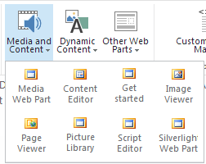
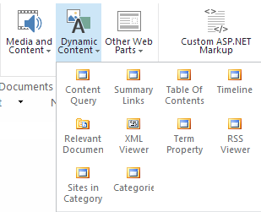
Web Parts –
Media and Content –
Media Web Part
Content Editor
Get started
Image Viewer
Page Viewer
Picture Library
Script Editor
Silverlight Web Part
Dynamic Content –
Content Query
Summary Links
Table of Contents
Timeline
Relevant Document
XML Viewer
Term Property
Rss Viewer
Sites in Category
Categories

Slide 35
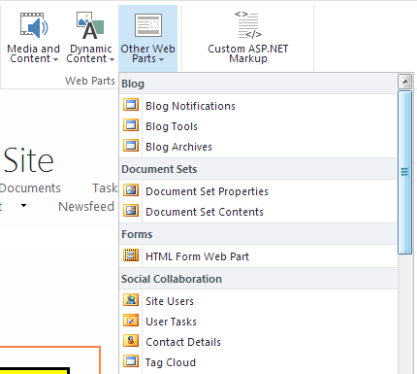
Other WebParts –
Custom ASP.NET Markup –
If you have any ASP.NET elements you’d like to include that aren’t available in the Snippet Gallery, paste the markup for those elements into the text box below, click the Update button, and paste the resulting HTML Snippet into your page.

Slide 36
Demo Editing Master Page
Add Custom Navigation
Add Search Box

