Slide 1
Exploring the Effectiveness of a DNN-based Branch Predictor that References Branch Target Buffer
Spring 2021 CompSci 752
Shuai Zhang

Slide 2
Outline
1. Introduction to Branch Predictor (quick recap)
2. Machine Learning (ML) based BP (explain)
3. prior work & proposed change
4. methods & results

Slide 3
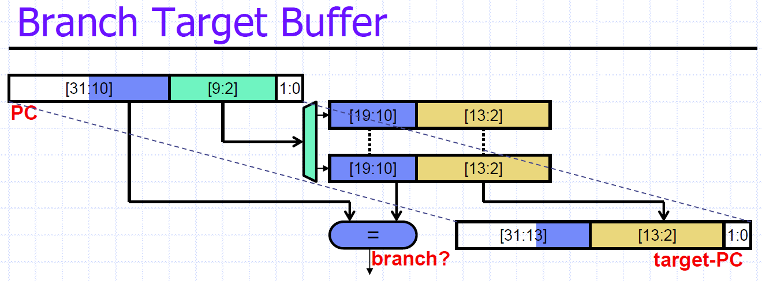
Branch Predictor (BP)
increasing important in deep pipeline
Branch Target Predictor
Branch Target Buffer (BTB)
Return Address Stack (RAS)
Branch Direction Predictor
2-bit, tournament, TAGE…
Deep Neural Network (DNN) based BP
Convolution Neural Network (CNN) based BP
Lecture note Unit 3

Slide 4
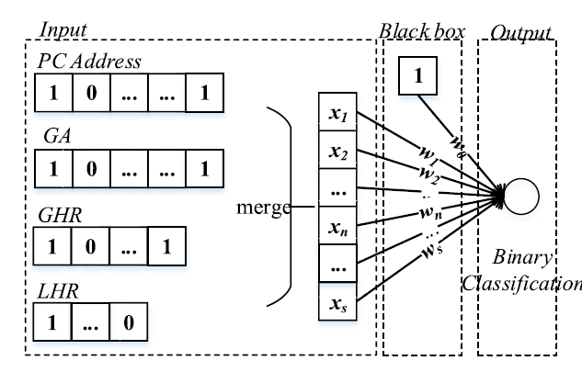
Machine Learning Based BP
Feed the following information into the black box
PC address - 32 bits
GA (past branch pc LSB) - 48 * 8 bits
GHR (global branch history) – 512 bits
LHR (local branch history) – 16 bits
Black box: a trainable DNN / CNN
Key idea: Branch Direction Prediction is
a Binary Classifier
Y. Mao et al (2020)

Slide 5
Observation and proposed change
Observation:
Branch Target may contain useful information for branch prediction
E.g., target direction, target offset, frequently being branched…
BTB hits most of the time (~80% +)(based on limited observation)
Proposed change:
Include the “Branch target” information inside the CNN model
Branch target can be inferred from BTB (if possible) (could be wrong target but OK)
Train the model using commonly used algorithm and evaluate

Slide 6
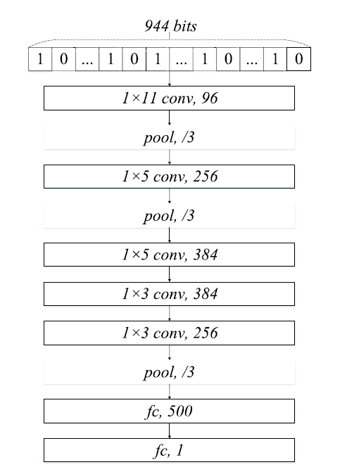
Methods
Simulator – Gem5
Full system simulation (SE) script, tournament BP (easy access to BTB)
Run 10,000 entry quick sort as training data (1,000,000 branch record)
Construct DNN as the same shape as prior work:
PC: 32 bits | target 32 bits | GHR 512 bits | GA 48*8 bits => 960 bits total
Reference from AlexNet
TensorFlow Keras as training tool
Check out if interested: Bald-Badger/DNN-Branch-Predictor (github.com)

Slide 7
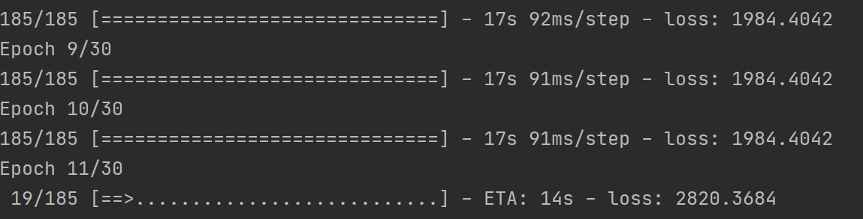
Results
Unfortunately, unable to replicate original approach, let alone the proposed improvements
The model failed to converge (reached local maximum)
Settled at ‘always predict taken’ -> likely because most of the branch in the data set were taken
Possible reasons:
No temporal / special relation among bits – low relevance
Parameter fine-tune

Slide 8
Future work
Try to replicate original approach then evaluate the new model
Fine tune parameters and try to converge model
Try more network shape (VGGNet, ResNet, etc.)

Slide 9
Q & A

