Slide 1
A DSP-based Bunker Cache Co-Processor
Sp2021 ECE757 Shuai Zhang

Slide 2
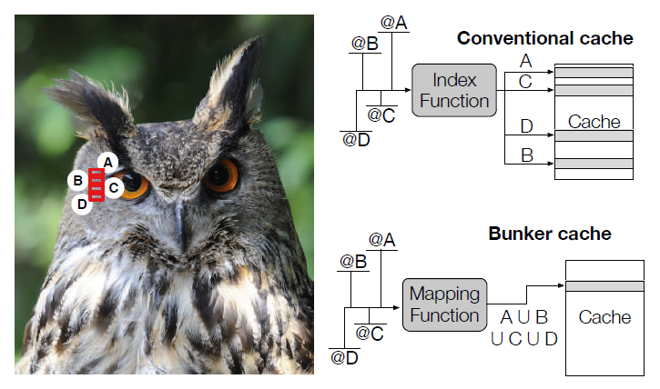
Bunker Cache
An approximate cache access method
Fetch neighbor row instead of precise row
Exploit spatial redundancy of images
Requires compiler / ISA support
Automate parameter generation?
J. S. Miguel et al, 2016

Slide 3
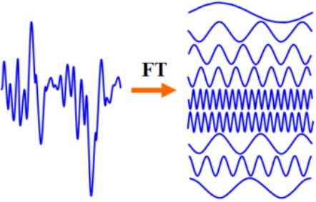
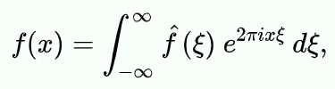
Fourier Transform (FT)
Decompose time domain signal to frequency domain (or reverse, same math!)
Very common place in audio / image processing
(before being taken over by ML)
Can be generalized into discrete signal and 2D
Discrete: digital, not continuous
2D: image !
Discrete Fourier Transform (DFT)
Can be calculated very fast
Fast Fourier Transform (FFT)

Slide 4
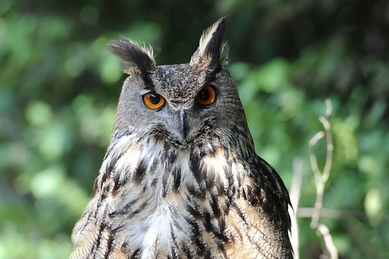
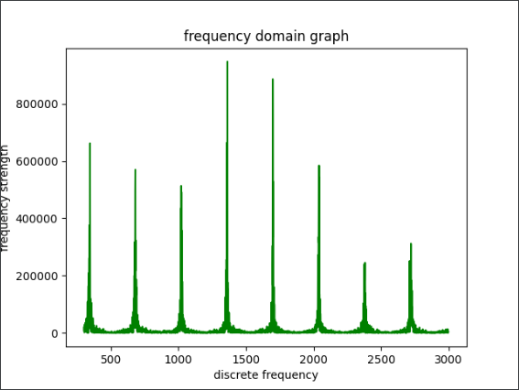
FFT can extract image dimension (kind of )
340
510 x 340 (W x H)
Observation: FFT on a row-major flattened image have peak on multiples its height, vice versa

Slide 5
Possible Structure
The co-processor probes on data bus from disk to memory
probe for continuous address access.
If the burst length is more than a certain number, store the FFT result
If the burst length is no more than the number, AKA, the address jumped to another location, reset
Store all calculated stride parameters in a small cache
index by the address of image
E.g. Image head @ 0x1000_0000
tail @ 0x1001_0000
then index is 4’b1000

Slide 6
Quick Proof-of-Concept Demo

Slide 7
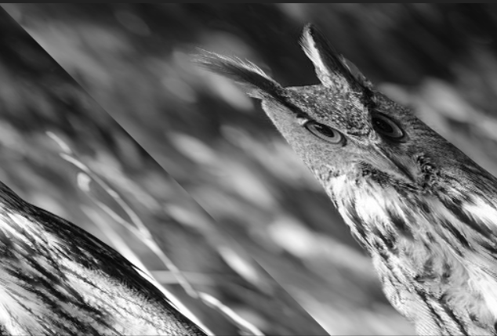
Major problems (and possible solution)
1. low Resilient to column shift
Perhaps not a very big issue in ML?
2. Power cost
~0.1W @ 50MHz clk
3. some delay (~10K cycle)
Still tiny compared to IO
4. “cheating image”
e.g. A zebra, zebra crossing, etc
No really good solution

Slide 8
Possible Future Plans
1. use real floating point instead of block floating point
2. better filtering

